Slide 1

Applied Data Science Capstone:
Battle of the Neighborhoods: Toronto Neighborhoods and its Latin American Areas
By: Alexandra Butke
Published: 8/5/2020

Slide 2
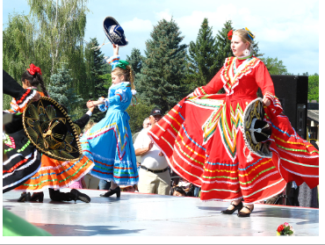
Canada’s Latin Overview
The Latin culture and people are a fast and growing population that brings beauty, knowledge and tradition to every country they are in. While the United States is the mecca for this community, the Canada Latin population is also rapidly growing.

Slide 3
Data and Resources
Canadian Latin American Population data scraped from Wikipedia page https://en.wikipedia.org/wiki/Latin_American_Canadians
Canada’s Postal code data scraped from Wikipedia page https://en.wikipedia.org/wiki/List_of_postal_codes_of_Canada:_M
~7000 rows of data in the Toronto venue data set
264 unique categories of venues
20+ Latin/Mexican venues found in the search
Downtown Toronto had the largest amount of venues catering to the Latin Demographic

Slide 4
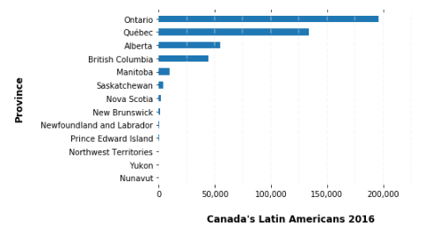
Canada’s Latin American Population
Using Population Count, Ontario ranks number 1 for Latin population: 196K

Slide 5
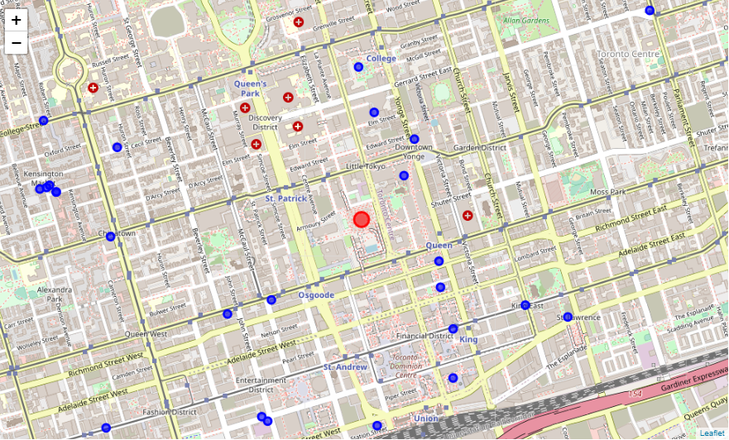
Where to Find Latin Venues
Using Foursquare search (key words Latin and Mexican) there are 25+ Venues that cater to the Latin Demographic
Latin Venues (blue circles)
Toronto Center (red circle)

Slide 6
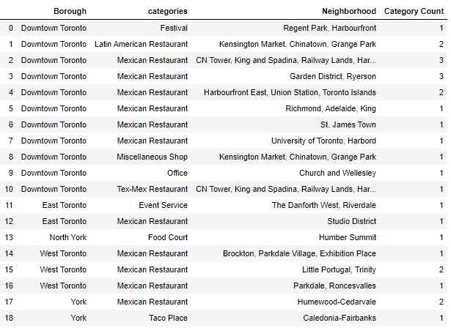
Downtown Toronto is a hotspot for Latin Venues!
Using Foursquare search (key words Latin and Mexican): Downtown Toronto has many Mexican Restaurants.

Slide 7
K-mean and Clusters Overview:
Cluster Method partitions dataset into groups or clusters based on how similar they are. The analyst assigns the number of random variable clusters to utilize, I chose k = 5.
K-means is the algorithm applied to the cluster.
In this analysis the clusters are used to determine the variety that each neighborhood has to offer and provide a brief comparison of the most common venues in each neighborhoods.
Summary of findings:
Lots of diversity in restaurant selections
Cluster 2 and 4 show that Downtown, North York, Etobicoke, and Scarborough neighborhoods have similar interest in most common venues
Similar to foursquare search, Downtown has Mexican Restaurant as one of the most common venues in the explore search
Pubs was pretty appeared very few times as the most common venue
Parks, Playground and dog runs venues appeared frequently in most neighborhood, which could indicate that the population in the neighborhoods like the outdoors

Slide 8

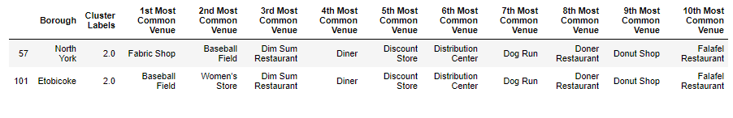

Toronto Neighborhood Comparison Using K-mean and Clustering: A total of 5 separate cluster groups were used to compare the various neighborhoods.
Clusters 1, 2 and 3 were the least ideal clusters generated, which made it difficult to compare the neighborhoods.
Cluster 1: Generated one result
Cluster 2: Generated two results
Cluster 3: Generated one result

Slide 9
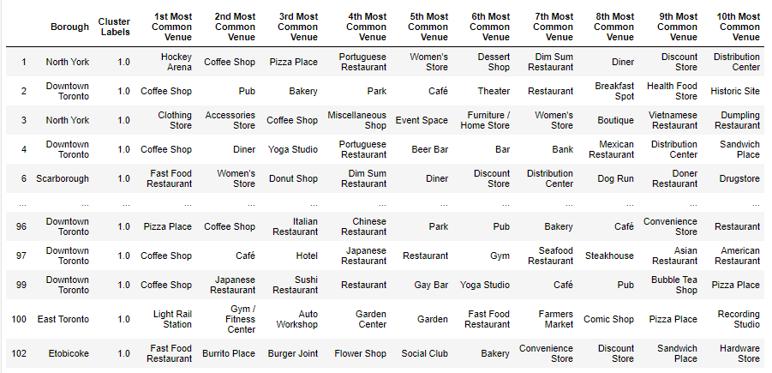
Toronto Neighborhood Comparison Using K-mean and Clustering: A total of 5 separate cluster groups were used to compare the various neighborhoods
Clusters 2 generated too many results so I will focus only on the ones shown below. This cluster confirms slide 6th findings about Latin venues. The figure below on Downtown line 4 shows Mexican Restaurant as the 8th most common venue.
Cluster 2: Generated many results

Slide 10
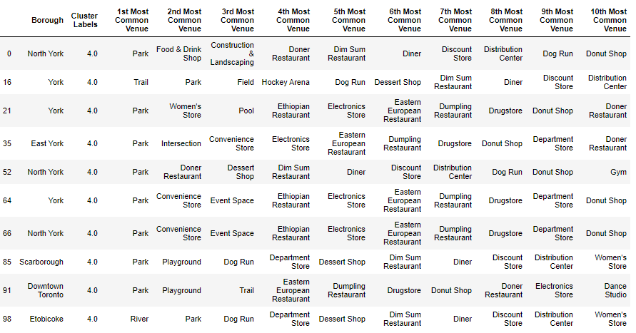
Toronto Neighborhood Comparison Using K-mean and Clustering: A total of 5 separate cluster groups were used to compare the various neighborhoods
Clusters 5 narrow down the exploration clusters to 6 boroughs . The are pretty similar. Most have Parks, Dog runs, Donut Shops, Restaurants and stores. These are great location to get pretty diverse venues for an evening out!
Cluster 5: Generated a manageable group of boroughs to compare

Slide 11
Conclusion:
Ontario has the largest Latin American Population
Downtown Toronto is a hotspot for those seeking to find a variety of Latin venues
Toronto has many venues in its surrounding areas that cater to the Latin demographic
Downtown, North York, Etobicoke, and Scarborough neighborhoods are very similar and have a good variety of venues to offer
Parks
Dog Runs
Play grounds

