Slide 1
Checkers Refactored
Group 2 - Victorious Bovine
Austin Cowan
Jon O’Brien
Joshua Berk
Abdulaziz Almerdasi Huseen Mahkareem
Notes:
JON

Slide 2
Overview
Original Design
New Design
Metrics
New Feature
Pattern Usage
Design Strengths/Weaknesses
Notes:
JON

Slide 3
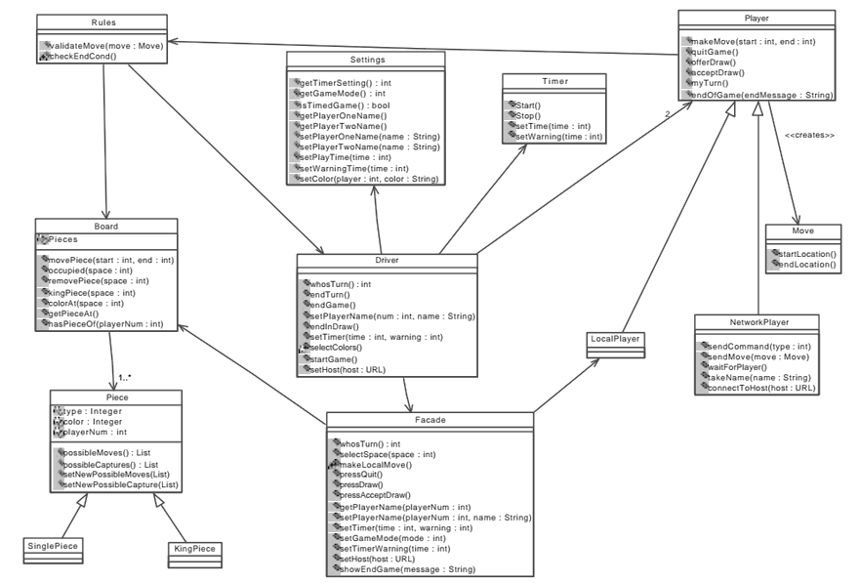
Original Design
Notes:
Josh

Slide 4
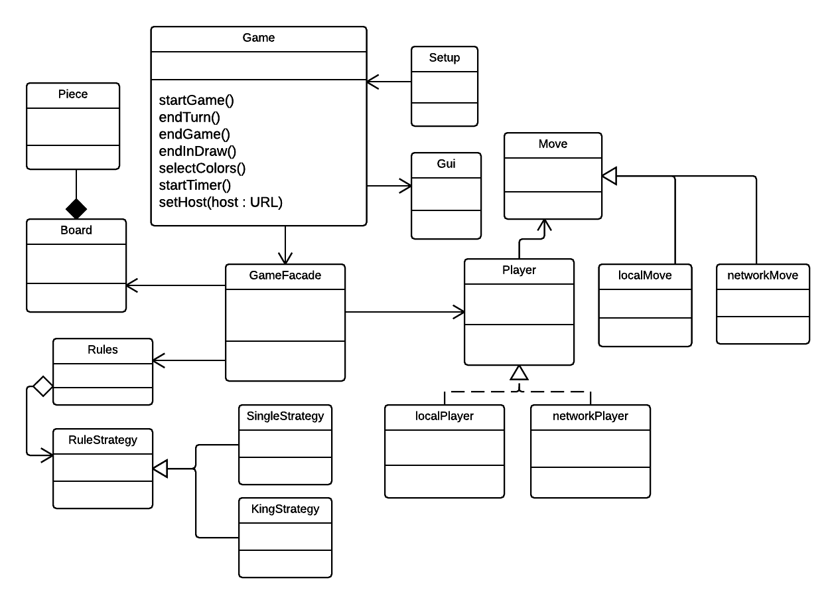
New Design
Notes:
Josh

Slide 5
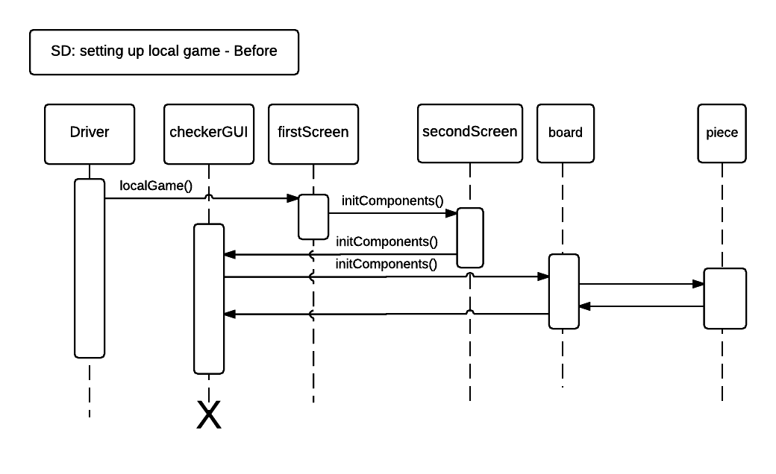
Setting up local game old sequence diagram
Notes:
AUSTIN

Slide 6
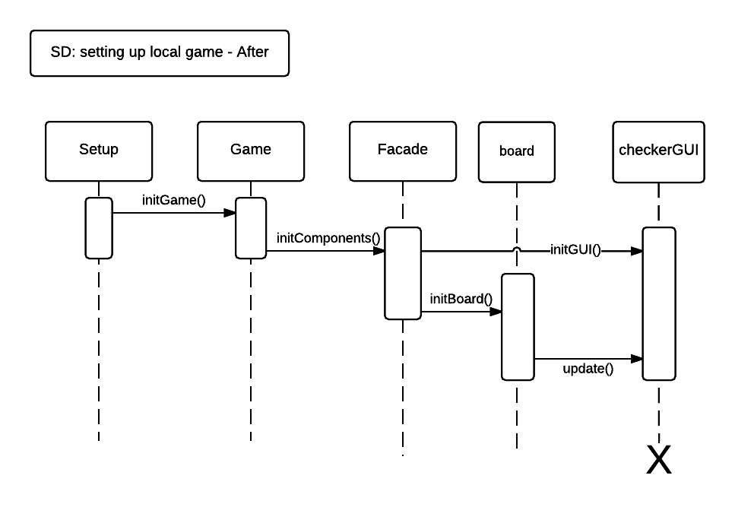
Setting up local game new sequence diagram
Notes:
AUSTIN

Slide 7
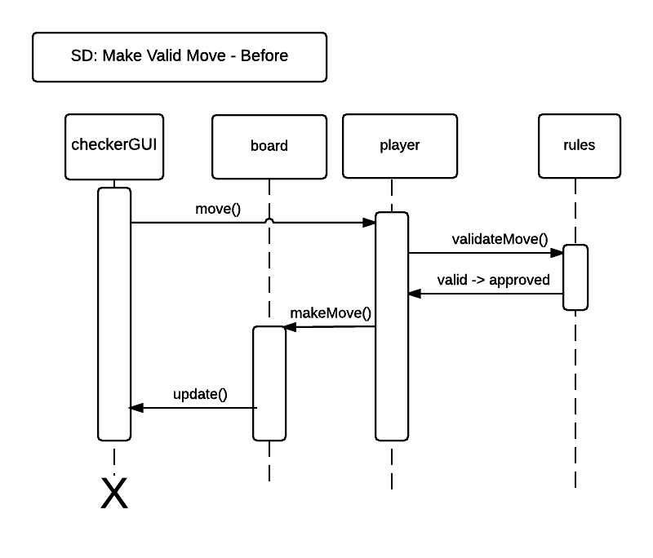
makeValidMove() old sequence diagram
Notes:
AUSTIN

Slide 8
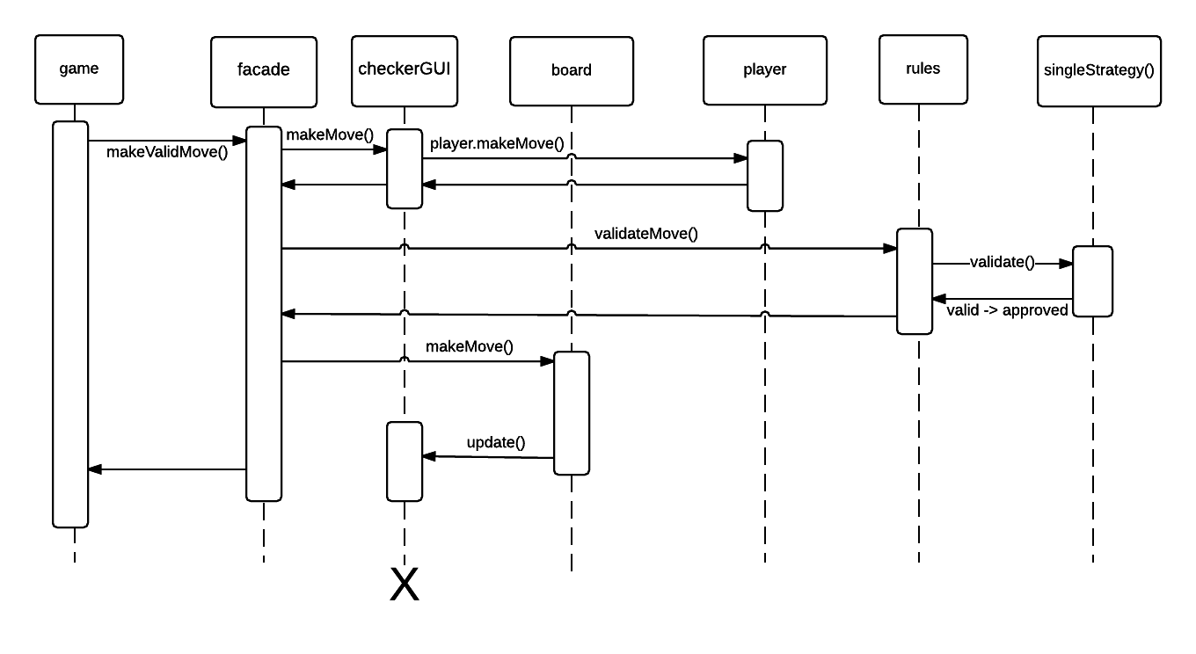
makeValidMove() new sequence diagram
Notes:
AUSTIN

Slide 9
Metrics
CheckerGUI
Old
LOC = 1433
New
LOC = 628
Notes:
Hussain

Slide 10
New Feature
Timer
Shows on gui, adjusts based on player turn
Notes:
Hussain

Slide 11
Pattern Usage
Facade: manages game interactions between subsystems
Observer: observer used for GUI communication with rest of the game.
Strategy: rules, makes things simpler to compute, knowing which type of piece was moved (King/Single) could lead to future move calculations being simpler
allows for modular game type extension (chess, etc)
State: Handles gui events to allow for restarting the game instead of just ending the program at the completion of the game
Notes:
JOSH

Slide 12
Design - Strengths & Weaknesses
Strengths
Modular design
implement more game types later on
checkers
chess
othello
Weaknesses
low cohesion of original design
restricted to high coupling of original design
high coupling, lots of classes referencing each other often
Notes:
Abdulaziz
our design is strong given how it is inheriting from the interfaces, our design allows for new game types to be added later on,
checkers can be expanded to allow for new games such as chess and othello
Implementation Weaknesses:
When our team began working on refactoring the original design, the most noticeable design flaws were apparent upon running the program. These included a bug where upon starting a game of checkers, all of the pieces were hidden. Fixing this problem only required changing a few lines of code referencing the image resources for the Graphics User Interface.
Other weaknesses included weak implementations of inheritance, specifically for the Piece classes and the Player classes. For instance, Piece, King Piece, and SinglePiece, did not share attributes describing their type. Instead, KingPiece and SinglePiece had their own individual attributes to describe their type and the abstract class Piece only described their color.
Probably the most notable weakness is the bloated Rules class. The rules class is supposed to function as a constraint on the kinds of moves players can make during gameplay. However, because of the data structure used for the board, a one-dimensional array, and the fact that all of the rule constraints are implemented in a single class, the Rules class is very large and hard to break down for potential future refactorings.
Implementation Strengths:
The first thing you’ll notice when using the original design of Checkers is that the interface is rather intuitive. The steps used to set up the game are straightforward and easy to understand. There is a logical sequence of steps, starting by selecting how the players will interact to play the game, whether by local play on one machine or over the internet, and moving to setup the actual game with player names and time constraints. Beyond the initial setup, playing checkers is also very easy. You simply click the space containing the piece you would like to move and then click the space where you would like to place it.
In regards to the internal structure, there are clear attempts to use inheritance to allow for modular changes to the software, for instance using different piece classes. However, these piece classes, KingPiece and SinglePiece do not share much functionality and the code is at times redundant.
Design Documentation:
Weaknesses:
The requirement file doesn’t have a description for the requirements, such as visualization constraints, interaction constraints.
The documents don’t have any interaction diagrams, such as sequence and state diagrams.
Class description in the analysis class diagram file is really similar to the code’s comments.
Strengths:
The use cases in the requirement file are really strong. They are organized and detailed very well.
The UML class diagram is clear and organized very well.
Strong description for the non-functional requirements
based on strategy implementation, can expand checkers game into chess

Slide 13
Questions?
Notes:
Question Slide

