Slide 1
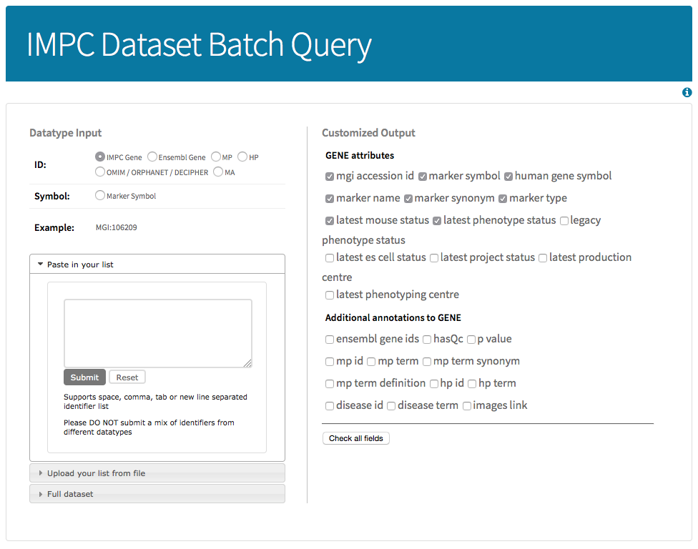
Customizable data fields
(the default ones pre-checked)
Searchable keywords
are IDs or symbols
Brief guide to use
the batch query tool
There are 2 ways to input your
search keywords:
Paste into the inputbox
File upload
Allows you to obtain a
full set of IMPC data
of current release

