Slide 1
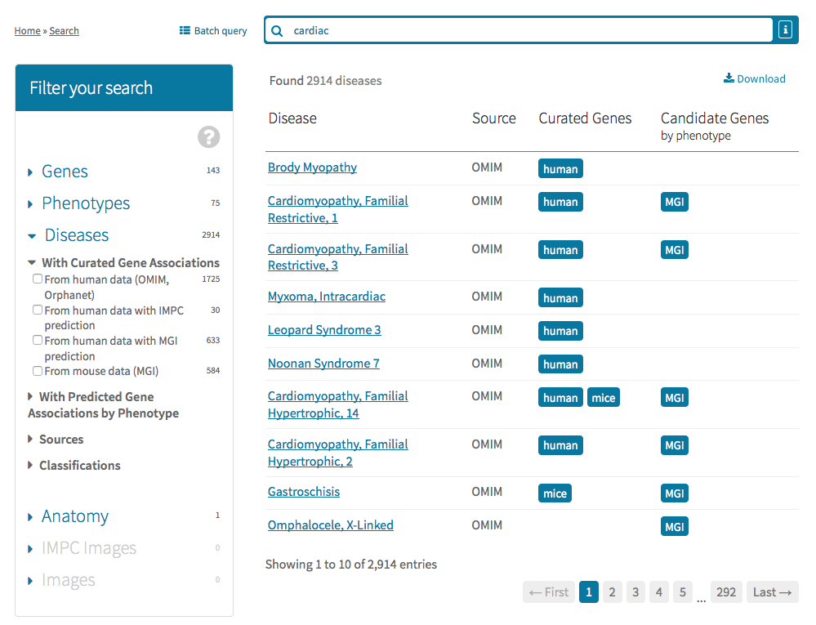
Human/mouse curated
gene associations
Known disease-gene
associations in human from
OMIM, Orphanet or DECIPHER
Predicted mouse models of
Disease based on the
PhenoDigm phenotypic
similarity tool using either
Sanger-MGP or MGI data
Predicted gene associations
based on mouse phenotype
similarity and if in known
linkage locus
Disease classification
From Orphanet
Literature curated
mouse models of
disease from MGI

