Slide 1
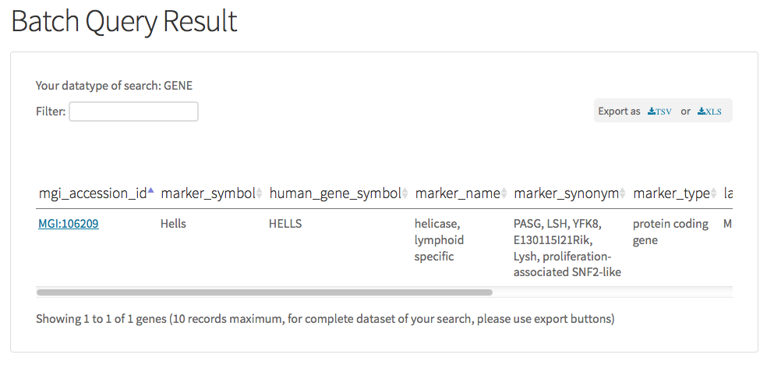
Current searched data type
Data export format
Seach results with
chosen attributes
Find stuff in result set quickly
Maximum of 10 sample records are shown

