Slide 1
Software Quality Assurance

Slide 2
Software Quality
Software quality is defined as the quality that ensures customer satisfaction by offering all the customer deliverables on performance, standards and ease of operations.

Slide 3
Role of Customer
Customers don’t buy products, they buy assurances that their expectations with the products would met.
You also, can only sell assurances – in other words, Quality.
Customer is in absolute position to judge the quality.

Slide 4
Quality Assurance
Quality assurance is a system of activities designed to ensure production that meets pre-established requirements and standards.

Slide 5
Quality Control
What is quality control -- the series of inspections, reviews, and test used throughout the develop cycle of a software product
Quality control includes a feedback loop to the process.
Objective ---> minimize the produced defects, increase the product quality
Key concept of quality control:
--> compare the work products with the specified and measurable standards

Slide 6
Cost of Quality
Cost of quality -->Quality is produced at cost. The cost of quality includes all costs incurred in the process of creation , generation , control and maintenance of quality or perform quality related work
Quality cost includes:
- Prevention cost:
- quality planning
- formal technical reviews
- testing equipment
- training to personnel

Slide 7
What is Software Quality Assurance (SQA)?
“Set of systematic activities providing evidence of the ability of the software process to produce a software product that is fit to use”

Slide 8
What is SQA?
Monitoring the processes
  Provides management with objective feedback regarding process compliance to approved plans, procedures, standards, and analysis

Slide 9
What is SQA?
Monitoring the products
  Focus on the quality of product within each phase of the SDLC
    e.g., requirements, test plan, architecture, etc.
  Objective: identify and remove defects throughout the lifecycle, as early as possible

Slide 10
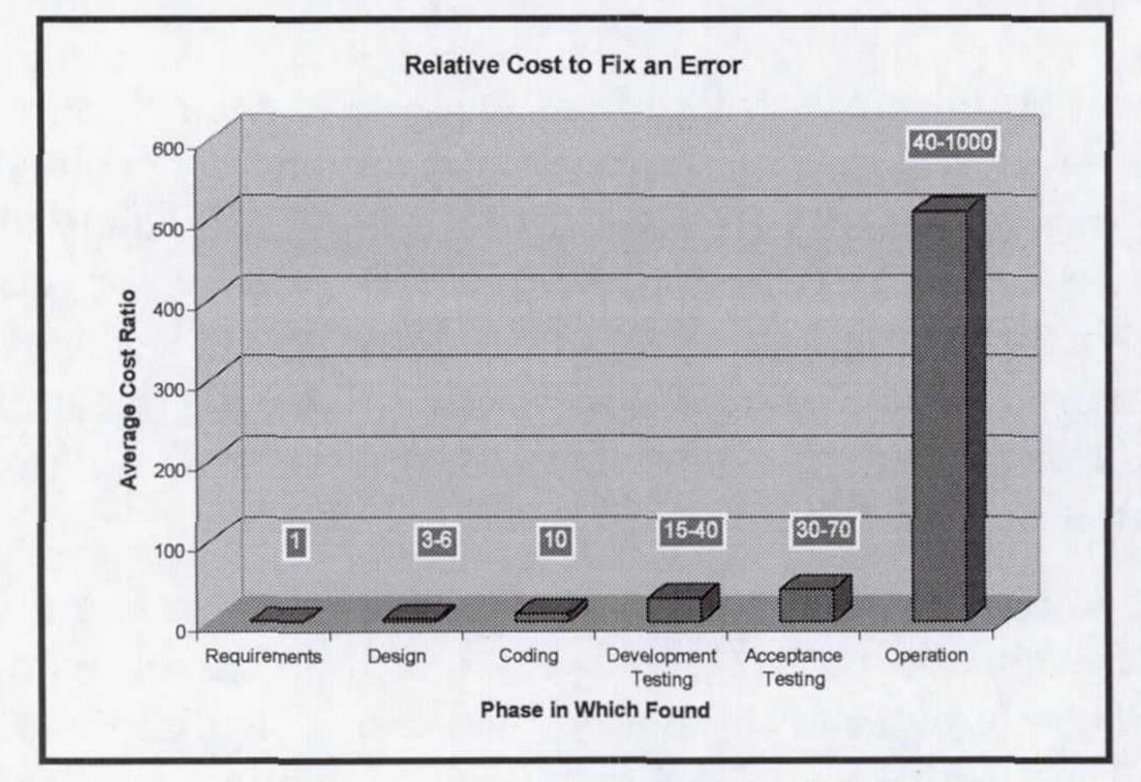
Cost of Software Errors
https://ntrs.nasa.gov/archive/nasa/casi.ntrs.nasa.gov/20100036670.pdf

Slide 11
Purpose of SQA Activities
Practically, zero defect product is not possible to achieve.
The purpose of quality assurance practices are to minimize the number of defects.
How much efforts are needed to minimize the number of defects?
  are you developing a customized project or product?
  how critical your application is?

Slide 12
SQA Responsibilities for a Project (cont...)
Typical SDLC phases and relevant Artifacts
SQA Responsibilities
Requirements Collection
Requirement Specs
Reviews
Analysis
Functional Specs
Reviews
Architecture & Design
Design Specs
Reviews
Development
Code & Executables
Implement
Test Cases
Testing
Deployment
Deployment Docs
Review

Slide 13
SQA Artifacts for a Project
Dev. Artifacts
SQA Artifacts
SQA Artifacts
(more)
Requirement Specs
RS Reviews
Functional Specs
FS Reviews
Test Plan
Design Specs
DS Reviews
Test Cases
Code & Executables
Bug Reports
More Test Cases
Deployment Docs
DD Reviews

Slide 14
Responsibilities of Testing Team
Responsibilities of a tester
  Design test cases
  Write test scripts
  Implement test cases
Responsibility of SQA manager
  Give 25% time for reviewing test cases written
  Lead review meetings
  Resolve conflicts

Slide 15
Other Responsibilities of SQA
Participate in product and process audits.
Initiate and participate in developing standards.
Develop SQA’s own standards, processes and checklists.

Slide 16
An Effective Testing Team
SQA Team should be composed of:
  Members with different background
  Members from different domains
  Technical gurus and user representatives
  Members with more analytical abilities.

