Slide 1

Optimizing solutions, demystified
Booz Allen Hamilton internal
Norfolk Decision Analytics Functional Community Brown Bag
Presented by Andrew McGregor | mcgregor_andrew@bah.com
Innovation center, Washington, D.C.
July 14, 2017

Slide 2



agenda
Defining an optimization problem
Classic and Creative Optimization Examples
Optimization Example using Excel/Solver
Demystifying a Genetic algorithm
AN Optimization model DEVELOPED in JAVASCRIPT
Brain Power
Required!

Slide 3
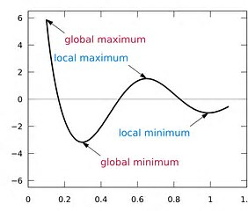
Defining an optimization problem
Finding the best solution from all feasible solutions
Optimization problems have an objective that is either to be maximized or minimized while all constraints are met.
Objective:
“I want to minimize overhead cost…”
“I want to maximize beer sales…”
“I want to minimize distance traveled over the holidays …”
Constraint:
“I want to minimize overhead cost…
…but still have enough offices for all employees”
“I want to maximize beer sales…
…but only utilize one refrigerator”
“I want to minimize distance traveled over the holidays…
…but still visit 3 out of 5 of my relatives”

Slide 4
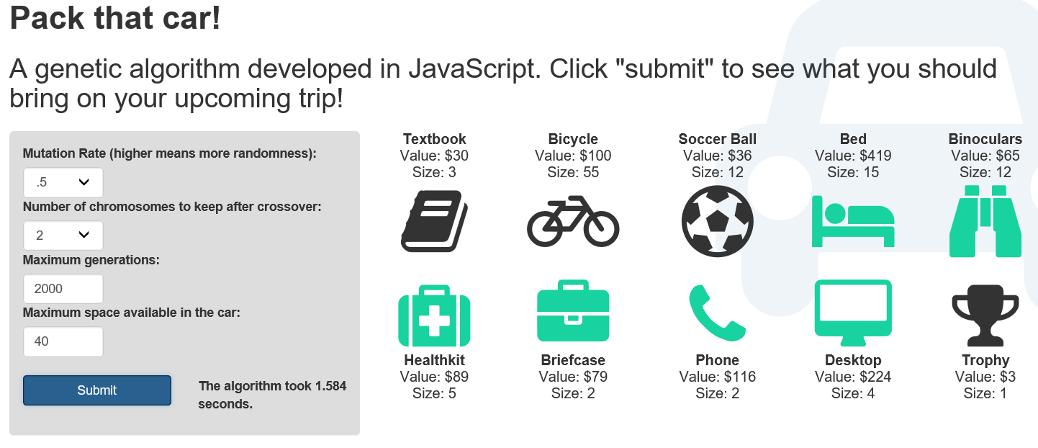

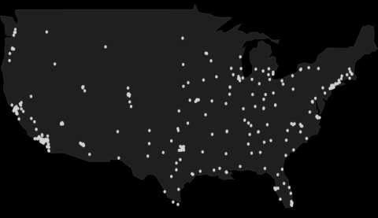

Optimization PROBLEM Examples
CLASSIC OPTIMIZATION EXAMPLES
“KnapSack” problem (LIVE DEMO)
Maximize the value of goods that you can fit in a given space
“Traveling Salesman” problem (video)
Minimize the total distance travelled while visiting all of the cities
AWESOME OPTIMIZATION EXAMPLES
Smart rockets (video)
Maximize the number of rockets that reach a target while avoiding an
Super Mario Brother’s Learning Algorithm (video)
Mario learns to maximize distance covered while avoiding moving obstacles

Slide 5
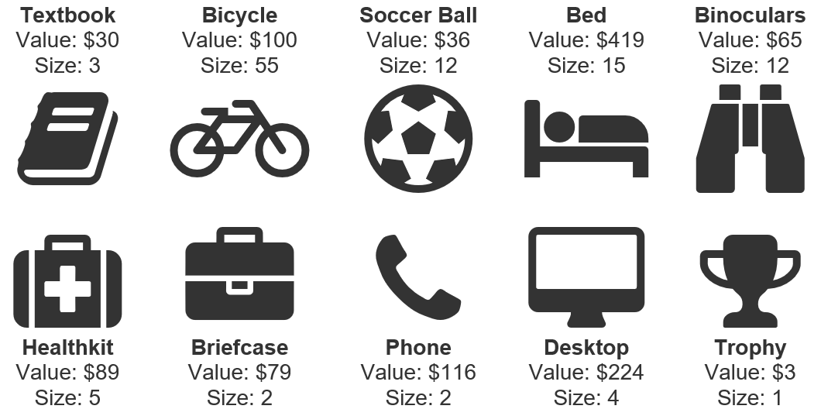

Optimization Example using Excel/Solver
Situation
You’re leaving for an upcoming trip. You’re worried that your valuable possessions might get stolen if you leave them in your apartment, so you’ve decided to bring some items with you. Unfortunately, you’re driving a Honda Fit, which doesn’t “fit” much stuff. You want to find an optimal combination of items to pack in your car, which maximizes the total value of items you bring, without surpassing the available space in your car.
Approach
This problem can be solved in Excel. We’ll use an add-in called “solver” to run a simplex LP solving method.
Why Simplex LP? With the Simplex LP Solving method, you can find a globally optimal solution given enough time – but you may have to settle for a solution that’s “close to optimal” found in a more reasonable amount of time. With the GRG Nonlinear and Evolutionary Solving methods, you should expect a “good,” but not necessarily the optimal solution.
Your car can fit 40 units!

Slide 6








Demystifying a Genetic algorithm
Excel’s Simplex LP method is the ideal solving method, as long as your objective and constraints are linear functions of the decision variable. Solver’s Evolutionary method utilizes genetic algorithms (GA). Using a GA doesn’t guarantee an optimal solution, but GAs are incredibly flexible and can find good solutions.
Let’s do an exercise to better understand genetic algorithms. We’ll step through a GA to pick out a t-shirt + pant combination that will provide us the most fashion points!
Step (1) Random Seeding
We introduce our first set of potential solutions. In this example, we’ve kept it simple (for demonstrations purposes) by creating our four seeds using matching t-shirt + pant colors. In reality, you’d want to create your initial seeds randomly.

Slide 7
Demystifying a Genetic algorithm
Step (2) Selection Process
We’re going to decide which of the four potential solutions that we want to keep. There are a few selection methods that could be used such as roulette wheel selection, but our rule will be to select the elite 3 solutions. We’ll eliminate the worst potential solution (yellow t-shirt + yellow pant) and carry our elite solutions to the next stage of the algorithm.
10 fashion points
9 fashion points
23 fashion points
21 fashion points
23 fashion points
21 fashion points
10 fashion points

Slide 8


Demystifying a Genetic algorithm
Step (4) Perform Crossover
Crossover is the means to swap different t-shirts + pants from our pool of solutions. We’re trying to breed better solutions, by mixing the shirts + pants of good combinations. Note that we’re only trying to swap shirts and bottoms, therefore our crossover position is at the waistline. But, imagine if this problem was to evaluate hats or shoes. In those cases, randomly selecting the crossover point is a way to better mix your chromosomes.
Crossover points can be randomly selected depending on the number of elements evaluated

Slide 9
Demystifying a Genetic algorithm
Step (3 continued): Potential solutions after crossover
We’re going to establish a new set of potential solutions to evaluate, so we reunite our potential solutions from the crossover process
Step (4): Re-evaluate the previous local optimum
Let’s not forget our previous best (aka local optimum). We’ll need to evaluate the local optimum against the new potential solutions.
Step (5) Apply Mutation
We need to randomly pick new chromosomes to introduce to the mix. Mutation keeps our mix fresh, searching for better possibilities!

Slide 10
Demystifying a Genetic algorithm
27 fashion points
25 fashion points
12 fashion points
18 fashion points
14 fashion points
26 fashion points
23 fashion points
21 fashion points
#1
Repeat Steps (2-5)
Remember our rule to select the elite 3 solutions. Let’s do that again and re-evaluate our results. What do you know, our best solution at this point has become a red t-shirt + grey pants, totaling 27 fashion points! There could be other solutions that are worth considering, so we’ll repeat the steps of crossover, mutation, and selection until we’re happy.
27 fashion points
26 fashion points
25 fashion points

Slide 11
A JavaScript Optimization model
LIVE DEMO AND Q&A!

