Slide 1
A Kickstarter predictive Model
By Andrew McGregor

Slide 2

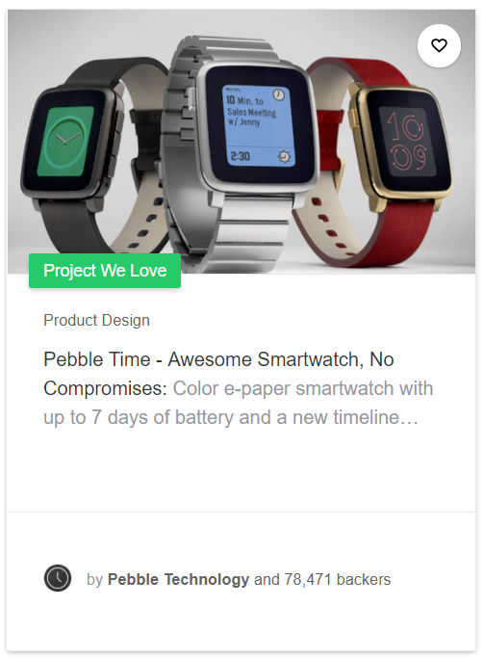
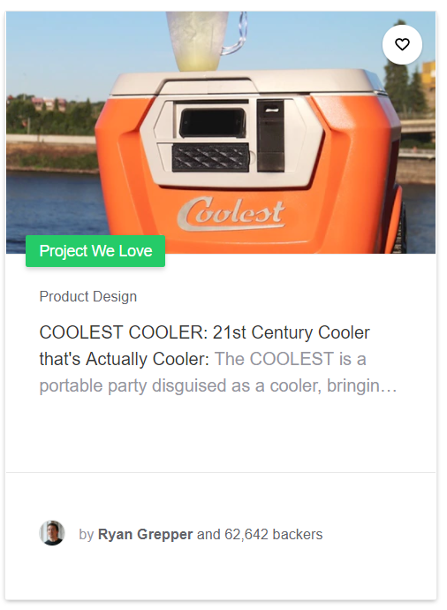
Problem Statement
Kickstarter is the world's largest funding platform for creative projects. Since the site launch on April 28, 2009, 13 million people have backed a project, $3.3 billion has been pledged, and 369,069 projects have been posted.
Nobody gets anything if a Kickstarter project fails to meet it’s goal… So it’s in the interest of pledgers, posters, and Kickstarter to help a project succeed.

Slide 3
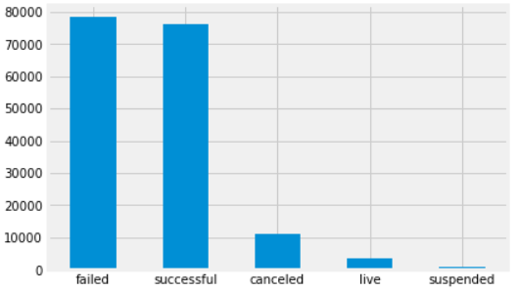
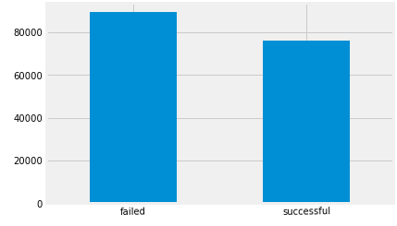
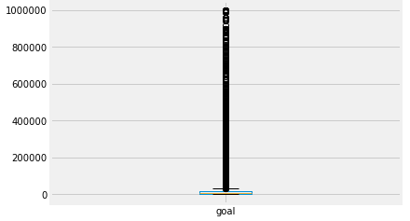
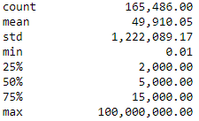

Initial Metrics and Assumptions
Data set contained 160,000+ Kickstarter projects launched between April 2009 and August 2017
For each project, there was an outcome variable which I defined below:
Failed or Canceled = 0
Successful = 1
Live & Suspended (dropped)
On average, 55% of projects fail, this will serve as a baseline for comparison
The data set also included a wide spread of goals ($.01 to $100,000,000), anything greater than $1,000,000 was dropped
Goal amount statistics (actual)

Slide 4
The Approach
Getting the data: Looped through a zipped file containing 42 .csv files, concatenated into a single DataFrame
Cleaning the data: Dropped columns containing no data, no unique data, and data leakage
Feature engineering:
Created more features from deadline, created at, launched at (h/d/m)
Calculated duration between launched at and deadline and created at and dealine
Parsed source URL to extract primary and secondary categories from URL
{"urls":{"web":{"discover":"http://www.kickstarter.com/discover/categories/art/mixed%20media"}},"color":16760235 ,"parent_id":1,"name":"Mixed Media","id":54,"position":6,"slug":"art/mixed media"}
Natural Language Processing: Used contents from Name and Blurb to do text analysis CountVectorizer(lowercase=True, stop_words=‘English’, ngram_range=(1, 2), min_df=2, max_features=1000)
ID | Disable Communication | Launched At
Photo | Country | Staff Pick
Name | Currency | Is Starrable
Blurb | Currency Symbol | Backers
Goal | Currency Trailing Code | USD Pledged
Pledged | Deadline | Creator
State [Target Variable] | State Changed | Source URL
Slug | Created At | Location

Slide 5
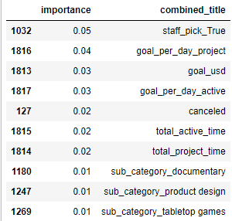
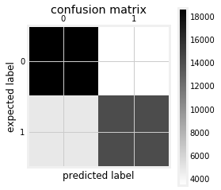
The Models
Model #1 (Random Forest w/NLP)
N-estimators of 100
Baseline accuracy from testing data of 57%
Random Forest Accuracy of 80% after a single train/test split! But wait a minute…
Model #2 (Random Forest w/NLP & Cross-val)
NLP with 1000 features
N-estimators of 150
Additional stop-words (canceled & cancelled)
Cross Validation of cv=5
Accuracy: 68%, Baseline: 55%, +13
Roughly the same results with TF-IDF
Naïve Bayes had poor performance
Model #3 (Random Forest w/o NLP)
N-estimators of 150
No natural language processing
Cross Validation of cv=5
Accuracy: 67%, Baseline: 55%, +12
Recommendations:
Explore key words that correlate with outcome variable and exclude noise from other words
Try a neural network
Data leakage!

Slide 6
Questions

