Slide 1
BUS-Z 798 Research Methods (II)
Aaron McKenny
1/10/2024

Slide 2
Agenda
Welcome - Introductions
About this course
This week’s readings
Research resources @ IU
Adjournment

Slide 3

About me
Assistant Professor of Management and Entrepreneurship
Research Focus
Language
Methods
Non-economic influences
Teaching Focus
Entrepreneurship
Methods

Slide 4
About you?

Slide 5
Agenda
Welcome - Introductions
About this course
This week’s readings
Research resources @ IU
Adjournment

Slide 6
About this course
“Advanced” methods
Meta-analysis, multilevel methods, text analysis, etc.
Expectation: Familiarity with basic methods
Methodological rolodex
What they are
How they’re used
Key considerations
Get your feet wet
Limitations

Slide 7
Course Grading

Slide 8
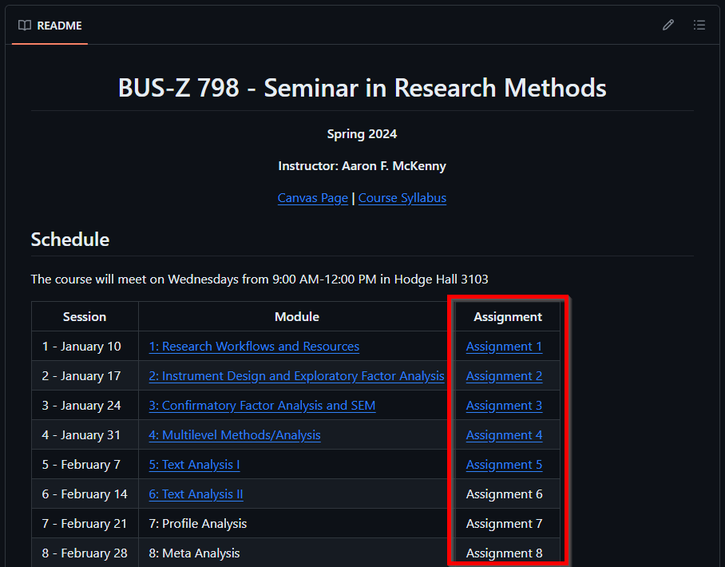
Components: Assignments
55% contribution
Individual work
Due
On GitHub
Tuesday night before class
Not accepted late
Grades:
Posted to Canvas
R&Rs

Slide 9
Components: Assignments
Goals
Hands on experience (to the extent practical)
Preparation for in-class discussion
Monitor learning
Expectations
Regurgitation and data/analysis dump
Analysis and reflection
Summary tables of analyses (not raw computer output)
Consideration of what this means beyond the numbers
Getting help
Conceptual-level/software package assistance: OK
Meat and potatoes of assignment must be done solo

Slide 10
Components: Participation and Disc. Leadership
15% contribution
How to make this course really boring:
100% Instructor Lecture
Uneven involvement
Keep everything at a conceptual level
Several people unprepared for class
Participation
Assessed:
Routine, active, verbal participation in class discussion
Content of participation indicates adequate preparation and reflection
Having an “off-day” is okay on occasion

Slide 11
Components: Participation and Disc. Leadership
Most classes will have a student “discussion leader”
2 times per semester
Co-leads the class with me
Two additional tasks as discussion leader
Co-lead discussion of method/readings
Prepare discussion questions
Stepped-up preparedness/participation
Mini-presentation during class
Read an additional article that applies the method
Present that article to the class (emphasis on method concerns)

Slide 12
Components: Final Exam
30% contribution
Final exam week
Comps Style
Free response
Depth and application expected
Anything we’ve covered is fair game
Closed book/note
…but I’m not expecting citation memorization at this point

Slide 13

BYOSP
Bring Your Own Statistical Package
I use (and thus can help you most with):
Stata
Python
You may use anything you like
What you and your advisor use
Some “translation” may be necessary
GitHub Copilot/ChatGPT

Slide 14
Agenda
Welcome - Introductions
About this course
This week’s readings
Research resources @ IU
Adjournment

Slide 15
Why I Recommended Rejecting Your Paper…
Why did I assign this paper?
Seems to emphasize theory…
What is the obsession with “operational base”?
This class is about “advanced” methods
What do we take away about our use of these methods?
What do we have to look out for?
Beyond methods – what else can we learn from the author?

Slide 16
Methodological Fit in Management
How does this article fit with the previous?
What are E&M’s key messages for method selection?
Are there “legitimate” opportunities off-the-diagonal?
If so, what do we have to look out for?
Is there room for variance within the diagonal?
How does this influence how we communicate our research?

Slide 17
Curating Research Assets: Git
Why should we care about version control?
Is it just for our own sanity/organization?
How might this help with collaboration with coauthors?
How does this fit with:
The open science movement?
The replication crisis?
What are some strengths limitations of Git/version control tools?
Let’s explore Git/GitHub!

Slide 18
Agenda
Welcome - Introductions
About this course
This week’s readings
Research resources @ IU
Adjournment

Slide 19
High Performance Computing
It’s not just for STEM
Most R1 and many R2 universities have HPC resources
Getting access at IU
Let’s take a look!

Slide 20
Agenda
Welcome - Introductions
About this course
This week’s readings
Research resources @ IU
Adjournment

