Slide 1
BUS-Z 798 Research Methods (II)
Aaron McKenny
4/10/2024

Slide 2
Agenda
ML Homework Review
This week’s readings
Homework Discussion
Adjournment

Slide 3
Agenda
ML Homework Review
This week’s readings
Homework Discussion
Adjournment

Slide 4
Frequentist vs Bayes… why do we care?
What does NHST actually test?
P(data|H₀)
Is that reflective of most of our research questions?
Do we care so much about the null hypothesis?
Do we care more about the falsity or truth about H₀/H_{A}?
Bayes: How can we flip this around?
P(H_{A}|data)

Slide 5
What do we actually believe?
Do we start from scratch regarding our pre-existing beliefs about a relationship with every study?
If yes, why bother with meta-analysis?
Frequentist statistics assume so
Sometimes seen as being more scientific/less biased for doing so
Is this a feature or a flaw?
Bayesian statistics:
Focus on updating prior beliefs

Slide 6
Much Ado about p < 0.05
What exactly does a p-value mean?
What is magic about 0.05?
“To show that the alternative hypothesis is true, one postulates that it is false so that the null hypothesis is true and demonstrates that this scenario is untenable.”
Is this actually what we set out to prove?
Is this parsimonious?

Slide 7
Where is the uncertainty?
What exactly is it we’re uncertain about…
The model parameters?
The data?
Is there no in-between reject and fail to reject H₀?
Frequentist: parameters are fixed, not random
So… what is a 95% Confidence interval?
If we sampled many times, 95% of intervals would contain true parameter
(Are we collecting many samples?)
Bayesian: parameters are random, uncertain
So what is a 95% Credible interval
There is a 95% probability that the true parameter is in this interval

Slide 8
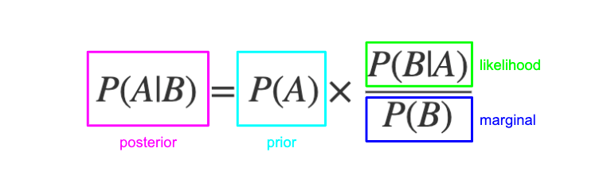

So what exactly is Bayes’ Rule?
$$P\left(Model | Data\right)= \frac{P\left(Data | Model\right)∗P(Model)}{P(Data)}$$
$$P\left(Model | Data\right)∝P\left(Data | Model\right)∗P(Model)$$

Slide 9
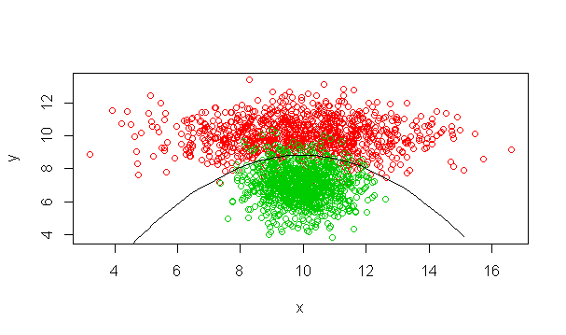
We’ve seen this before!
Naïve Bayes Classifier (Machine learning week)
$$P\left(Classification | Data\right)∝P\left(Data | Classification\right)∗P(Classification)$$

Slide 10
The process (from Kruschke)
Collect data
Identify a model containing parameters to be tested (based on theory)
Specify prior distributions for parameters
Use Bayesian estimation (MCMC/Gibbs Sampling) to estimate posterior distributions
Evaluate posteriors

Slide 11
Prior Distributions
What are they?
Expressions of a priori beliefs about parameters
Where do these beliefs come from?
Theory
Existing research (e.g., meta-analysis)
Empirical data
Assumptions/Expert knowledge
They can materially influence the posterior distribution!
So… is that good or bad?

Slide 12
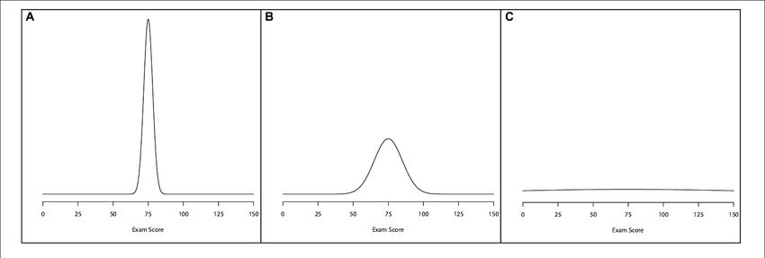
Prior Distributions
Informative
Weakly Informative
Uninformative/ Diffuse
(Depaoli & Winter, 2020)

Slide 13
Uninformative priors
What do these suggest about state of theory/knowledge?
Is this realistic?
Is there a reason we cannot trust past research?
What do these suggest about uncertainty about parameters?
Brings Bayesian analysis closer to frequentist analysis
(maybe a good idea to include as a robustness test)
Frequently used/implemented

Slide 14
Priors from existing research
Use empirical research to establish priors
Challenges
Lack of replications
Variability in study design and context
Replication crisis
Schwab’s (2024) recommendations
Aggregate from a few selected studies
Meta analyses

Slide 15
Thoughts on priors (h/t Schwab, 2024)
Enable empirical analysis to reflect
Uncertainty regarding parameters
Current state of knowledge about phenomena
When selecting priors
Be transparent and provide rationale
Provide sensitivity analysis (different values, different priors)
Can enable analysis with smaller sample sizes

Slide 16
Evolution of Bayesian Analysis
Past:
Select set of conjugate priors to enable easy calculation
Still generally computationally complex
Should we select models based on ease of calculations?
Now: Markov Chain Monte Carlo
Simulate random samples step-by-step
Each new sample depends on the previous one
Approximates complex probability distributions
Much more possible!
…but more parameters = more time to calculate

Slide 17
Let’s take a look at Bayesian analysis in Stata!

Slide 18
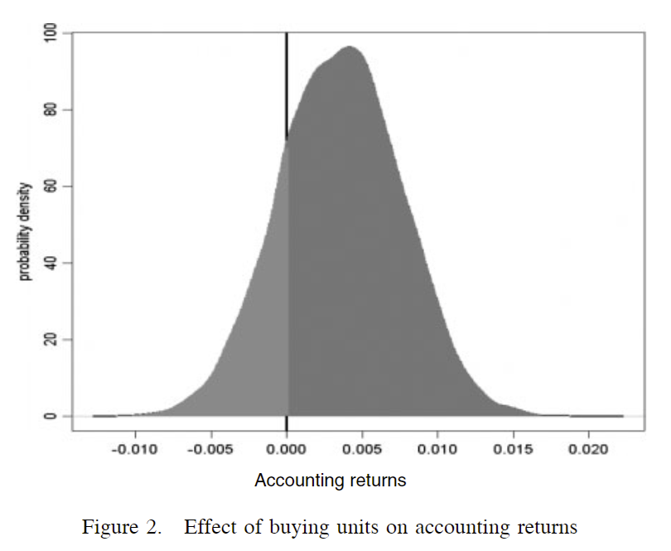
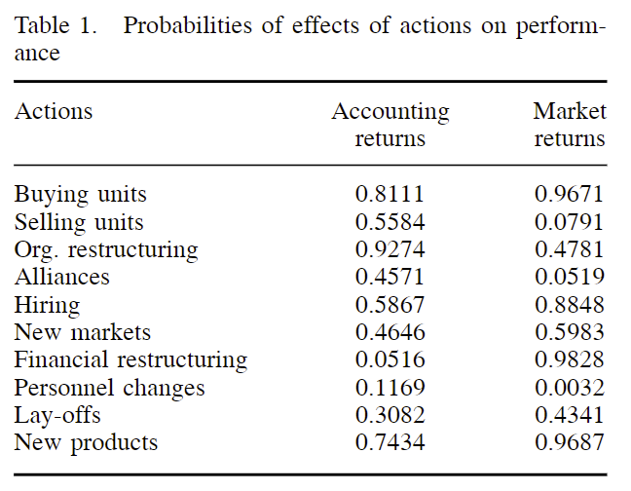
Looking at a posterior distribution
81% Chance of improving accounting returns
(Hansen et al., 2004)

Slide 19
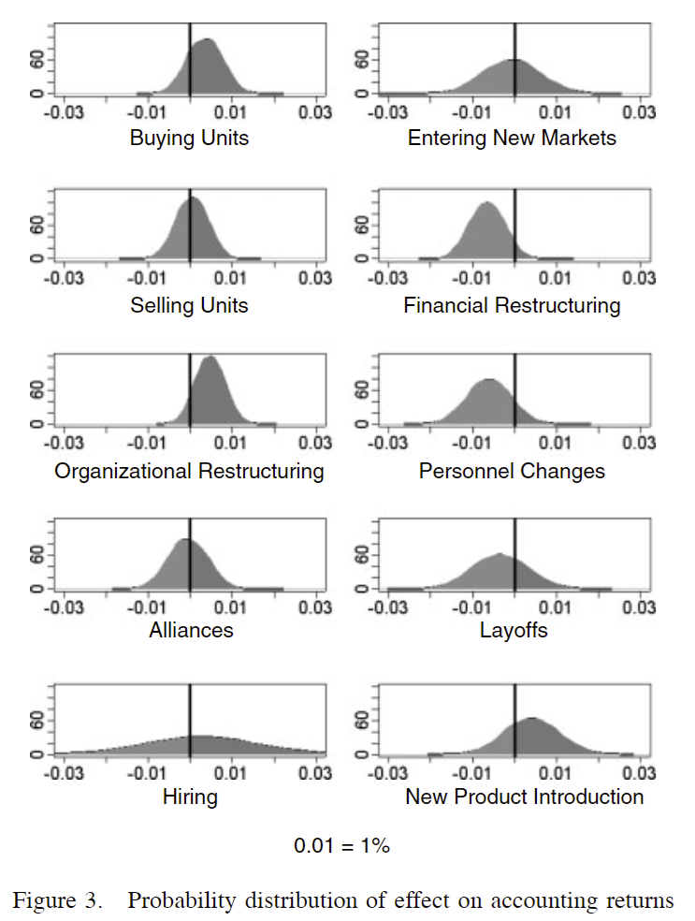
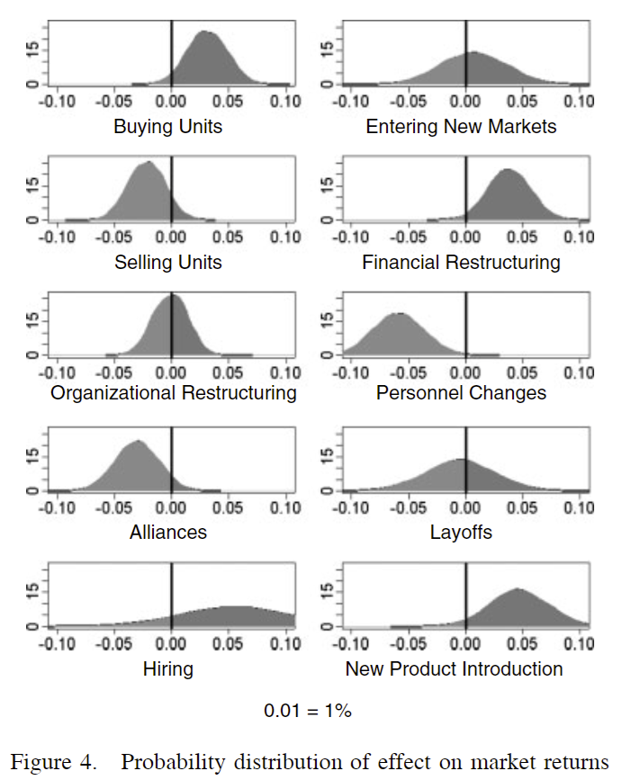
Posterior distributions
(Hansen et al., 2004)

Slide 20
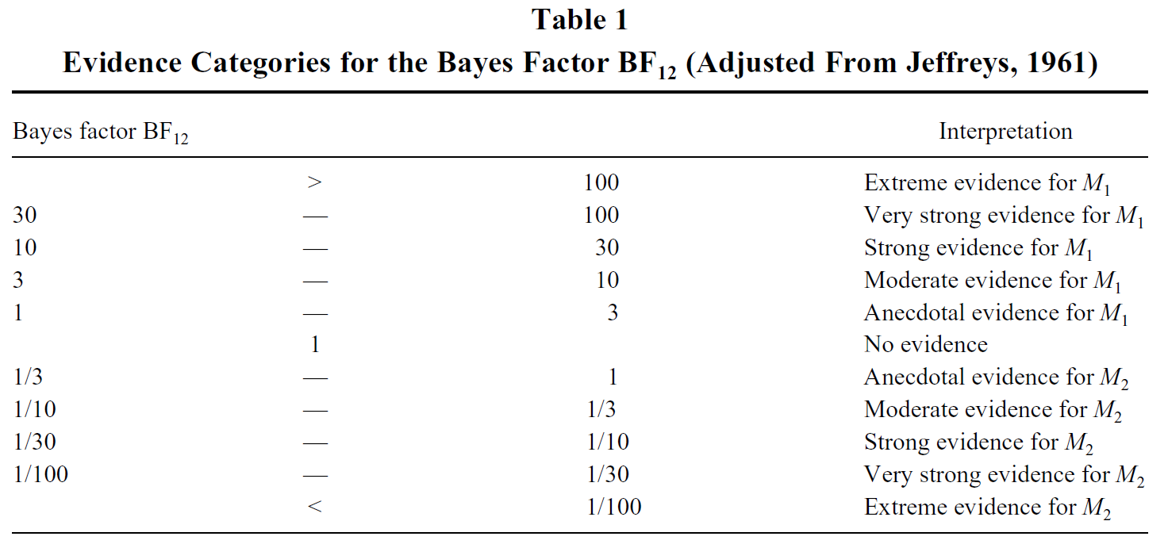

Bayes Factors
Quantifies the amount of change from prior beliefs to posterior distribution from the data analyzed
$${BF}_{10}=\frac{p(D|H_{1})}{p(D|H_{0})}$$
How many times more likely are the data under H₁ vs H₀?

Slide 21
Confirming the null
What do we mean by ‘confirming the null’?
Why would we do this?
How can Bayesian analysis help us accomplish this?
Why is it able to do so?
Is Bayesian analysis strictly necessary for doing so?

Slide 22
Agenda
ML Homework Review
This week’s readings
Homework Discussion
Adjournment

Slide 23
Agenda
ML Homework Review
This week’s readings
Homework Discussion
Adjournment

