Slide 1
BUS-Z 798 Research Methods (II)
Aaron McKenny
1/31/2024

Slide 2
Agenda
Last week’s homework
This week’s readings
Homework Discussion
Adjournment

Slide 3
Agenda
Last week’s homework
This week’s readings
Aggregation
Multilevel models
Homework Discussion
Adjournment

Slide 4
Chan (1998)
Conceptual basis for aggregation to a higher level
When/why would this be appropriate?
What are the implications…
Theoretical?
Methodological?
What did you think?
Applications to research in your area?

Slide 5
LeBreton & Senter (2005)
What is the difference between:
Interrater reliability, and
Interrater agreement
Why are both important?
When is each more/less important?

Slide 6
IRA vs IRA+IRR
IRA: r_{wg}
Compare within-group variance to different distributions
Which distribution?
Uniform is most common, but is it realistic?
How should cutoffs be handled
IRA+IRR: ICC1, ICC2
ICC1 - % variance at higher level
ICC2 – reliability of the group mean

Slide 7
Agenda
Last week’s homework
This week’s readings
Aggregation
Multilevel models
Homework Discussion
Adjournment

Slide 8

The simplest regression possible
y_{i} = ß₀ + e_{i}
ß₀ = the estimated population mean of y
e = residuals not explained by the population mean
ALL sources of error combined
Within-person (i.e., temporal) variability
Individual variability
Firm variability
Industry variability
Country variability
$$e\sim N(0,σ_{e}^{2})$$

Slide 9
So… what’s wrong with that?
Works great when residuals are… independent…
are they, generally?
Why aren’t we all:
Psychologists?
Economists?
A lot of organization science relies on the notion that things can work differently in organizations & teams – the context matters!
Country
Industry
Ind.
Firm
Team
Ob.

Slide 10
Doing better with ‘e’
y_{ij} = ß_{0j} + e_{ij}
y_{ij} = π₀₀ + ζ_{j} + ε_{ij}
How did we actually get there?
(1) y_{ij} = ß_{0j} + e_{ij}
(2) ß_{0j} = π₀₀ + ζ_{j}
(3) y_{ij} = (π₀₀ + ζ_{j}) + ε_{ij} ← substituting (2) into (1)
Residual error explained by industry membership
All residual error not explained by industry membership or the population mean

Slide 11
Multilevel Variance Components (2-level)
Organizations
Industries
ε_{ij}
μ_{j} ≡ β₀+ζ_{j}
Industry (j) mean
ε_{ij}
ζ_{j}
β₀

Slide 12
Doing even better with ‘e’
y_{ijk} = ß_{0jk} + e_{ijk}
y = γ₀₀₀ + ζ_{k}⁽³⁾ + ζ_{jk}⁽²⁾ + ε_{ijk}
How did we actually get there?
(1) y_{ijk} = ß_{0jk} + e_{ijk}
(2) ß_{0jk} = π_{00k} + ζ_{jk}⁽²⁾
(3) π_{00k} = γ₀₀₀ + ζ_{k}⁽³⁾
(4) y_{ij} = ((γ₀₀₀ + ζ_{k}⁽³⁾) + ζ_{jk}⁽²⁾) + ε_{ijk} ← substituting (3) into (2) and (2) into (1)
Residual error explained by country
Residual error explained by industry membership
All residual error not explained by industry, country or the population mean

Slide 13
Multilevel Variance Components (3-level)
Organizations
Industries
Countries
μ_{jk} ≡ β + ζ_{k}⁽³⁾ + ζ_{jk}⁽²⁾
Industry (j) mean
ε_{ijk}
ε_{ijk}
ζ_{jk}⁽²⁾
μ_{j} ≡ β+ζ_{k}⁽³⁾
Country (k) mean
ζ_{jk}⁽²⁾
μ_{jk} ≡ β + ζ_{k}⁽³⁾ + ζ_{jk}⁽²⁾
Industry (j) mean
ε_{ijk}
ζ_{k}⁽³⁾
ε_{ijk}
β₁

Slide 14
What are Fixed vs. Random Effects?
OLS Regression
Example:
y = ß₀ + ß₁x₁ + ß₂x₂ + e
Fixed
Random
Performance = ß₀ + ß₁Innovation + e
The intercept is fixed, it cannot differ by industry
So is the relationship between innovation and performance

Slide 15
OLS model
Performance
No differences between industries’ relationships between innovation and performance…
You’d draw the same regression line for each.
Innovation
Industry 1
Industry 2
Industry 3

Slide 16
Should intercepts to be allowed to differ?
OLS Regression
Random Intercept Model
Should look familiar…
Perform = ß₀ + ß₁Innov + e
Perform = π₀₀ + ß₁Innov + ζ_{j} + ε_{ij}
Estimated population intercept
Adjusts intercept for industry-specific variance

Slide 17
Random Intercepts
Performance
The regression line you’d draw for each industry has different intercepts, but the same slope
There appear to be industry-specific effects on the starting level (intercept) for the relationship between innovation and performance, but not on the actual relationship (slope)
Innovation
Industry 1
Industry 2
Industry 3

Slide 18
Should coefficients to be allowed to differ?
Random Intercept Model
ß₁ = π₁₀ + ζ_{1j}
Random Intercept & Slopes Model
Perform = π₀₀ + ß₁Innov + ζ_{0j} + ε_{ij}
Perform = π₀₀ + (π₁₀ + ζ_{1j})Innov + ζ_{0j} + ε_{ij}
Perform = π₀₀ + π₁₀Innov + ζ_{1j}Innov + ζ_{0j} + ε_{ij}
Estimated population regression coefficient
Adjusts slope for industry

Slide 19
Random Intercepts & Slopes
Performance
The regression line you’d draw for each industry has different intercepts and slopes
There appear to be industry-specific effects on both the starting level (intercept) and on the relationship (slope) between innovation and performance
Innovation
Industry 1
Industry 2
Industry 3

Slide 20
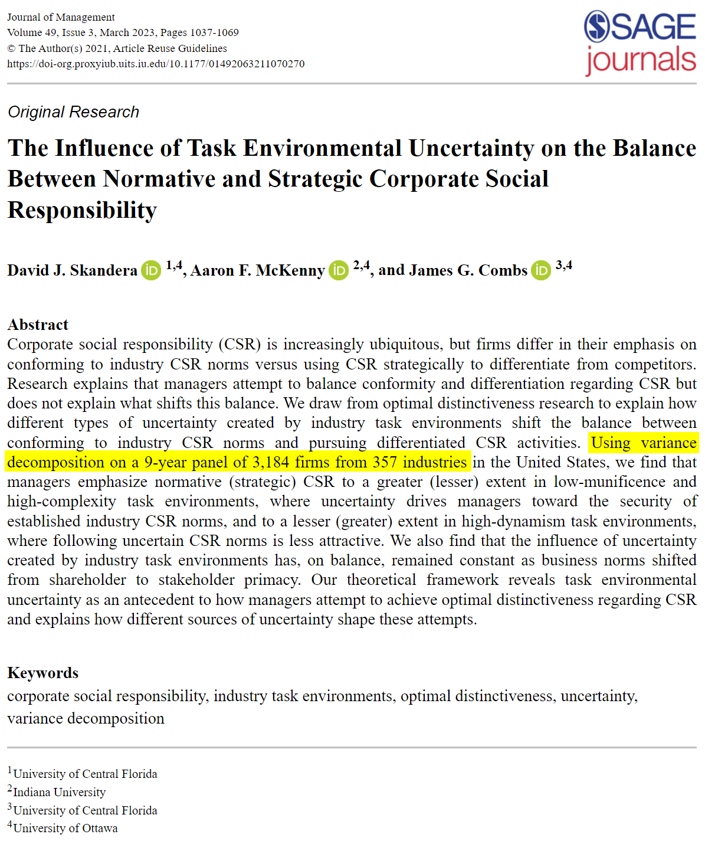
What kinds of research questions?
My research:
How do environmental characteristics influence balance of strategic and normative CSR?
How about you?
What kinds of research questions in your area?

Slide 21
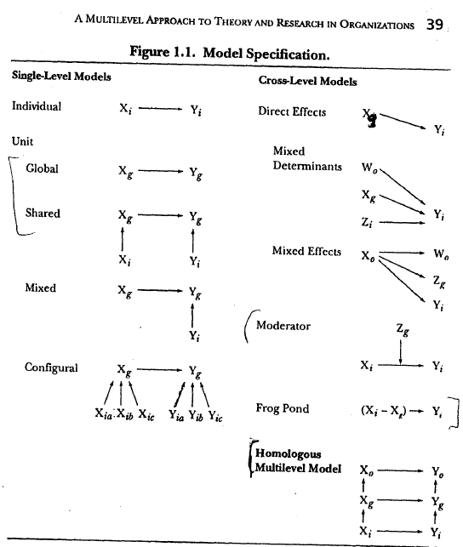
Different multilevel models

Slide 22
Centering decisions
What do Hofmann & Gavin say?
General problem: confounding of level 1 and level 2 effects
Good general practice:
group-mean center L1 predictors
control for the group means of level 1 variables when testing cross-level interactions or mediation effects
See: Zhang, Zyphur, & Preacher (2009)
Group-mean centering allows testing “frog pond” effects

Slide 23
Some rules of thumb
If you have fewer than 42 ‘groups’
Use restricted maximum likelihood
REML in Stata
MLE and REML begin to converge at around 40
If you have a small sample
Consider using the Kenward-Roger degrees of freedom
dfmethod(kroger) in Stata
Only usable with REML estimator
Specify an unstructured covariance matrix
Allows random intercepts and slopes to covary
cov(unstructured) in Stata

Slide 24
Agenda
Last week…
This week’s readings
Homework Discussion
Adjournment

Slide 25
Agenda
Last week…
This week’s readings
Homework Discussion
Adjournment

