Slide 1
BUS-Z 798 Research Methods (II)
Aaron McKenny
2/7/2024

Slide 2
Agenda
Decisions, Decisions
Last week’s homework
This week’s readings
Homework Discussion
Adjournment

Slide 3
Decisions To Make
Discussion Leadership –
Keep
Present only once
Between homework and method discussion
Drop
Still be prepared with questions, but no empirical article
Grade mostly on active participation
Homework Reviews –
30 minutes at beginning of class
Whatever time remains at end

Slide 4
Agenda
Decisions, Decisions
Last week’s homework
This week’s readings
Homework Discussion
Adjournment

Slide 5
Agenda
Decisions, Decisions
Last week’s homework
This week’s readings
Homework Discussion
Adjournment

Slide 6
What is Content Analysis?
“…a research technique for the objective, systematic, and quantitative description of the manifest content of communication” (Berelson, 1952)
“…any research technique for making inferences by systematically and objectively identifying specified characteristics within text” (Stone et al., 1966)
“…a research technique for making replicable and valid inferences from texts [broadly conceived] to the contexts of their use.” (Krippendorff, 2004)
“…a research method that uses a set of procedures to make valid inferences from text” (Weber, 1990)
“…the systematic, objective, quantitative analysis of message characteristics.” (Neuendorf, 2016)

Slide 7
Common Threads?
Systematic
Not ad hoc/purely subjective
Same reliability and validity concerns as other techniques
Based in text (though text here is broader than just the written word)
Organizational communication generates our data
Context (medium, communicator, recipient, intent) matters
Role of Inference
Often using text to infer something about reality

Slide 8

Not Everyone Agrees
Qualitative vs Quantitative… both?
Inductive vs Deductive… both?
Manifest vs Latent content.. Both?
What do the readings suggest?
What do you think?

Slide 9
What content is being analyzed and how?
Inductive theory building
Narrative analysis
Discourse analysis
Semantic analysis
Rhetorical analysis
Critical analysis
Quantitative content analysis
How do these differ? How are they similar?

Slide 10

Assumption: Words have meaning…
I love you…
I like you…

Slide 11
Assumption: Words have meaning…
“I love you”
“Dammit Janet”
“We are an innovative company”
“I like you”
“Gosh Janet”
“We are a software company”

Slide 12
Assumption: Words have meaning…
Language is important in…
Human psychology (Sapir, 1944; Whorf, 1956)
Sociological processes (Fishman, 1967)
Economic processes (Rubinstein, 2000)
They tell us something about reality
How we think
What we value
Where our attention is

Slide 13
Pennebaker et al (2003)
What do our words tell us about ourselves
How are our ‘selves’ reflected in the words we use?
What can we glean from the analysis of words?
Manifest content?
Latent content?

Slide 14
Duraiu et al. (2007)
How is content analysis being applied to organizational research?
What kinds of research questions are being answered?
What are some of the:
Advantages?
Disadvantages?

Slide 15
We have computers, why use humans?
Latent vs manifest content
Context and reading between the lines
Inductive elements
AI tools are getting better at these things
But, the human coder isn’t going anywhere soon
AI will be a bigger ‘tool’ in the toolbox

Slide 16

We said content analysis is systematic…
…but people are problematic
Confirmation bias
Role of expertise
Inattention
Fatigue
Recording errors
Inadequate scheme/coder training
Both within and between people
…sound familiar?

Slide 17
So we implement a systematic process…
Theory and Codebook
Initial Training and Discussion
Joint Coding
Revisions and Training
Independent Coding
Check Reliability and Discuss
Revisions and Training
Final Coding
Final Interrater Reliability
(Based on Bundy, 2013; Neuendorf, 2016)

Slide 18
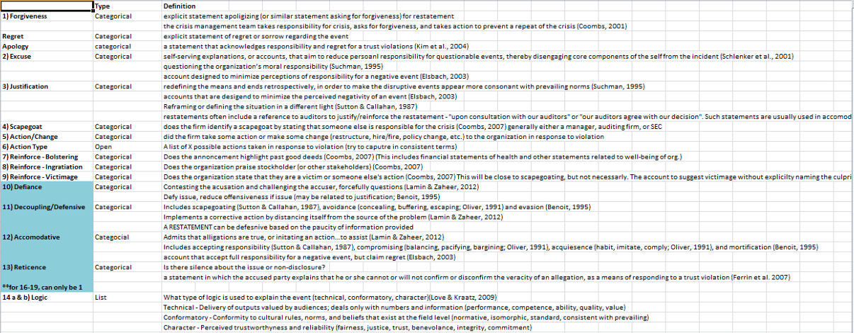
Sample Codebook
(Bundy, 2013)

Slide 19
How did your codebook development go?
Were the constructs equally easy to measure?
How did coder training go?
What challenges did you face?
How did you resolve them?
What would you anticipate doing differently going forward?

Slide 20
Coder selection
Expert vs novice?
Should the researcher be a coder?
Should a random Joe/Jane off the street?
What role does familiarity with the ______ play?
Construct
Context
Method
Motivation/Timeliness
Conscientiousness
Consistency

Slide 21
Sampling considerations
At least 2 coders
10% overlap up to ~300 texts
Big corpora of texts…
Reliability
Subsample
Coder 1 | Coder 2 | Coder 3 | Coder 4 | Coder 5
Text 1 | Text 1 | Text 1 | Text 1 | Text 1
Text 2 | Text 2 | Text 2 | Text 2 | Text 2
Text 3 | Text 3 | Text 3 | Text 3 | Text 3
Text 4 | Text 4 | Text 4 | Text 4 | Text 4
Texts 5-100 | Texts 5-100 | Texts 5-100 | Texts 5-100 | Texts 5-100
Texts 101-300 | Texts 301-500 | Texts 501-700 | Texts 701-900 | Texts 901-1000
TOT: 300 | TOT: 300 | TOT: 300 | TOT: 300 | TOT: 200
Total: 1000

Slide 22
Reliability Metrics
Percentage agreement/Holsti’s PA₀
Straight agreement
It has its place, and it’s not in manual coding
Cohen’s Kappa
Agreement but accounting for chance
Most commonly reported metric in content analysis (my subjective reading)
Krippendorff’s Alpha
Agreement but accounting for chance
Gold standard

Slide 23

What if you get low reliability?
Not… ideal…
You have options, none great
Retraining
Drop variables
Drop coder
Are there some aspects of the variable that can be kept?
Certain codes in a nominal variable
This is why the iterative training process is so important

Slide 24
Konig et al – Metaphors paper
How do they use content analysis?
What key decisions did they make in their analysis
What all did they disclose for transparency
What likely didn’t make it into the final paper?
Why did they include Table 1?

Slide 25
Other tips
Don’t plough through coding in one sitting
Coder fatigue
Start with theory and revisit theory often
Codebook revisions still need to fit theory
Make sure the data your coders will generate is appropriate for your analysis
Know your data
Train, train, train

Slide 26
Agenda
Decisions, Decisions
Last week’s homework
This week’s readings
Homework Discussion
Adjournment

Slide 27
Agenda
Decisions, Decisions
Last week’s homework
This week’s readings
Homework Discussion
Adjournment

