Slide 1
BUS-Z 798 Research Methods (II)
Aaron McKenny
2/14/2024

Slide 2
Agenda
Decisions, Decisions
Last week’s homework
This week’s readings
Homework Discussion
Adjournment

Slide 3
Decisions Made
Discussion Leadership – Dropped
Still be prepared with questions, but no empirical article
Grade mostly on active participation
Homework Reviews –
30 minutes at beginning of class
Whatever time remains at end

Slide 4
Agenda
Decisions, Decisions
Last week’s homework
This week’s readings
Homework Discussion
Adjournment

Slide 5
Agenda
Decisions, Decisions
Last week’s homework
This week’s readings
How computers understand text
What can we do with this?
Homework Discussion
Adjournment

Slide 6
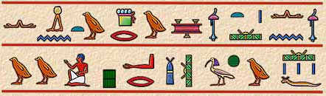
Be the computer…
What is the meaning of this passage?
…or at least tell me how many words are presented here?

Slide 7
What You See vs What the Computer Sees
“I am happier. I have had 3 good days in a row.”
Words
Sentences
Person References
Indicators of Sentiment

Slide 8
What You See vs What the Computer Sees
“I am happier. I have had 3 good days in a row.”
Characters (44)
Words
Sentences
Person References
Indicators of Sentiment
…but is most of the meaning from understanding the individual characters?

Slide 9
Where is the meaning?
Sentences
Words/Tokens
And some words convey more meaning than others
“I am happier. I have had 3 good days in a row.”
Transformed: [ [happier], [3, good, days, row] ]
Sentence Segmentation
Tokenization
Stopword/Non-word Character Removal

Slide 10
Bigger Vocabulary, Greater Complexity
Happy: Happy, happier, happiest, happily, happiness
Be: Be, is, am, are, was, were, been
Same meaning, but different conjugations/inflections/words
Stemming – Happier→Happi, Were→Were
Lemmatization – Happiness→Happy, Were→Be
Transformed: [ [happy], [3, good, day, row] ]

Slide 11
Challenges with Processing Language
Are these words different? “Have” “have”
The computer thinks so by default (“H” vs “h”)
Often normalize the casing of words
Are these ‘words’? “☺”, “:)”, “3”
Decide how to treat emoji/emoticons/numerals
Transformed: [ [happy], [three, good, day, row] ]

Slide 12
A Final Catch
Most NLP applications don’t work with words
[ [happy], [three, good, day, row] ] ← simpler, but still uninterpretable
Solution: Use numeric vectors based on the words used (“vector space model”)
Document-Term Matrix →
One-Hot Vectors
Word Embeddings
 | day | good | happy | row | three
S1. | 0 | 0 | 1 | 0 | 0
S2. | 1 | 1 | 0 | 1 | 1

Slide 13
What are word embeddings?
Whiskey
Beer
Wine
United States
Germany
France
Entrepreneur
Capitalist
CEO

Slide 14
Interesting tendencies of word embeddings
Wine
Vector Algebra: Beer – Germany + France = ????
Beer
Wine
Germany
France
The word embeddings capture elements of ‘meaning’ of the word
as reflected in the corpus in which the embeddings were trained

Slide 15
Embedding Nuances
Static vs Dynamic
Static – 1 word, 1 embedding
Dynamic – 1 word, many embeddings based on context of the word
Do you see any potential issues?
BANK

Slide 16
Merriam-Webster: Bank
Noun:
a mound, pile, or ridge raised above the surrounding level – Fog bank
the rising ground bordering a lake, river, or sea or forming the edge of a cut or hollow – River bank
a steep slope (as of a hill) – Bank of the hill
a protective or cushioning rim or piece – Road bank
an establishment for the custody, loan, exchange, or issue of money, for the extension of credit, and for facilitating the transmission of funds – Bank One
a person conducting a gambling house or game – Break the bank
a supply of something held in reserve – Domino bank
a place where something is held available – Memory bank

Slide 17
Merriam-Webster: Bank (continued)
Noun:
a group or series of objects arranged together in a row or a tier – Bank of vending machines
one of the horizontal and usually secondary or lower divisions of a headline – Bank of the headline
Verb:
to build a raised border of earth around – Bank a fishpond
to heap or pile in a bank – Bank sand along the river
to drive (a ball) into a cushion – Bank shot
to form or group in a tier – Bank bottles on a shelf

Slide 18
Merriam-Webster: Bank (continued)
Verb:
to rise in or form a bank – Clouds would bank up
to incline laterally – The road banks
to follow a curve or incline – To bank around the corner
to manage a bank – I am a banker
to deposit money or have an account in a bank – I bank at Bank One
to deposit or store in a bank – I bank blood at the blood bank
to depend or rely on – To bank on someone

Slide 19
Embedding Nuances (continued)
Level:
Subword (em | ##bed | ##ding)
Word (embedding)
Sentence (This is an example embedding.)
Paragraph (This is […] are important for text analysis)
Document (This is […] and so concludes my dissertation)
Why subword embeddings?
Are vocabularies static?

Slide 20
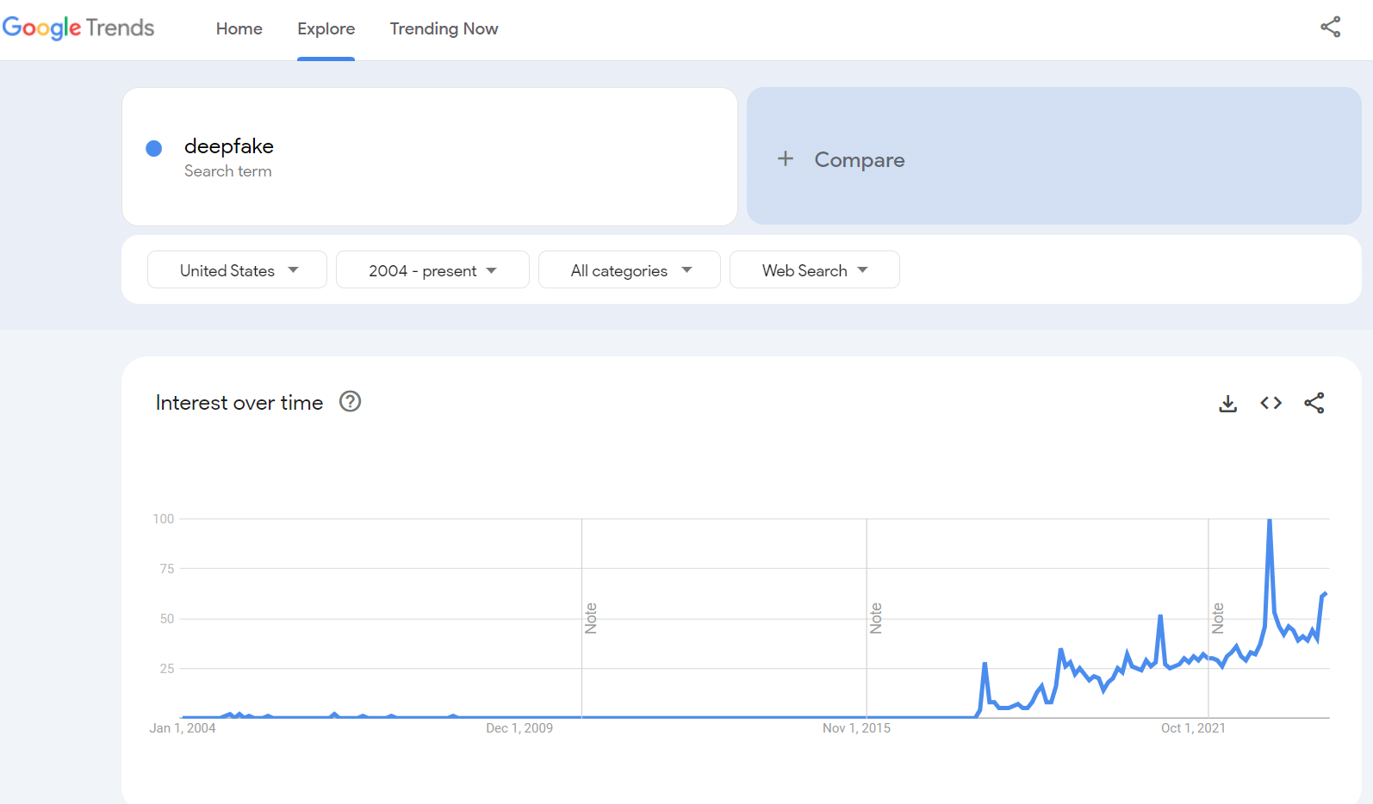
“Deepfake”
What if we had trained our model in 2017?

Slide 21
Agenda
Decisions, Decisions
Last week’s homework
This week’s readings
How computers understand text
What can we do with this?
Homework Discussion
Adjournment

Slide 22
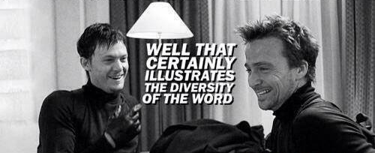
Understand contextualized meaning
Older approaches assume words have a single meaning/use
“Buffalo buffalo Buffalo buffalo buffalo buffalo Buffalo buffalo”
Noun
Verb
N-Place
N-Animal
Part of Speech Tagging
Word Sense Disambiguation

Slide 23
Who is doing what with/to whom?
“During his trip to the United Kingdom, Jeff visited Oxford University. Hana visited Cambridge University in hers.”
Coreference Resolution
People
GPE
Anaphora Resolution
Location
Named Entity Recognition

Slide 24

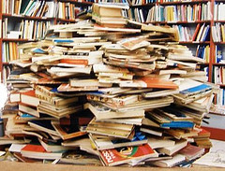
Investigate what is being discussed
Text Summarization
Topic 1: CEO, executive, manage
Topic 2: supply, source, procure, chain
Topic 3: manufacture, create, develop
Topic Modeling

Slide 25
Topic Modeling
Corpus of Texts
Topics
Words
each of which contains
which are comprised of
Observed
Latent
Observed
Have: Texts
Want: Topics/Themes
Guiding principle:
Look for words that show up frequently within a text
Discount words that show up in nearly every text
Think: Factor analysis of words

Slide 26
Example of topic modeling:
Topics:
Green, Bean, Good
Mother, Gift, Happy
Text 1: “I like green beans, they are good for you. Eating green beans can taste good too. There are several good green bean recipes”
Text 2: “Green beans have multiple good effects on the body. For instance, green beans have been shown to improve good cholesterol.”
Text 3: “Receiving gifts on mother’s day makes most mothers happy. So you should definitely get your mother a gift”
Text 4: “When you give a gift to your mother you not only make your mother happy, but you make the entire family happy.”

Slide 27

Label/Score texts based on their contents
Text Classification Regression Analysis
“Goldman Sachs analysts are pessimistic regarding the promise of this new object recognition technology to obtain a significant market foothold.”
Sentiment | Positive | Neutral | Negative
Intent | Investment Guidance | Financial Disclosure | Other
Future Orientation | 5.7/7.0

Slide 28
Agenda
Decisions, Decisions
Last week’s homework
This week’s readings
How computers understand text
What can we do with this?
Dictionary-based CATA
More advanced techniques
Homework Discussion
Adjournment

Slide 29
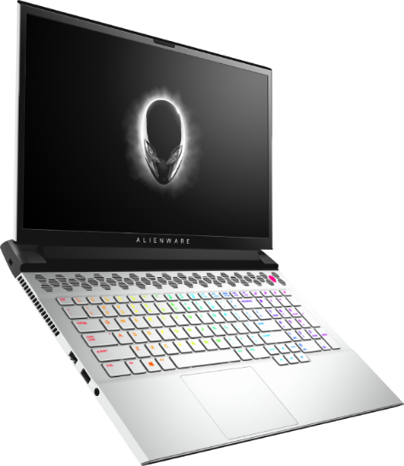
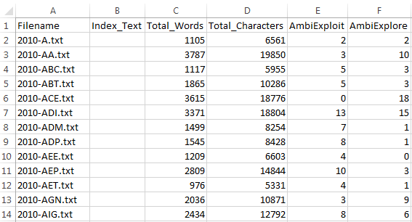
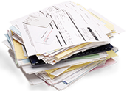
Dictionary-based CATA
Organizational Ambidexterity

Slide 30
Dictionary-Based CATA
Have:
Texts
“Dictionaries” associated with constructs
Want: Scores for constructs
Premise: Work frequency → Salience
Who cares more about innovation?
The person who won’t stop talking about it…
The person who mentions it once in passing…

Slide 31
How it works
Sample Dictionary: Innovativeness
“Innovative” “Innovation” “Innovate” “Research” “Inventions” “Inventive” “Creative” “Creativity”
Sample narrative to analyze:
“The creativity of our research and development team make this organization one of the most innovative in the industry, with patents on over 2,300 inventions.”
Innovativeness: 4

Slide 32
Dictionary considerations…
Word stems:
Innov*: innovative, innovating, innovation, innovations, innovatively
Hop*: hopeful, hopeless, hoplite, hopping
Words vs phrases
New: new product, new endeavor, New York, New Jersey
But if you use phrases, will you catch them all?
What about context?

Slide 33
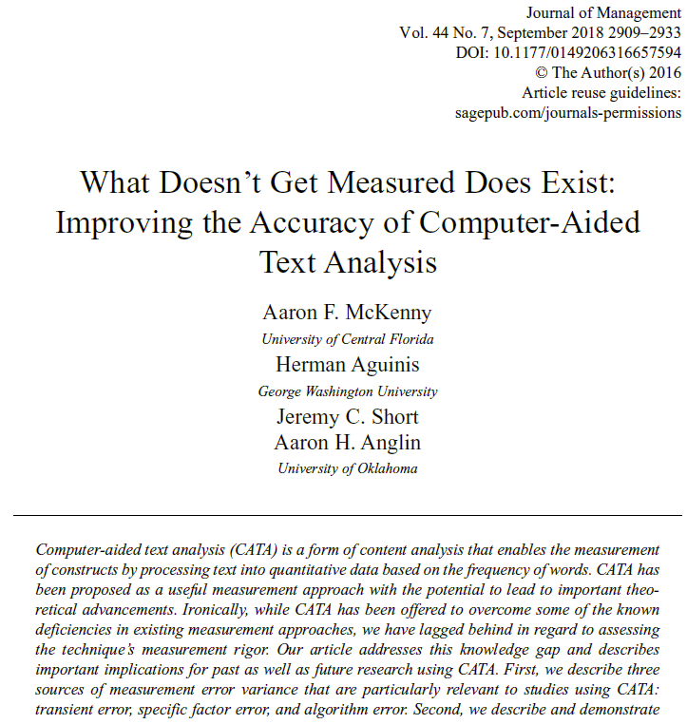
Measurement Error
Transient Error
Changes over time
Specific Factor Error
Inconsistent usage of words
Algorithm Error
Algorithm differences

Slide 34

Validation
Dimensionality
Content Validity
External Validity
Predictive Validity
Discriminant/Convergent Validity

Slide 35
Data Post-Processing
Document length normalization
Which is more innovative?
25 innovation words out of 1,000 total?
25 innovation words out of 10,000 total?
Positive skew
Square root
Logarithm
Inverse hyperbolic sine

Slide 36
Analysis Options
Raw word counts as a DV?
Violates normality
Violates homoscedasticity
Things you can do
Poisson
Zero-inflated poisson
Negative binomial
Raw word counts as an IV?
Cornucopia of options

Slide 37
Writing tips
Justify Everything!
Why content analysis
Why computer-aided text analysis
Why these texts
Be forthright about limitations
Some things often highlighted
Non-response/demand characteristics are less of an issue
Link between psychological processes and language
Link between text content and organizational action

Slide 38
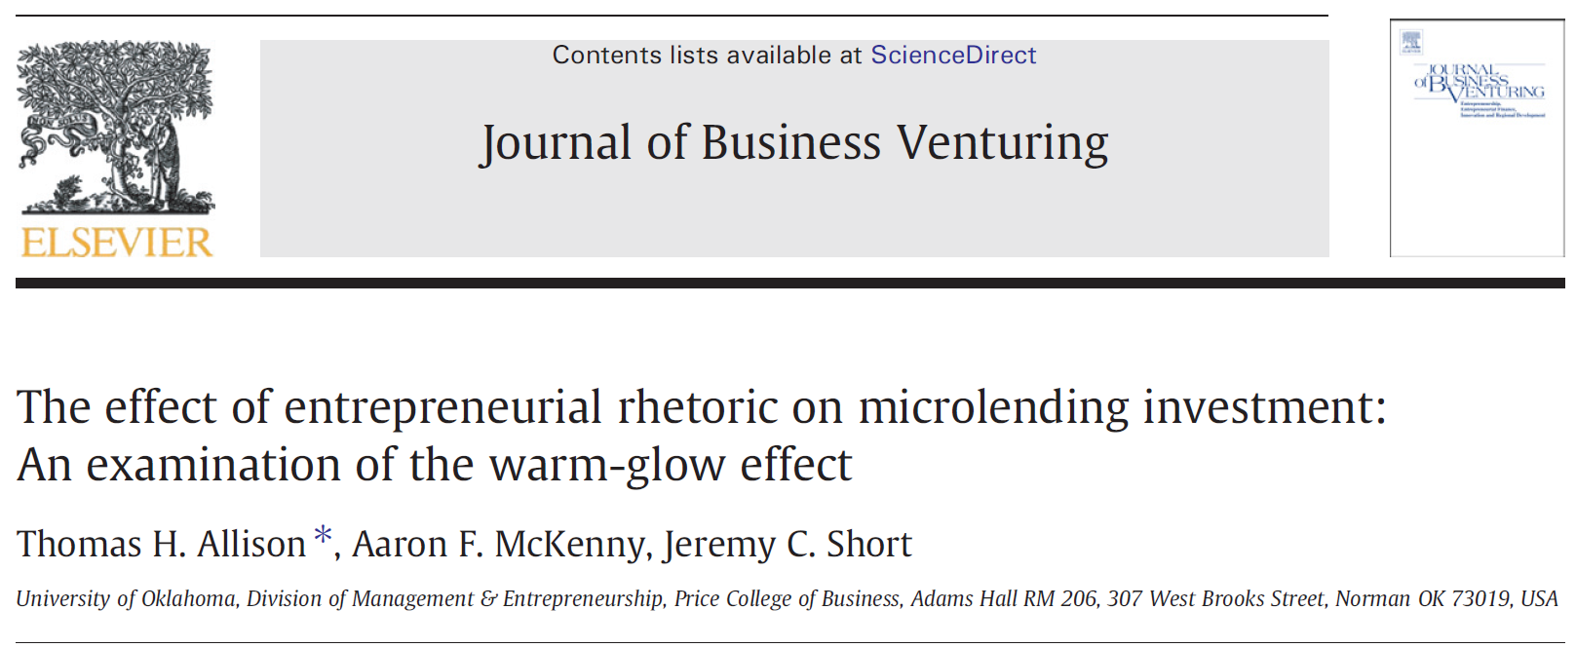
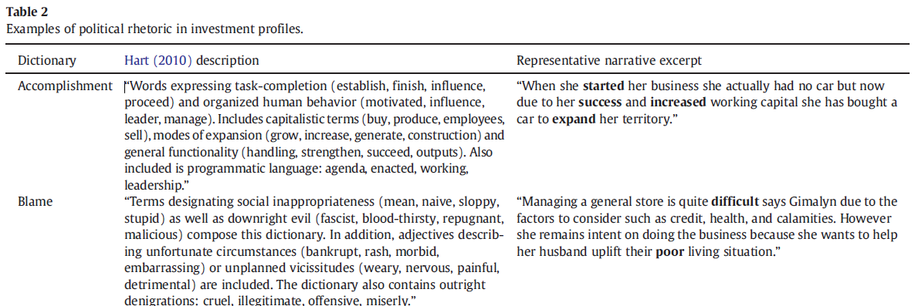
Writing tip: Show them the text!

Slide 39
Agenda
Decisions, Decisions
Last week’s homework
This week’s readings
How computers understand text
What can we do with this?
Dictionary-based CATA
More advanced techniques
Homework Discussion
Adjournment

Slide 40
Transformer-based language models
A type of neural network architecture
Use context to interpret meaning of text
Uses “attention” to look at an entire sequence (e.g., sentence) of text at once
Older approaches (e.g., RNN, LSTM) looked at text sequentially
Most popular foundation models use transformers
GPT, BERT

Slide 41
So… What about ChatGPT?
Next Word Prediction (using transformers)
Encoding step:
Preprocess your input text
“Attention” and a pretrained NN transform embeddings into contextualized vectors
Decoding step:
Take output from encoding step (and previously generated tokens) as input
Attention and a pretrained NN identify the highest probability next word
Repeat decoding step until the next word is an indicator to stop

Slide 42
Agenda
Decisions, Decisions
Last week’s homework
This week’s readings
Homework Discussion
Adjournment

Slide 43
Agenda
Decisions, Decisions
Last week’s homework
This week’s readings
Homework Discussion
Adjournment

