Slide 1
BUS-Z 798 Research Methods (II)
Aaron McKenny
1/17/2024

Slide 2
Agenda
Last week…
This week’s readings
Homework Discussion
Adjournment

Slide 3

Last week…
I got excited
… so I got to talking…
… too much
More Socratic for paper takeaways
Will work on it going forward

Slide 4
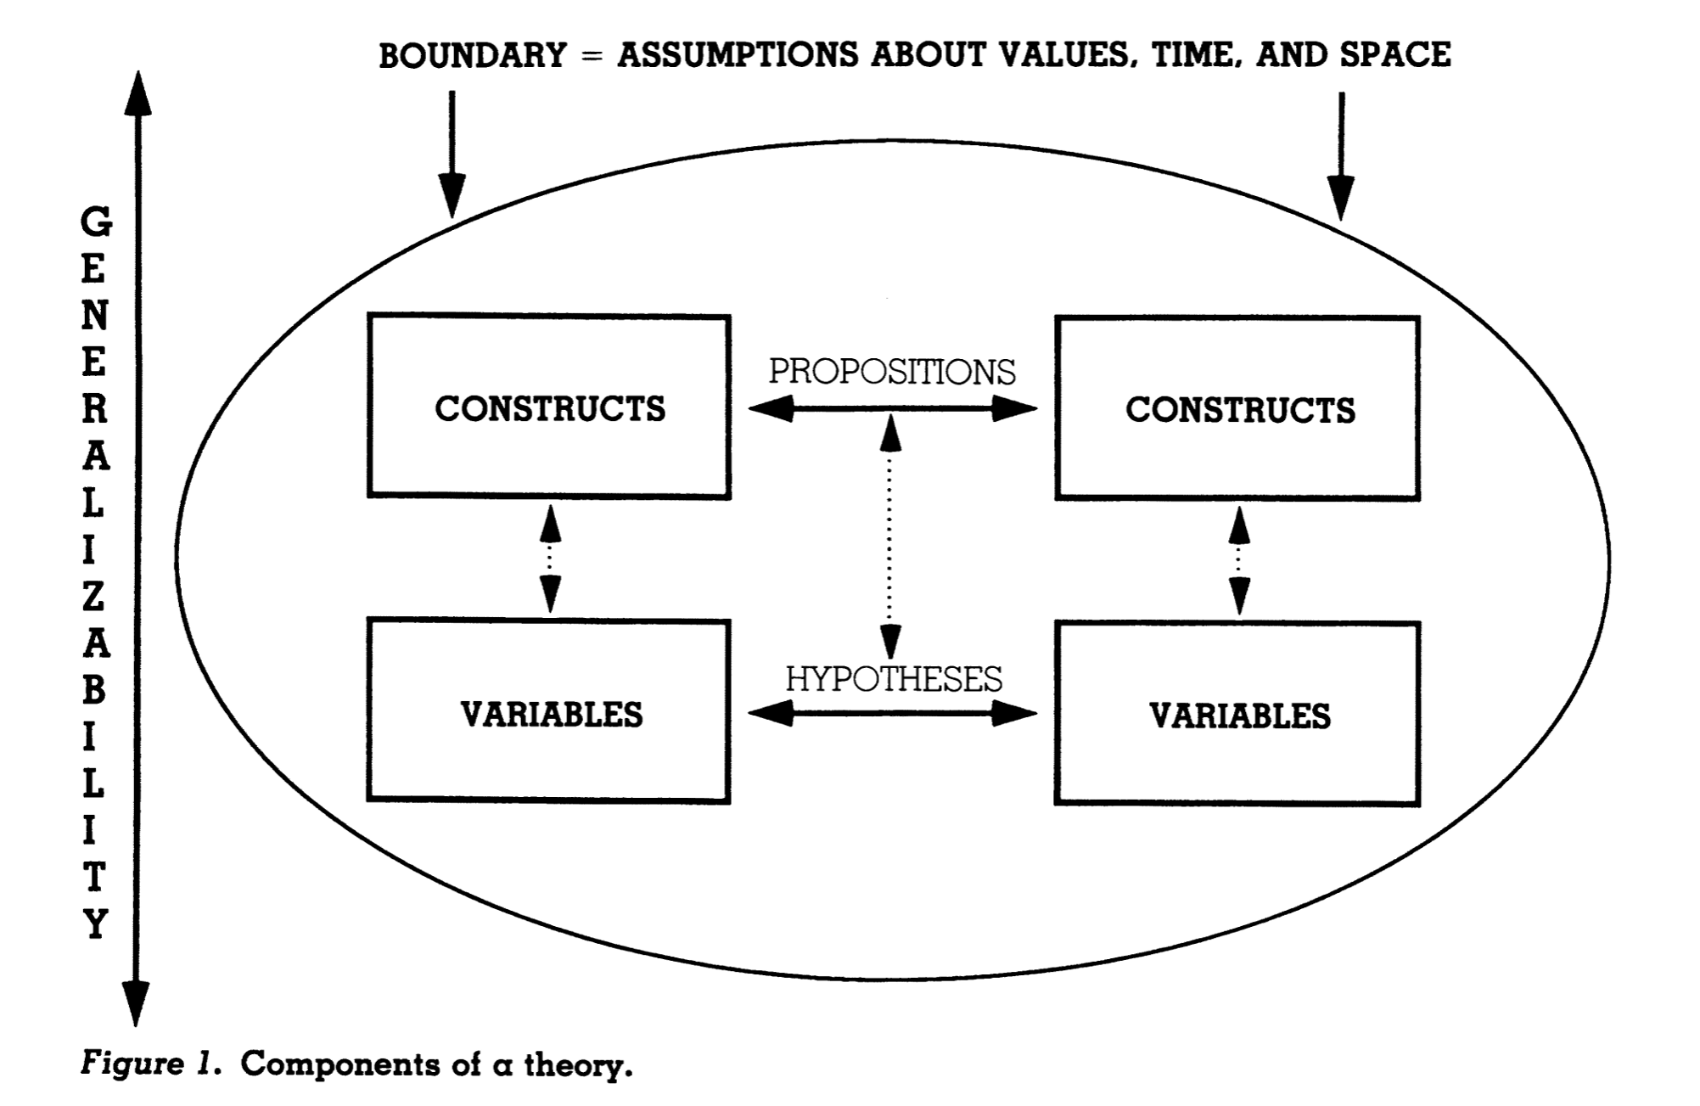
Working Model of Theory (Bacharach, 1989)

Slide 5
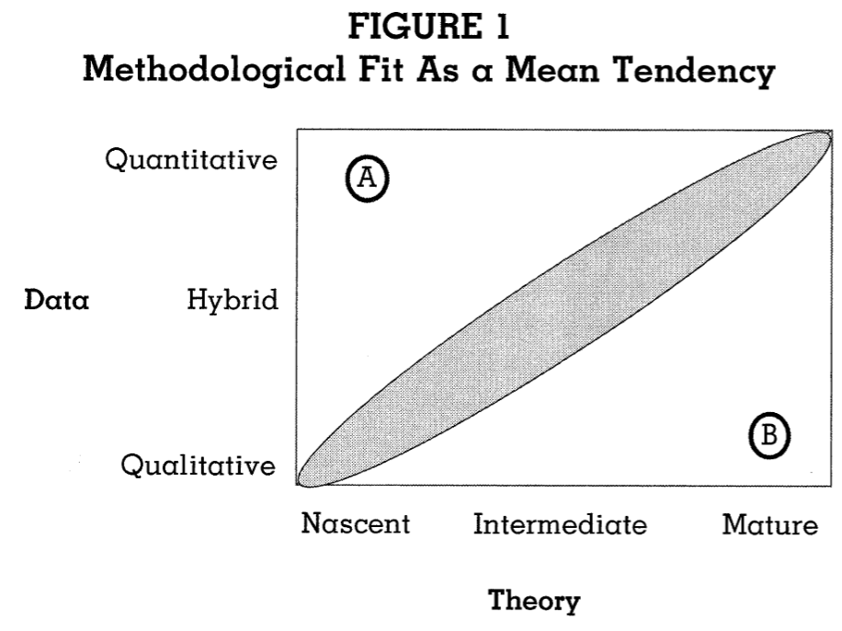
Methodological Fit in Management
Are there “legitimate” opportunities off-the-diagonal?
If so, what do we have to look out for?
Is there room for variance within the diagonal?
Curating Research Assets: Git
How does this fit with:
The open science movement?
The replication crisis?
Let’s explore Git/GitHub!

Slide 6
Agenda
Last week…
This week’s readings
Homework Discussion
Adjournment

Slide 7
Lambert & Newman - Construct Development
What’s the big deal?
How does construct development fit with our model of theory?

Slide 8

Lambert & Newman - Construct Development
For firm innovation orientation, why can’t we just ask…
“How many patents does your company hold?” or…
“How much emphasis does your R&D team place on new product development?”
Classical Test Theory
What does it assume about individual items?
So what should we do then?

Slide 9
Step 1: Conceptualization and Definition
Why? And why first?
What things should we be looking for? Avoiding?
What constitutes a good definition?
How do we determine whether to…
Use an existing/adapt an existing/create a new construct and measure?
What is this jingle and jangle fallacy stuff?

Slide 10
Step 2: Operationalization
Measurement models
What are they and why do we care?
What kinds of models should we be considering?
How do we select a model?
Item generation
Key considerations?
How do we maximize content validity?

Slide 11
Step 3: Confirm Construct Validity
Where do we get data?
What’s the big deal about CFA vs EFA?
Why did I assign readings about EFA and assign EFA homework?
Review: What is the difference between reliability and validity?
What kinds of validity should we be looking for?

Slide 12
Factor Analysis
What does factor analysis say about the relationship between latent factors and observable indicators?
Latent factors explain (cause?) variance in observable indicators
My positive attitude (latent factor) causes me to rate the following highly
“I like doing my job”
“I try to give 100% at work”

Slide 13
Factor Analysis
Dimensionality reduction technique
15 variables = 15 dimensions
Can we create a smaller number of ‘factors’ that explain most of that variance?
Works by looking for:
High within-group covariance
Low between-group covariance
Factors *might* reflect something theoretically meaningful

Slide 14
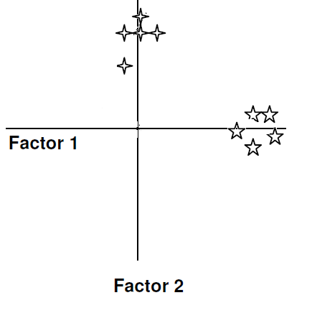
10 items → 2 factors
2 “factors” (x-axis and y-axis in this case)
Move the axes to minimize the distances between the (eigen)vector and the grouped items
Eigenvalue: % variance of the items that a factor explains

Slide 15
Two key outputs
Factor scores – scores of a subject on the factor
Handy for regression… but
SEM and dominance analysis have made somewhat obsolete
Factor loadings – how important an item is to a factor
Use to evaluate measurement
Square of Factor loading determines amount of variance accounted for by that item

Slide 16
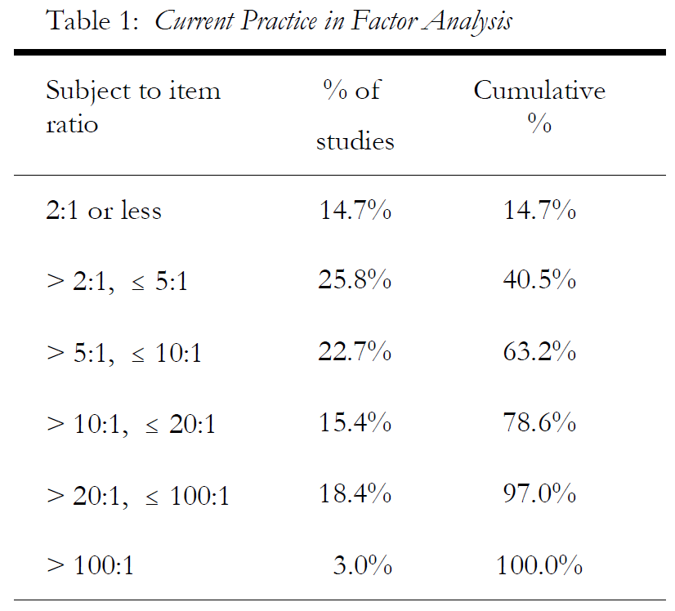
Data requirements
Interval or ratio-level data
Normally distributed variables
Reasonable sample size (bigger is better)

Slide 17
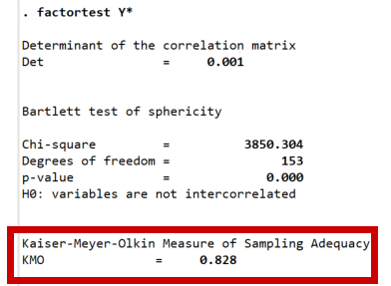
Sample size adequacy
Most important determinants of reliable & stable factor solutions
Sample size
Magnitude of factor loadings
Kaiser-Meyer-Olkin measure of sampling adequacy (KMO-test).
Rule of thumb: adequate if KMO > .50.

Slide 18
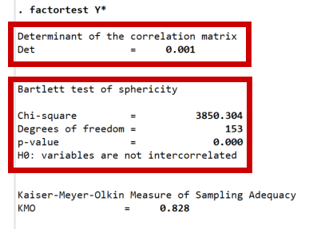
Correlation Considerations
Variables need to be intercorrelated
Why?
Bartlett’s test of sphericity - tests the null hypothesis that the original correlation matrix is an identity matrix
…but not too highly correlated
Multicollinearity detected via the determinant of the correlation matrix
det > 0.00001: multicollinearity not much of a concern

Slide 19
Costello & Osborne – EFA Review
Reviewed 1700 EFA studies
What were the major takeaways regarding the state of the literature?
What are some of the best practices for EFA analysis
Why?

Slide 20

Face-palm
Over half:
Principal Components Analysis
Varimax (orthogonal) rotation
Use Kaiser criterion
…when they report anything at all
What gives?
Default options for SPSS and SAS
PCA is less computationally intensive
… used to matter more

Slide 21
…So what is PCA?
Also a data reduction tool
Decomposes data into a smaller number of components
Components are linear combinations of original variables
Does not presuppose latent causal factors
Uses all variance in items (shared and unique)
All that variance appears in the solution
Most variance explained by first component and decreases therein
Takeaway: Don’t use PCA if you expect a latent variable

Slide 22
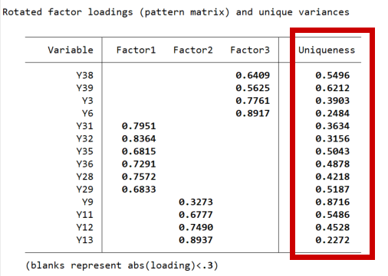
Communalities
Proportion of variation in item explained by factors
R², but where item is outcome and factors are predictors
Complement of “Uniqueness” in Stata
High if 0.8 or greater (Velicer & Fava, 1998)
In social sciences, more likely to find.4-.7
Reviewer pushback below 0.40

Slide 23
Algorithm choice
If data are normally distributed, use maximum likelihood
GOF indices
Significance testing of factor loadings and factor intercorrelations
Confidence intervals
Otherwise, use Principal Axis Factoring
…just don’t use PCA for factor analysis
Fabrigar, Wegener, MacCallum and Strahan (1999)

Slide 24
Algorithm Outputs (PCA, ML, PAF)
Eigenvalues will be similar
PCA will overestimate
Total variance accounted for
Item loadings
PCA does not partition unique variance from shared variance
sets all item communalities at 1.0

Slide 25
Factor retention
Most controversial part of EFA
Kaiser rule – retain factors where eigenvalue > 1
Keep factors which cumulatively explain 70-80% of variance
Look for an elbow in the scree-plot
Parallel analysis – loved by quant jocks
Triangulate!

Slide 26
Scree plots
Popular and easy to use
But sometimes:
Difficult to find a clear elbow
Counterintuitive results
Try:
Compare item loading tables after rotation
Look for clean factor structure
High (> 0.3) factor loadings
Minimal cross-loadings
Factors with 3+ items

Slide 27
Hayton et al - Parallel Analysis
What are the issues with other criteria for factor retention?
What does Parallel analysis do to help overcome this limitation?
What is the decision criterion for interpreting parallel analysis results?

Slide 28
Dropping items
Bad items
Low loadings
Cross-loading
Freestanding
Make sure to report it in the manuscript!
Can improve factor retention decision
Make sure to check communalities after removal!

Slide 29
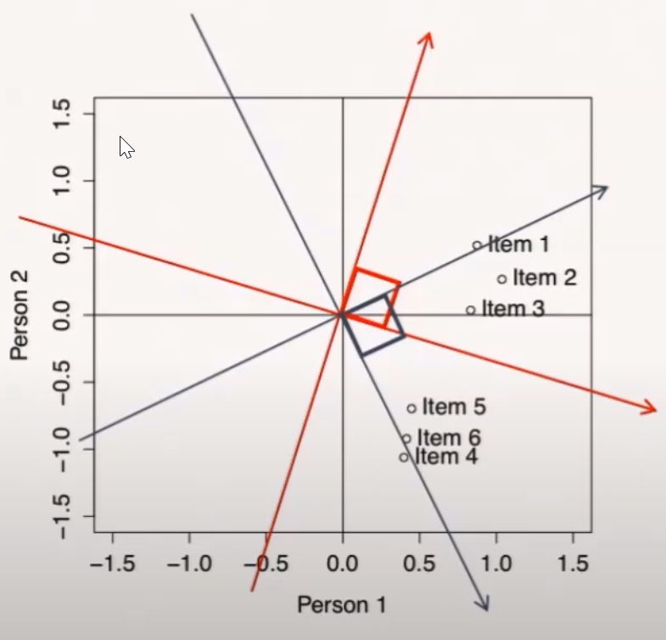
Factor Rotation
First factor will account for the most variance and dominate model
Remaining factors and loadings will be net of first factor (hard to interpret)
Makes factor structure more interpretable
Doesn’t change basic aspects of analysis (e.g., variance explained)

Slide 30
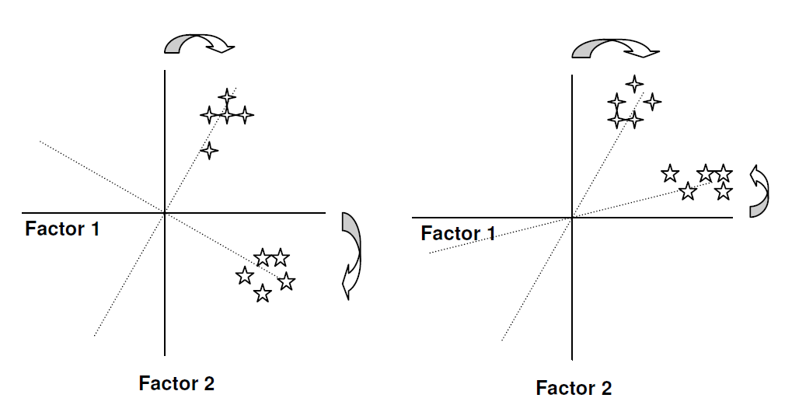
Rely on theory, but when in doubt: oblique
Orthogonal rotation
Oblique rotation

Slide 31
Rotated Factor Loadings
Represented in the rotated component matrix
Interpret factor loadings >=
|0.4| ~ Stevens (1992)
|0.32| ~ Tabachnick and Fidell (2001)
Watch out for cross-loading (strong loading on 2+ factors)
Decide whether to drop – do you have many other good items?
Rietveld & Van Hout (1993)-“although the loading patterns of the factors extracted by the two methods do not differ substantially, their respective amounts of explained variance do”

Slide 32
Dropping Items - Revisited
A factor with fewer than three items is generally weak and unstable
5+ strongly loading items (.50 or better) are desirable and indicate a solid factor

Slide 33
Podsakoff et al. – Common Method Variance
What is Common Method Variance?
Why is this so problematic?
What can should we do about it…
At design phase?
At analysis phase?

Slide 34
Agenda
Last week…
This week’s readings
Homework Discussion
Adjournment

Slide 35
Agenda
Last week…
This week’s readings
Homework Discussion
Adjournment

