Slide 1
BUS-Z 798 Research Methods (II)
Aaron McKenny
2/21/2024

Slide 2
Agenda
Last week’s homework
This week’s readings
Homework Discussion
Adjournment

Slide 3
Agenda
Last week’s homework
This week’s readings
Homework Discussion
Adjournment

Slide 4
Agenda
Last week’s homework
This week’s readings
Latent Profile Analysis
Fuzzy Set Qualitative Comparative Analysis
Cluster Analysis
Homework Discussion
Adjournment

Slide 5
Traditional SEM vs Latent Profile Analysis
Latent Construct
Continuous measurement
SEM in Stata
Indicator₁
Indicator₂
Indicator₃
2
3
2.8
e
e
e

Slide 6
Traditional SEM vs Latent Profile Analysis
Latent
Profiles
Categorical measurement
GSEM in Stata
Indicator₁
Indicator₂
Indicator₃
2
3
2.8
e
e
e

Slide 7
Some Terminology
Latent Class Analysis
Latent variable: Static and categorical
Observed variables: categorical
Latent Profile Analysis
Latent variable: Static and categorical
Observed variables: continuous
Latent Transition Analysis
Latent variable: Dynamic and categorical

Slide 8
The Basic Idea
There are unknown groups in the data
Mutually exclusive
Mutually exhaustive
Estimated parameters:
Prevalence of latent classes
probability of membership in a class
Latent class means and variances
Mean/variance of indicators given class membership

Slide 9
Indicators
Must be normally distributed within classes
If not, you may extract too many classes (Bauer & Curran, 2003)
Must be independent within classes
Called “conditional independence”

Slide 10
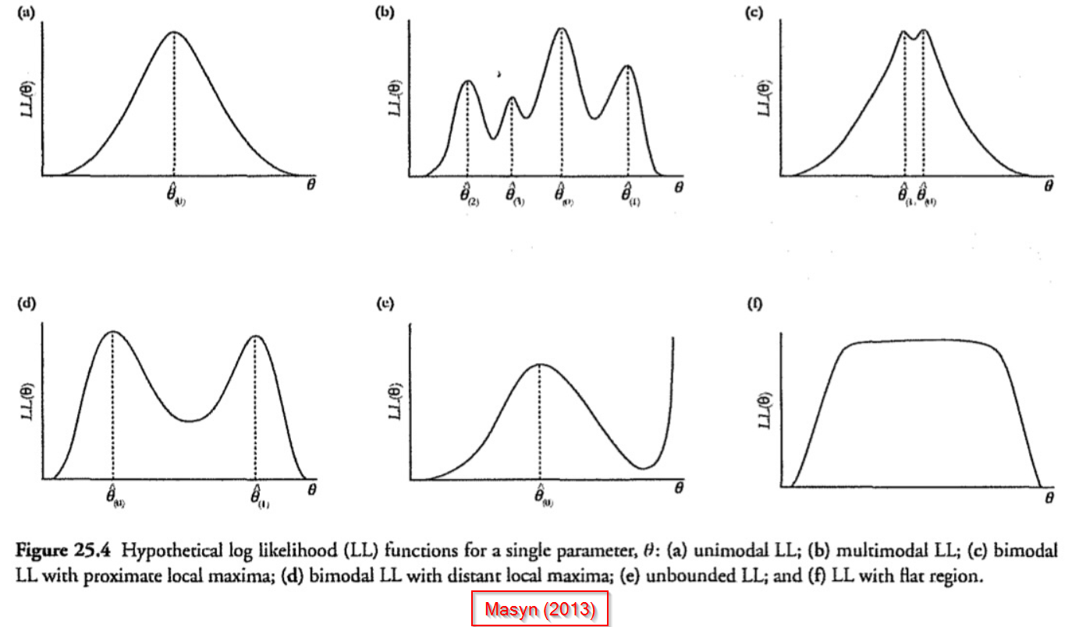
Starting Values
Select randomly
One draw
Local maxima
Not the best fit
Many draws
Global maxima more likely
More latent classes
More complex likelihood funct.
More draws needed

Slide 11
What can we do then…?
Antecedents
Latent
Profiles
Consequences
Indicator₁
Indicator₂
Indicator₃
2
3
2.8
e
e
e

Slide 12
Examining consequences isn’t straightforward
Not as simple as including DV in GSEM model
Resources:
Bakk, Z., & Vermunt, J. K. (2016). Robustness of stepwise latent class modeling with continuous distal outcomes. Structural Equation Modeling, 23, 20-31.
Bray, B. C., Lanza. S. T., & Tan, X. (2015). Eliminating bias in classify-analyze approaches for latent class analysis. Structural Equation Modeling, 22, 1-11.
Dziak, J. J., Bray, B. C., Zhang, J.-T., Zhang, M., & Lanza, S. T. (2016). Comparing the performance of improved classify-analyze approaches for distal outcomes in latent profile analysis. Methodology: European Journal of Research Methods for the Behavioral and Social Sciences, 12, 107-116.

Slide 13
Agenda
Last week’s homework
This week’s readings
Latent Profile Analysis
Fuzzy Set Qualitative Comparative Analysis
Cluster Analysis
Homework Discussion
Adjournment

Slide 14
fsQCA is a set-theoretic method
All variables are coded as set memberships
Crisp sets – dichotomous: fully out/fully in
Set: innovative firms
0 – Not an innovative firm
1 – Is an innovative firm
Fuzzy sets – continuous from 0 to 1
Set: innovative firms
[0,1] – calibration is needed

Slide 15
Calibration of sets
Uses
Theory – What does extant theory suggest about set membership
Knowledge of the phenomenon – What makes sense given extant knowledge of the phenomenon
“Calibrate” function in fsQCA (full out, full in, crossover)
This is a point of contention with reviewers
Can come across as ‘subjective’
Be prepared to defend ‘why’ thresholds were used
Be prepared to use alternative calibrations

Slide 16
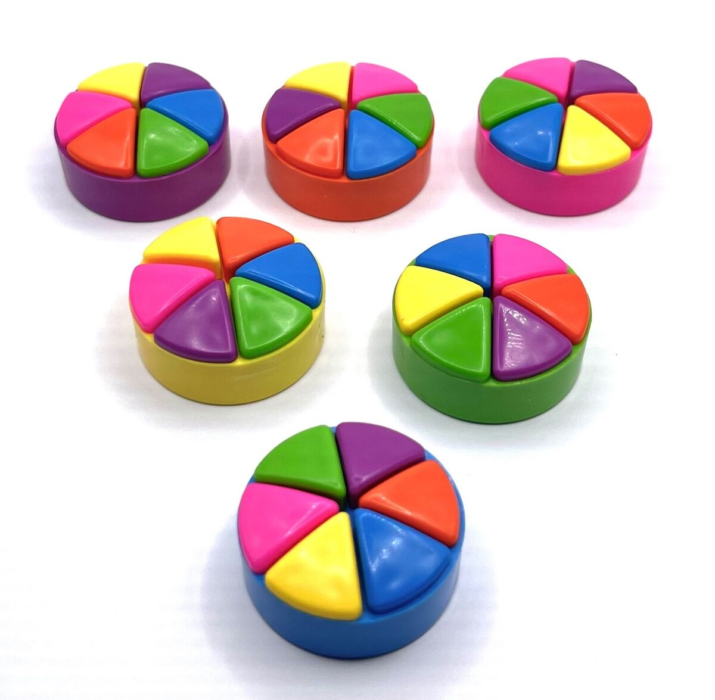
“INUS”
We are looking for
Insufficient but Necessary part of a configuration, that is
Unnecessary but Sufficient
To cause the outcome (Mackie, 1965)
Causality!

Slide 17
Benefits of Fuzzy Set Analysis
Causal complexity
Non-linear relationships
Sample flexibility
Size of sample
Data types

Slide 18
How does it work? Boolean Algebra
Causal Conditions |  | Outcome Condition
Product Novelty | Experienced Founder | Crowdfunding Success
True (1) | True (1) | True (1)
True (1) | False (0) | True (1)
False (0) | True (1) | False (0)
False (0) | False (0) | False (0)
Product novelty is both
Necessary, and
Sufficient
Product novelty on its own is enough for crowdfunding success

Slide 19
How does it work? Boolean Algebra
Causal Conditions |  | Outcome Condition
Product Novelty | Experienced Founder | Crowdfunding Success
True (1) | True (1) | True (1)
True (1) | False (0) | False (0)
False (0) | True (1) | False (0)
False (0) | False (0) | False (0)
Product novelty is
Necessary, but not
Sufficient
You also need an experienced founder!

Slide 20
How does it work? Boolean Algebra
Causal Conditions |  | Outcome Condition
Product Novelty | Experienced Founder | Crowdfunding Success
True (1) | True (1) | True (1)
True (1) | False (0) | True (1)
False (0) | True (1) | True (1)
False (0) | False (0) | False (0)
Product novelty is both
Not necessary, but
Sufficient
There are successful patterns that don’t require product novelty

Slide 21
How does it work? Boolean Algebra
Causal Conditions |  | Outcome Condition
Product Novelty | Experienced Founder | Crowdfunding Success
True (1) | True (1) | True (1)
True (1) | False (0) | False (0)
False (0) | True (1) | False (0)
False (0) | False (0) | True (1)
Product novelty is INUS
Insufficient but Necessary part of a configuration, that is itself
Unnecessary but Sufficient
To cause the outcome

Slide 22
Complicating things a bit…
Causal Conditions |  | Outcome Condition
Product Novelty | Experienced Founder | Crowdfunding Success
True (1) | True (1) | True (1)
True (1) | False (0) | True (1)
False (0) | True (1) | True (1)
False (0) | False (0) | False (0)
Is social science data ever this clean?
What happens when
We have no/few cases in some rows?
Some cases in the row were successful and others weren’t

Slide 23
Minimum Frequency Threshold
Balance
Elimination of idiosyncratic configurations
Include enough configurations to enable the analysis
Small sample sizes (10-40 cases)
Thresholds of 1-2
Configuration complexity decreases cases per configuration rapidly
Larger samples
Higher threshold, but still consider configuration complexity

Slide 24
Minimum Consistency Threshold
How often did the cases in the row lead to the outcome of interest
.83 = 83% of cases in that row were members of the outcome set
You set a threshold, based on
Sample size
Research purpose
Nature of extant knowledge and theory
Heuristics
No less than 0.75 (Ragin, 2006)
Often 0.8 (Bell, Filatotchev, & Aguilera, 2014; Misangyi & Acharya, 2014)

Slide 25
PRI – Proportional Reduction in Inconsistency
Problem: some causal conditions could predict both the presence and absence of the outcome condition with a high level of consistency
Somewhat unique to QCA
PRI: consistency score of a given configuration relative to the outcome of interest without it also being sufficient for the opposite outcome
Heuristic – keep above 0.75

Slide 26
Counterfactual analysis
Rows with missing cases
Easy counterfactuals
existing theory or empirics indicate that the presence of an additional causal condition would still lead to the outcome of interest
Suppose:
We have: Novelty*Dedication*~Experience→FundingSuccess
We don’t have: Novelty*Dedication*Experience
What is the recipe with no outside knowledge?
What is the recipe if we know that Experience generally improves success?

Slide 27
Counterfactual analysis
Rows with missing cases
Difficult counterfactuals
what would have happened if the causal condition were absent?
Suppose:
We have: Novelty*Dedication*Experience→FundingSuccess
We don’t have: Novelty*Dedication*~Experience
Why is this more “difficult”?
combination of novelty and dedication might not have led to crowdfunding success without the entrepreneur having experience

Slide 28
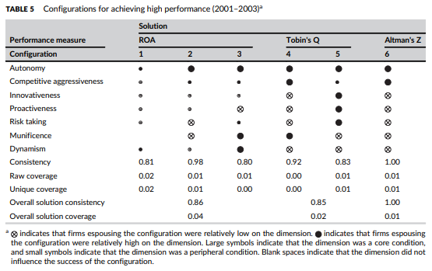
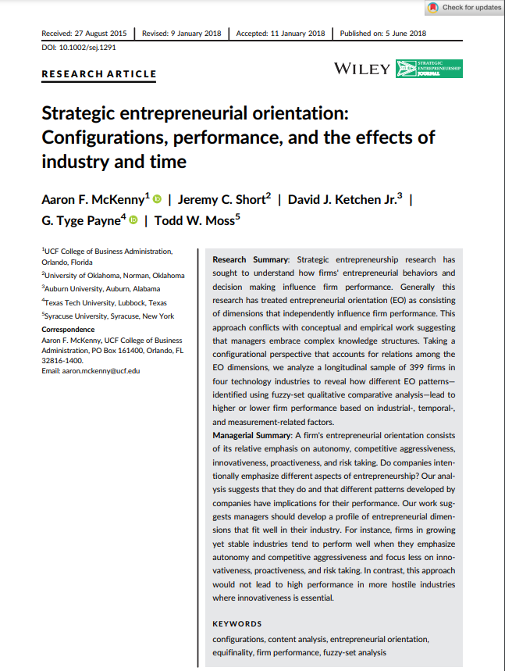
Interpreting Results

Slide 29
Three solutions, one analysis
Complex
Only uses observed data, no counterfactuals
More configurations
Intermediate
Uses observed data, easy counterfactuals, no difficult counterfactuals
Use to identify number/components of configurations
Parsimonious
Uses observed data, easy counterfactuals, difficult counterfactuals
Fewest configurations
Use to identify core elements of configurations

Slide 30
Agenda
Last week’s homework
This week’s readings
Latent Profile Analysis
Fuzzy Set Qualitative Comparative Analysis
Cluster Analysis
Homework Discussion
Adjournment

Slide 31
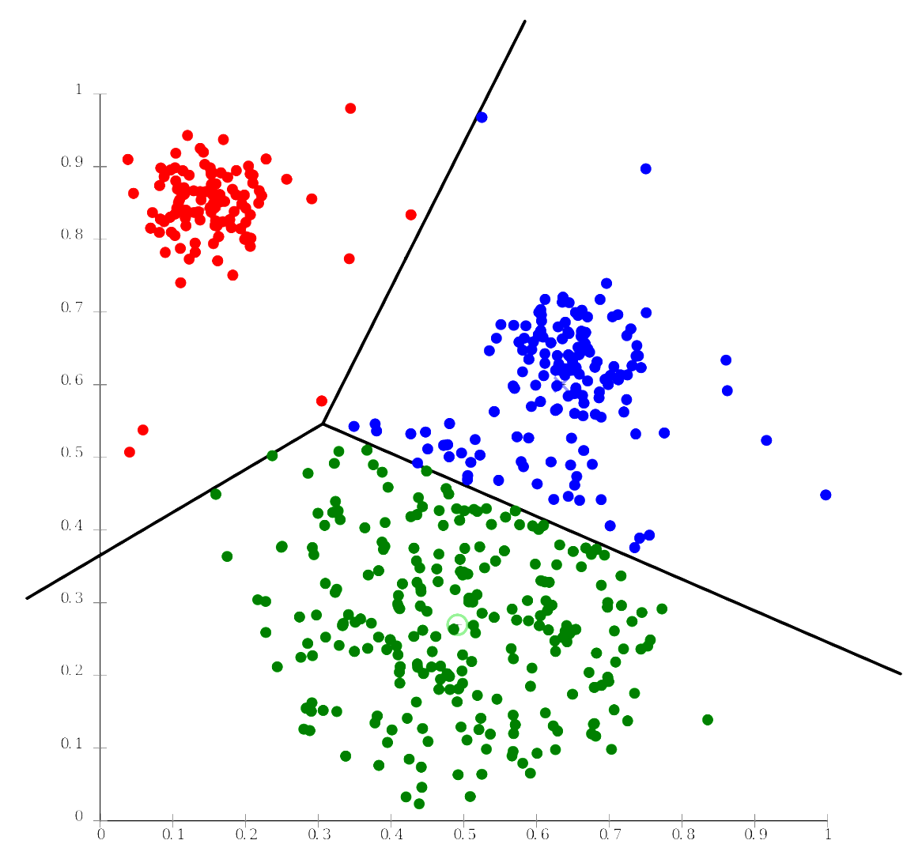
Cluster Analysis
What are clusters?
Goal is to maximize
Within group homogeneity
Between group heterogeneity
What does that look like?

Slide 32
Factors affecting cluster analysis
Selection of variables
Variable scaling
Multicollinearity
Algorithm used
Hierarchical vs iterative
Distance metric

Slide 33
How does Hierarchical clustering work?
We’ll focus on Agglomerative
Each observation starts as a cluster
Find the two clusters that are nearest each other
Combine them
Repeat until…
all of the observations are in one cluster, or more appropriately…
The researcher tells you to stop

Slide 34
How to decide when to stop…
This is one of the challenges with cluster analysis
Dendogram/tree
Look at when you see dissimilar clusters being combined
Not unlike EFA analytics
Calinski/Harabasz Pseudo F
Look for high numbers
Duda/Hart
Look for largest Je(2)/Je(1) that…
corresponds with a low pseudo T-squared

Slide 35
Next steps – K-means
Use hierarchical clustering to seed initial centroids for k-means clustering
Start with initial centroids
Find observation closest to one of the centroids
Calculate new centroids
Repeat

Slide 36
Let’s discuss
Advantages/Disadvantages
LPA
fsQCA
Cluster Analysis
When should we prefer one over the other?
What kinds of research questions can we ask?

Slide 37
Agenda
Last week…
This week’s readings
Homework Discussion – There is none!
Adjournment

Slide 38
Agenda
Last week…
This week’s readings
Homework Discussion
Adjournment

