Slide 1
BUS-Z 798 Research Methods (II)
Aaron McKenny
1/17/2024

Slide 2
Agenda
Last week’s homework
This week’s readings
Homework Discussion
Adjournment

Slide 3

Let’s go through it!
Identifying factors
Dropping items
Rotations
Oblique
Orthogonal
PCA vs Factor Analysis

Slide 4
Agenda
Last week’s homework
This week’s readings
CFA
SEM
Homework Discussion
Adjournment

Slide 5
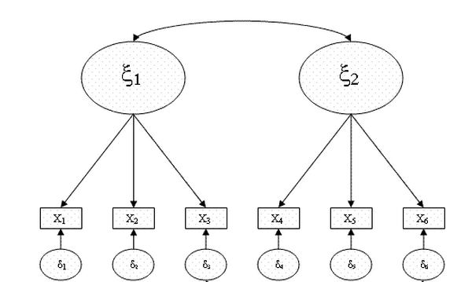
CFA/SEM Notation
Correlation
Latent Construct
Observed Variable
Causal Arrow

Slide 6
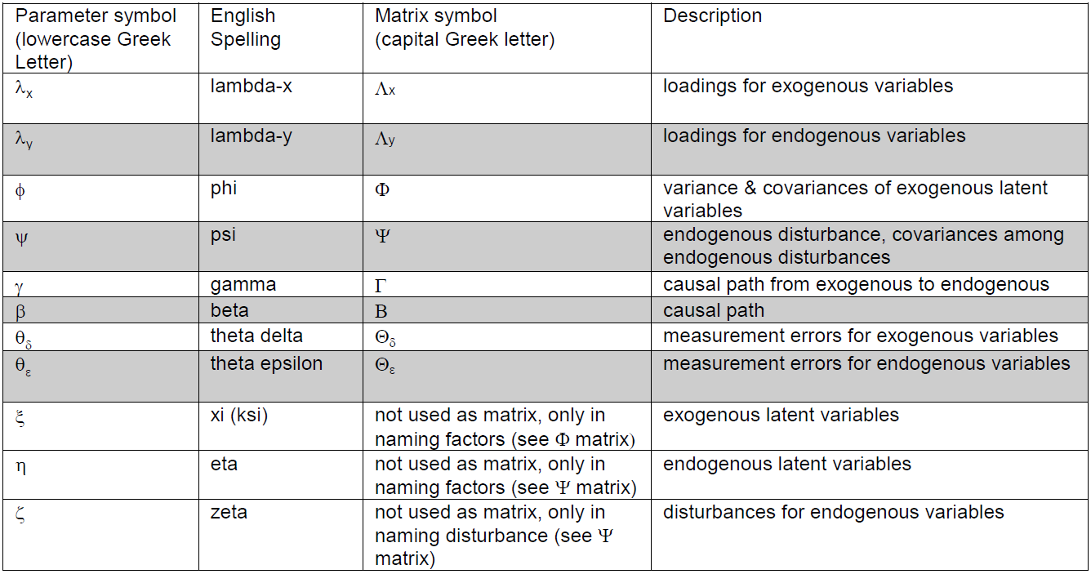
CFA/SEM Notation

Slide 7
Important Terminology
Measurement model – model that links indicators to their constructs and error (aka. disturbance) terms

Slide 8
Important Terminology
Structural model – model that links constructs to other constructs (your theoretical model)
Long-term Orientation
Socioemotional Wealth Goal Salience
Firm Performance
Organizational Ambidexterity

Slide 9
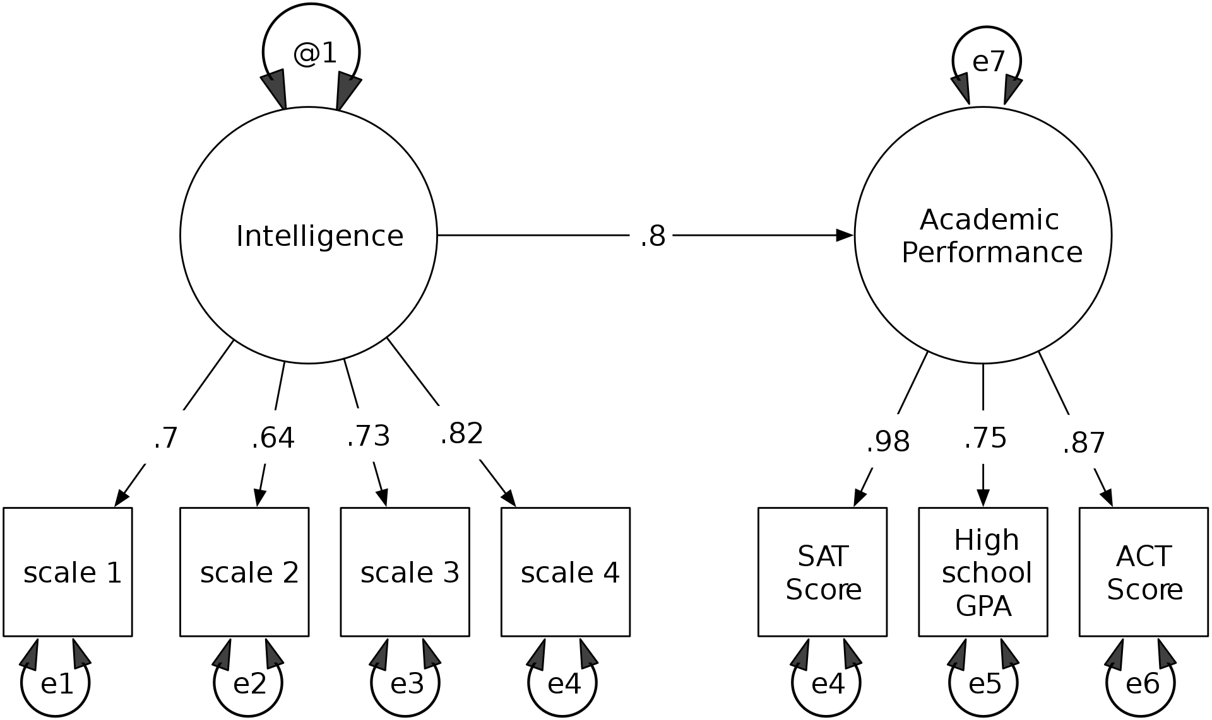
Important Terminology
Composite model – Combination of the two

Slide 10
EFA vs CFA
Same basic goal:
Describe a large number of observed variables in terms of a smaller number of latent variables (i.e., factors)
So then how/why are they different?

Slide 11
EFA vs CFA
Exploratory Factor Analysis
Confirmatory Factor Analysis
Statistically-driven approach
No ability to test hypotheses
A bit subjective/‘exploratory’
Theory-driven approach
Can test specific hypotheses
Indicators of model fit
Absolute and relative
Stronger Evidence for construct validity

Slide 12
Falsification is a central goal of science
The ‘real’ model produces data
Problem: We don’t get to know the real model, we just get the data
Our goal: Find a hypothesized model that nearly produces the same data
If our model doesn’t fit the data
Our model isn’t the ‘real’ model
What does this say about EFA vs CFA and falsification?

Slide 13
Degrees of freedom (CFA)
df = m*(m+1)/2 – 2*m – ζ*(ζ-1)/2
m = number of indicators/observed variables
ζ = number of independent latent constructs
M=6
X=2
df = (6*(6+1)/2) - (2*6) - 2*(2-1)/2 = 21-12-1 = 8

Slide 14
Degrees of freedom (SEM)
df = m*(m+1)/2 – 2*m – ζ*(ζ-1)/2 – g – b
g (gamma) – relationships between IVs and DVs/Mediators
b (beta) – relationships between Mediators/DVs and other Mediators/DVs
ζ =1
b=0
g=1
M=7
df = (7*8/2) - (2*7) - 1*0/2 - 1 = 28-14-0-1 = 13

Slide 15
Why is this important?
Needs to be positive for identification
“A statistical model is identified if the known information available implies that there is one best value for each parameter in the model whose value is not known”
Not Identified: X+2Y = 7
Just Identified: 3X = 6
Over Identified: {3X=6; 2X=4; 1X=2}
We like this!

Slide 16
Identification in CFA
Parameters for estimation:
Factor loadings
Measurement error variances
Factor variances
Factor correlations/covariances
Measurement error correlations/covariances (sometimes)
General rule:
Most models will be identified if each construct has 3+ indicators, or
All constructs have 2+ indicators and every construct is correlated with at least one other construct

Slide 17
Setting the metric for identification
No inherent scale for latent constructs
Two ways to set the metric
Set one factor loading per construct to 1.0
Set construct variances to 1.0
But…
Setting factor loadings doesn’t allow us to test its significance
Setting variance doesn’t allow us to test significance of path coefficient
Choice influences interpretation of factor loadings

Slide 18
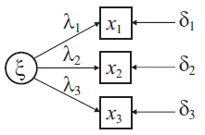
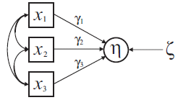
Formative vs Reflective Measurement
Reflective
Formative
Job autonomy
Do work my own way
Make my own decisions
Determine the way work is done
Socioeconomic status
Income
Education
Occupation

Slide 19
Formative vs Reflective Measurement
Reflective
Formative
Unidimensional
High internal consistency desired
Just identified with 3 items
Measurement error is incorporated
Constructs are real, but measured imperfectly by items
Multidimensional
Internal consistency is not expected/relevant
Not identified
No measurement error, just latent factor residual
Construct doesn’t exist separately of its items

Slide 20
Sample size: Heuristics vary widely
100-200 for a simple model (some suggest up to 400)
10 subjects per parameter estimated
5 subjects per observed variable
<100 = too small; 100-200 = moderate; >200 = large
These oversimplify sample size needs!
Better to rely on number of parameters in the model and reliability of variables
See MacCallum et al., 1999

Slide 21
Model Estimation
Begin with a sample covariance matrix (S)
Obtain parameter estimates with software
Estimates imply predicted covariance matrix (∑_{est})
Estimates minimize differences between S and ∑_{est}
Model adequacy based on differences between S and ∑_{est} (matrix of residuals ∑_{res} )
Differences reflected in variety of fit indices used in model evaluation process

Slide 22
Model Fit Heuristics
Absolute Fit
χ² : Non significant or χ²:df ratio of less than 3:1 (Kline, 2005)
CFI/TLI: > 0.95 is good (Hu &Bentler, 1999; Vandenberg & Lance, 2000)
> 0.90 is adequate (Bentler, 1990; Hu & Bentler, 1999)
RMSEA/SRMR: < 0.05 is good (Browne and Cudeck, 1989)
< 0.08 is reasonable (Browne and Cudeck, 1989)
Relative Fit
AIC/BIC – smaller is better
CFI, RMSEA, AIC, BIC all penalize model complexity

Slide 23
CFA and testing alternative models
Common hypothesis: number of factors
Compare models using hierarchical chi-square or chi-square difference tests
Can be done for any set of nested models
If one can be derived from the other by constraining or eliminating one or more parameters.
Δχ² test
Null hypothesis: Models are the same – use more restricted model
Alternative hypothesis: Models are different – don’t add constraints

Slide 24
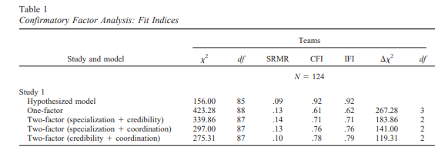
Sample

Slide 25
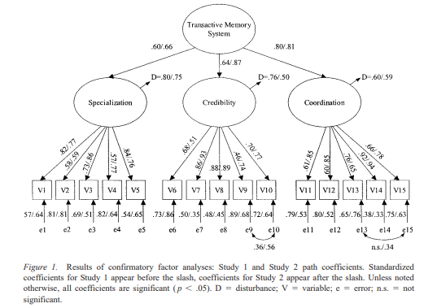
Higher-Order CFA Models

Slide 26
Agenda
Last week’s homework
This week’s readings
CFA
SEM
Homework Discussion
Adjournment

Slide 27
Regression: y=a+bx+e
Structural relationships at the observed variable level
Ŷ: estimate of y
Error isn’t modeled
Linear combination of predictors – best guess
Regression line
Always goes through midpoint of data
Average fitted residual = 0
Fitted residuals are uncorrelated with predictors
Unstandardized slope gives how much y is predicted to change with a one-unit change in x

Slide 28
Benefits of SEM over OLS
Model complexity
Multiple stages
Multiple DVs
Multiple relationship forms (GSEM)
Handling of measurement error
Handling of mediation

Slide 29
Assumptions of SEM
Many of the same assumptions as Regression
Especially normality and outliers
Multivariate normality
Stata: mvtest normality <varlist>, stats(all)
If significant: either use method(adf) or vce(robust) on your SEM

Slide 30
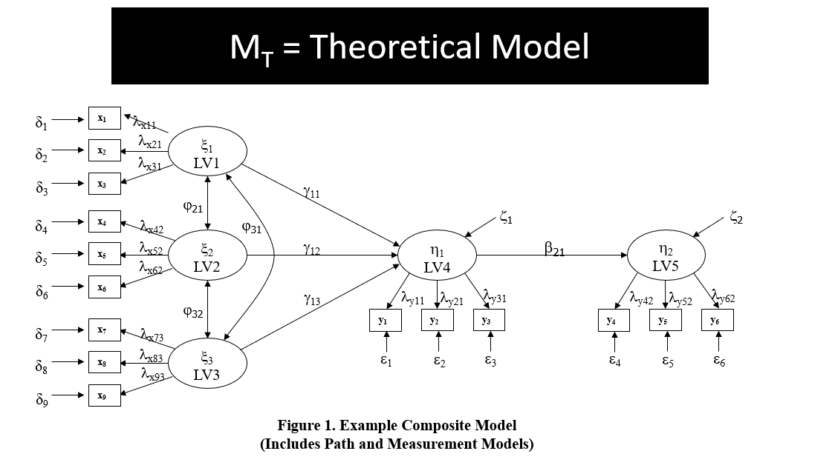

Slide 31
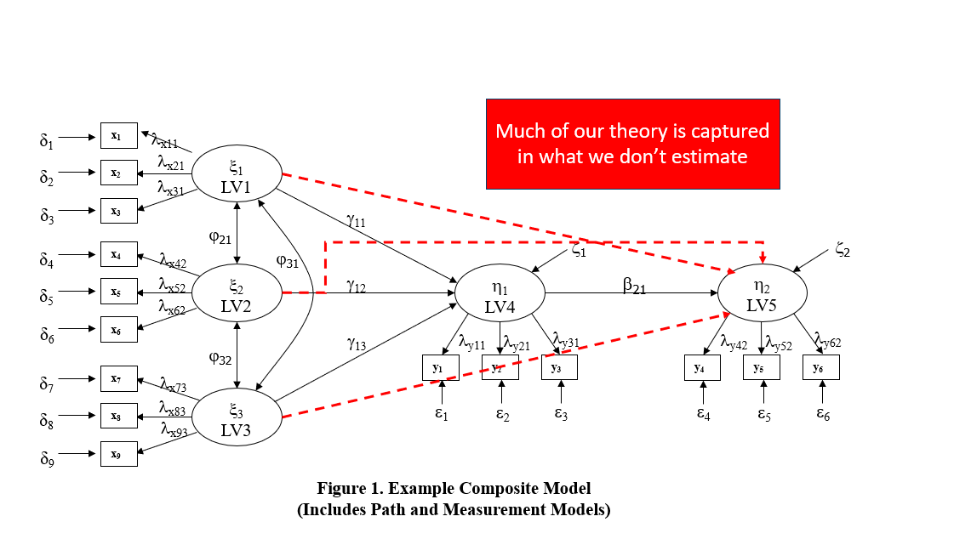

Slide 32
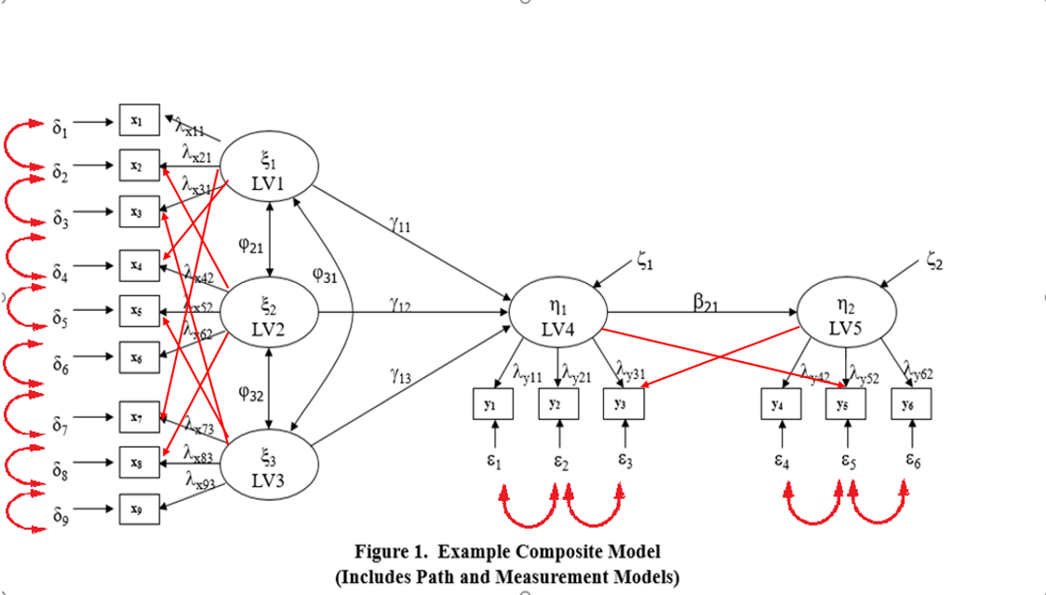

Slide 33
SEM Model Fit
Are path estimates different from zero?
Do nested model comparisons increase misfit?
Is theoretical model worse than measurement model?
How do fit indices look?

Slide 34
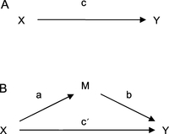
Mediation (Baron & Kenny, 1986)

Slide 35
Testing for mediation
Product of coefficients (Sobel test) – Not good
Wald test for significance of ab
Assumes normal SEs (unlikely)
SEM estimation of indirect effect – Also not great
Stata: estat teffects ML estimation to see if ab is significant
Monte Carlo simulation – Better
Assumes a and b are normally distributed, but not ab
Simulates values of ab based on estimate and SE of a and b
Quantpsy.org calculator

Slide 36
Best test for mediation
Bootstrapping!
Relies on resampling to determine appropriate SE
1000’s of samples from data
Run model on each sample
Get distribution of estimates from samples
Let’s do it!

Slide 37
Agenda
Last week…
This week’s readings
Homework Discussion
Adjournment

Slide 38
Agenda
Last week…
This week’s readings
Homework Discussion
Adjournment

