Slide 1
MAN 7916
Session 3: Manual Content Analysis
Aaron McKenny
10/27/2026

Slide 2
AGENDA
1 Homework review
2 This week’s readings
3 Whither manual content analysis
4 In class activity
5 For next week

Slide 3
Manual Content Analysis
Questions?
Points of Confusion?
What did you find?
  Codebook development
  Coder training
  Reliability

Slide 4
AGENDA
1 Homework review
2 This week’s readings
3 Whither manual content analysis?
4 In class activity
5 For next week

Slide 5
Neuendorf Chapter 4: Variables and Predictions
Neuendorf highlights that “Failure to identify all the form and content/substance variables that distinguish a set of messages can result in misleading outcomes.”
  What does she mean by this? What is our take-away?
What are Universal variables? How might these apply in our research?
What is the role of theory in variable selection/operationalization?
Neuendorf highlights possibilities for reusing content analysis/adapting non-CA measures
  What do you think? Strengths/Weaknesses?

Slide 6
Neuendorf Chapter 5: Measurement and Validity
What is precision? What is its role in content analysis and measurement?
What are the various forms of validity and how do they apply in content analysis research?
How might we examine validity in content analysis? What are some of the challenges?
What are some key considerations for
  Codebook development?
  Coder selection?
  Coder training?

Slide 7
Neuendorf Chapter 6: Reliability
What is reliability and why does it matter?
  What are different types of reliability relevant to content analysis?
What is the difference between IRR and IRA?
What are some of the key threats to reliability and how can we address them?

Slide 8
Sonpar & Golden-Biddle: Theory Elaboration
What (dis-)advantages do content analysis methods offer for
  refining theoretical constructs
  relationships, and
  boundaries in organizational research?
What techniques (protocols) did they use and what do these do?
How did they apply this to better understand the Attention-Based View?
Would this work equally well for all adolescent theory? Why?

Slide 9
O’Kane et al: Transparency and Trustworthiness w/ CAQDAS
What are transparency and trustworthiness?
  What is the role of CAQDAS in facilitating these?
  Why are we talking about this vs validity and reliability?
What does CAQDAS do to facilitate qualitative data analysis?
What are some of the capabilities/techniques of CAQDAS software?
How can researchers balance use of CAQDAS against depth and richness?

Slide 10
Nguyen & Welch: Gen AI in Qualitative Data Analysis?
Does Nguyen and Welch’s critiques apply equally to discovering themes inductively and applying a predefined codebook?
  Does the distinction between manifest and latent content affect your answer?
Suppose an AI coder achieved high IRA with your manual coding. What would this establish?
  What additional evidence would you need to judge whether it measures your intended construct?
When does refining a prompt resemble improving a codebook, and when does it become steering the results toward what we want to find?
  How would you distinguish these in practice?
  What role should separate training texts and independent coding play?

Slide 11
Choose Your Own Adventure
What article did you read?
What was the main premise/RQs/Hypotheses?
How did they use content analysis to examine this?
What was your assessment of their analysis?
  Clear/rigorous/well-documented? Why (not)?
  What was made explicit vs left implicit?

Slide 12
AGENDA
1 Homework review
2 This week’s readings
3 Whither manual content analysis?
4 In class activity
5 For next week

Slide 13
We have computers, why use humans?
Latent vs manifest content
Context and reading between the lines
Inductive elements
AI tools are getting better at these things
  But, the human coder isn’t going anywhere soon
  AI will be a bigger ‘tool’ in the toolbox

Slide 14
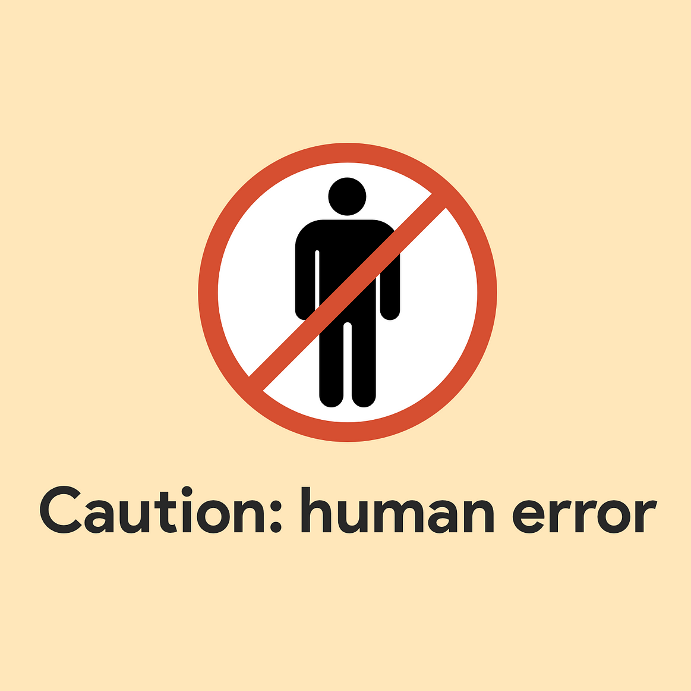
We said content analysis is systematic…
…but people are problematic
  Confirmation bias
  Role of expertise
  Inattention
  Fatigue
  Recording errors
  Inadequate scheme/coder training
Both within and between people
  …sound familiar?

Slide 15
How did your codebook development go?
Were the constructs equally easy to measure?
How did coder training go?
  What challenges did you face?
  How did you resolve them?
What would you anticipate doing differently going forward?

Slide 16
So we implement a systematic process…
Theory and Codebook
Initial Training and Discussion
Joint Coding
Revisions and Training
Independent Coding
Check Reliability and Discuss
Revisions and Training
Final Coding
Final Interrater Reliability
(Based on Bundy, 2013; Neuendorf, 2016)

Slide 17
Avoid…
Theory and Codebook
Initial Training and Discussion
Joint Coding
Revisions and Training
Independent Coding
Check Reliability and Discuss
Revisions and Training
Final Coding
Final Interrater Reliability
(Based on Bundy, 2013; Neuendorf, 2016)

Slide 18
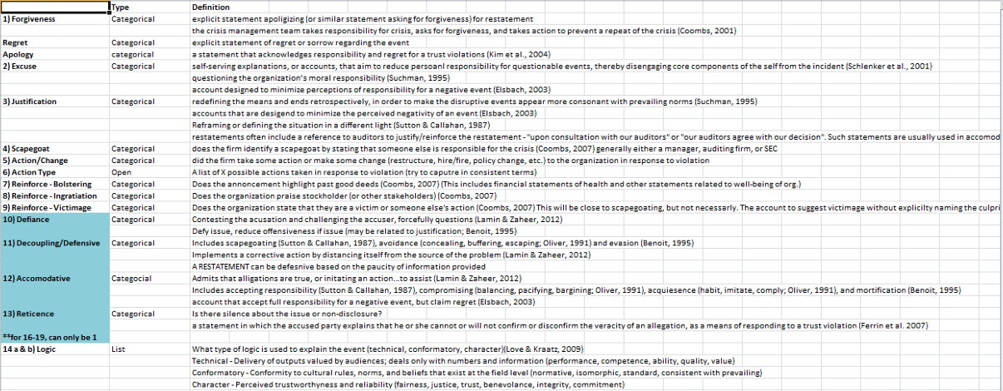
Sample Codebook
(Bundy, 2013)

Slide 19
Coder selection
Expert vs novice?
  Should the researcher be a coder?
  Should a random Joe/Jane off the street?
  What role does familiarity with the ______ play?
    Construct
    Context
    Method
Motivation/Timeliness
Conscientiousness
Consistency

Slide 20
Sampling considerations
At least 2 coders
10% overlap up to ~300 texts
Big corpora of texts…
Reliability
Subsample
Coder 1 | Coder 2 | Coder 3 | Coder 4 | Coder 5
Text 1 | Text 1 | Text 1 | Text 1 | Text 1
Text 2 | Text 2 | Text 2 | Text 2 | Text 2
Text 3 | Text 3 | Text 3 | Text 3 | Text 3
Text 4 | Text 4 | Text 4 | Text 4 | Text 4
Texts 5-100 | Texts 5-100 | Texts 5-100 | Texts 5-100 | Texts 5-100
Texts 101-300 | Texts 301-500 | Texts 501-700 | Texts 701-900 | Texts 901-1000
TOT: 300 | TOT: 300 | TOT: 300 | TOT: 300 | TOT: 200
Total: 1000

Slide 21
Reliability Metrics
Percentage agreement/Holsti’s PA₀
  Straight agreement
  It has its place, and it’s not in manual coding
Cohen’s Kappa
  Agreement but accounting for chance
  Most commonly reported metric in content analysis (my subjective reading)
Krippendorff’s Alpha
  Agreement but accounting for chance
  Gold standard

Slide 22

What if you get low reliability?
Not… ideal…
You have options, none great
  Retraining
  Drop variables
  Drop coder
  Are there some aspects of the variable that can be kept?
    Certain codes in a nominal variable
This is why the iterative training process is so important

Slide 23
AGENDA
1 Homework review
2 This week’s readings
3 Whither manual content analysis?
4 In class activity
5 For next week

Slide 24
Would you trust these codes?
A fictional study examines 120 employee interviews across six companies.
The team uses a theory-based codebook to measure scheduling control and intention to stay.
You will audit six selected excerpts and their assigned codes.
These six cases are teaching examples, not a representative sample.

Slide 25
Your audit
Identify incorrect codes. Cite the rule and propose a correction.
Separate coding errors from concerns about the codebook itself.
Write a defensible replacement finding in two sentences or fewer.
Request one additional analysis or piece of documentation. Explain what it would help you judge.
Which problem most threatens the study’s conclusions?

Slide 26
Discussion
Where did your coding judgments differ?
  Which rule resolves the difference?
Would correcting the codes make the report’s conclusion defensible?
What does 90% agreement establish?
  What information is missing?
Do the excerpts reveal a limitation in the construct’s operationalization?

Slide 27
Source of codes – Soes it matter?
Suppose the codes and report came from:
  A doctoral researcher
  A generative AI tool using the supplied codebook
  A researcher who reviewed and approved AI-generated coding
Would your judgment or request for evidence change? Why?
What standards should apply in every case?

Slide 28
AGENDA
1 Homework review
2 This week’s readings
3 Whither manual content analysis?
4 In class activity
5 For next week

Slide 29
Intro to Computer-Aided Text Analysis
Jurafsky & Martin readings
  Don’t worry about technical/mathematical aspects/algorithms
  Worry more about conceptual understanding and application

