Slide 1
woRldnews
By: Eshita Zaman, Coskun Erden, and Alex Cleveringa
Stat 585
5/3/2022

Slide 2
Outline
Original Plan – Job Search Package
HigherEdJobs
Indeed
3-legged authorization
2-legged authorization
New Plan – News
Parameters
Examples

Slide 3
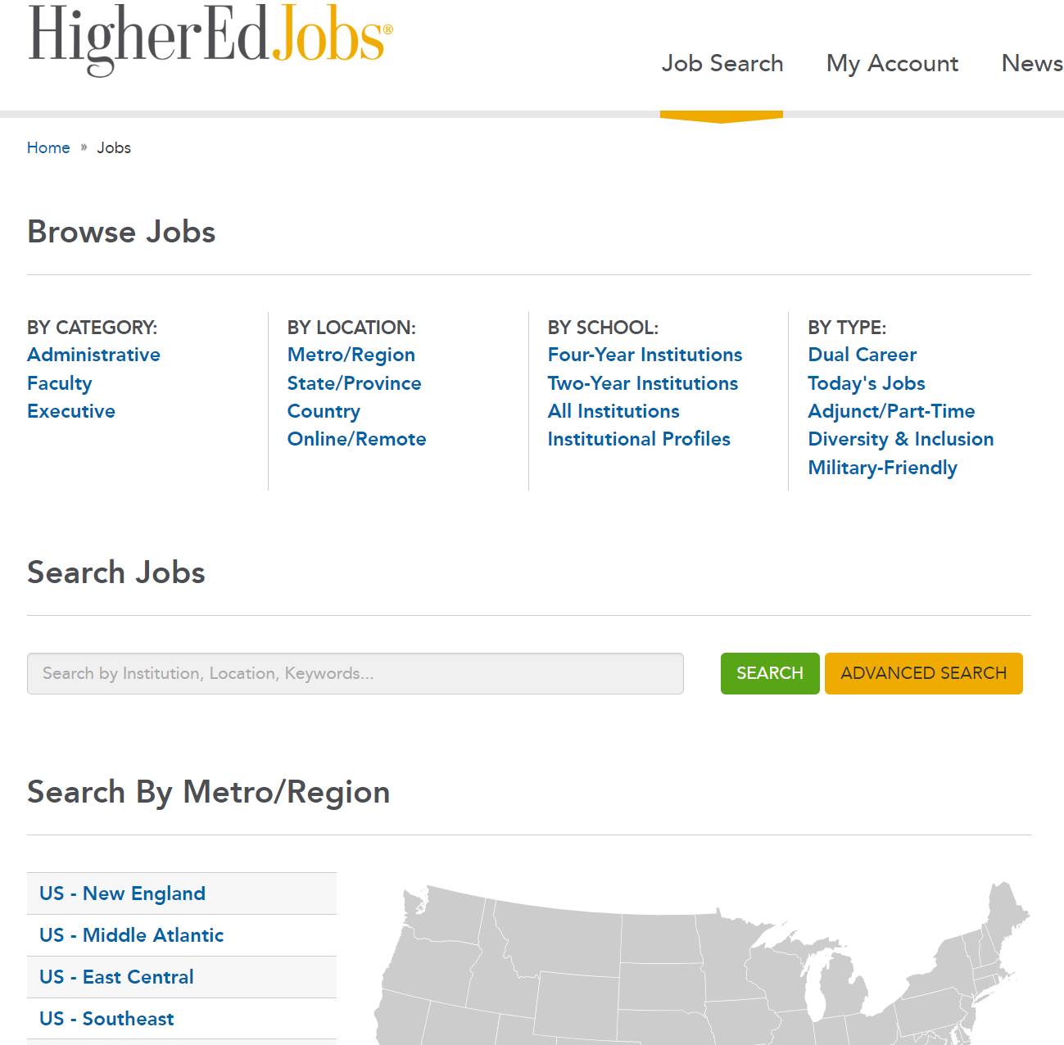

where API

Slide 4
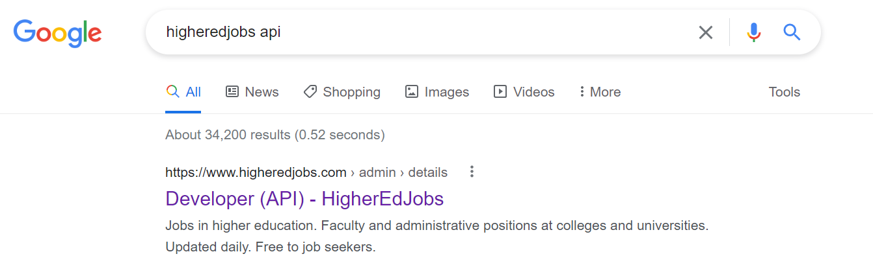
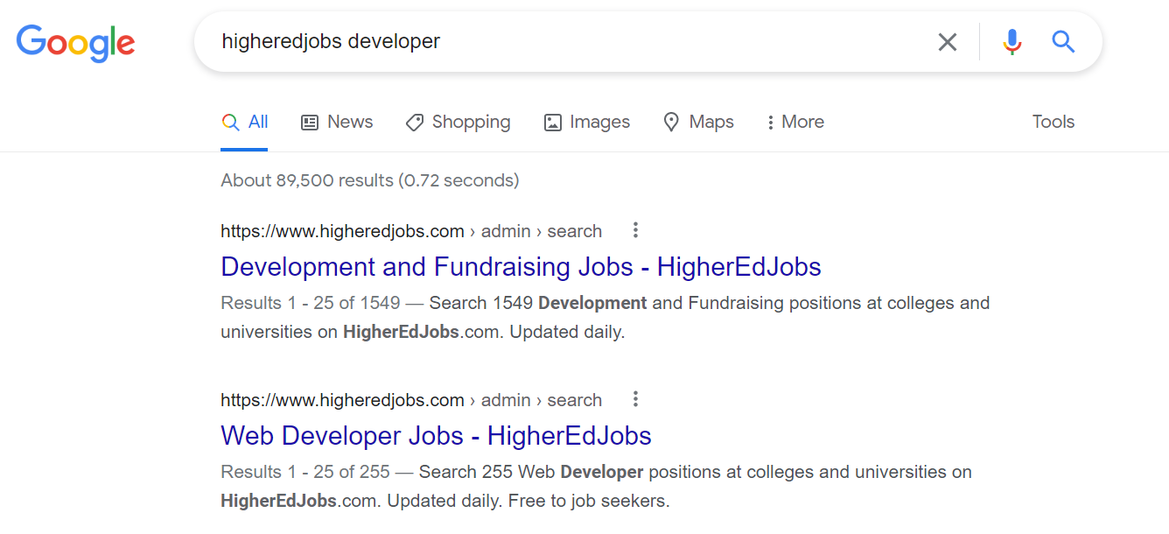

Slide 5
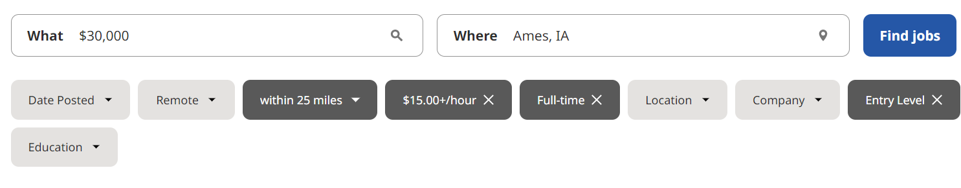
Indeed
https://www.indeed.com/jobs?q=%2430%2C000&l=Ames%2C%20IA&jt=fulltime&explvl=entry_level&vjk=fcb03a9fd5c6b472

Slide 6
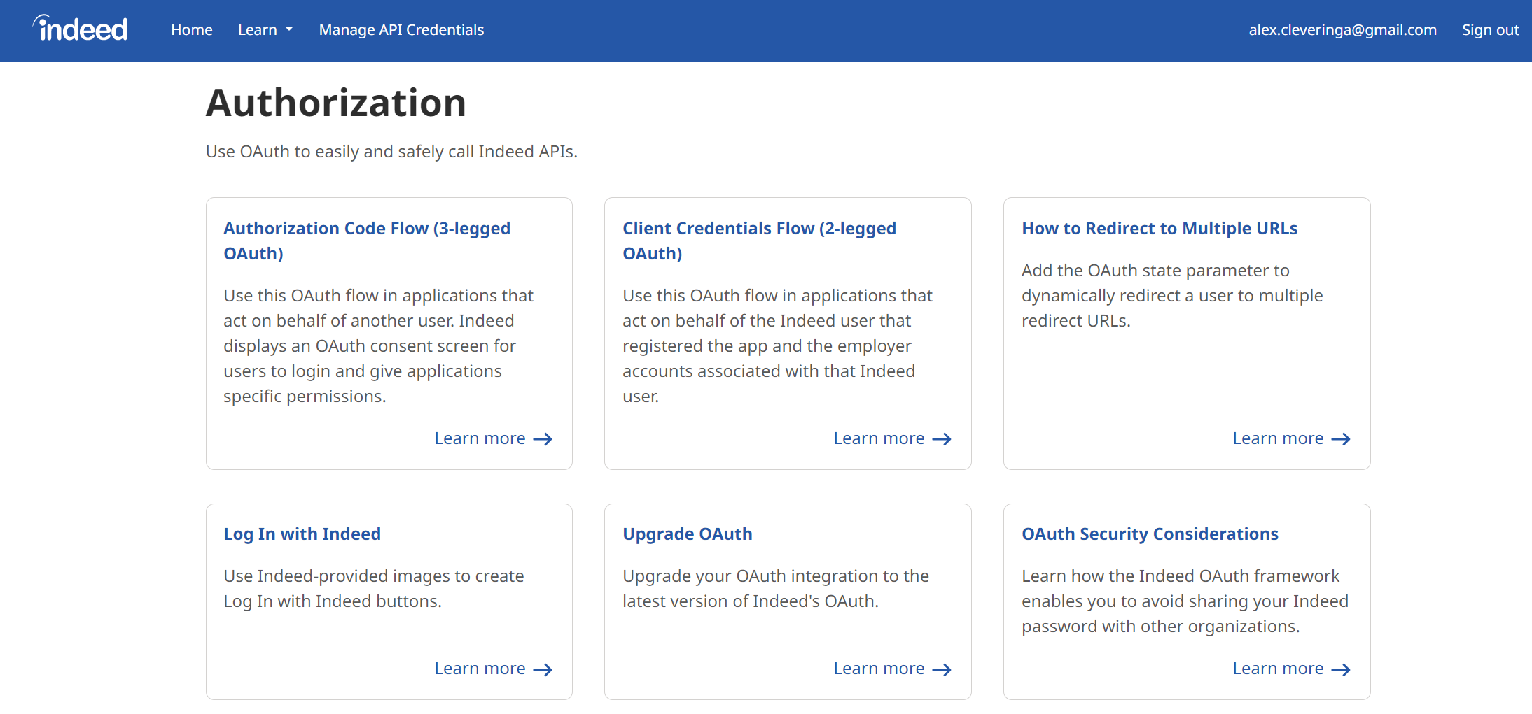

Trouble, Indeed

Slide 7
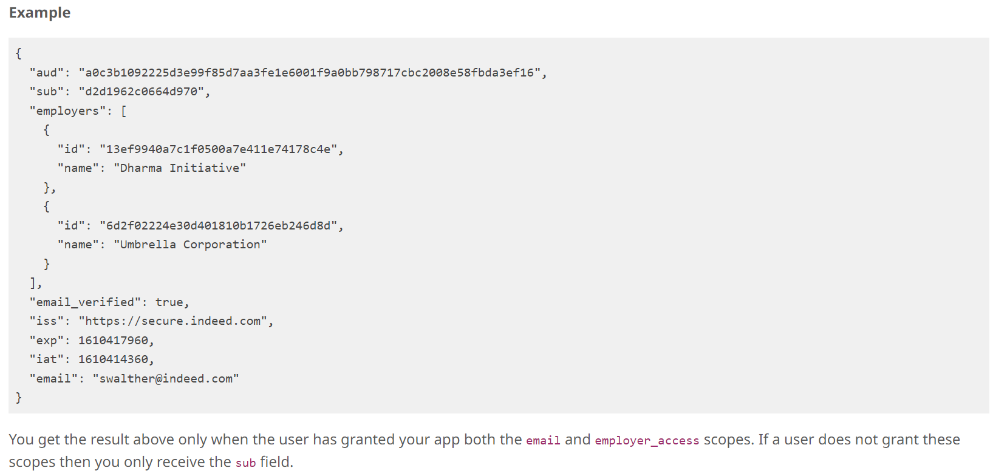
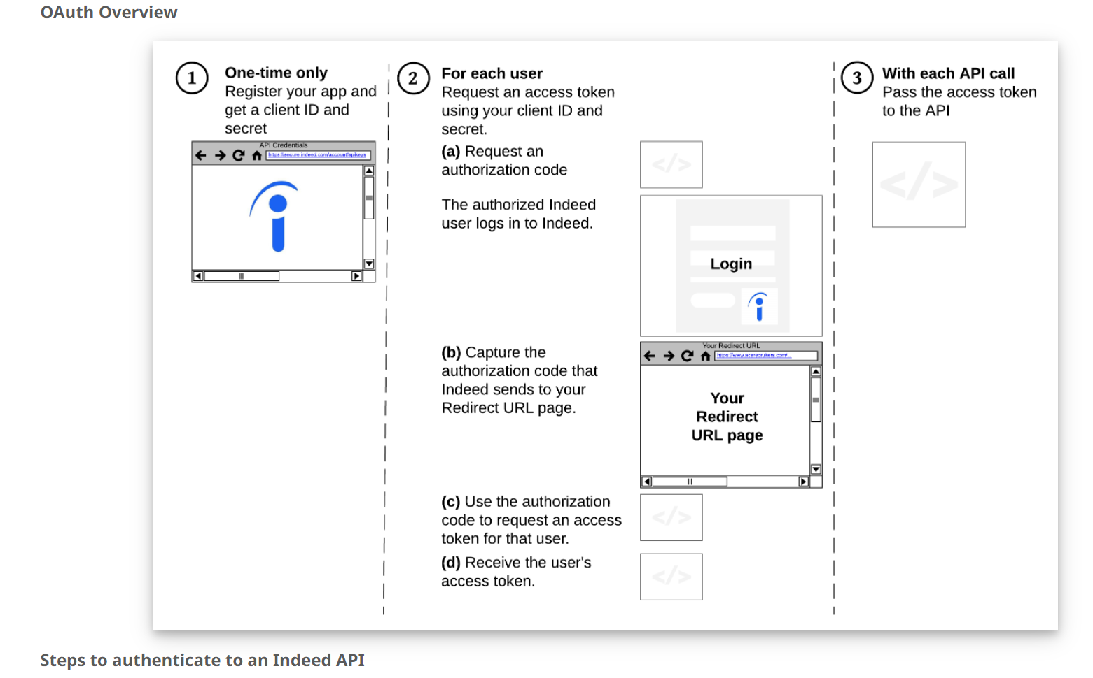
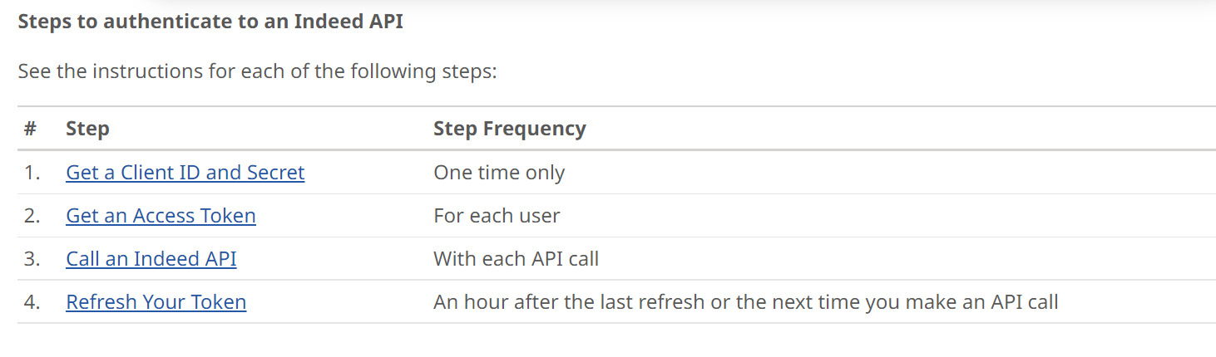
3-Legged OAuth

Slide 8
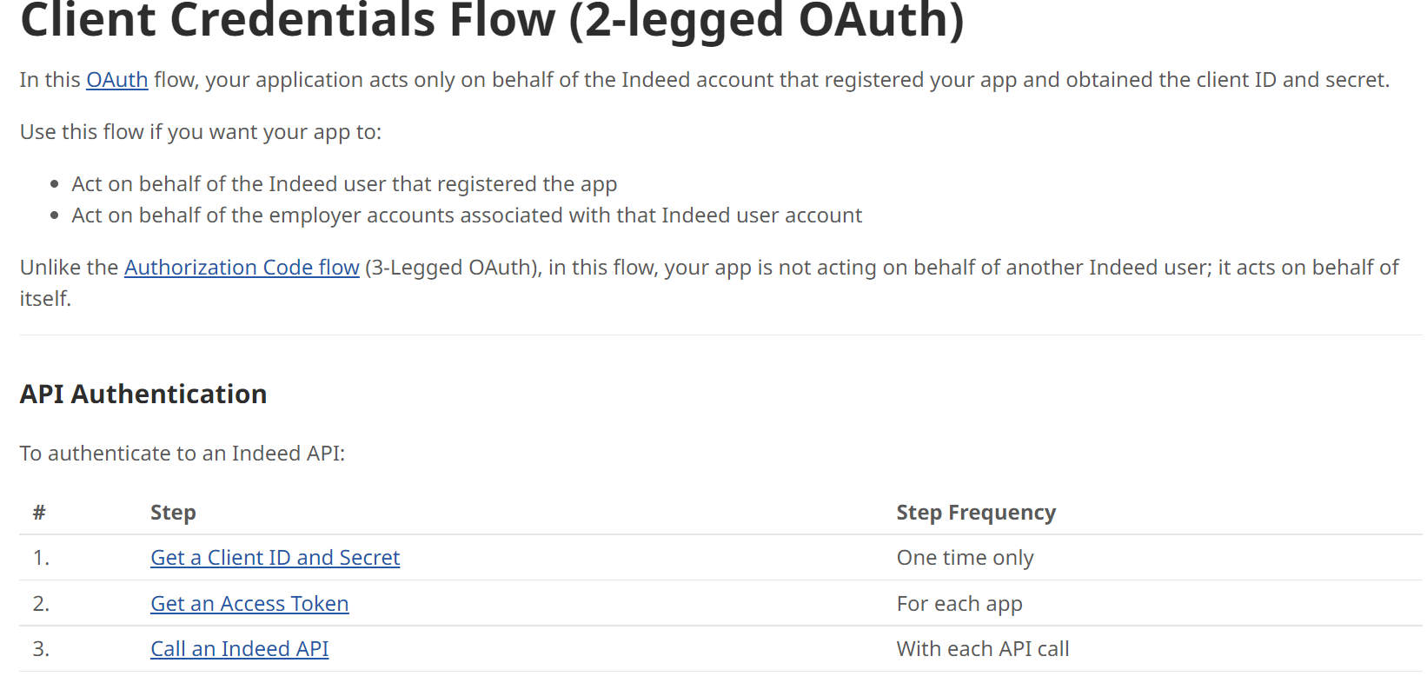

Slide 9
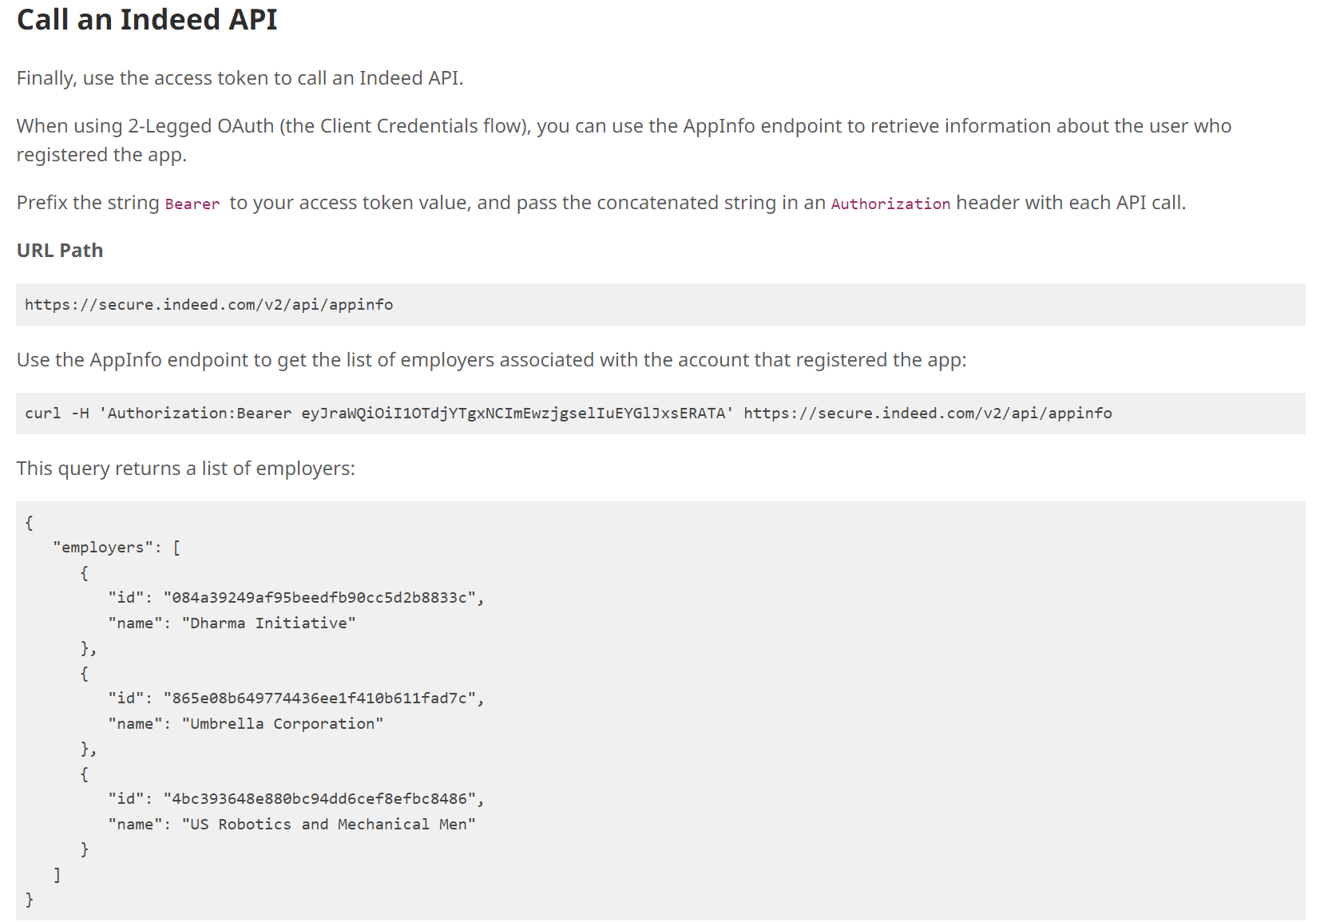

Slide 10
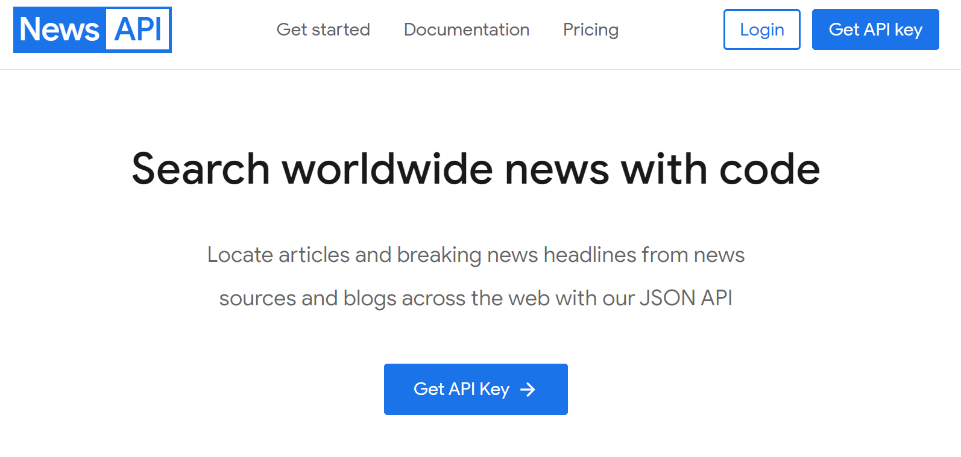
In Other News…
https://newsapi.org/

Slide 11
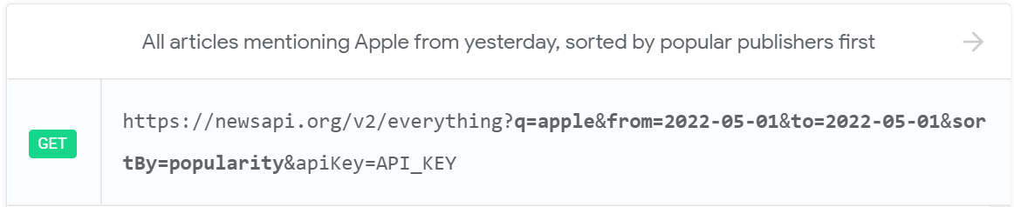
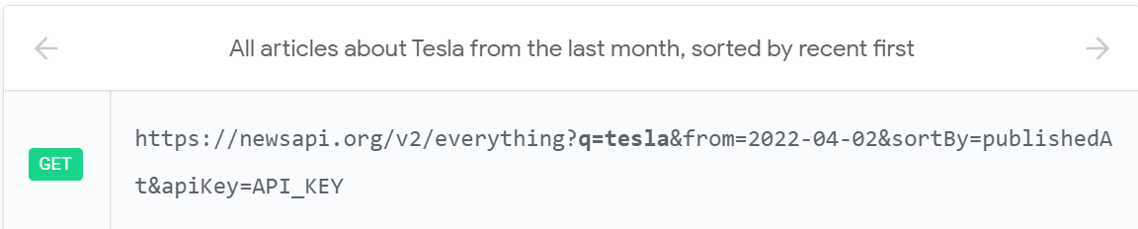
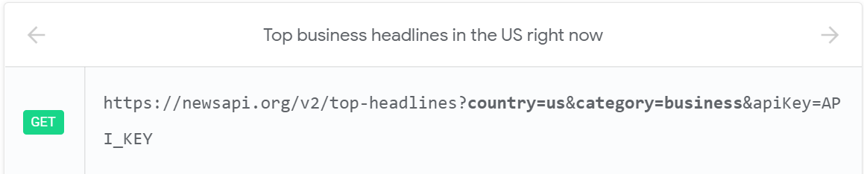

Slide 12
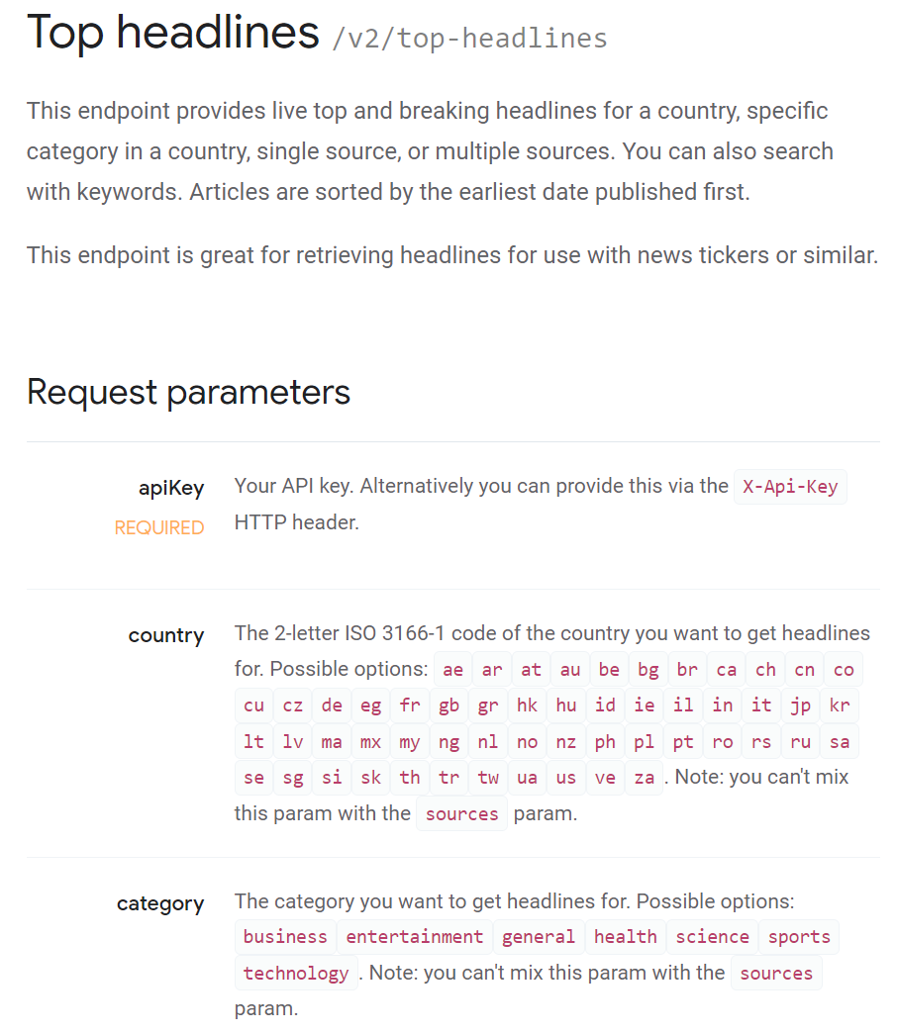
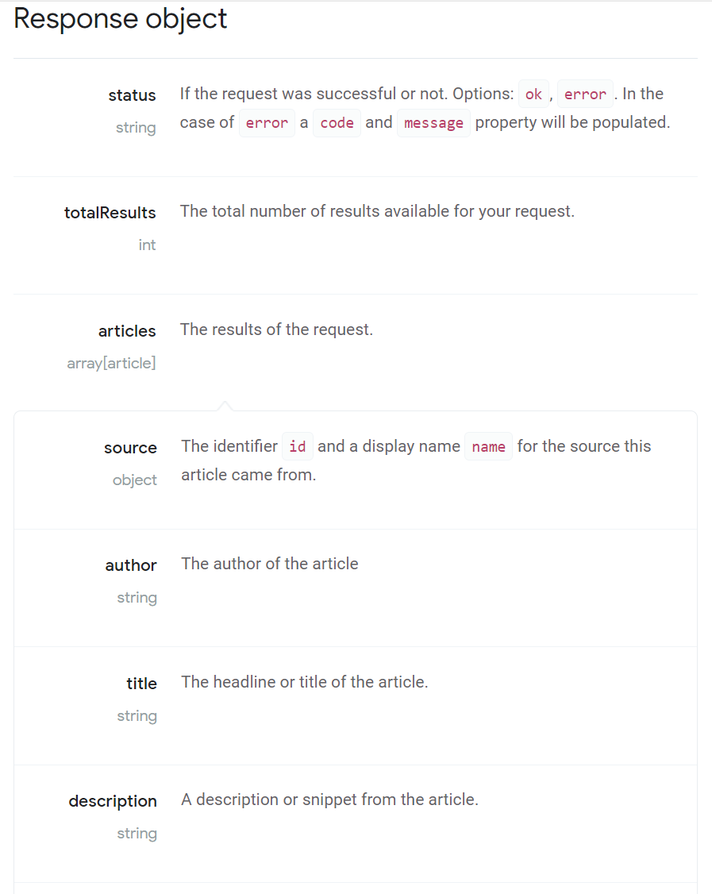
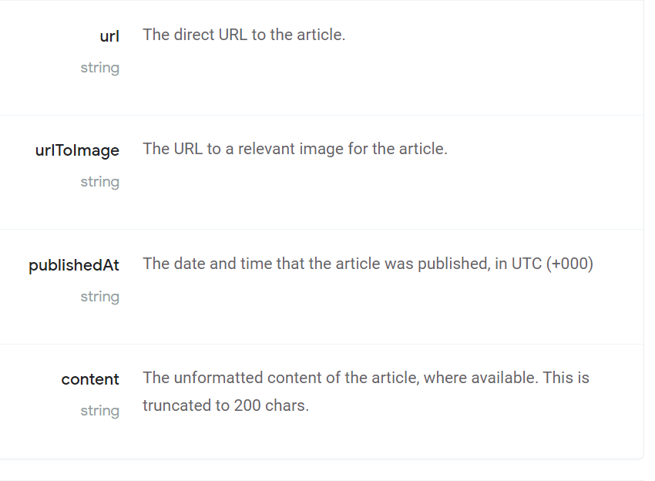

Slide 13
Let’s check it out!
Runshiny(‘headlines’)
Runshiny(‘articles’)

Slide 14
Thank you!

