Slide 1

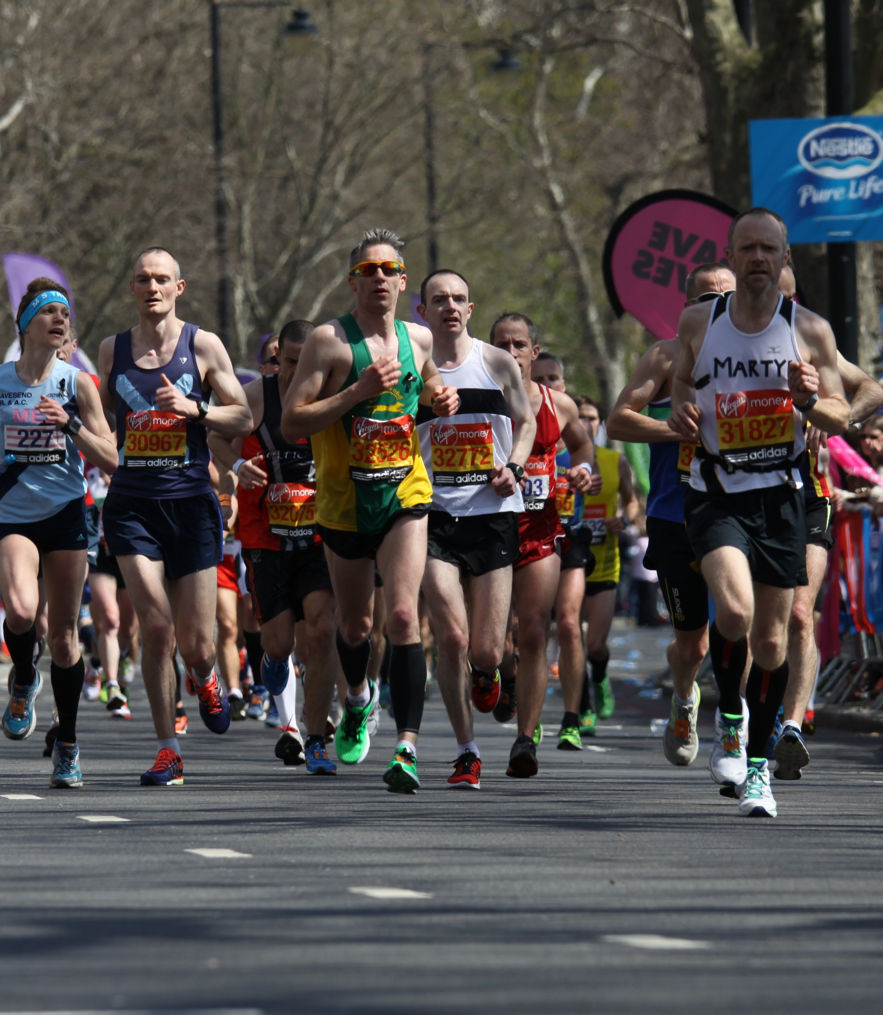
Data Analytics Bootcamp Project Diana Batten, Charles Dixon and Amy McMahon
Machine Learning with Boston Marathon Finishers Data
This Photo by Unknown Author is licensed under CC BY-SA

Slide 2
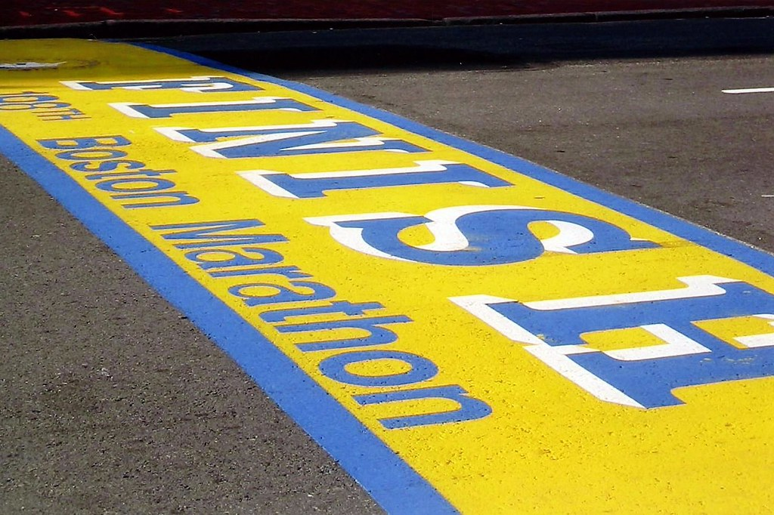
Machine Learning Process
Boston Marathon Finishers Data
Data Cleanup & Preparation
Assign Data to Target & Split
Create Model
Test & Analyze Model Accuracy
Use Model for Predictions
Convert gender to binary values
Remove null rows
Convert split times to seconds
Determine data attributes to train model
Assign the data set to a target
Split into Train and Test datasets
Built a linear regression model
Train the model using specific attributes of our dataset
Run the model with test data
Calculate MSE and R2 to determine model accuracy
Finished model saved as static file
Use HTML to gather user’s input
Load model with Flask and run with user’s inputs
Return results to the HTML

Slide 3
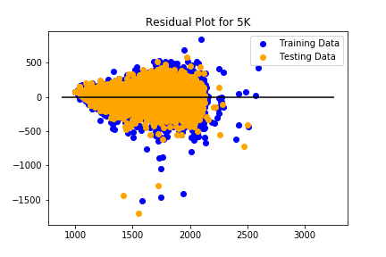
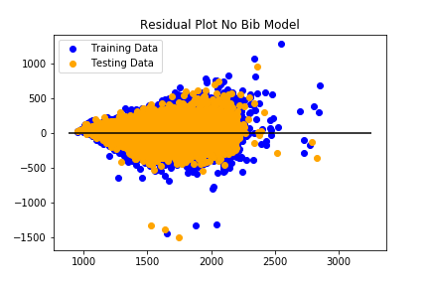
Residual Plots
After testing the model, we reviewed the residual plots to determine model accuracy. The residual is the difference between the actual value and the predicted value for each point of test data.
We wanted to see if the bib number impacted the accuracy of the model predictions. The plots below show residuals with and without bib number. Since the R2 is better for model on the left, bib number does impact the accuracy of the model.
MSE: 7302.074522731132
R2: 0.8684670365890306
MSE: 7302.025220648334
R2: 0.805284760701195

Slide 4
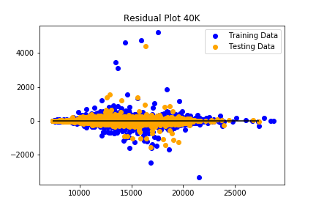
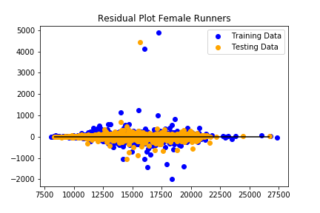

Slide 5
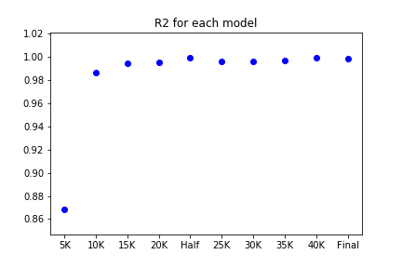
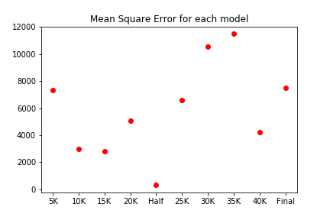
R2 & MSE for Each Model
We run the model for each km marker as well as the half and final time. Below are plots showing the R2 and MSE for each model.
Since each consecutive model uses the km split times of the prior, the R2 improves considerably after the first 5K prediction.

