Slide 1

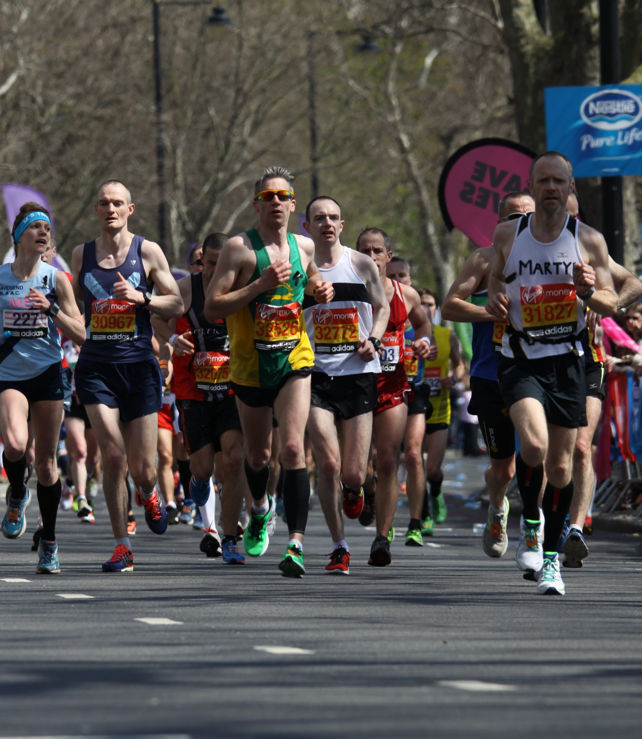
Data Analytics Bootcamp Project Diana Batten, Charles Dixon and Amy McMahon
Machine Learning with Boston Marathon Finishers Data
This Photo by Unknown Author is licensed under CC BY-SA

Slide 2
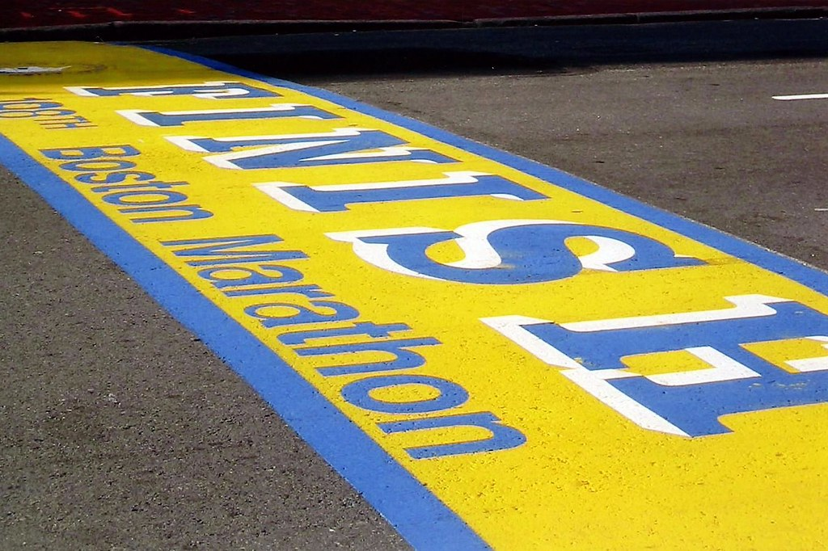
Boston Marathon Finishers Data
Data cleanup and pre-processing
Assign data to target
Split target into training and test data
Convert gender to 0/1 values
Remove null rows
Convert split times to seconds
Create Model
Use model to make predictions
Analyze the model’s accuracy
Use model to predict users’ times
Model is a linear regression model
Train the model with training data
Make predictions
with test data
Calculate MSE and R2
Model is saved as
a static file once it
Is trained

Slide 3
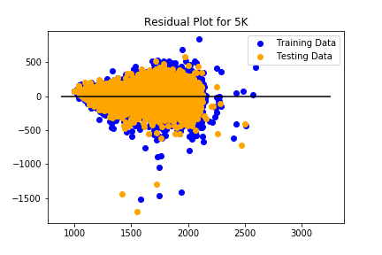
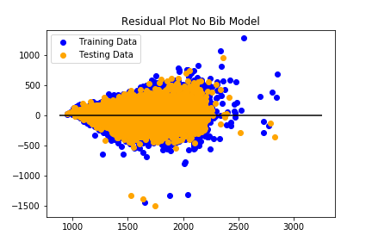
MSE: 7302.025220648334, R2: 0.805284760701195
MSE: 7302.025220648334, R2: 0.805284760701195
MSE: 7302.074522731132
R2: 0.8684670365890306
MSE: 7302.025220648334
R2: 0.805284760701195

Slide 4
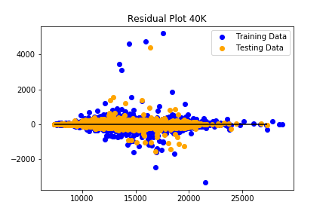
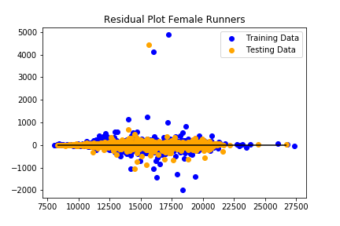

Slide 5
