Slide 1
Capstone Project 7: Security Solution For a Small Business
Team Members: Eric Whang, Mark Schuler, Daniel McDuffie, Alex McMath, Ryan Smith, Samuel Olubummo
IT4983/W01
9/24/2021
URL: https://10.96.61.110/core/

Slide 2
Project Summary
Goal – Enable a server with web access and launch a functional website
Updating and installing all the required Linux packages was key to the success of this milestone
After launching WordPress, we dealt with some errors on the back-end server and began building out the website’s layout
Designing our catalog and giving the website an appropriate aesthetic appeal was the final step for this milestone

Slide 3
Step 1: Determine Business Type
For this step, the team got together and quickly decided that an ecommerce business would be the best choice for this type of project
After determining ecommerce, we decided that we would go with something that each of us knows well being in the IT track, so we went with a hardware/software ecommerce company
This was the perfect first step to the project, as it gave us the opportunity to learn how to communicate effectively as a new team
Completed

Slide 4
Step 2: Enable the Red Hat Server
Initially, the installation of OpenCart proved to be difficult, which ended up being due to some errors that were likely created on our end
Server reset was necessary, but after that the installation of WordPress went as we had originally hoped for
Updating PHP to version 7.4 took some research and enabling httpd to make a network connection resulted in the success of loading the ecommerce plugin for our webpage
Completed

Slide 5
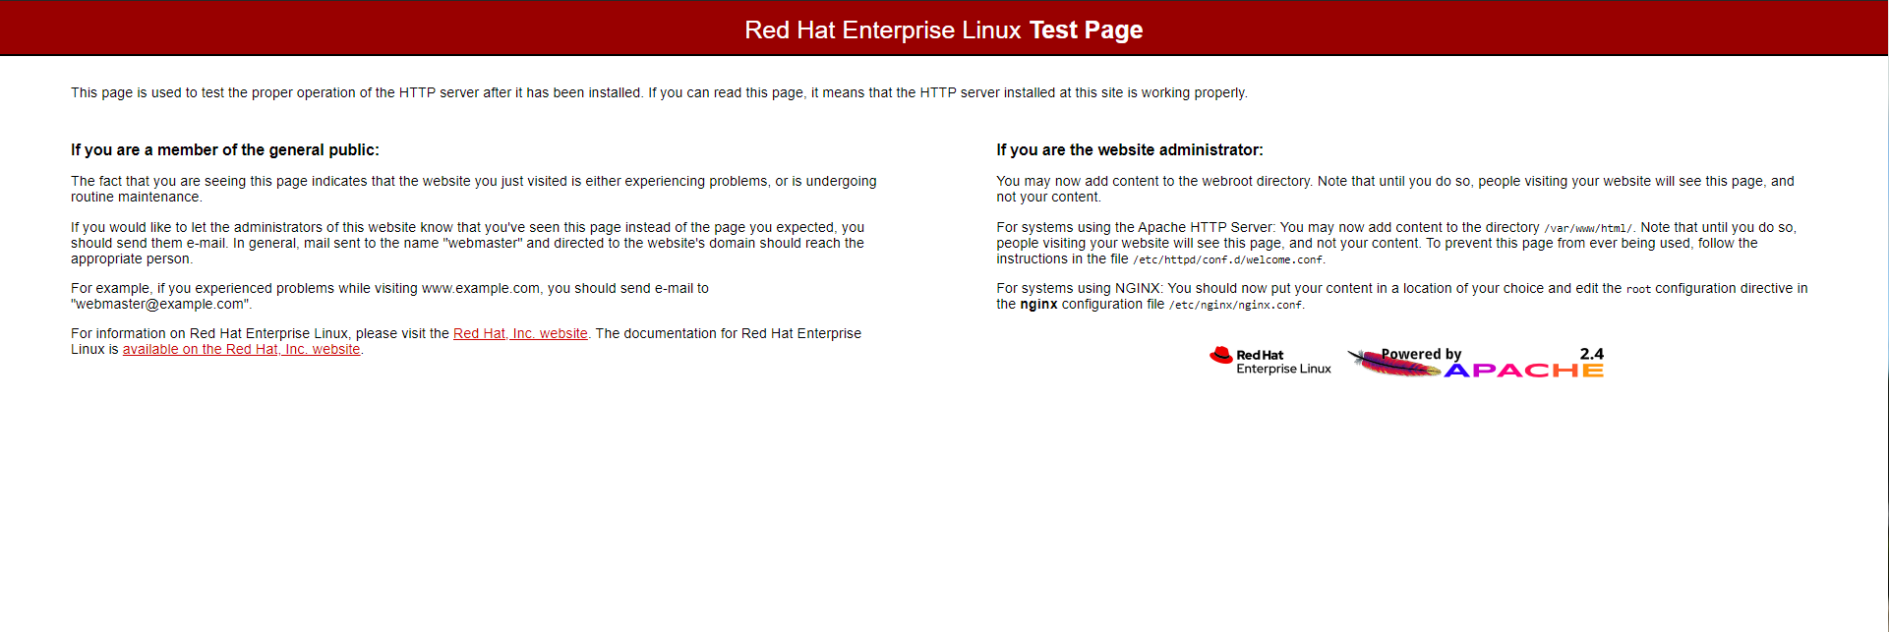
Step 2 Screenshots

Slide 6
Step 3: Design Website Layout
This step went almost exactly as we had expected
The group discussed the types of pages that would be necessary for our website and wasted little time putting together the components of our ecommerce page
Overall, this step in the process was a success and the team worked together perfectly to accomplish it
Completed

Slide 7
Step 4: Build Website
After the web server was properly configured and the tentative layout was completed, building the website might have been the easiest component of the entire process
Since we were able to use WordPress to build the site, it essentially came down to creating the necessary blocks for each page, moving them around to match our layout and selecting the appropriate theme
We also added the catalog page to allow for users to purchase items, making it a fully-functional ecommerce website
Completed

Slide 8
Step 5: Launch Live Site
Initially we thought that we would need to do some work to migrate the server to the public IP address; however, after speaking the VM manager, Kirk Inman, we determined that our currently assigned IP address was what would be used
After completing the webpage build and assigning the theme, we published the pages and launched the site
Completed

Slide 9
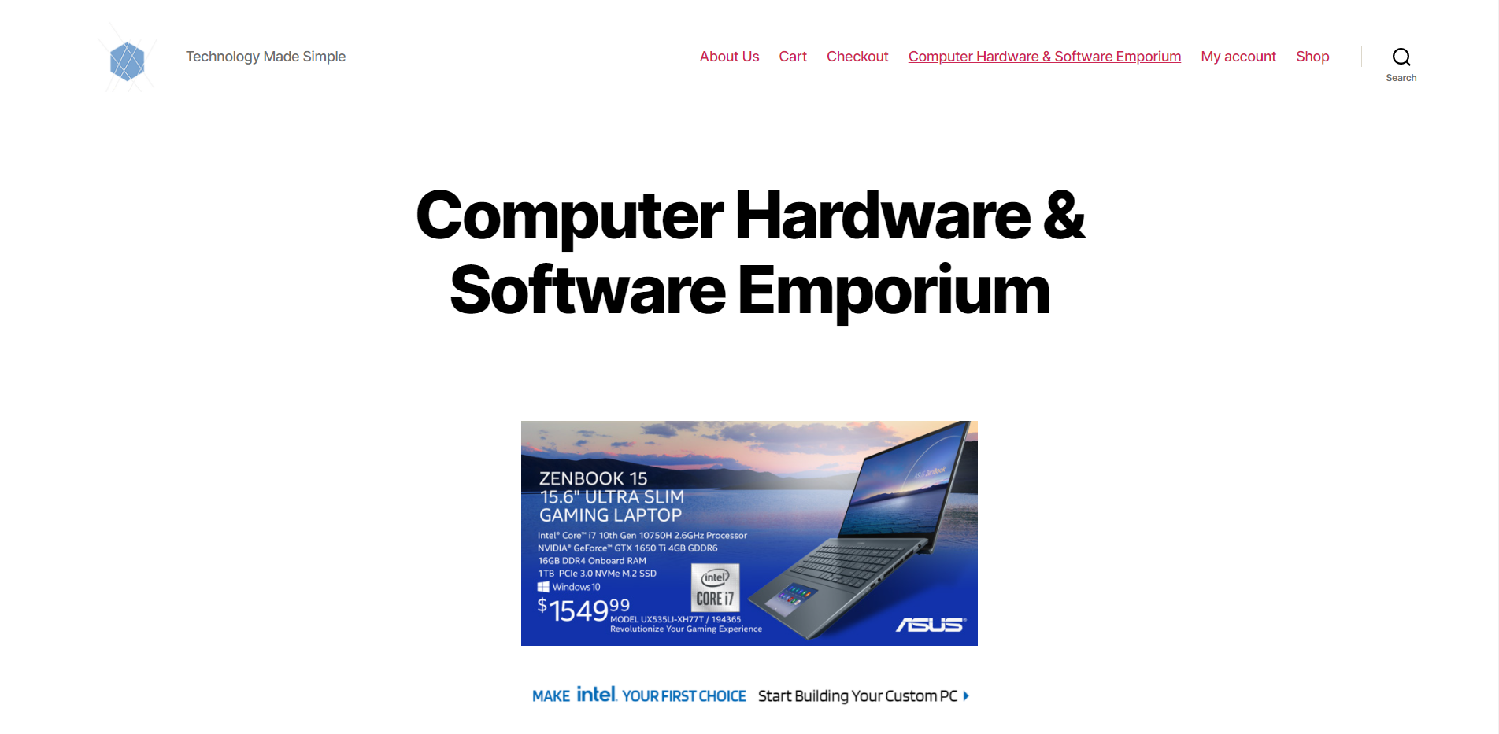
Step 5 Screenshots

Slide 10
Project Experiences
Challenges: Our biggest challenge was learning to be careful with root privileges in Linux. Early on we made a mistake that cost us almost an entire week’s worth of progress. We were lucky to have been able to push on and complete our tasks on schedule.
Lessons Learned: Communication is key to the success of any team. We learned to communicate constantly and lean on each other’s strengths throughout the process.
Areas to Improve: We need to implement proper change management throughout our team. Ensuring that someone else looks over any major changes and that snapshots are taken prior to any major changes will be key to our success as a team.

Slide 11
Gantt Chart
 |  |  |  |  | Milestone #1 |  |  | Milestone #2 |  |  |  | Milestone #3
Deliverable | Tasks | Complete% | Status Notes | Assigned To | 6-Sep | 13-Sep | 20-Sep | 27-Sep | 4-Oct | 11-Oct | 18-Oct | 25-Oct | 1-Nov | 8-Nov | 15-Nov | 22-Nov | 29-Nov | 6-Dec
Launch Business Website | Determine Business Type | 100 |  | All | 5
 | Enable Red Hat Server | 100 |  | Eric, Ryan | 10 | 5
 | Design Website Layout | 100 |  | Alex, Ryan, Eric | 10
 | Build Website | 100 |  | Ryan, Mark |  | 5 | 15
 | Launch Live Site | 100 |  | Daniel |  |  | 10
Implement Security | Research Security Tools | 0 |  | Alex, Samuel |  |  |  | 20 | 15
 | Select Tools to Implement | 0 |  | All |  |  |  |  |  | 5
 | Install Applications and Implement Tools | 0 |  | Daniel, Eric |  |  |  |  |  | 10 | 15
Penetration Testing | Research Penetration Tools and Tactics | 0 |  | All |  |  |  |  |  |  |  | 15
 | Practice Using Tools and Applications | 0 |  | All |  |  |  |  |  |  |  | 5 | 15
 | Map Target Server | 0 |  | Eric, Daniel |  |  |  |  |  |  |  |  | 10 | 10
 | Attack Target Server | 0 |  | Mark, Ryan |  |  |  |  |  |  |  |  |  | 10 | 15
 | Determine Effectiveness of Attack Methods | 0 |  | All |  |  |  |  |  |  |  |  |  |  |  | 10
Final Report | Presentation Preparation | 0 |  | Mark, Samuel, Eric |  |  |  |  |  |  |  |  |  |  |  | 15 | 10
 | Formal Presentation | 0 |  | All |  |  |  |  |  |  |  |  |  |  |  |  | 10
 | Final Report Submission | 0 |  | Eric |  |  |  |  |  |  |  |  |  |  |  |  | 5

Slide 12
Plans for Milestone 2
Stick to the schedule and continue learning at all times throughout this milestone
Thoroughly research tools to ensure that the server’s defenses are strong → Implementation is obviously key; however, knowing what is required for this stage will be just as important
Testing our own perimeter prior to Milestone 3 will be detrimental in our success in the final phase of this project

