Slide 1
Capstone Project 7: Security Solution For a Small Business Milestone 2
Team Members: Eric Whang, Mark Schuler, Daniel McDuffie, Alex McMath, Ryan Smith, Samuel Olubummo
IT4983/W01
10/20/2021
URL: https://cyberlei04.kennesaw.edu/

Slide 2
Project Summary
Goal:
Enable a server with web access and launch a functional website – Milestone 1
Conduct a risk assessment and harden the server using open-source tools, built-in Linux packages, and WordPress plugins – Milestone 2
Keys to success for Milestone 2:
Ensuring software remained up to date to close patched vulnerabilities
Configuring firewall services and intrusion detection software
Selecting and making use of the WordPress platform’s many plugins and tools
Lessons learned:
Updating software does not always fix problems, it can have serious affects on the functionality of a system

Slide 3
Step 1: Develop a Risk Assessment
Determining the assets that we needed to protect on our server was the first step in developing our risk assessment
Afterwards each member of the team reviewed the assessment and added information where necessary
This phase in the project was highly important because it drove the hardening process and allowed our team to determine what software we needed to load and how we wanted to allocate our time and resources over the next couple weeks
Completed

Slide 4
Risk Assessment Matrix
Threat | Vulnerability | Asset | Impact | Likelihood | Risk | Recommended Controls
Natural Disasters Medium | Server stored offsite at secure facility Low | Server Critical | E-Commerce site down, lost sales. Critical | Tornadoes, floods are unlikely Low | Low | No action needed at this time
Malicious Activity High | Improper Configurations Medium | Website Critical | Lost Sales Critical | Word is crazed students plan an attack later this year Certain | High | A defense in depth strategy along with modern best practices for administrative controls
Theft/Loss of sensitive data High | Information improperly stored Low | Proprietary Customer / Supplier Information Critical | Loss of Partner trust and competitive advantage Critical | Could be a target in anticipated attack High | High | Ensure back-ups are maintained in case of accidental deletion. Use encryption for sensitive data at rest

Slide 5
Step 2: Research Security Tools
Our team determined that there were certain types of vulnerabilities that we needed to close in step 1, so in step two we needed to review what tools and resources were available to us to ensure that our server’s defenses were implemented correctly
We had experts in several fields, so we split up the research into those sections accordingly. The team researched tools from different sources such as WordPress, the Linux YUM repository, and external resources that were available across the web that we could download using wget
Through this research, we were able to come together at our group meeting with several ideas for tools to implement and discuss as a team which tools would best suit our needs
Completed

Slide 6
Step 3: Select Tools to Implement
After the initial risk assessment, we determined that we needed a strong firewall, a detection system to alert us if/when an attacker probed our server and some type of protection against web injection attacks (i.e. – SQL Injection, XSS, Buffer Overflow, etc.)
The built-in firewalld service met our needs for the firewall after our network engineer configured it properly
While a HIDS would prevent us from attack, we could at least determine if we were being probed, which led us to implement OSSEC on our server using an external tar download with wget
Our web-design expert was familiar with several plugins available through WordPress that met our needs for securing our website from injection and overflow attacks
Completed

Slide 7
Step 4: Install Applications and Implement Tools
After selecting the appropriate tools, our team knew that it was important to schedule their implementation so that if one of them hindered the availability or functionality of our server, we could determine which tool it was
We learned after the mistakes made on our previous milestone that taking snapshots was important, so prior to installing any major applications on our server, we contacted the University ISM to capture a snapshot of our server
From there, we followed our schedule to ensure that the tools we selected were installed and configured to provide us the best security possible while still allowing our server to function as necessary
Completed

Slide 8
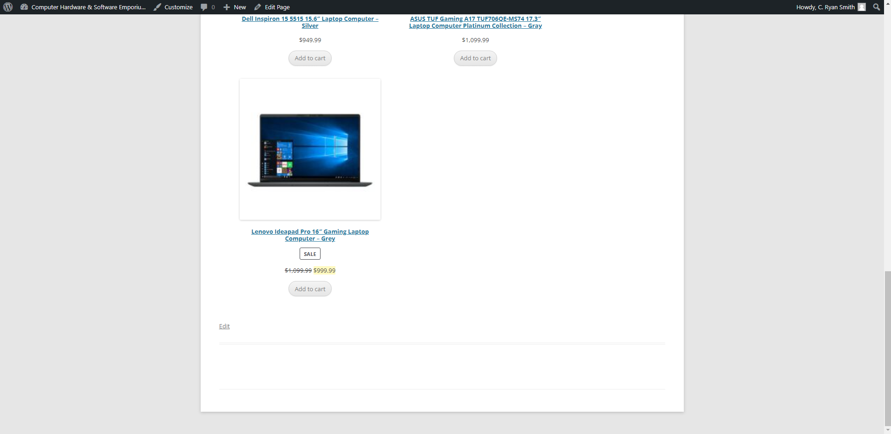
WordPress Plugins - Obfuscation

Slide 9
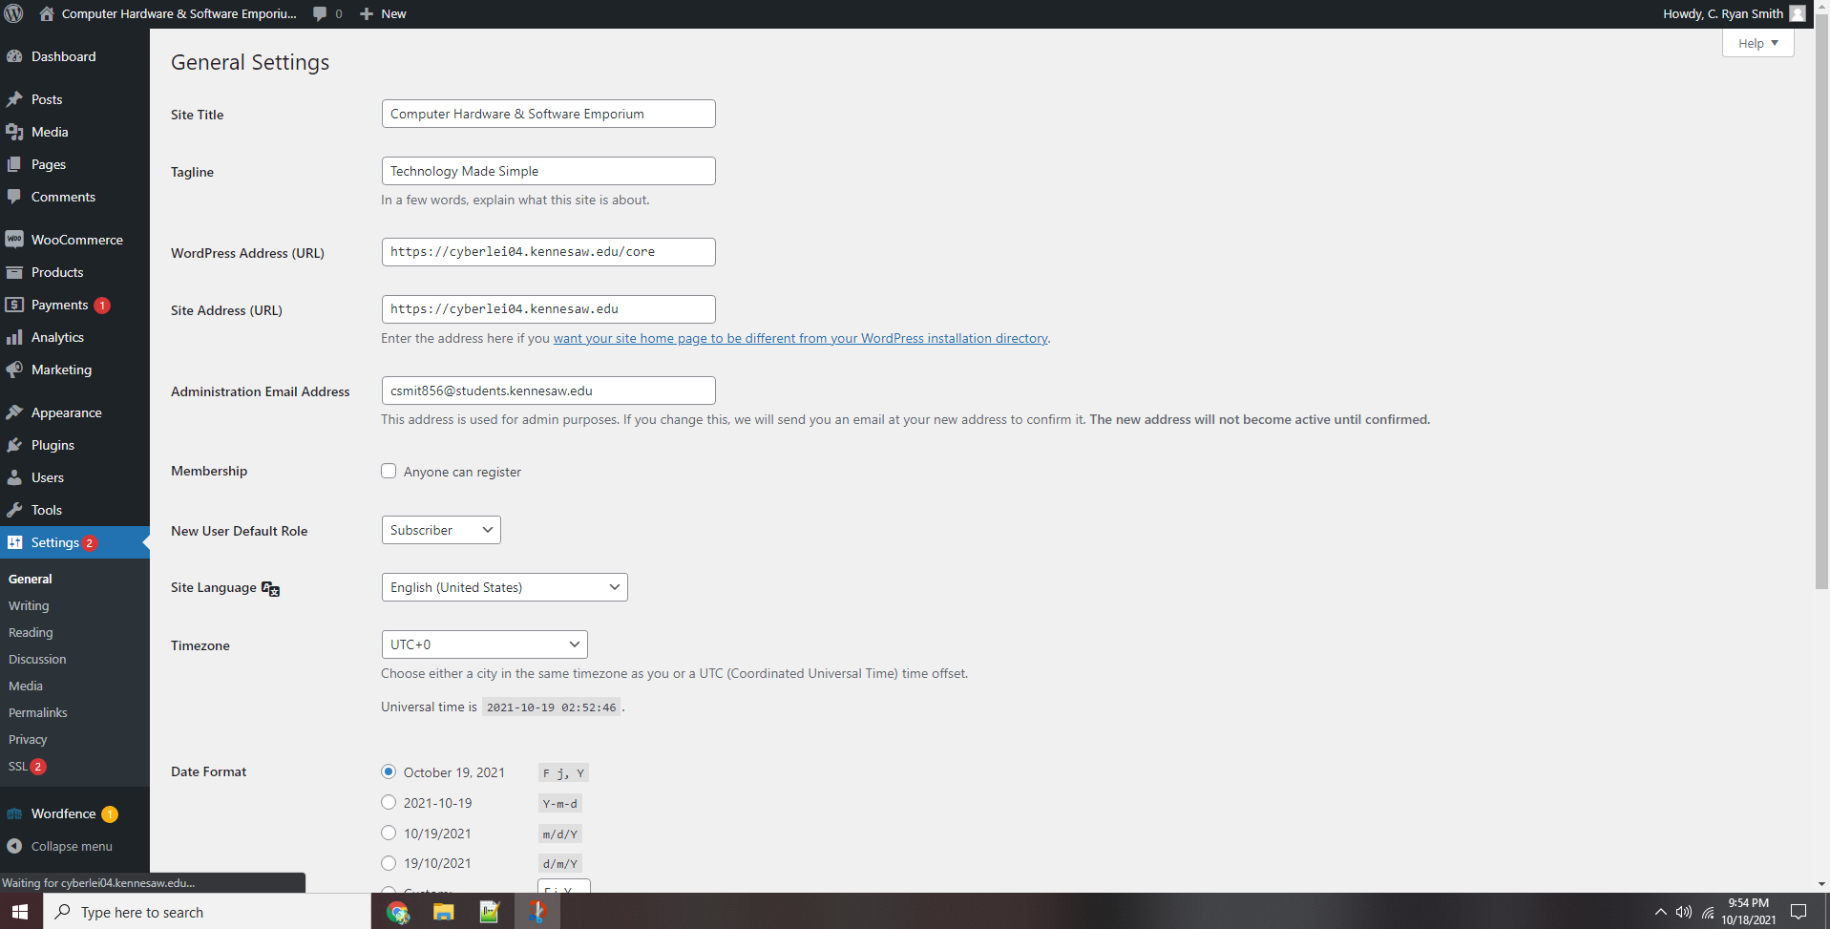
WordPress - Site URL Change

Slide 10
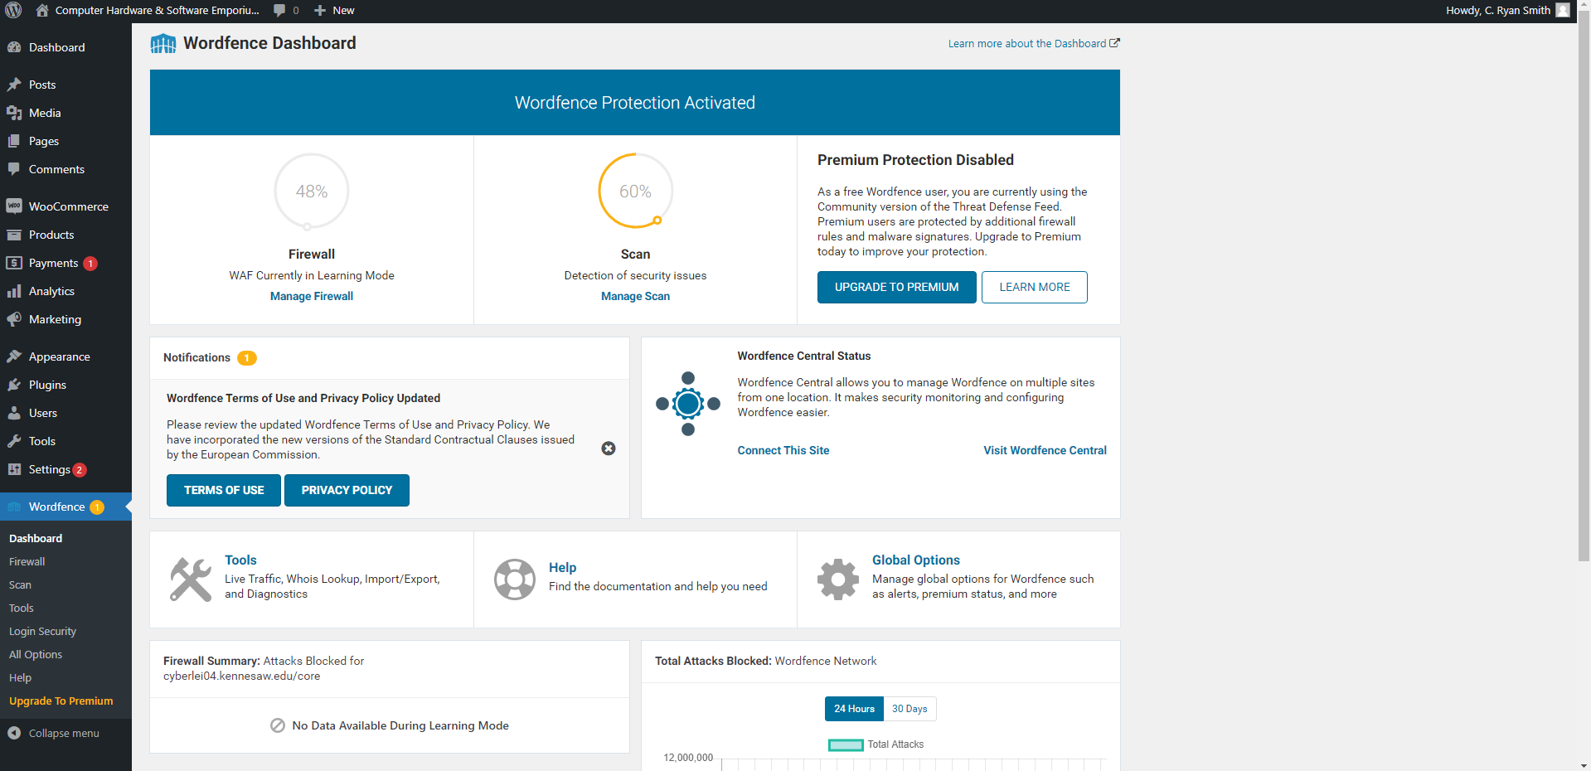
WordPress Plugins

Slide 11
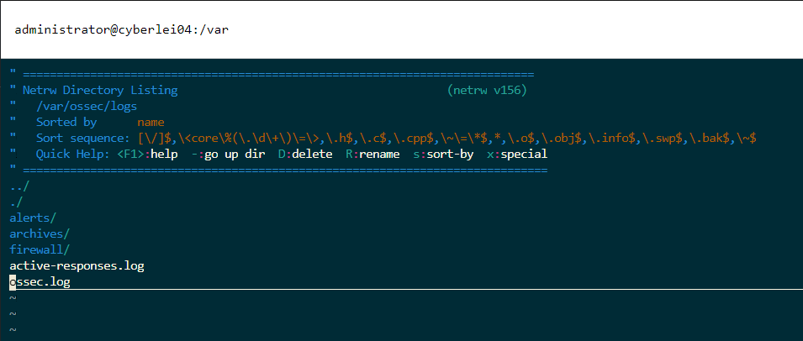
OSSEC - Logs

Slide 12
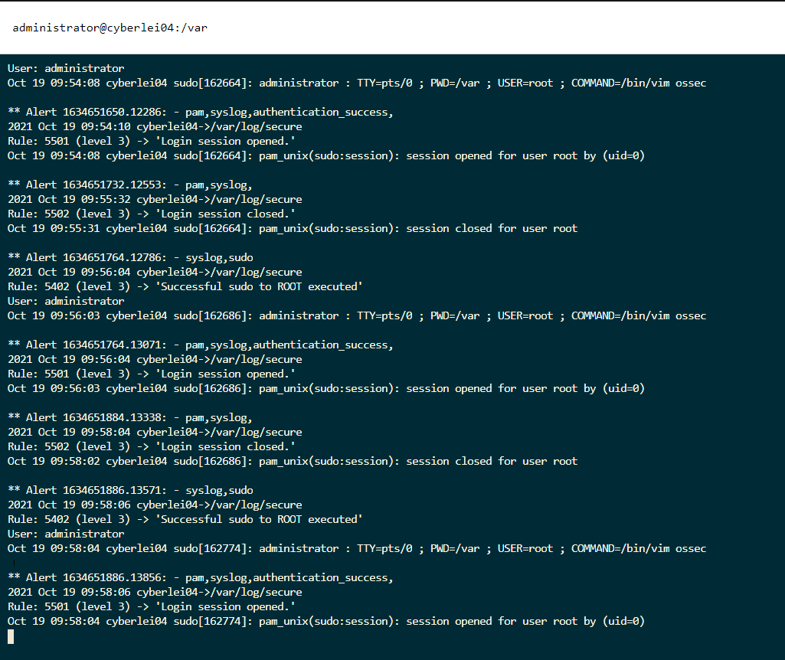
OSSEC – Logs (Alerts)

Slide 13
Project Experiences
Challenges: Determining which tools we would use to close our vulnerabilities was probably the most difficult part of this milestone. For the most part, this group is well versed in how to manage systems, but our knowledge of policy and how applications affect our server’s overall performance is lacking.
Lessons Learned: Patching a system’s applications and packages may seem like a great idea, and much of the advice found in forums on the web suggests that patching will solve issues; however, we learned the hard way that patching can take down your entire system if you are not fully aware of how that patch affects services running.
Areas to Improve: The biggest room for improvement that our group has at this time is continuing communication while making changes to the server. We implemented a schedule and maintained good change management for this milestone, but we could definitely improve on our day-to-day communication on our progress.

Slide 14
Gantt Chart
 |  |  |  | Milestone #1 |  |  | Milestone #2 |  |  |  | Milestone #3
Deliverable | Tasks | Complete% | Assigned To | 6-Sep | 13-Sep | 20-Sep | 27-Sep | 4-Oct | 11-Oct | 18-Oct | 25-Oct | 1-Nov | 8-Nov | 15-Nov | 22-Nov | 29-Nov | 6-Dec
Launch Business Website | Determine Business Type | 100 | All | 5
 | Enable Red Hat Server | 100 | Eric, Ryan | 10 | 5
 | Design Website Layout | 100 | Alex, Ryan, Eric | 10
 | Build Website | 100 | Ryan, Mark |  | 5 | 15
 | Launch Live Site | 100 | Daniel |  |  | 10
Implement Security | Risk Assessment | 100 | Mark |  |  |  | 10
 | Research Security Tools | 100 | Alex, Samuel |  |  |  | 10 | 15
 | Select Tools to Implement | 100 | All |  |  |  |  |  | 5
 | Install Applications and Implement Tools | 100 | Daniel, Eric, Ryan |  |  |  |  |  | 10 | 15
Penetration Testing | Research Penetration Tools and Tactics | 0 | All |  |  |  |  |  |  |  | 15
 | Practice Using Tools and Applications | 0 | All |  |  |  |  |  |  |  | 5 | 15
 | Map Target Server | 0 | Eric, Daniel |  |  |  |  |  |  |  |  | 10 | 10
 | Attack Target Server | 0 | Mark, Ryan |  |  |  |  |  |  |  |  |  | 10 | 15
 | Determine Effectiveness of Attack Methods | 0 | All |  |  |  |  |  |  |  |  |  |  |  | 10
Final Report | Presentation Preparation | 0 | Mark, Samuel, Eric |  |  |  |  |  |  |  |  |  |  |  | 15 | 10
 | Formal Presentation | 0 | All |  |  |  |  |  |  |  |  |  |  |  |  | 10
 | Final Report Submission | 0 | Eric |  |  |  |  |  |  |  |  |  |  |  |  | 5

Slide 15
Plans for Milestone 3
Continuously learn and try new things while attempting to exploit vulnerabilities on the target server
Follow a proper procedure for the testing and continuously document any findings to help the rest of the team when searching for exploits
Use proper mapping techniques and use tools like nmap and wpscan to search for vulnerabilities prior to engaging in attacks to leave the lightest footprint possible
Constant monitoring of our detection systems and monitoring the functionality of our server and SQL database will be necessary throughout this milestone

