Slide 1
Capstone Project 7: Security Solution For a Small Business Milestone 3
Team Members: Eric Whang, Mark Schuler, Daniel McDuffie, Alex McMath, Ryan Smith, Samuel Olubummo
IT4983/W01
Due Date: 11/29/2021
URL: https://cyberlei04.kennesaw.edu/

Slide 2
Project Summary
Goal:
Enable a server with web access and launch a functional website – Milestone 1
Conduct a risk assessment and harden the server using open-source tools, built-in Linux packages, and WordPress plugins – Milestone 2
Conduct a penetration test of a server configured by another team of students while maintaining security measures set in the previous two milestones – Milestone 3
Keys to success for Milestone 3:
Frequently analyzing system logs
Determining next steps when intrusion was attempted
Careful analysis of the target team leads to success
Lessons learned:
Frequently check the logs, if you do not check them, then they are useless

Slide 3
Step 1: Research Penetration Tools and Tactics
Knowing what tools to use and what each tool is key to determining how to attack
Nmap
John the Ripper
DirBuster
Wpscan
Social Engineering Schemes
Depending on results, the next step or method of attack may vary
Completed

Slide 4
Step 2: Practice Using Tools and Applications
Using penetration tools and tactics in a contained environment helps to avoid detection
Virtual Machines
Containerized Virtual Networks
Testing our own server
There is a lot of information as to what may trigger a firewall or IPS/IDS when scanning and attacking methods are used
Completed

Slide 5
Step 3: Map Target Server/Team
Putting tools into practice is important to map out the target server
We used nslookup and dig to find our target server’s IP address
Nmap was used to find open ports on the server
Open-source intelligence was our next step
Facebook
LinkedIn
Twitter
GroupMe
Completed

Slide 6
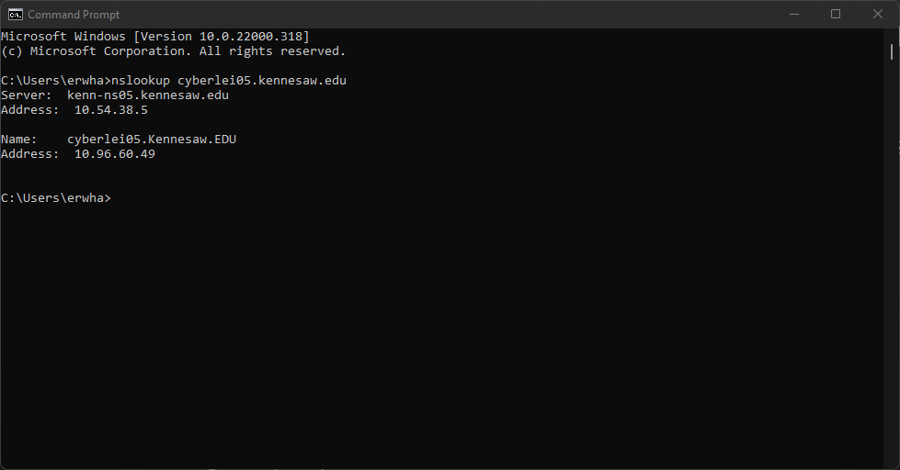

Slide 7
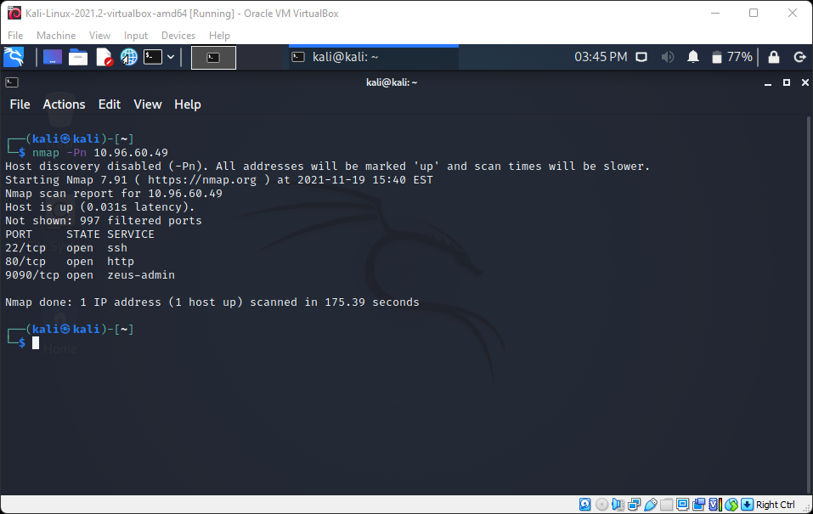

Slide 8
Step 4: Attack Target Server
Enemy server was well protected from tools like John the Ripper
Good choice of password – Utilized uppercase, lowercase, numbers, and special characters
Social Engineering was utilized to obtain both the root and administrator passwords
Students from the target team were part of a spear-phishing campaign through GroupMe
Backdoor created for threat persistence – named Apache3
Very few valuable assets were discovered
No SQL database loaded on server
No JavaScript utilized – empty HTML shell
Ransomware using GPG
Target HTML page was ransomed
Completed

Slide 10

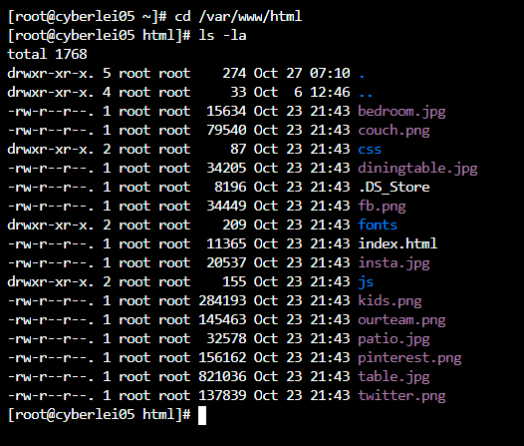
Backdoor
No SQL
Website Files

Slide 11
Project Experiences
Challenges:
Offensive: Once the target was breached, there was little to do – the target had little to discover
Defensive: Our IDS discovered only one attempt on our server’s defenses
Lessons Learned:
Checking logs frequently is pertinent to catching an attack – logs are only useful if reviewed
Be careful of what information is talked about with other people, even students – they may be the “enemy”
Areas to Improve:
Set up a schedule or regular rhythm to check the host server’s status and logs
Maintain communication and stay aware of what each member of the team is doing during the testing phase

Slide 12
Gantt Chart
 |  |  |  | Milestone #1 |  |  | Milestone #2 |  |  |  | Milestone #3
Deliverable | Tasks | Complete% | Assigned To | 6-Sep | 13-Sep | 20-Sep | 27-Sep | 4-Oct | 11-Oct | 18-Oct | 25-Oct | 1-Nov | 8-Nov | 15-Nov | 22-Nov | 29-Nov | 6-Dec
Launch Business Website | Determine Business Type | 100 | All | 5
 | Enable Red Hat Server | 100 | Eric, Ryan | 10 | 5
 | Design Website Layout | 100 | Alex, Ryan, Eric | 10
 | Build Website | 100 | Ryan, Mark |  | 5 | 15
 | Launch Live Site | 100 | Daniel |  |  | 10
Implement Security | Risk Assessment | 100 | Mark |  |  |  | 10
 | Research Security Tools | 100 | Alex, Samuel |  |  |  | 10 | 15
 | Select Tools to Implement | 100 | All |  |  |  |  |  | 5
 | Install Applications and Implement Tools | 100 | Daniel, Eric, Ryan |  |  |  |  |  | 10 | 15
Penetration Testing | Research Penetration Tools and Tactics | 100 | All |  |  |  |  |  |  |  | 15
 | Practice Using Tools and Applications | 100 | All |  |  |  |  |  |  |  | 5 | 15
 | Map Target Server | 100 | Eric, Daniel |  |  |  |  |  |  |  |  | 10 | 10
 | Attack Target Server | 100 | Mark, Ryan |  |  |  |  |  |  |  |  |  | 10 | 15
Final Report | Presentation Preparation | 30 | Mark, Samuel, Eric |  |  |  |  |  |  |  |  |  |  |  | 15 | 10
 | Formal Presentation | 20 | All |  |  |  |  |  |  |  |  |  |  |  |  | 10
 | Final Report Submission | 0 | Eric |  |  |  |  |  |  |  |  |  |  |  |  | 5

