Slide 1

MAKE GROUP TRIP PLANNING A BREEZE!

Slide 2
Make group trip planning a breeze!
Problem
Our needfinding exercises revealed that those who plan group trips struggle to track others down, split payments and weigh the input of participants when decision making , particularly if members of the group are geographically dispersed. Email, the conventional means for managing such logistics, simply doesn’t do the trick.
Solution
Instagator streamlines trip planning collaboration by aggregating all related tasks and participant responses into a single, actionable platform. The app is geared at improving the lives of the instigators among us (get it!?).

Slide 3
Sample core tasks
Invite guests and manage responses (medium)
Instagator provides a calendar like RSVP system so the planner can spend more time making informed booking decisions versus parsing through texts and emails to keep track of who’s coming and whose response has changed.
Get and incorporate group input on activities (complex)
When planning a trip everyone has an opinion (and/or a restriction) on where to go and what to do. Intagator takes the pain out of finding the optimal set of activities (including where to eat) by automatically collecting responses and computing the path of least resistance.
Manage documents and payments (simple)
No more hunting others down. Instagator makes payment and final confirmations seamless.

Slide 4
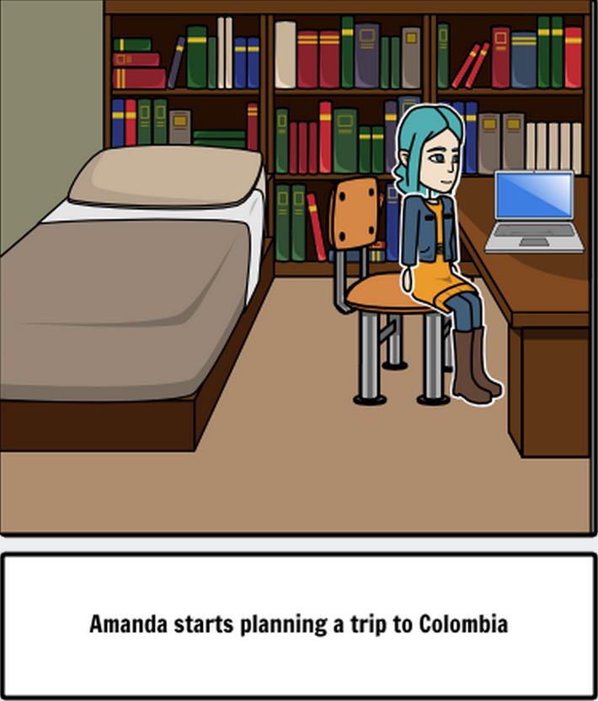
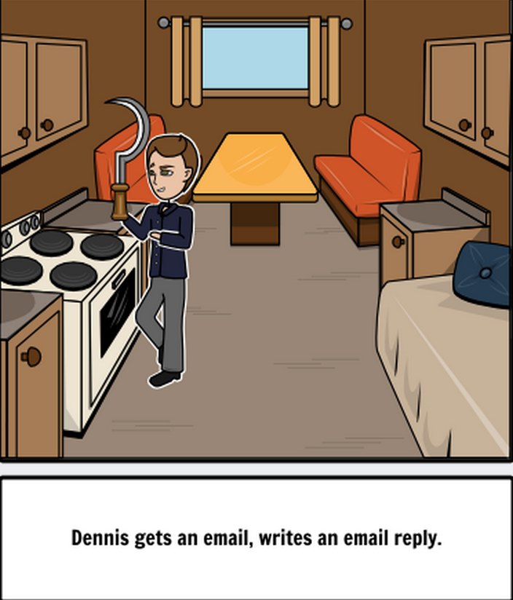
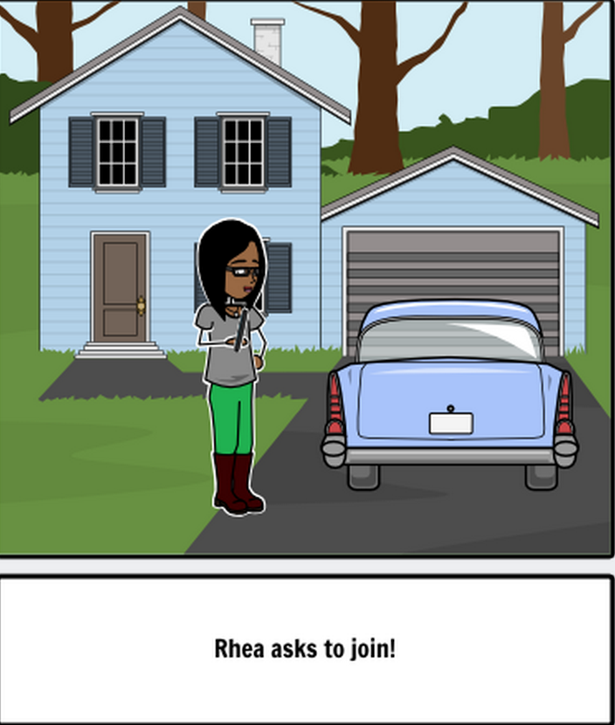
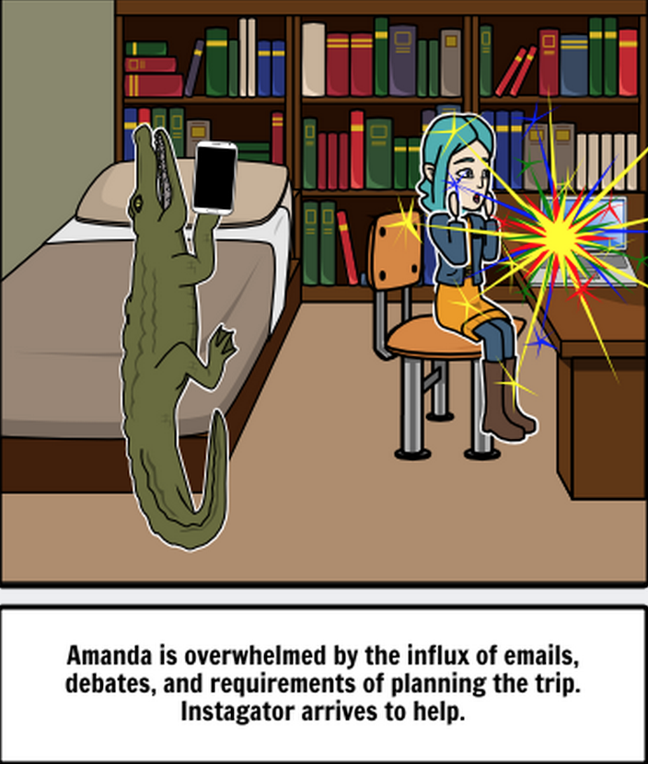
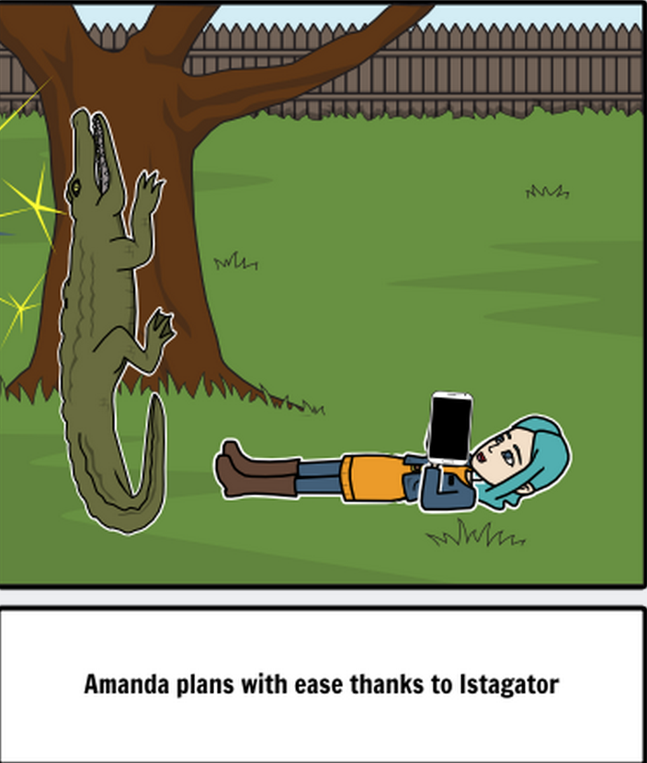
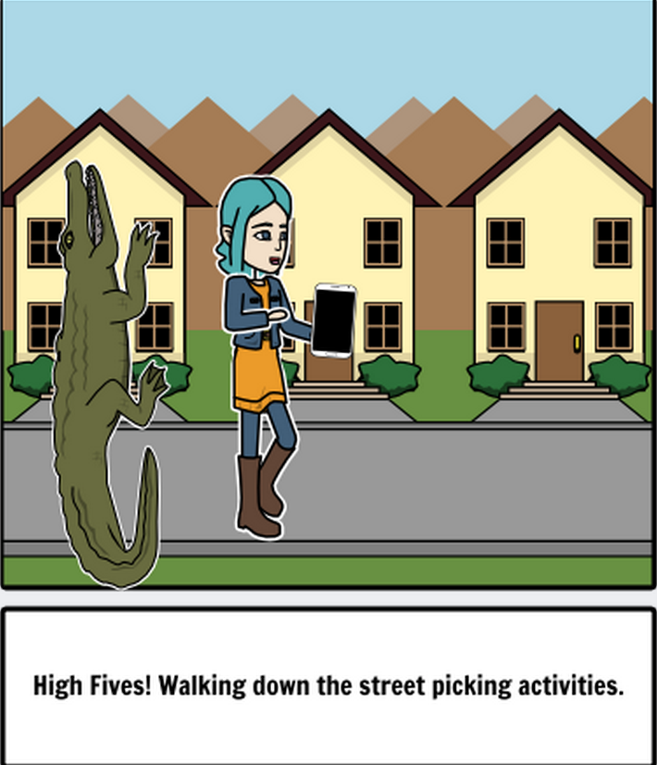
Starts planning a trip to Colombia
People respond and planner needs to process
Random folks ask to join, overcomplicating things
Planner overwhelmed by responses and logistics. Instagator comes to the rescue.
Planner’s life is immediately made better - lounging, smiling and planning.
Planner and Instagator become best buddies as she executes tasks

