Slide 1
C.elegans Analysis
Suhail Rajah, Andrew McNeill, Drew Roberts

Slide 2
Goals
Compare Putzke’s wild type and freak data with online c.elegan genome
Utilize R, available packages, and utilities to compute and analyze differences between freak and wild type data
Visualize data
Research and analyze outlier genes(WB gene expressions)
Find pathways and display them
Personal goals
Familiarize ourselves with R and its packages
Experience in Linux operating system
Learning relevant research procedures

Slide 3
Process Description
Kent’s script
Downloaded appropriate packages
Downloaded c.elegans data for comparison to concatenated fastqs files
Run feature counts on Putzke’s data to label expression levels
Filter out low gene expressions
Compute specific values (CPM, log(CPM))
Remove duplicate genes
Calculate normalization factors

Slide 4
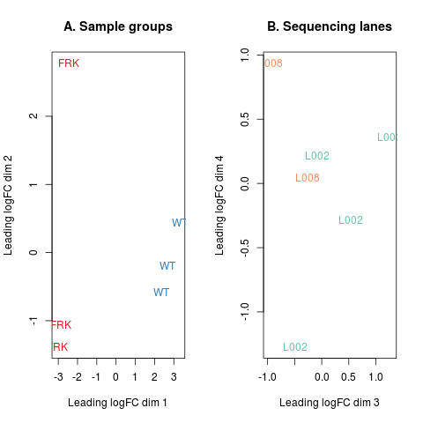
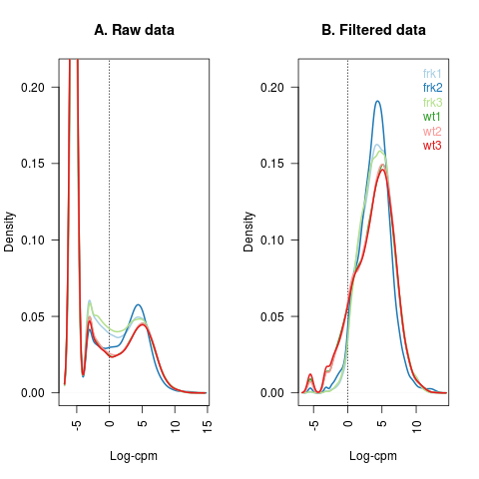
Findings
Glimma plots

Slide 5
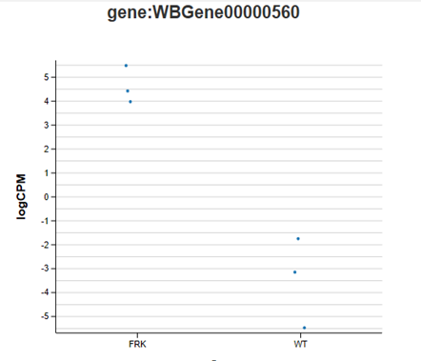
Research
Most Upregulated: Wormbase ID: WBGene00000560
ENTREZ ID: 184721
NCBI Reference ID: 175324
Function: Encodes one of eleven C.elegans caenacin peptides (cnc-6)

Slide 6
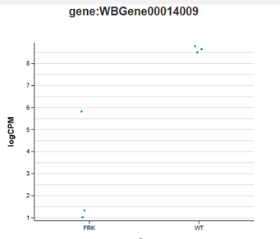
Research
Most Downregulated: Wormbase ID: WBGene00014009
ENTREZ ID: 182336
NCBI Reference ID: 191364
Function: Predicted to have hydrolase activity, based on protein domain information
Our findings reveals that lips-6 is induced by octapamine. Hence, by knocking out the FRK1 gene the molecular function of octapamine is hindered, therefore not inducing the expression of the lips-6 gene eliciting lipid mobilization.

Slide 7
Utilities
R
biocLite
Accesses the Bioconductor repository and retrieve packages for download
Rsubread
Aligns and maps genomic DNA and RNA sequencing reads
biomaRt
Huge database of scientific research including gene ID types
Helped retrieve C.elegans data from Ensembl database
Gplots
Constructed graphs based off data
Pathview
Tracked gene paths
Couldn’t get to work

Slide 8
Member Contributions
Andrew
Coding, initial steps from Kent’s script
Researching R packages
Drew
Coding, translating gene id’s to entrezgene id’s
Pathway research
Suhail
Gene expression research
Graph analysis

Slide 9
Sources
http://www.wormbase.org/resources/paper/WBPaper00049785#0--10
https://www.ncbi.nlm.nih.gov/gene/?term=WBGene00000560
https://www.ncbi.nlm.nih.gov/gene/?term=WBGene00014009

