Slide 1
Science Online?
Björn Brembs
Inst. Zoology – Neurogenetics
Regensburg, Germany
http://brembs.net

Slide 2
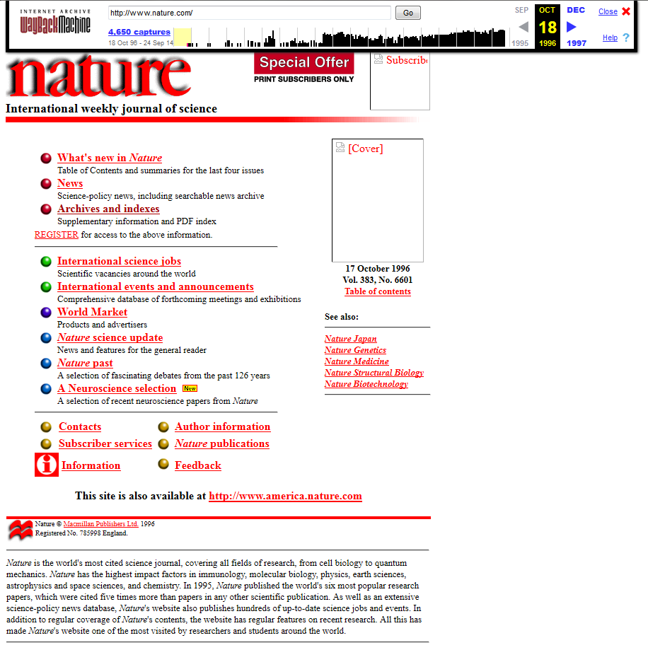

Slide 3
Conversations are moving online?
Blogging
Online commenting on peer-reviewed papers
Email
Twitter

Slide 4
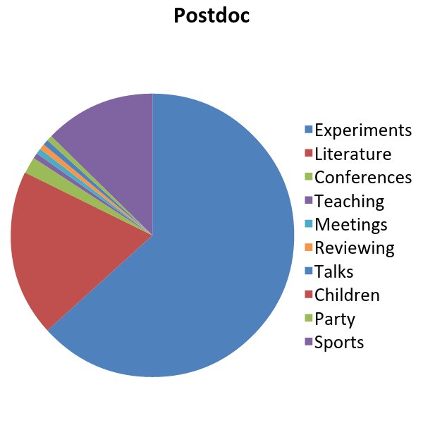
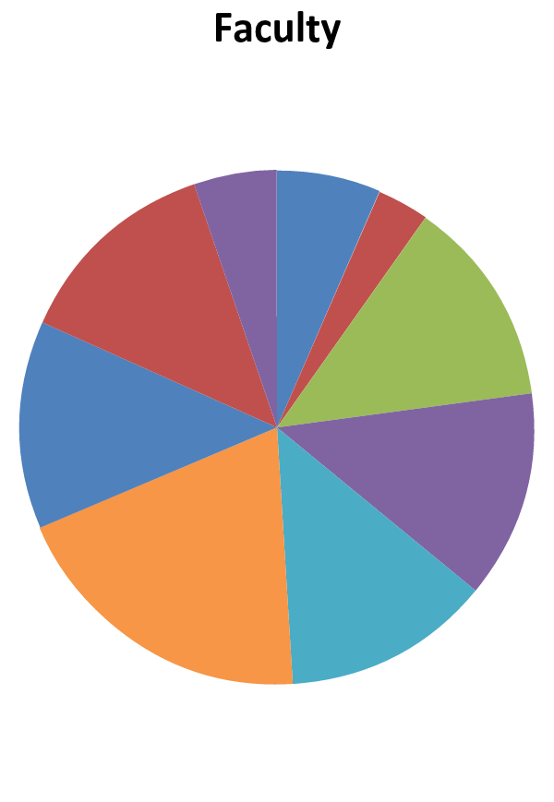
Faculty Blogging?

Slide 5
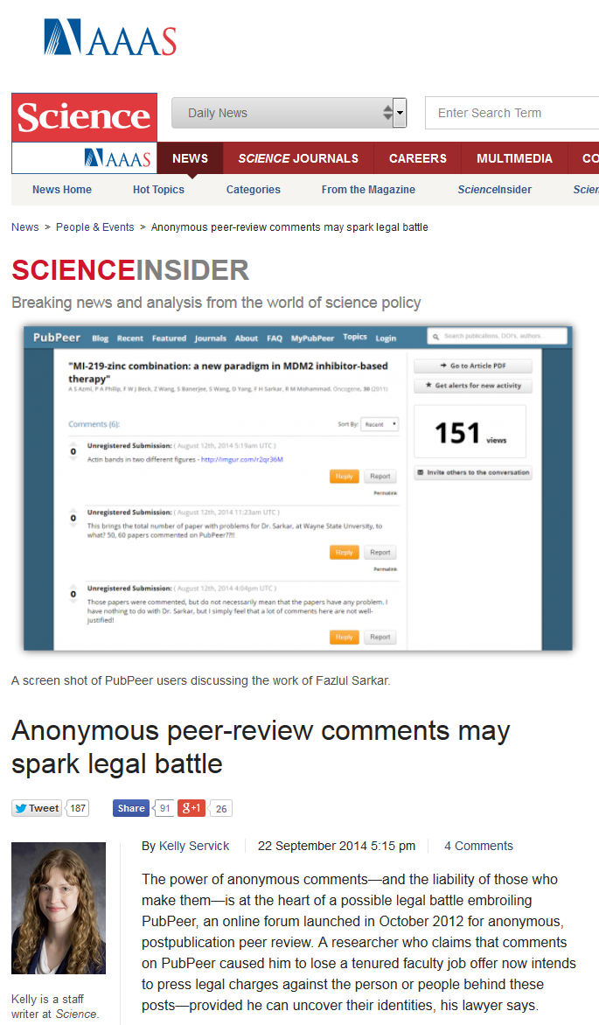
Online Commenting?

Slide 6
Email?
“What’s RSS? I have set up email alerts, they work fine for me”
“What’s wrong with sending Word documents around?”
“Why do you say our infrastructure is antiquated? Isn’t all our literature on the web these days?”

Slide 7
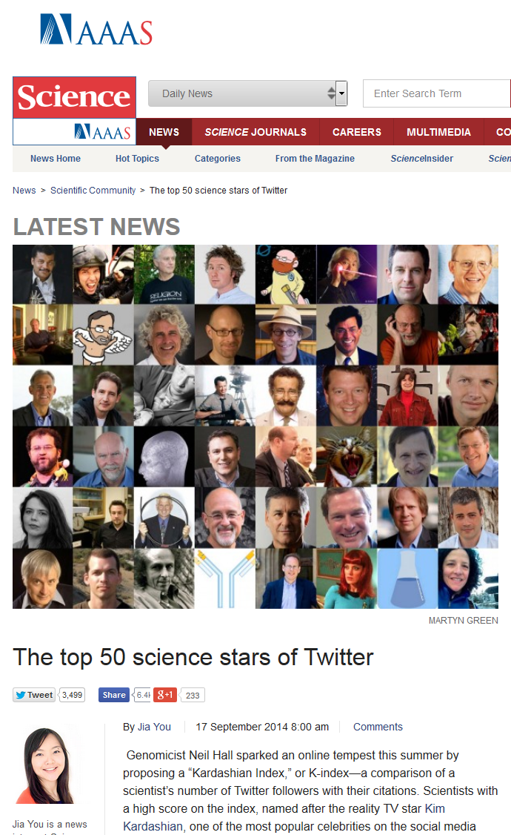

Twitter

Slide 8

“New forms of communication”
“There are signs that these new forms of communication and the acceleration of the scientific discourse they entail may profoundly alter scholarly publishing”

Slide 9
What does the online landscape offer?
The distance between the ‘avantgarde’ and the ‘luddites’ is increasing
The majority of scientists doesn’t even realize the need for improvement
We need to develop applications that pull scientists into the 21st century

Slide 10

INFRASTRUCTURE
Julien Colomb
What we are doing

Slide 11
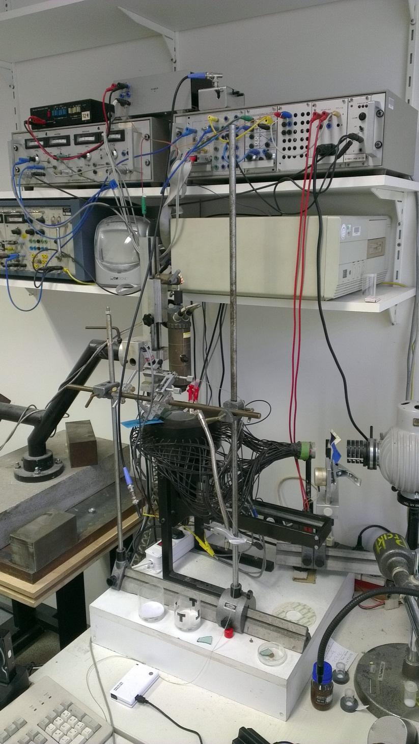
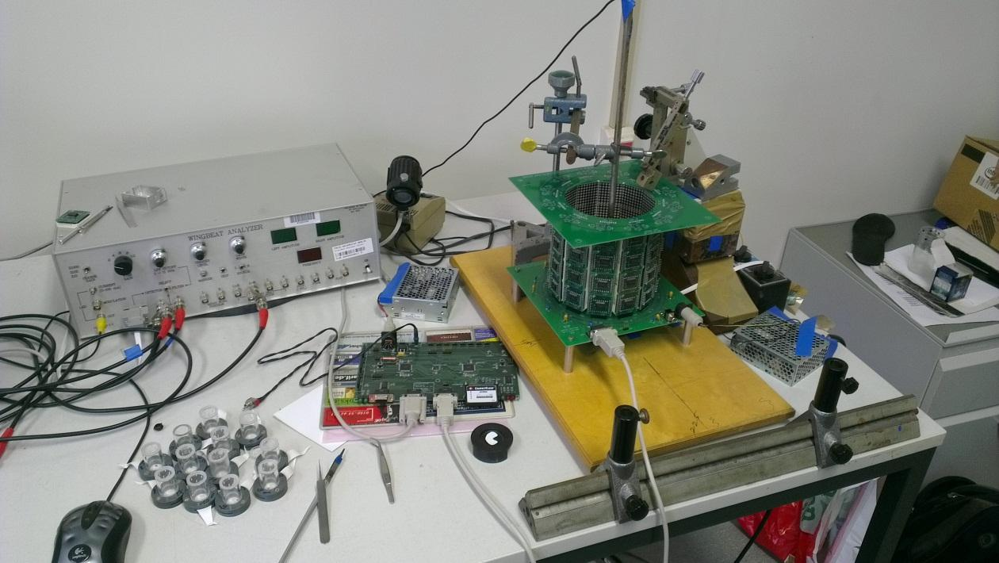
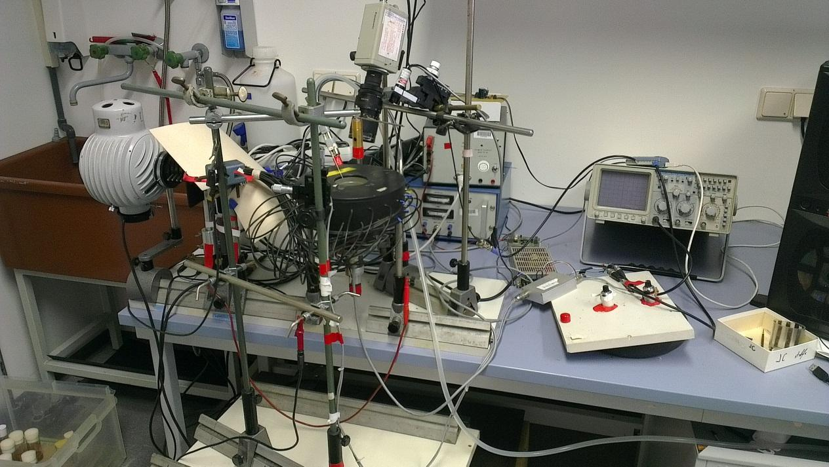

Slide 12
Software to control the experiment and save the data

Slide 13
Software to analyze and visualize the data

Slide 14
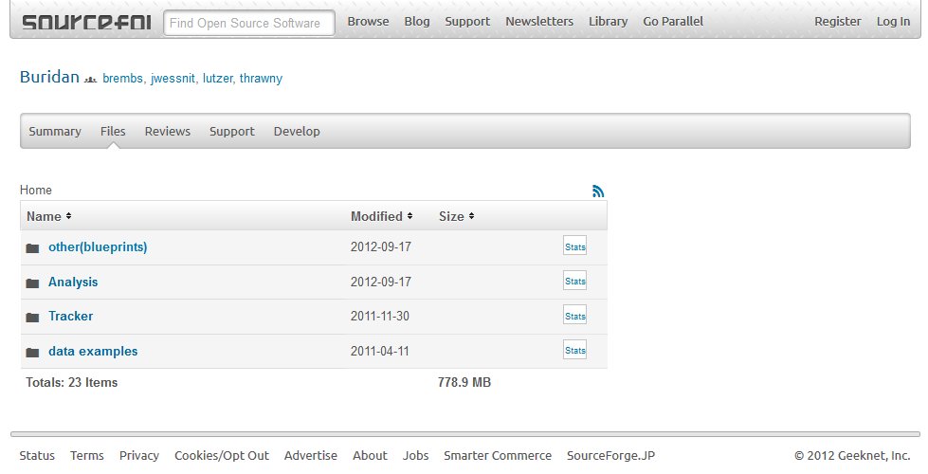
buridan.sourceforge.net

Slide 15
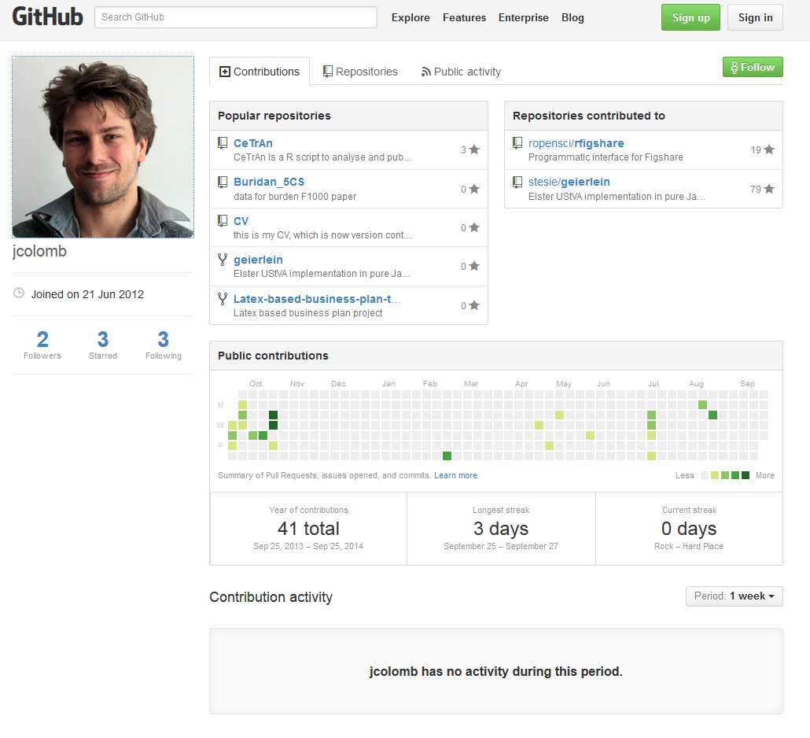
GitHub

Slide 16
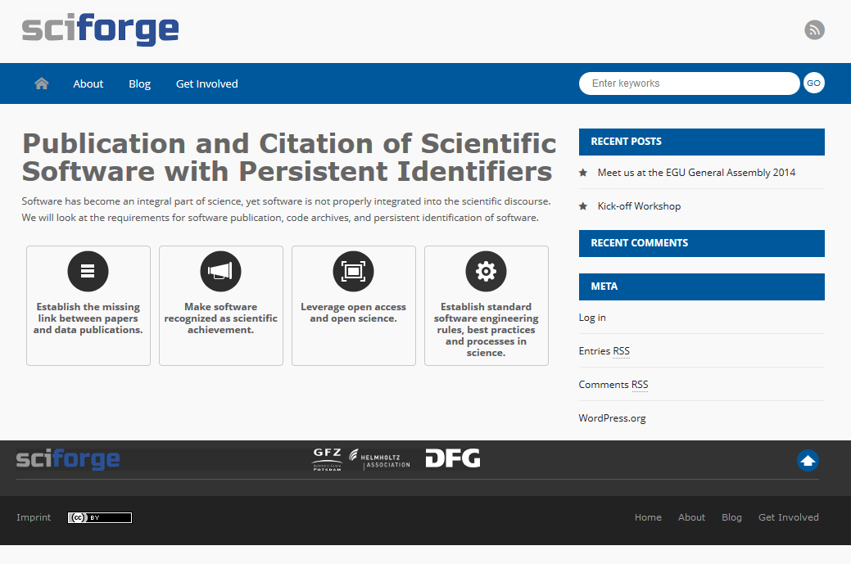
Scientific Code with Persistent Identifiers

Slide 17
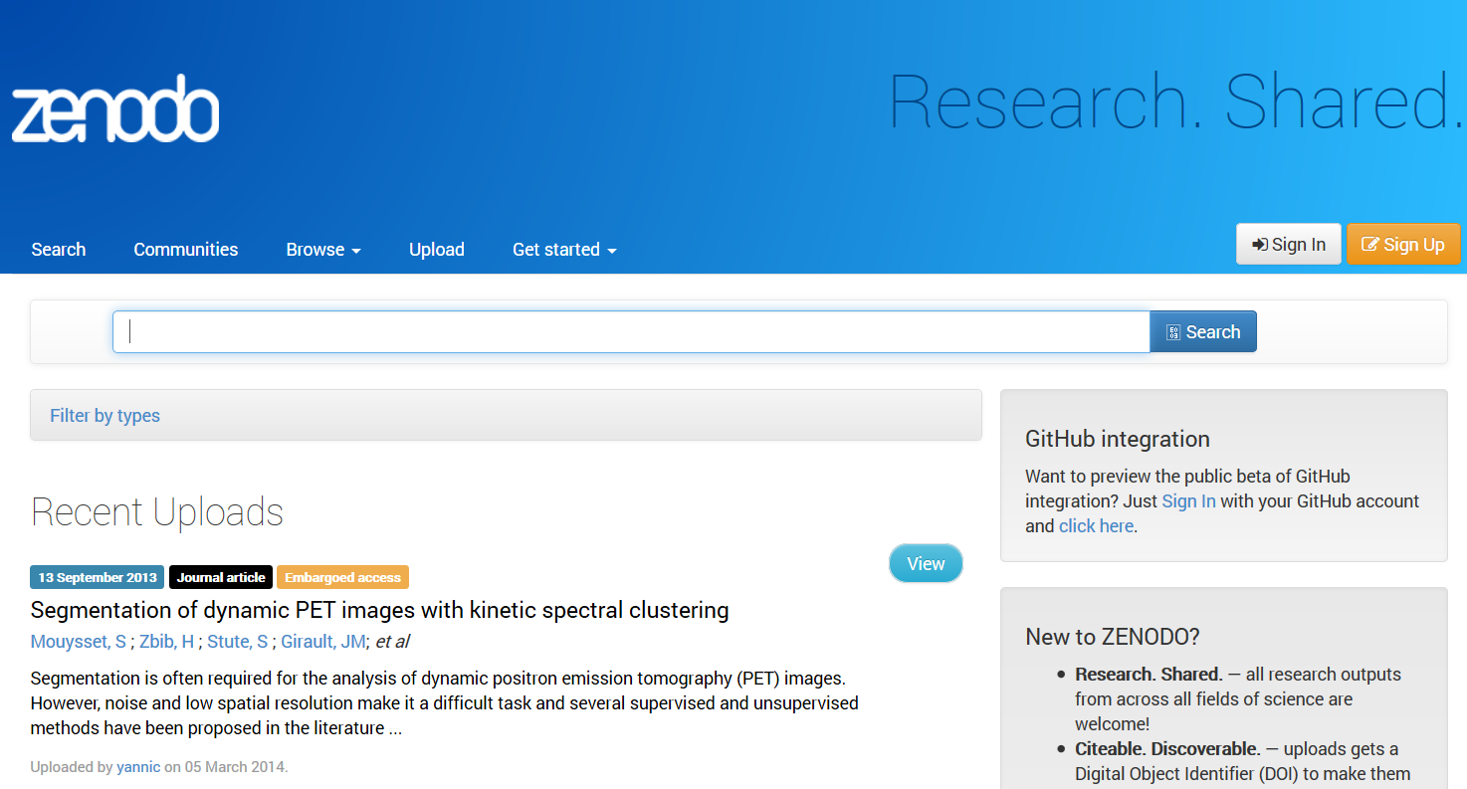

Slide 18
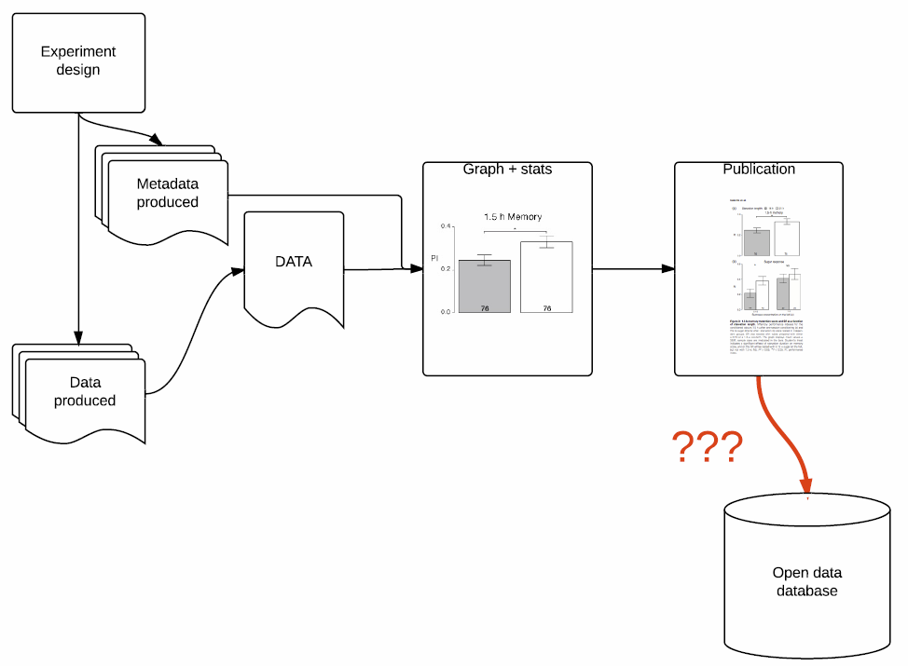

Slide 19
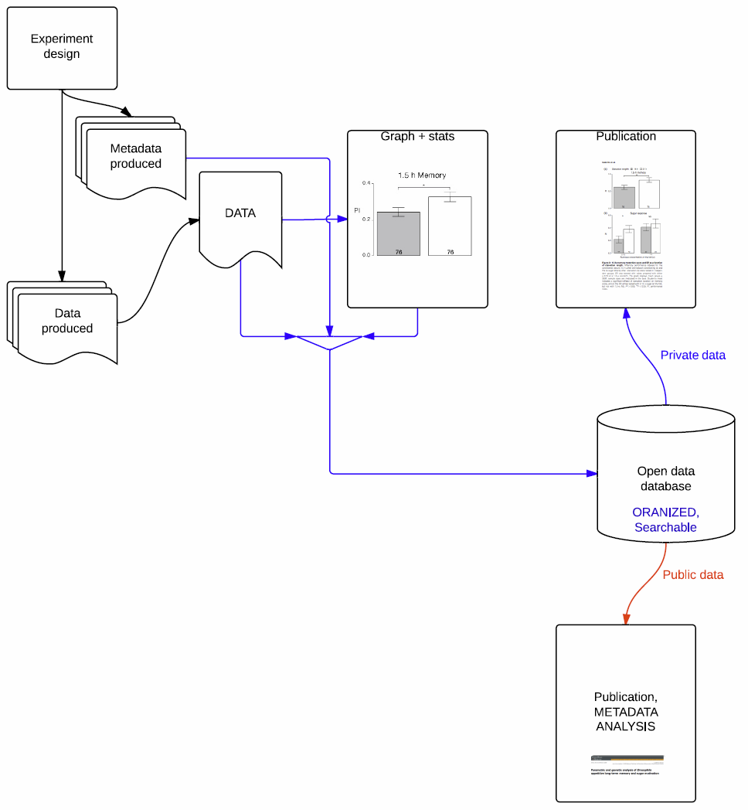

Slide 20


Slide 21

FigShare API
The figshare API allows you to push data to figshare, or pull data out. This first version is a basic implementation that allows you to manage your figshare account or build applications on top of the figshare platform and public research.

Slide 22
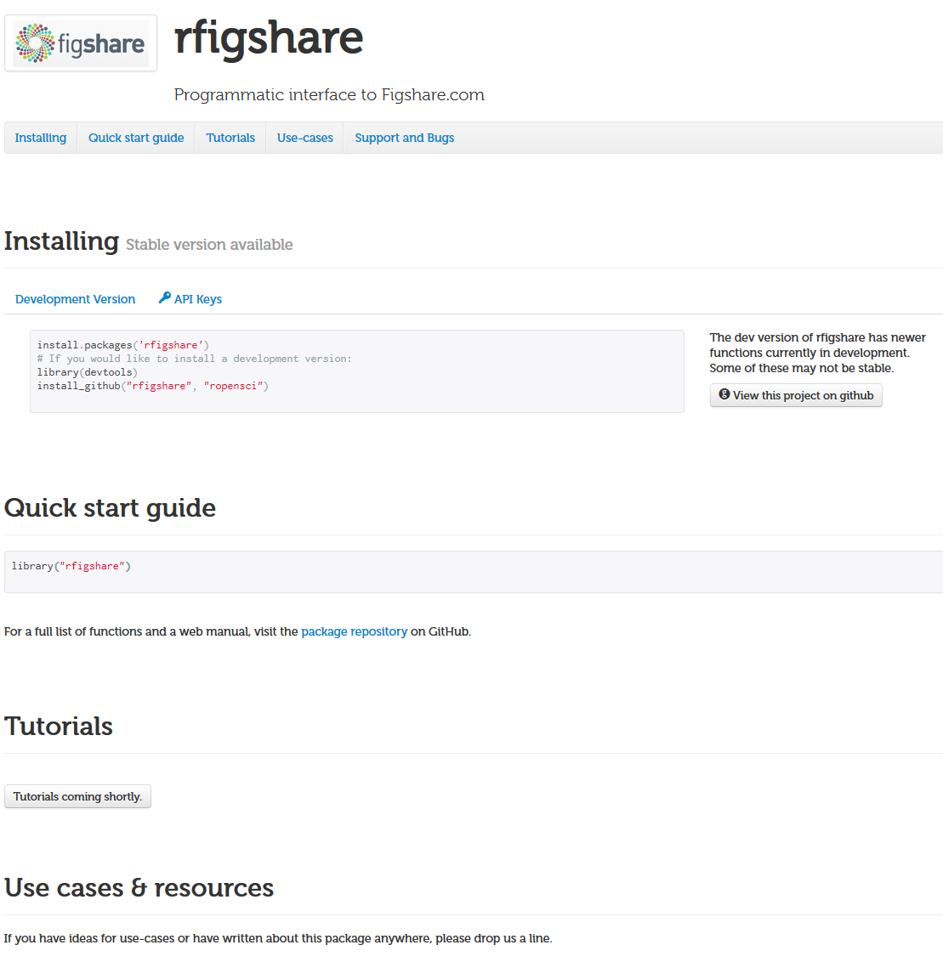

Slide 23
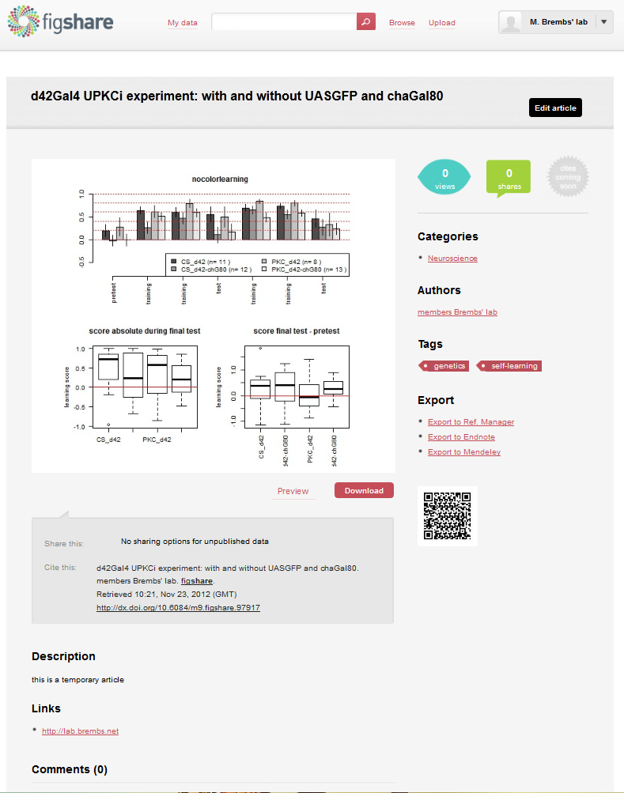
Run your script and...
Same type of experiments → same script
Default: → same categories
→ same tags
→ same authors
→ same links
→ same description
→ One complete article, in one click.
Update the figure:
Higher sample size directly published while analysed, your boss may see the results before you do! (or you may see the results of your student before they do)
Possibility to make it public and citable in one click or directly in the R code.

Slide 24

Citable?
http://dx.doi.org/10.6084/m9.figshare.97792

Slide 25
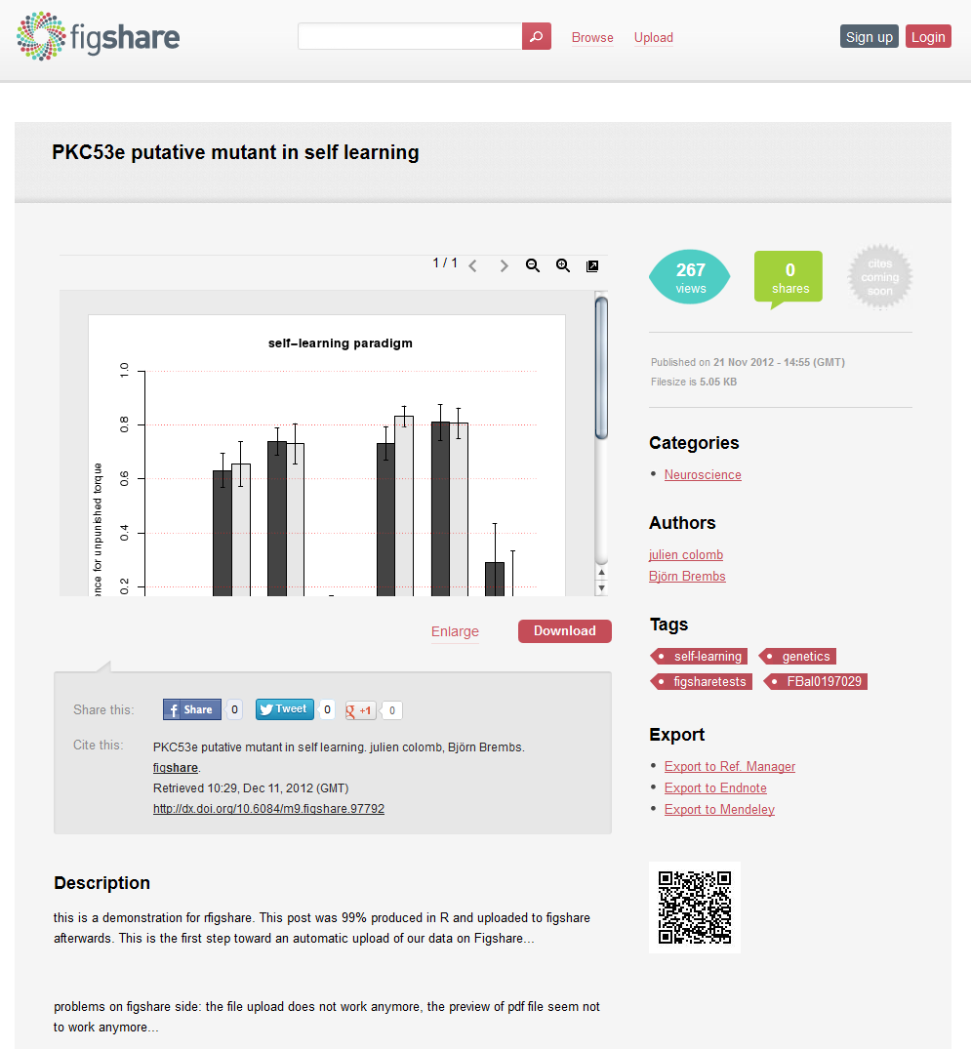
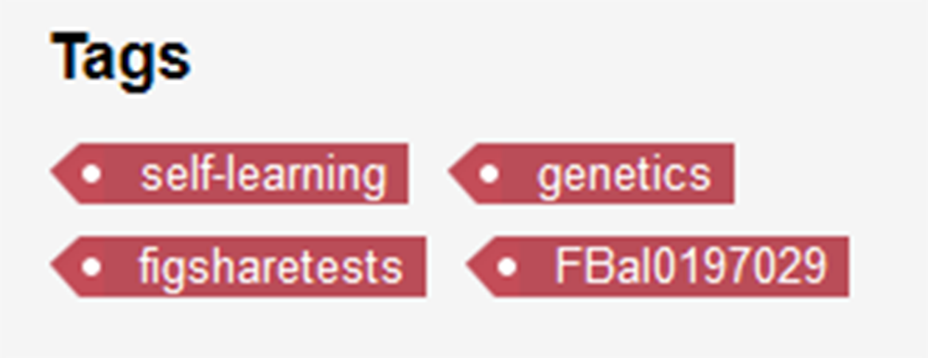
Citable!

Slide 26
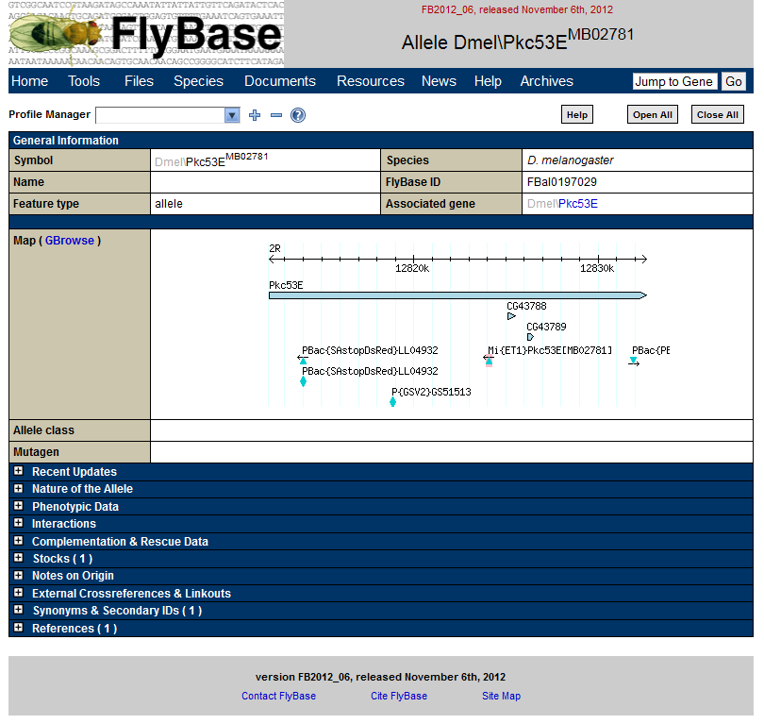

Slide 27
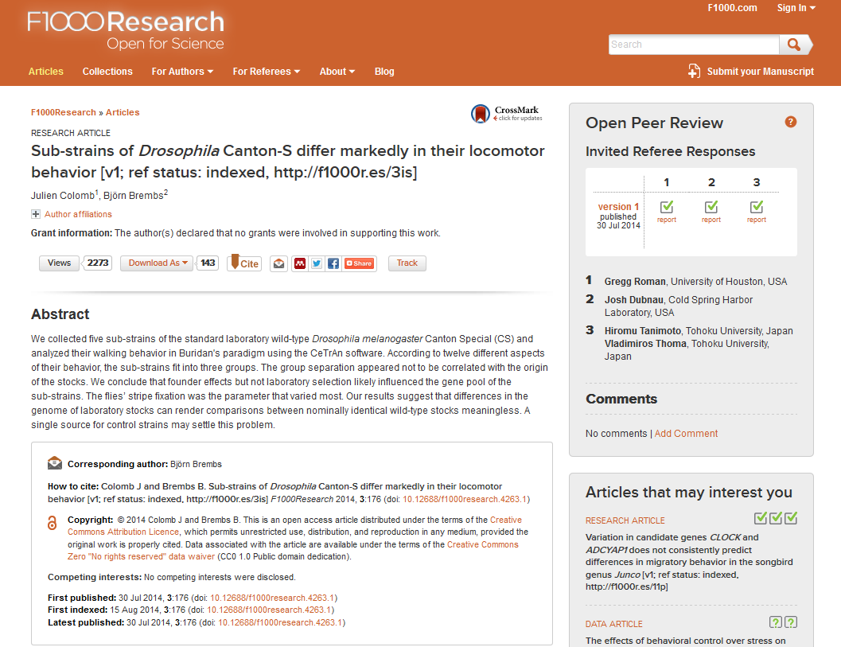

Slide 28
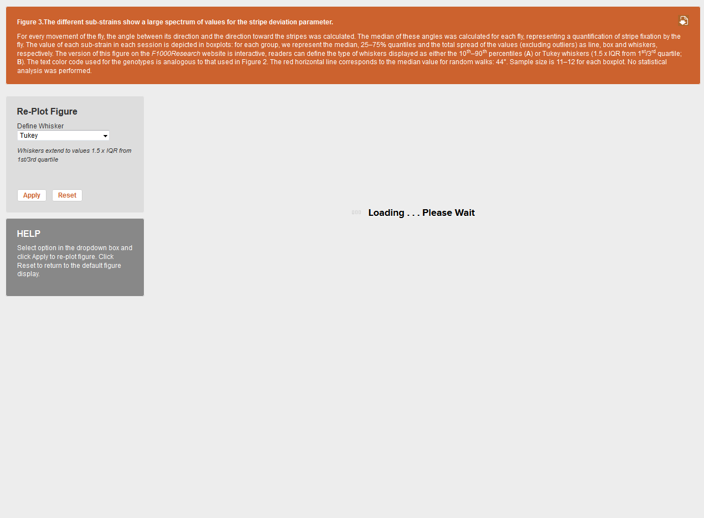

Slide 29
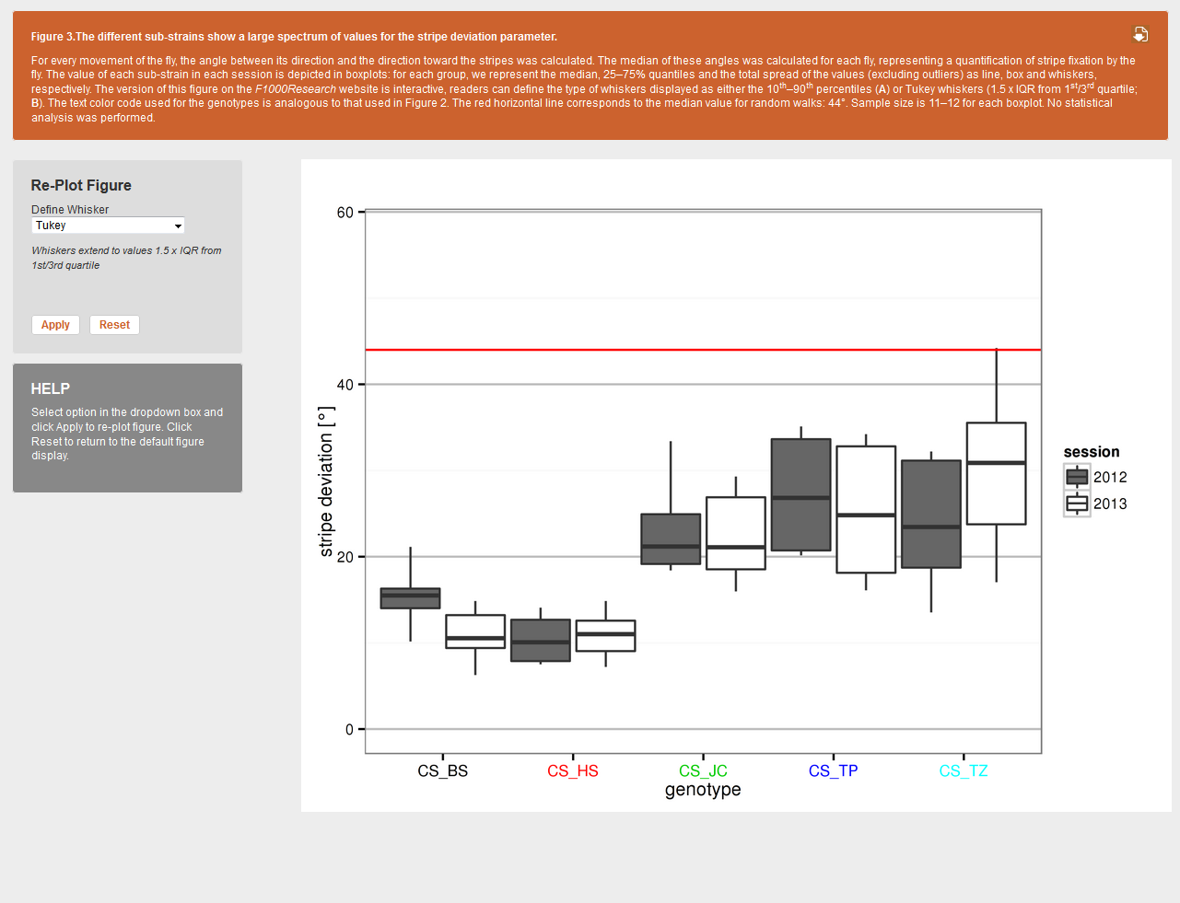

Slide 30
