Slide 1
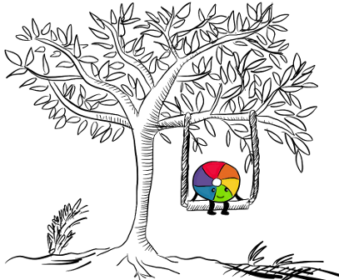
Beyond the article: Altmetrics, publishing and marketing
1: AM, Altmetrics conference, London, 26 September 2014, Hans Zijlstra, h.zijlstra@elsevier.com

Slide 2
Overview
About Hans
Observations
What role do altmetrics play?
What can publishers do with altmetrics?
So what did Elsevier do?
Feedback
Tips/Ideas
What’s next
Notes:
Across the company, there are a lot of departments actively engaged with altmetrics.
However, in most cases we are still testing the waters and senior management has yet to take a decision about the direction to take.
In this presentation, I will take you through the main initiatives which are currently happening.

Slide 3
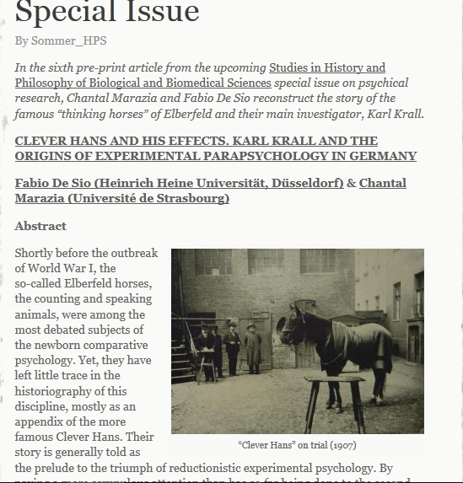
About Hans
Marketing projects @ Elsevier STM journals
Covering all science areas
Focus on journal and article metrics for authors
Passion for bridging communication gaps
http://www.sciencedirect.com/science/article/pii/S1369848614000855

Slide 4
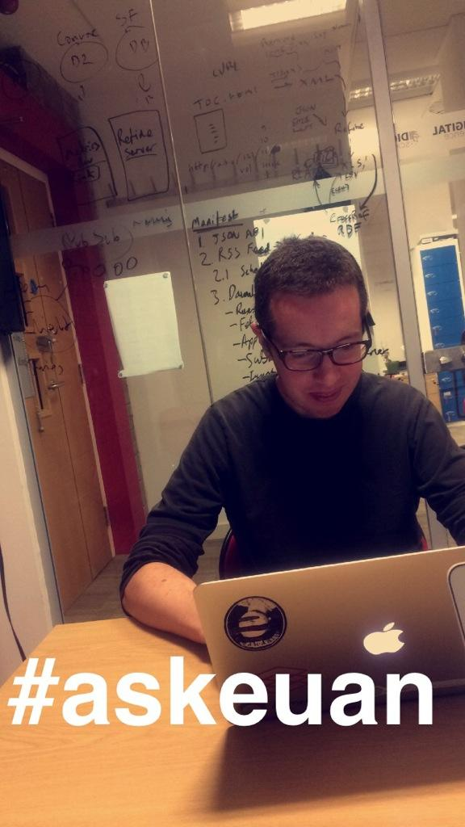
Observations
Scientists spend a lot of time on their paper but hardly any on marketing and promoting it.
Good science is not good enough!
Funding bodies are more demanding (proof of societal impact).
Importance for both scientists and institutions. Universities are building up marketing departments.
Publishers and marketeers can help (or Euan).

Slide 5
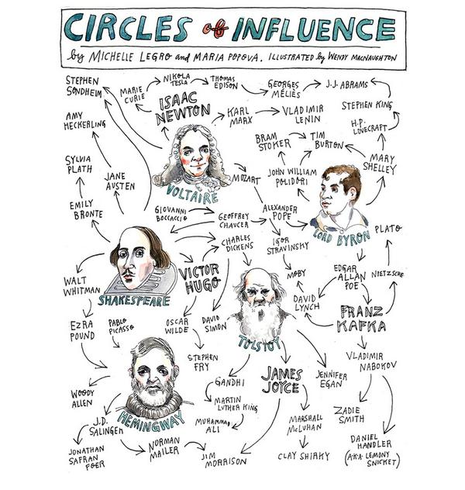
What role do altmetrics play? Taking the pulse!
Make scientists/institutions want to be part of it, the new(s)paper in science
Create insights in networks
Another (new) angle on impact
Reach beyond academia
Change science?
But also:
Confuse people

Slide 6

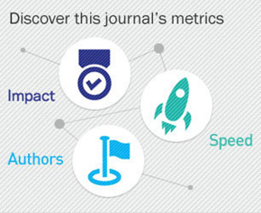
What can publishers do with altmetrics? Help scientists promote their work
Listen, collaborate, explain, educate, promote: advancing science
Bridge gap between alpha and beta
Support sharing=multiplying
Support holistic approach to metrics
Great science->Great Visibility->Great Visualizations
Link to journal metrics

Slide 7

So what did Elsevier do? Pilots, tests and engagement
ScienceDirect pilot
Scopus*: altmetrics + Mendeley app
STM journal homepages pilot
STMJ campaigns: email, virtual special issues, banners, social media mentions, corporate media
Engage in conferences/ discussions
* Scopus is the largest abstract and citation database of peer-reviewed literature: scientific journals, books and conference proceedings.
Notes:
Across the company, there are a lot of departments actively engaged with altmetrics. We really embraced the concept and put a lot of effort in spreading the word. Piloting and testing it, because we believe it can be a great help to scientists and publishers.

Slide 8

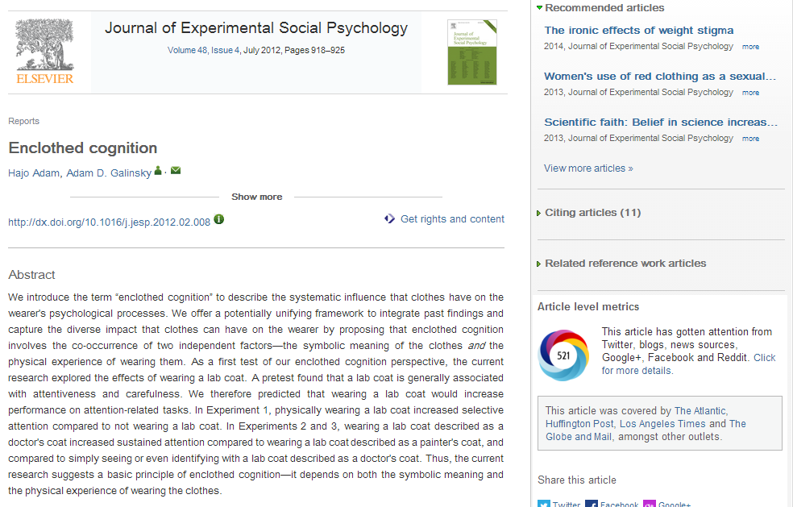
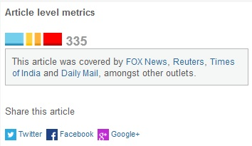
ScienceDirect
Piloting the Altmetric.com app (27 journals)
Testing donut versus brick display
No significant difference in clicks
Notes:
On ScienceDirect, users could already for a few years download the altmetric.com app via the application marketplace. Now, it’s a permanent feature for 27 journals, which the ScienceDirect product team is testing the interest of readers in this app.

Slide 9

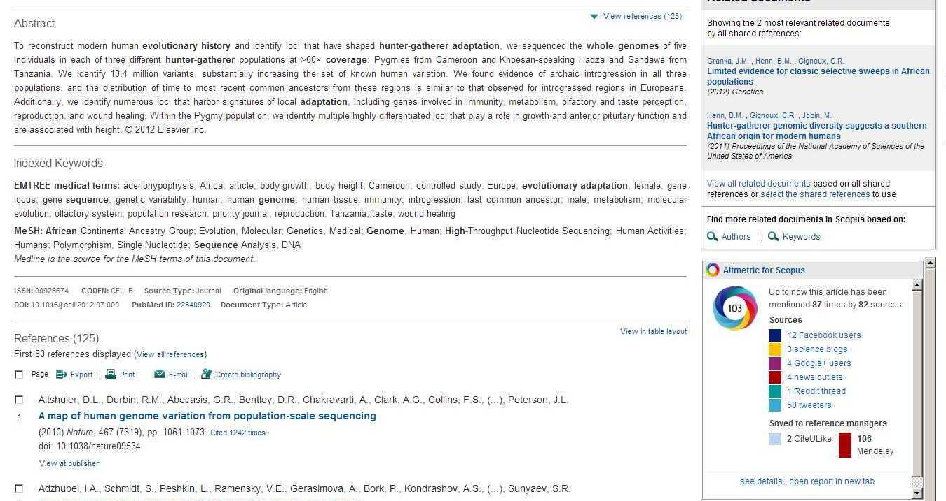
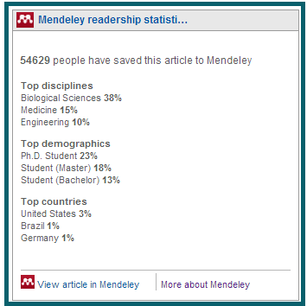
Scopus
Altmetric.com app live since June 2012
Mendeley readership app live since March 2014
Notes:
Scopus was the first Elsevier product to embrace altmetrics.
The altmetric app has been live there for all content on Scopus

Slide 10

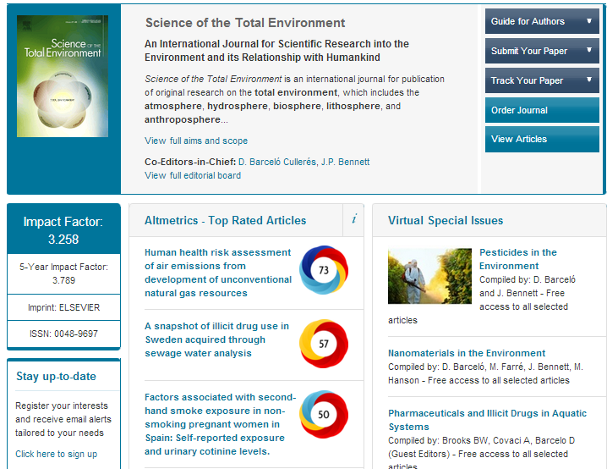
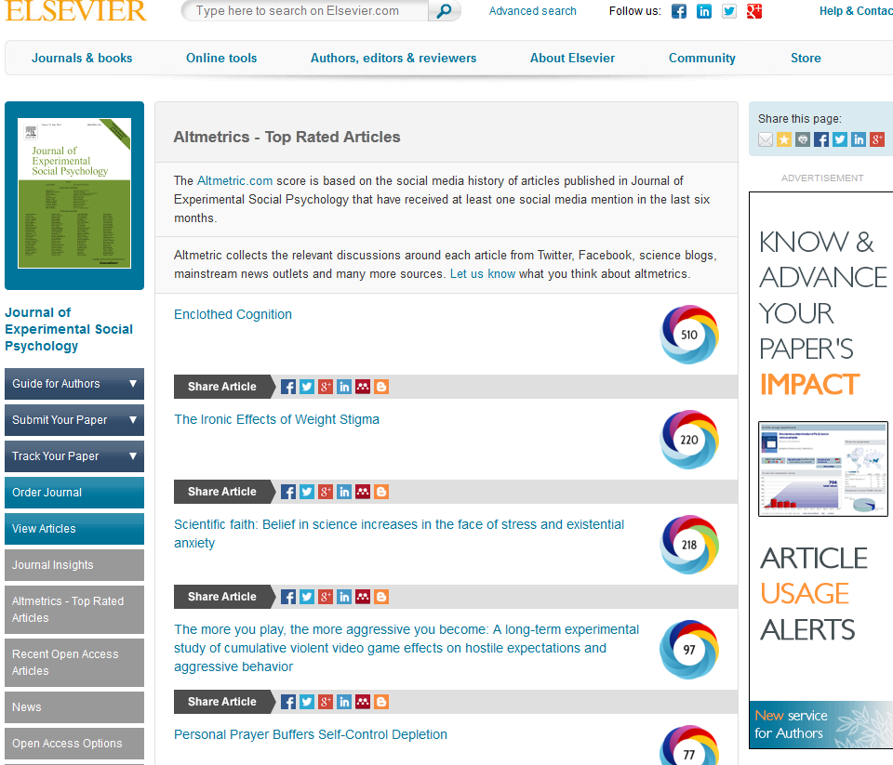
Altmetrics on Journal Homepages
Altmetrics information available via dedicated pod, linking to SD and Altmetric.com (since November 2013) for 33 journals
Notes:
We have been displaying the top 10 best rated articles for 33 journals on Elsevier.com since November 2013.

Slide 11
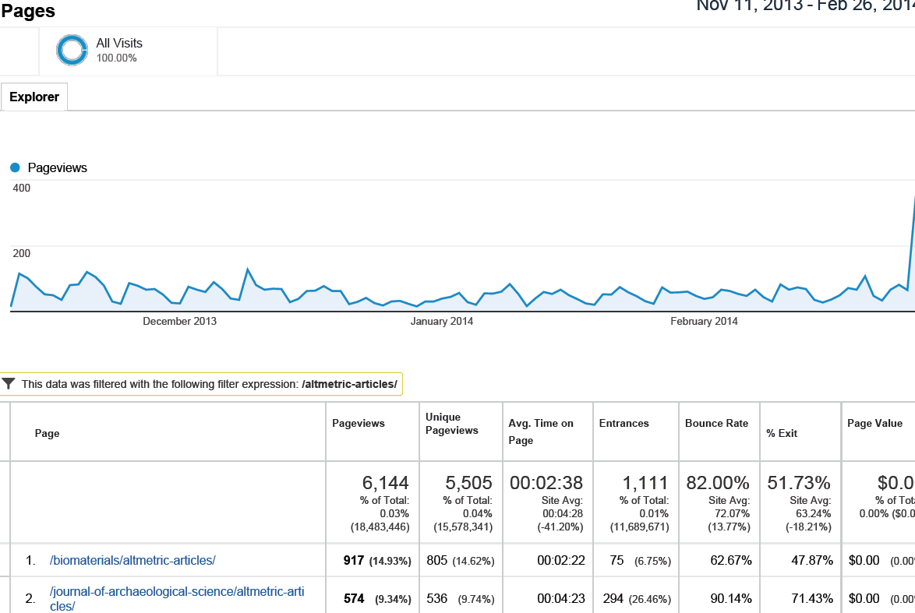
Altmetrics web statistics
Generally: Not a lot of extra traffic (around 1%), but staying relatively long: 2.30 min/session. Quality over quantity.
Same pattern clicks Donut vs Article as in emailings. In pod: 86% click Article, only 14% donut.

Slide 12
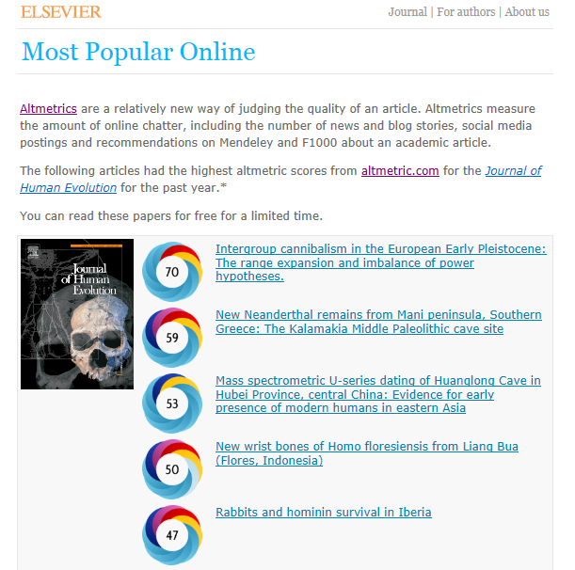
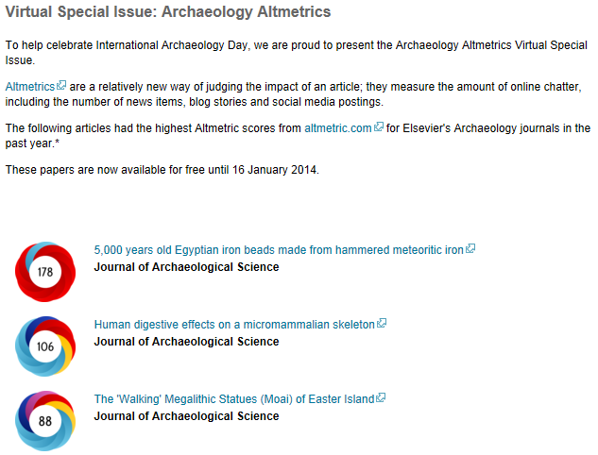
Altmetrics campaigns in STMJ
Altmetric.com Explorer used for internal analysis and e.g. Virtual Special issues
Marketing is using the tool for email campaigns too
Publishers use reports in Ed.Board meetings and receive e-alerts.
Notes:
The marketing department also makes use of the Altmetrics Explorer, which is a tool that allows you to monitor, search and measure conversations about your publications and those of your competitors. Making use of the data in the Explorer, marketing managers can also use those data in campaigns, such as the e-mail campaigns done for Physical Sciences in December last year.

Slide 13

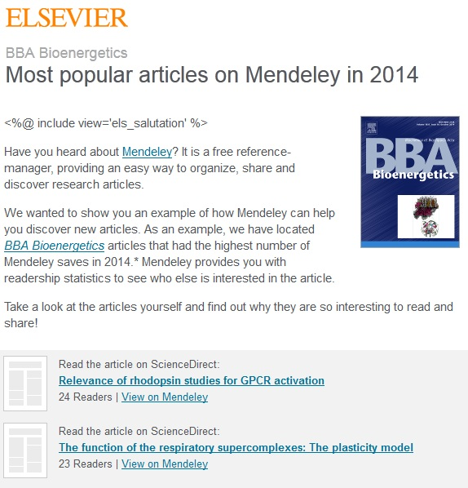
Mendeley in STMJ
Integration in altmetrics display
Bannering
Email campaigns
Journal homepage pod with Top-3/10
In sharing options

Slide 14
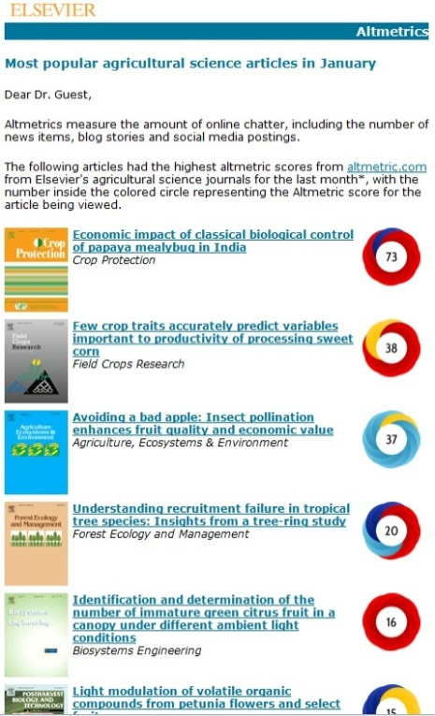
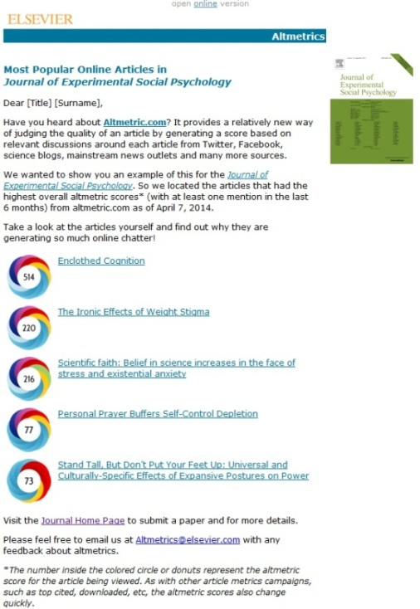
Altmetrics Email statistics
December 2013. Total 280 journals.
Total emails: 145,781, Open 26%, Click 10%
May 2014. Total 144 journals. Minimum 5 articles with Altmetric score 10 or higher
Total emails: 108,756, Open 32%, Click 7%
Notes:
These are the statistics for the campaigns for Physical Sciences. As you can see, there was a lot of interest in this campaign. This was repeated as a global campaign within the journal and article metrics sponsorship.

Slide 15
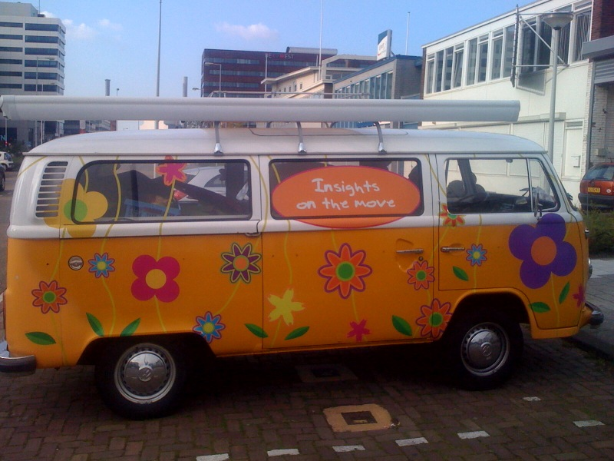
Altmetrics feedback
Generally: Positive but critical on usefulness.
Scientific Societies and institutions are demanding it.
Beware of impact controversial articles.

Slide 16
Feedback from individuals
“This service looks like it might be both useful and interesting for an EIC.” - Editor-in-Chief
“I was thinking that you could track the number of mentions of papers in Wikipedia. It is a great measure of the "social utility" of a paper.” - Senior Research Fellow
“I very much appreciate the possibility to track relevant online discussions on social media through Altmetrics” – Researcher
“It is really unclear how your system works and what criteria you are using to select papers”. - Researcher

Slide 17
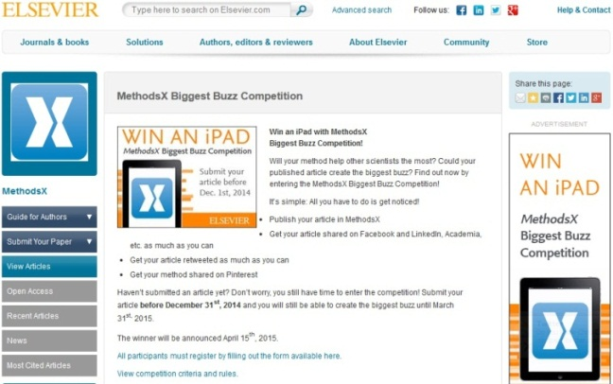

Tips and Ideas
Talk to people who take effort to contact you, both positive, negative and confused.
Do not take data too seriously! It just gives you indications: There is no perfect data set.
Virtual Special issues
Buzz competition
Remarkable article of the week/month etc.
Personal altmetric score (Impactstory), journal level altmetric scores
Test. Just do it.

Slide 18
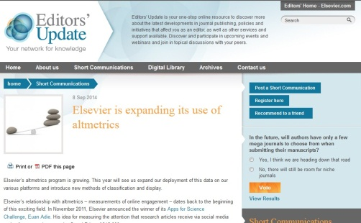
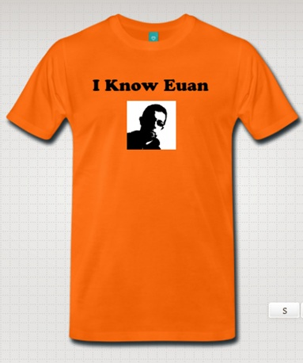
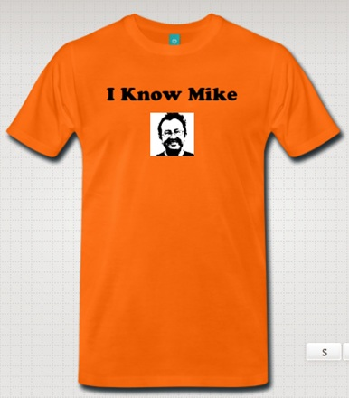
What’s next?
Rolling out to STMJ Elsevier.com and Science Direct.
Integration with Usage/Citations.
Testing alternative display, buckets.
Keep listening, collaborating, explaining, educating, promoting.
Make big data small: Visualize!
The Che Guevara’s of Altmetrics

