Slide 1
Altmetrics & Publishers: Making Metrics Count
Jennifer Lin, PhD
Senior Product Manager, PLOS

Slide 2
“Not everything that can be counted counts, and not everything that counts can be counted.” – Albert Einstein

Slide 3

Front End

Slide 4
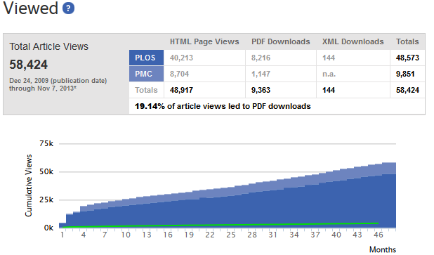
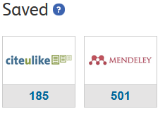
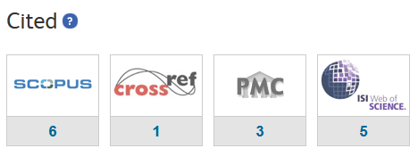
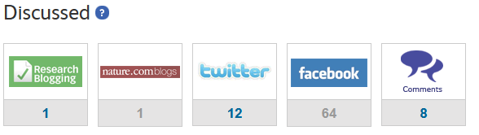
Authors want to see the reach of their article
Notes:
Let’s assume that authors want to see the impact of their article

Slide 5
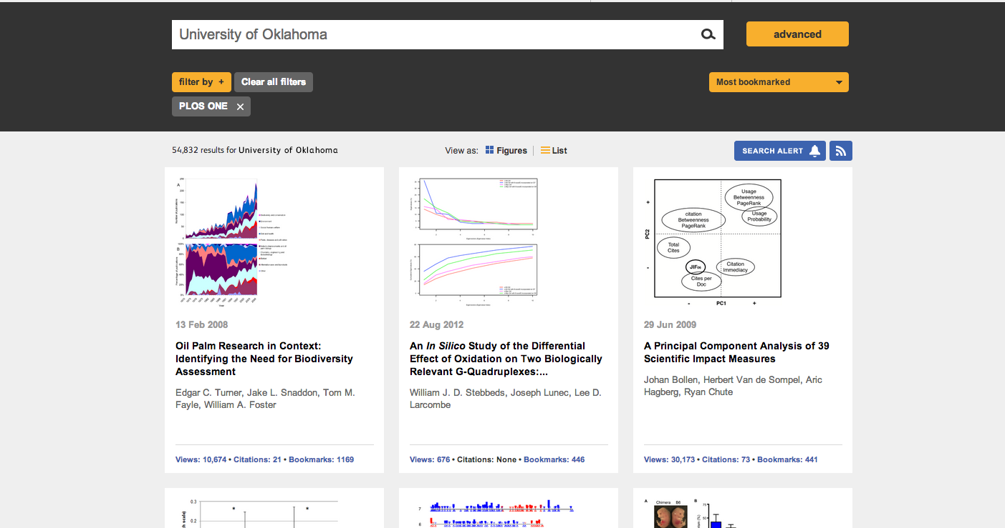
Researchers want to find relevant papers…

Slide 6
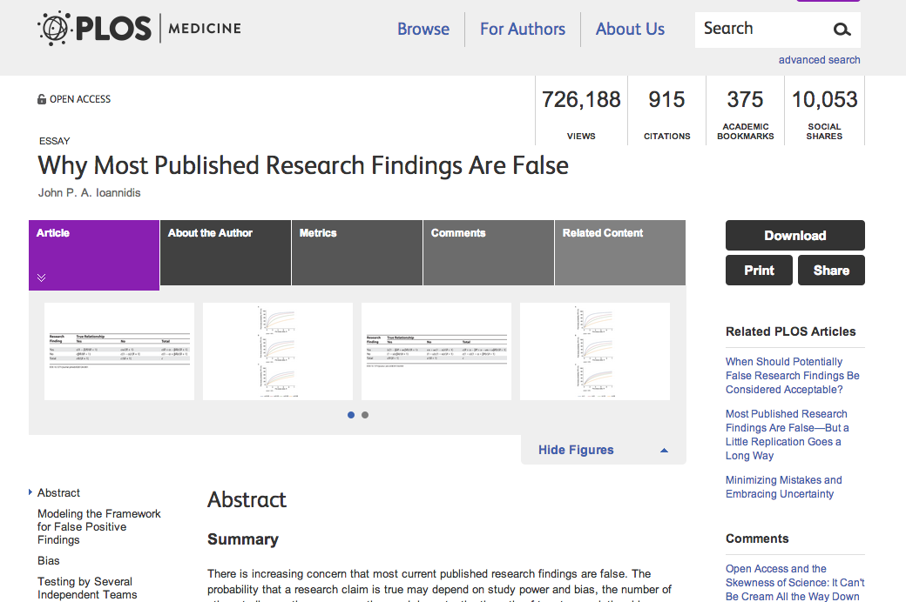

… and navigate through the literature

Slide 7

Back End
Notes:
integrating it into our CMS tool for home pages
will be using it to better the article recommendations from Eigenfactor Recommends

Slide 8


Slide 9
Editorial
Publication Services
Marketing
Notes:
Editorial – curation, promotion, Track dissemination of articles published (types of channels, rate of growth, etc.)
Publication Services – supporting our external editors, Provide data & the content behind the metrics on downstream impact of publications (media coverage, blog coverage, etc.)
Marketing - Attract authors and new audiences by offering data on the audience’s research interest
Executive team – support reporting to our Board, provide hard-data to inform strategic decision-making for the organization

Slide 10
PLOS ONE Highlights
Link
DOI | Title | Authors
10.1371/journal.pone.0099438 | The 2.1 Ga Old Francevillian Biota: Biogenicity, Taphonomy and Biodiversity | Abderrazak El Albani, Stefan Bengtson, et al.
10.1371/journal.pone.0099868 | Behavioral and Neural Correlates of Executive Functioning in Musicians and Non-Musicians | Jennifer Zuk, Christopher Benjamin, Arnold Kenyon, Nadine Gaab
10.1371/journal.pone.0098819 | Reactivation of Multiple Viruses in Patients with Sepsis | Andrew H. Walton, Jared T. Muenzer, et al.
10.1371/journal.pone.0097138 | An Additional Baurusuchid from the Cretaceous of Brazil with Evidence of Interspecific Predation among Crocodyliformes | Pedro L. Godoy, Felipe C. Montefeltro, et al.
10.1371/journal.pone.0094346 | Capturing Natural-Colour 3D Models of Insects for Species Discovery and Diagnostics | Chuong V. Nguyen, David R. Lovell, et al.
10.1371/journal.pone.0095384 | The Microbial Diversity of Traditional Spontaneously Fermented Lambic Beer | Freek Spitaels, Anneleen D. Wieme, et al.
10.1371/journal.pone.0095101 | CRISPR/Cas9 Allows Efficient and Complete Knock-In of a Destabilization Domain-Tagged Essential Protein in a Human Cell Line, Allowing Rapid Knockdown of Protein Function | Arnold Park, Sohui T. Won, et al.
10.1371/journal.pone.0093195 | Correlates of Research Effort in Carnivores: Body Size, Range Size and Diet Matter | Zoe M. Brooke, Jon Bielby ,et al.
10.1371/journal.pone.0090785 | Humpback Whale Populations Share a Core Skin Bacterial Community: Towards a Health Index for Marine Mammals? | Amy Apprill, Jooke Robbin, et al.
10.1371/journal.pone.0088987 | Early Triassic Marine Biotic Recovery: The Predators' Perspective | Torsten M. Scheyer, Carlo Romano, Jim Jenks, Hugo Bucher
Notes:
This list will be selected each month from a report of papers generated based on the following ALMs ratio: PDF downloads/HTML ratios. Only papers published within the last four calendar months were eligible for inclusion. (This list was pulled from March 15, 2014- July 15, 2014)
http://almreports.plos.org/reports/metrics/15583
1. Investigating “knockin” and “knockdown” in a human cell line
2. The shapes of 2.1 billion year-old macroscopic marine biota
3. Musical training may benefit young brains
4. Cheers for the “bugs” in Lambic beers’ (yeast and bacteria)
5. Latent virus reactivation in patients with sepsis
6. Prehistoric crocodiles may have dined on each other
7. Microbes hitching a ride on the skin of a humpback whale
8. Up close with 3D insects

Slide 11
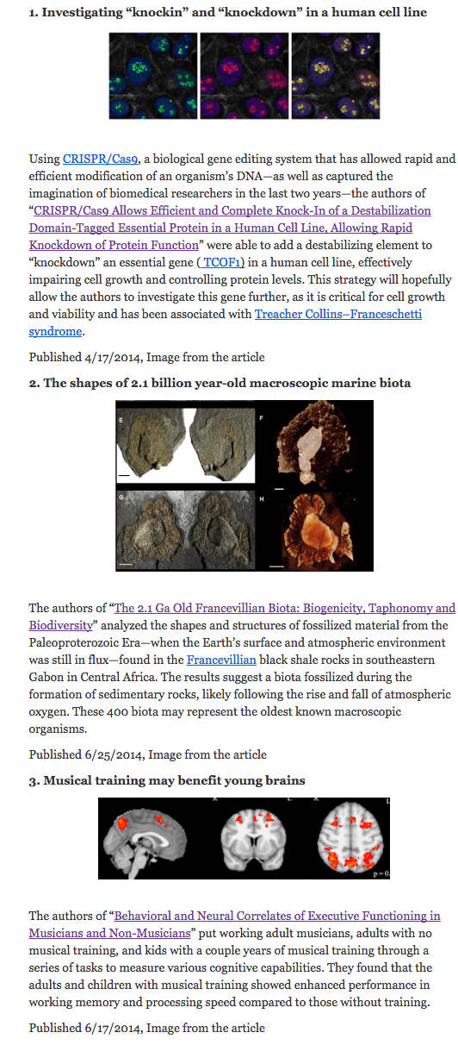
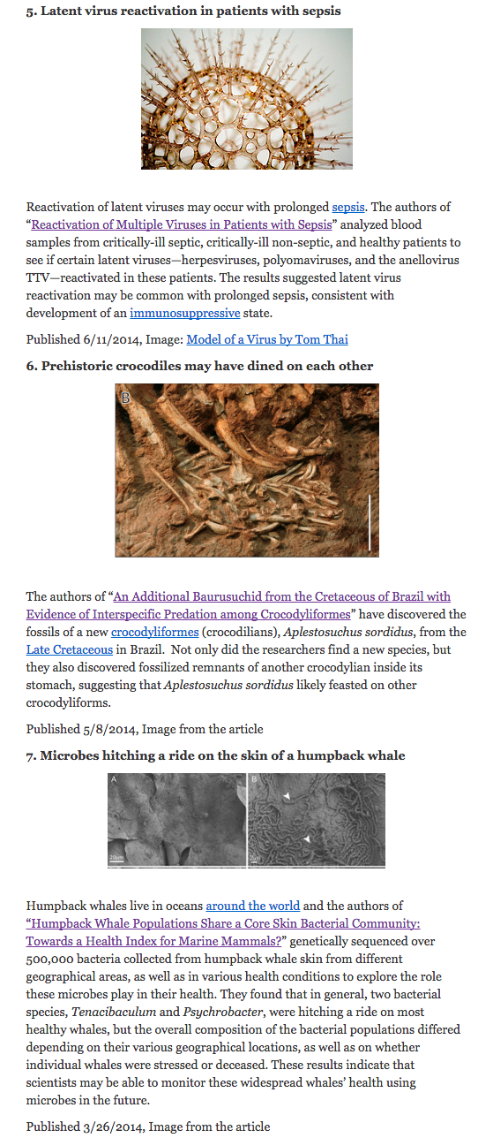

Slide 12
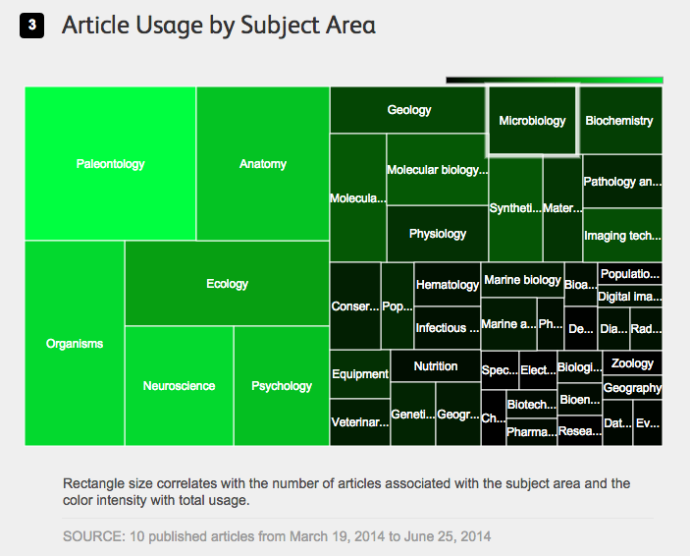
Notes:
I can track these papers over time, within this cohort, merely rerunning the report to see how they change as they age.
http://almreports.plos.org/reports/visualizations/15675

Slide 13
ALM Article Feature
Link
Journal | Article Feature | Journal Article
PLOS Medicine | From One to One Million Article Views | John Ioannidis: Why Most Published Research Findings are False
PLOS Biology | You Just Read my Mind… | Brian Pasley, et al.: Reconstructing Speech from Human Auditory Cortex
PLOS ONE | “Low T” and Prescription Testosterone: Public Viewing of the Science Does Matter | William Finkle, et al.: Increased Risk of Non-fatal Myocardial Infarction following Testosterone Therapy Prescription in Men
PLOS NTDs | Reflections on feces and its synonyms | Stefanie J. Krauth, et al.: An In-Depth Analysis of a Piece of Shit: Distribution of Schistosoma mansoniand Hookworm Eggs in Human Stool
PLOS Genetics | How Much of Your Genome is Functional? | Chris Rands, et al.: 8.2% of the Human Genome Is Constrained: Variation in Rates of Turnover across Functional Element Classes in the Human Lineage
PLOS Pathogens | When Retroviral Research Goes Viral | Ilona Hauber, et al.: Highly Significant Antiviral Activity of HIV-1 LTR-Specific Tre-Recombinase in Humanized Mice
Notes:
Regularly occuring, ongoing series - This series will not only highlight individual articles but will celebrate what in the end is a core editorial function of journals—curating content that matters to their, and we hope wider, audiences.
ONE – public viewing of science does matter

Slide 14
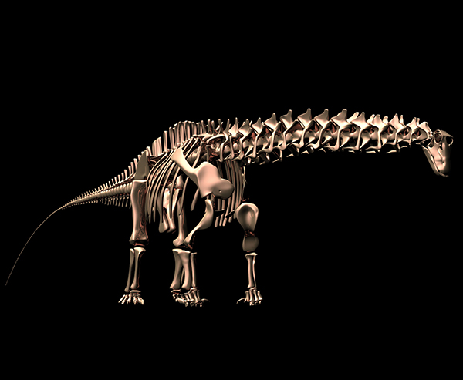
Notes:
Sauropod Gigantism: Sauropod dinosaurs were the largest terrestrial animals to roam the Earth, exceeding all other land-dwelling vertebrates in both mean and maximal body size. While convergently evolving many features seen in large terrestrial mammals, such as upright, columnar limbs and barrel-shaped trunks, sauropods evolved some unique features, such as the extremely long neck and diminutive head they are famous for. This new PLOS Collection discusses major efforts by evolutionary biologists and paleontologists to understand sauropods as living animals and to explain their evolutionary success and uniquely gigantic body size. The articles address these questions from the widest selection of disciplinary viewpoints, including those of ecology, engineering, functional morphology, animal nutrition and palaeontology.
collections reporting, reports for CJ, community building (author emails)

Slide 15
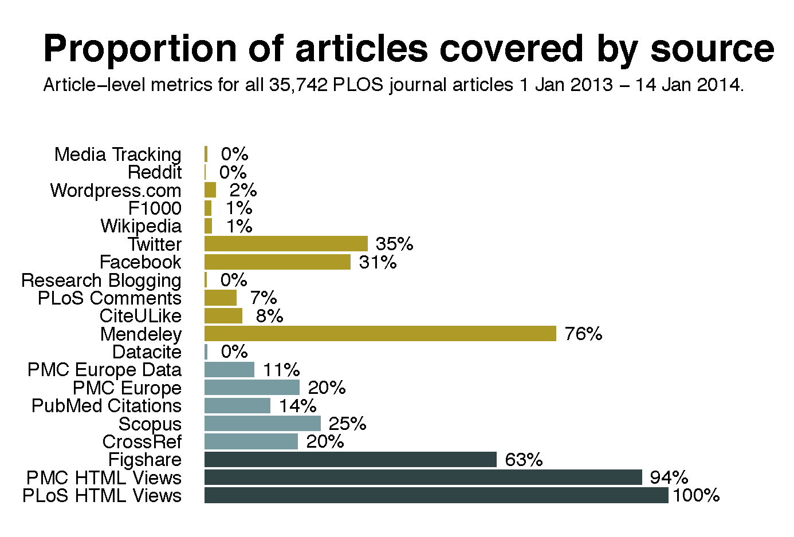
Bibliometrics

Slide 16
What we want as a publisher
Notes:
Context
Clean Data
Looking beyond the article to other fundamental or associated components (figures, data, software, etc.)
Article page metrics tab refresh (historical view, interactive graphs)
Relative metrics for all ALM
Data-level metrics (NSF Project - Making Data Count)

Slide 17
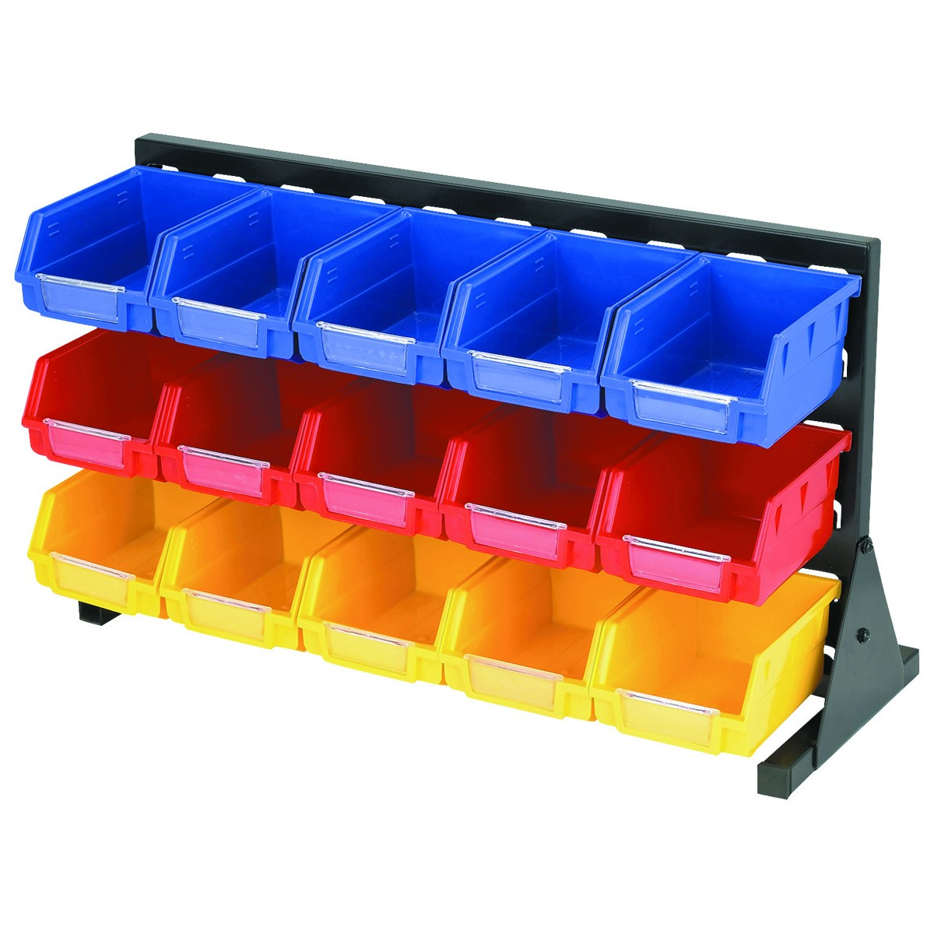
Notes:
Structured metadata for cleanest results:
Author names (ORCID)
Funder names (FundRef)
Institution names (Ringgold)

Slide 18

Notes:
Smokestack/funnel of the titanic

Slide 19

Sometimes, context REALLY matters.

Slide 20





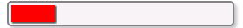
Raw data needs context to have meaning
?
?
1468 counts
?
1468 != 921
?
Notes:
Different modes of activity counted
Different objects counted - versions and copies – in the case of a research paper

Slide 21
Scholarly Community Infrastructure
Notes:
How are we going to get there? We can’t do it alone… never envisioned it and have never acted based on this premise.
Coordination between other publishers
technology etiquette for content publishers so that data is available & easily consumable (data stewardship)
basic degree of coordination between actors (best practices, standards, etc.)
NISO Altmetrics Project
For us to have fully realize the use of ALMs for research published by PLOS, we need open metrics, open ALM
Scholarly community infrastructure
- trusted, engaging the right communities, and financially sustainable
Sustainable future:
Organisations like Crossref, ORCID, as well as systems like PubMed and ArXiv reduce the burden of requiring bilateral agreements across organisations to exchange information. We now need to tackle a similar problem - a multitude of bilateral agreements between these organisations. But without a single place to negotiate such agreements for many identifier systems, a supra-organization is necessary. To this end, we envision a general and open system that enables the deposition, distribution, and exchange of claims about the identifiers that these systems manage and curate. This system offers the most sustainable solution for the future.

Slide 22
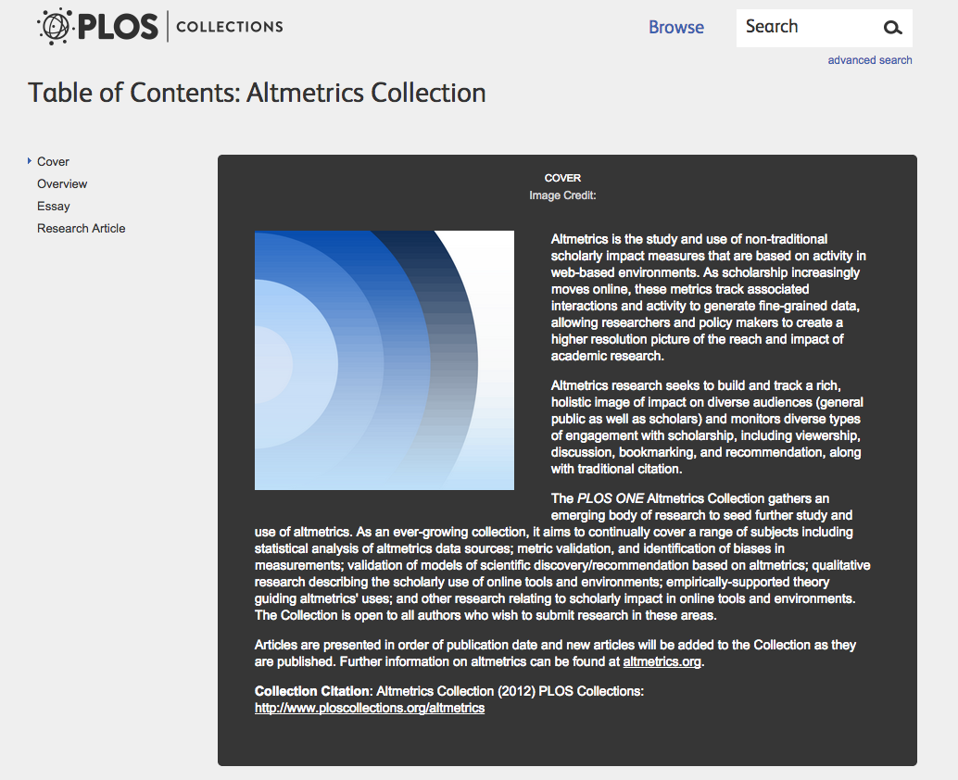
Altmetrics Collection
http://www.ploscollections.org/
Announcement
http://bit.ly/1stjaPP
Notes:
Open call for papers in the PLOS Altmetrics Collection.
The PLOS Altmetrics Collection launched back in 2012 with an aim to provide a forum for the dissemination of innovative research on metrics. Today along with the original altmetrics architects, we reissue a call for papers under the topic of Altmetrics in order to better establish a concrete set of tools and data for future scholars.
Paper topics:
Statistical analysis of altmetrics data sources
Metric validation, and identification of biases in measurements
Validation of models of scientific discovery/recommendation based on altmetrics
Qualitative research describing the scholarly use of online tools and environments
Empirically-supported theory guiding altmetrics uses
Other research relating to scholarly impact in online tools and environments

