Slide 1
Thanks for attending 1AM! http://lanyrd.com/2014/1amconf/

Slide 2
Research grant
Thanks Thompson Reuters!
http://www.altmetricsconference.com/funding/
You have until the end of October to apply.

Slide 3
Things I did not expect when waking up yesterday morning
Slashfic
Sexy archaeology
Poo emoji
Conference wifi that worked

Slide 4
Success as we didn’t mention
Winnie the Pooh, cannabis, dinosaurs
Difference between article level metrics and altmetrics
Renaming (or redefining) altmetrics

Slide 5
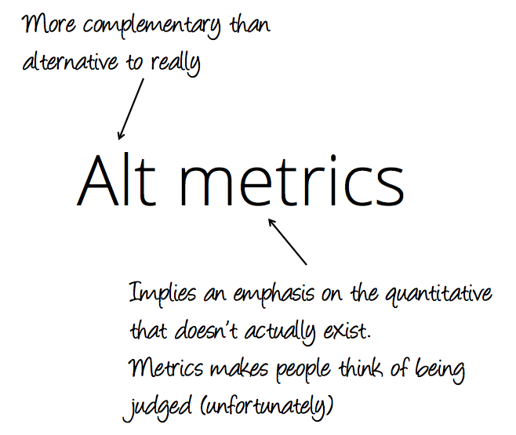

Slide 6
What were some themes?

Slide 7
Different groups…
Bibliometrics researchers
Researchers
Librarians
Funders
Publishers
Service providers

Slide 8
… have different uses
… as a first step, correlate with citations
Support researchers and their needs
Use in evaluation, help highlight pathways to impact
Help authors communicate good science
Discover articles you wouldn’t otherwise
Highlight opportunities for content

Slide 9
Definitions
The word “impact” means different things to different groups.
In terms of semantics and genuinely because people care about different things
Sometimes shorthand within an industry
Notes:
Julie Bayley

Slide 10
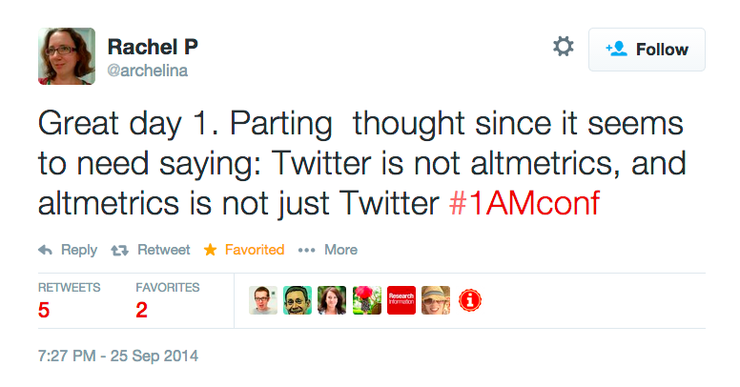
Definitions
Notes:
Julie Bayley

Slide 11

Vanity metrics
#1amconf: 3,585 tweets
#altmetrics14: 1,758 tweets

Slide 12
A prescription for data:
Consistent
Transparent
Available

Slide 13
Infrastructure
Do we want to look back in ten years and say “oh, I wish we’d all stepped in and not left everything to industry”?

Slide 14
Incentives
May need to change the environment – your reputation, career shouldn’t suffer if you engage with research stakeholders (public, policy makers…). Training? Case studies? Prizes?

Slide 15
Research outputs
Article level metrics != altmetrics
Research data
Software
Chapters
People
… different things are important to each

Slide 16
Don’t forget the humanities! Books Not all about biomedical research

Slide 17
Still lots of room to work with the data Contextualize it More demographics! Visualize it

Slide 18
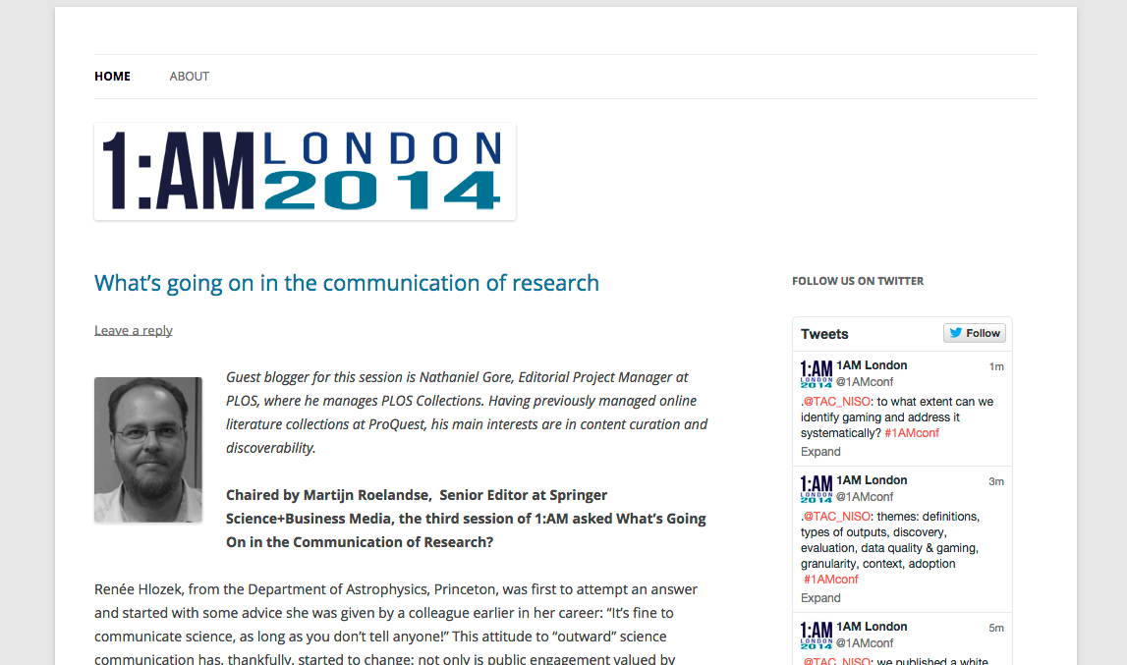

Slide 19
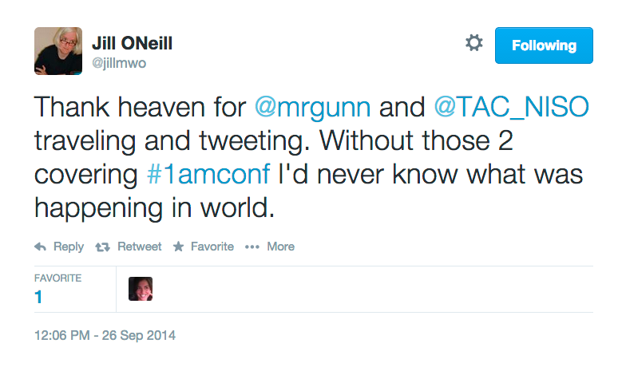
Thanks!
also Andy Tattersall, Simon Kerridge, Yvonne Nobis, Brian Kelly, Mary Ann Zimmerman, Jo Young, Julie Bayley. Kaveh Bazargan, many others…

Slide 20
Thanks!
Cat, Laura, Fran, George
All the organizing committee –
Martijn Roelandse
Mike Taylor
Ian Mulvaney
Jennifer Lin
Martin Fenner
Cat Chimes
Adam Dinsmore
Kevin Dolby

Slide 21
See you at 2AM

Slide 22
See you at 2AM The Betjeman Arms (in St Pancras – 3 mins walk down Euston road)

