Slide 1

Andrea Michalek
President and Co-founder, Plum Analytics
September 24, 2014
@amichalek | @PlumAnalytics

Slide 2
The Plum Story
2012
Founded Plum Analytics
University of Pittsburgh – first customer
2013
Launched PlumX product
Customers include universities, corporations, publishers
2014
EBSCO acquired Plum in January
Customers now include funders
Poised for growth as altmetrics come of age

Slide 3

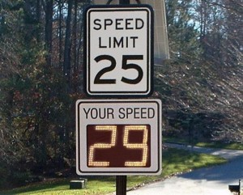
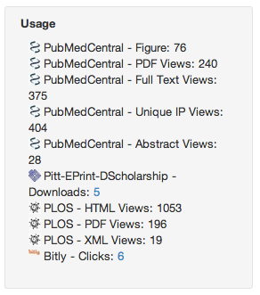
Metrics provide a Feedback Loop
What impact has our research had in the past 18 months?

Slide 4






Metrics
Categories
USAGE
(clicks, downloads, views, library holdings, video plays)
CAPTURES
(bookmarks, code forks, favorites, readers, watchers)
MENTIONS
(blog posts, comments, reviews, Wikipedia links)
SOCIAL MEDIA
(+1s, likes, shares, tweets)
CITATIONS
(PubMed Central, Scopus, patents)

Slide 5
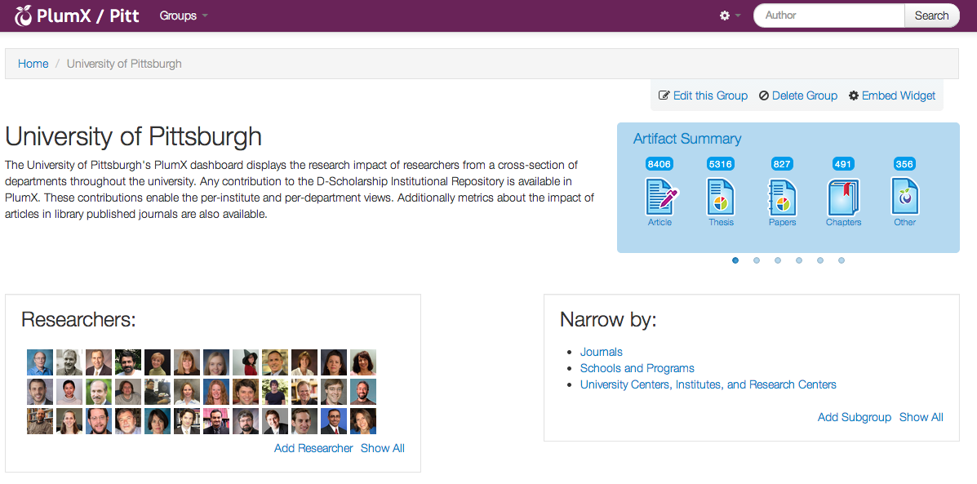
Metrics Dashboards

Slide 6
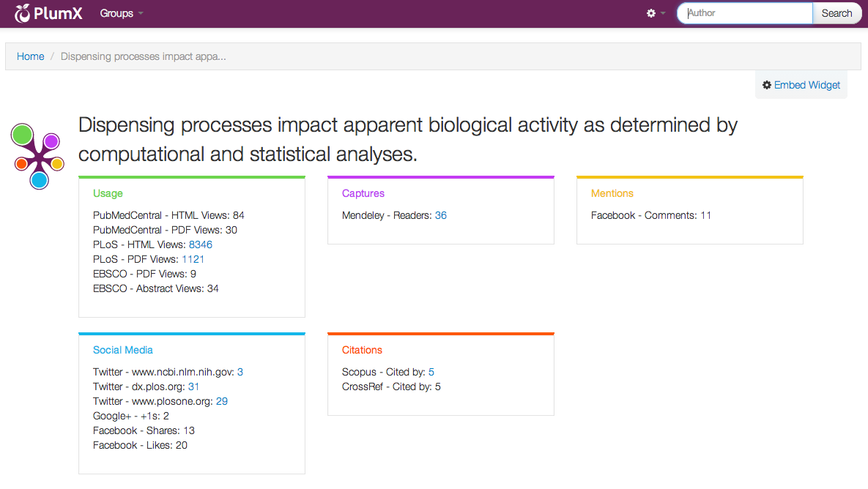
Artifact / Article Level Metrics

Slide 7
Institutional Features
Shibboleth / Single Sign-On
IP Authentication
Administrative users
New User / User Login Reports
UI Customization

Slide 8



Sources of Data Exhaust
Amazon
Bit.ly
CrossRef
Delicious
Dryad
dSpace
EBSCO
ePrints
Facebook
figshare
Github
Goodreads
Google+
Medwave
Mendeley
PLOS
PubMed Central
Reddit
Research Blogging
Scopus
SlideShare
SourceForge
Stack Overflow
Twitter
USPTO
Vimeo
Wikipedia
Worldcat
YouTube

Slide 9



EBSCO + Plum Analytics
Abstract Views
Clicks
ePub Downloads
HTML Views
PDF Views
Plays
Supporting Data Views

Slide 10
Customer Reaction…
"Wow, bringing in EBSCO usage stats is an impressive development. The benefits of being able to see EBSCO “hits” by author is really going to bring tremendous amounts of relevant scholarly data to Plum. That is a big, and I mean, big, development. I don’t think anyone has ever done that before, to be honest."
Alain Dussert, MLIS
Director of Library Services
Pacifica Graduate Institute

Slide 11
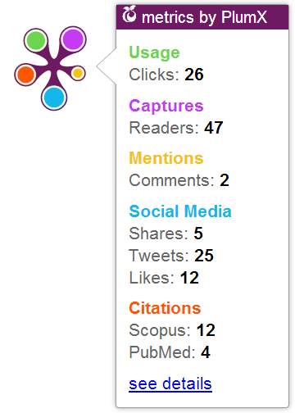
Visualizing Impact: Plum Print

Slide 12
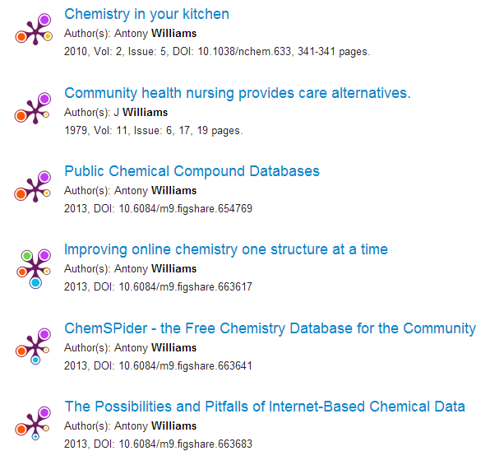

Slide 13
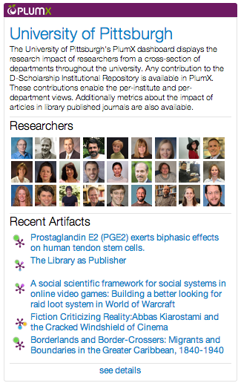
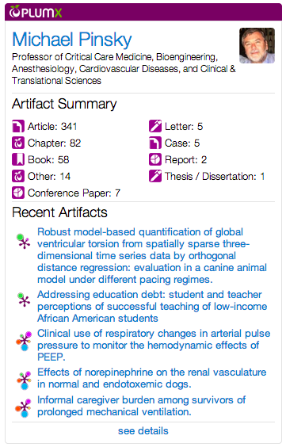
Group and Researcher Widgets

Slide 14
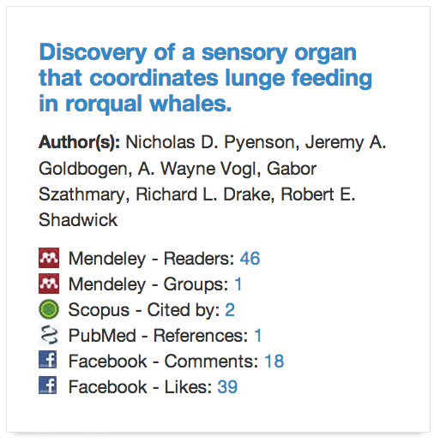

Citations are lagging indicators
Scopus = 2
Web of Science = 0
Google Scholar = 8
PubMed = 1
Research output is
more than articles…
Measure all of it
Photo credit: A. Wayne Vogl and Nicholas D. Pyenson / Smithsonian Institution.

Slide 15










Beyond the Journal Article
Articles
Blog posts
Book chapters
Books
Cases
Clinical Trials
Conference Papers
Data Sets
Figures
Grants
Interviews
Letters
Media
Patents
Posters
Presentations
Reports
Source Code
Theses / Dissertations
Videos
Web Pages
Notes:
These are the types of research output we are already tracking in PlumX.
We want to be able to measure whatever researchers consider using to communicate their scholarship.
They shouldn’t be trapped anymore by having to publish an article and nothing else matters.

Slide 16







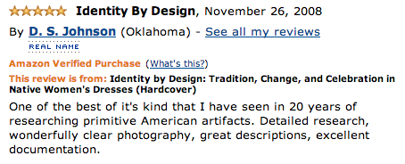
Books count!

Slide 17
How does this help me?
Performing Research
Publishing Research
Funding Research

Slide 18
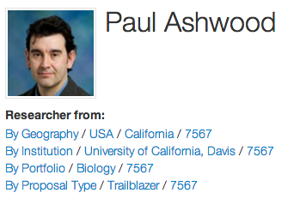

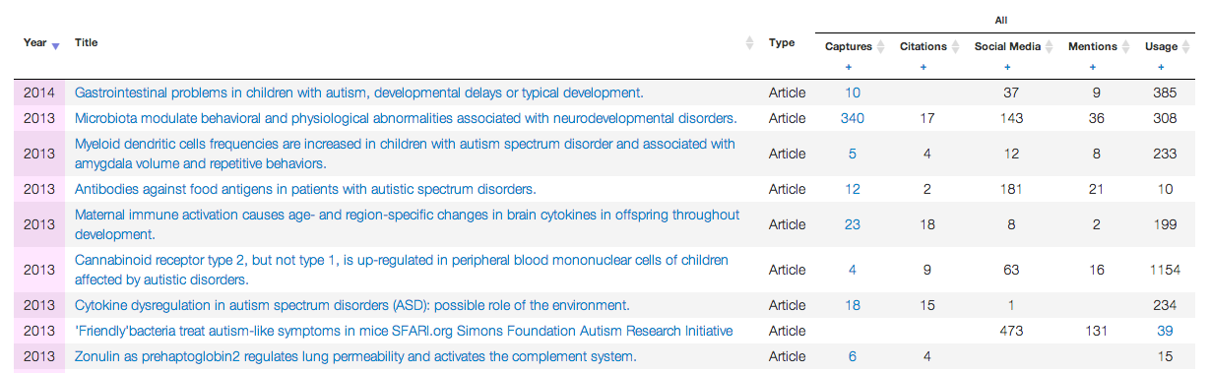
Funders are using PlumX

Slide 19
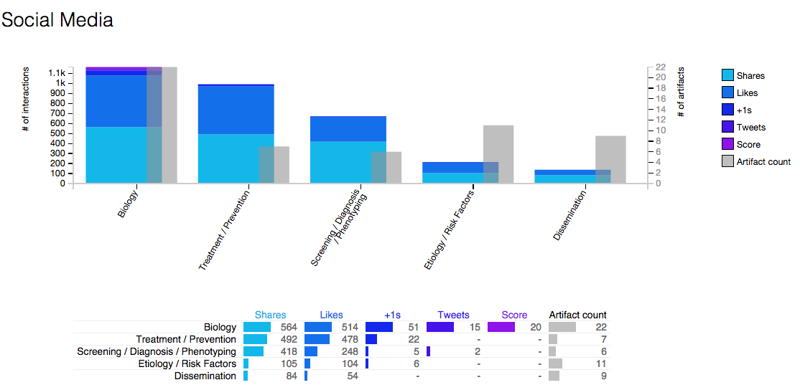
PlumX Reports

Slide 20
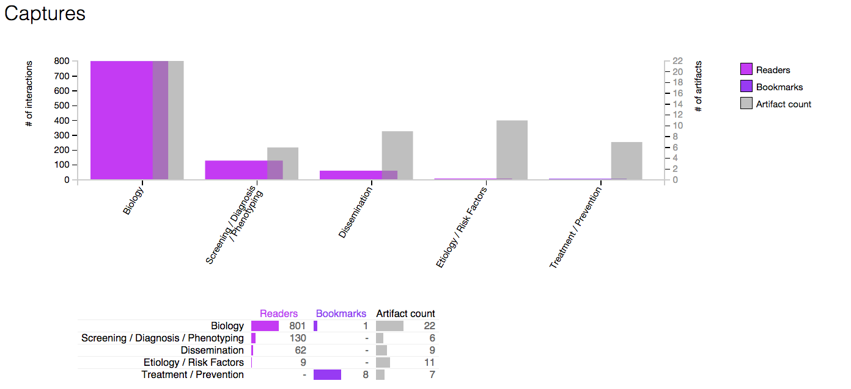
PlumX

Slide 21
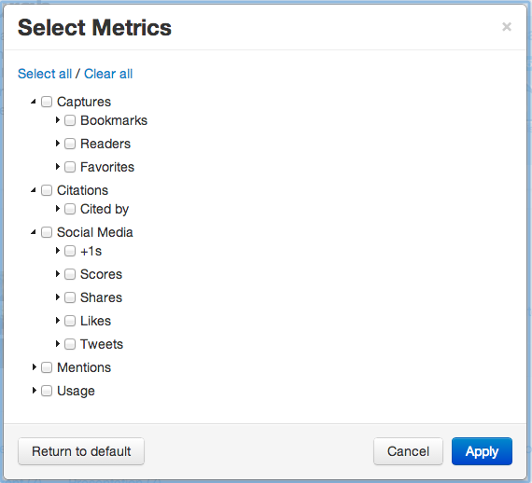
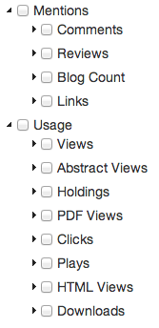

Allow data to be compared in many ways

Slide 22
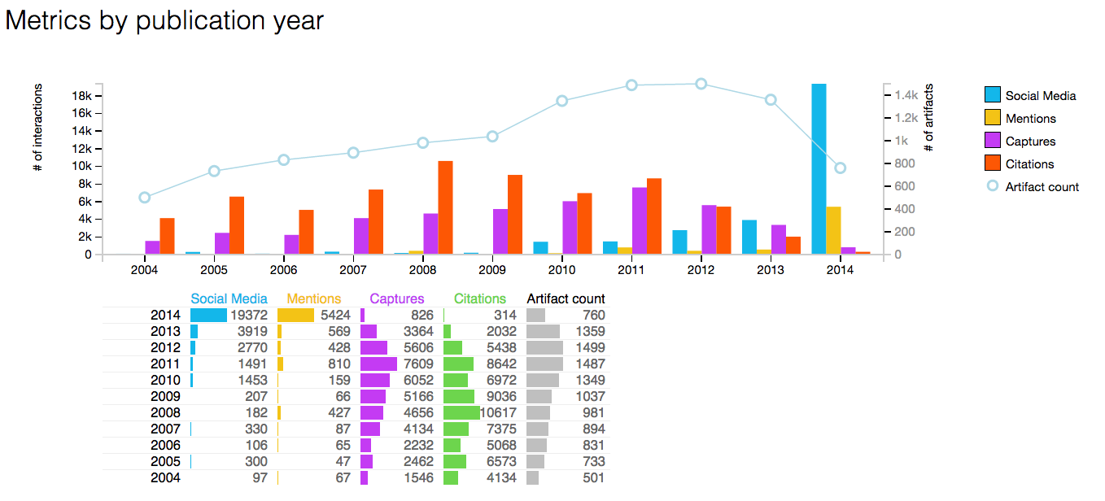
Real Data – Citations Lag

Slide 23

in Action
Information: http://www.plumanalytics.com
Demo: http://plu.mx
Free trials with your data: plumx@ebsco.com

Slide 24
Citations are lagging indicators
Scopus = 2
Web of Science = 0
Google Scholar = 8
PubMed = 1
Thank You!
Photo credit: A. Wayne Vogl and Nicholas D. Pyenson / Smithsonian Institution.

