Slide 1
Introducing DET
1am: ALM workshop
Mark Patterson, eLife/OASPA

Slide 2
The case for new indicators and approaches for research assessment

Slide 3
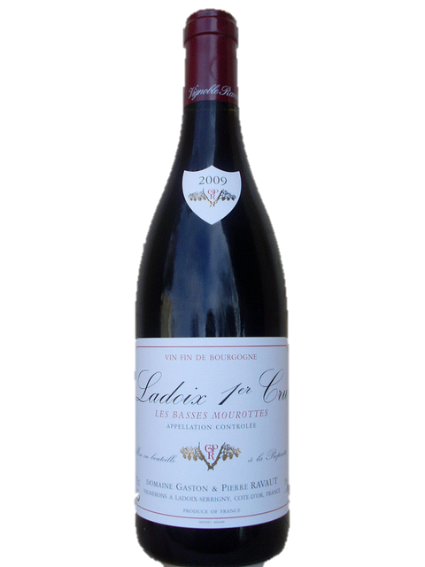

From the container to the work
https://flic.kr/p/aEejyu
https://flic.kr/p/dxgsqB

Slide 4



Exploring collaboration

Slide 5
DET working group
Co-Action, eLife, BMC, Elsevier, OUP, PLOS, Wiley
University of Wolverhampton
Wellcome
Mendeley
CrossRef

Slide 6
A tool for data collection
DOI
Event
Tracker
DET
Open
Data
Institutions
Researchers
Funders
Service providers

Slide 7
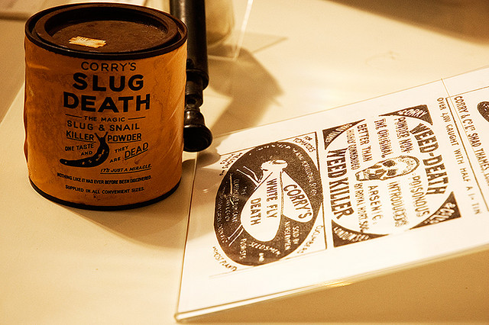
https://flic.kr/p/5mJExt

Slide 8
A tool for data collection
DOI
Event
Tracker
DET
Open
Data
Institutions
Researchers
Funders
Service providers

Slide 9
Questions for the DET Pilot
Can the Lagotto scale to tens of millions of DOIs?
Which data sources will work with this project?
How open will the data be?
How might this service be sustained within CrossRef?

Slide 10
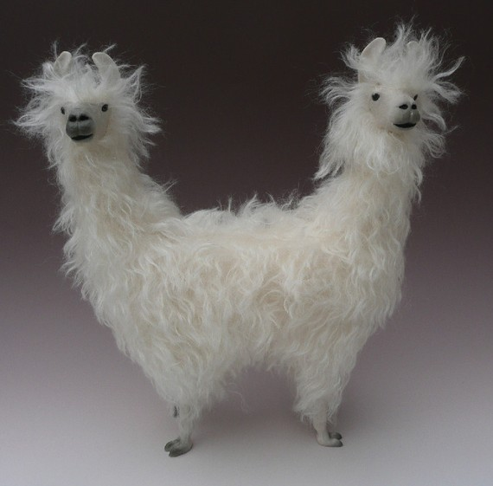
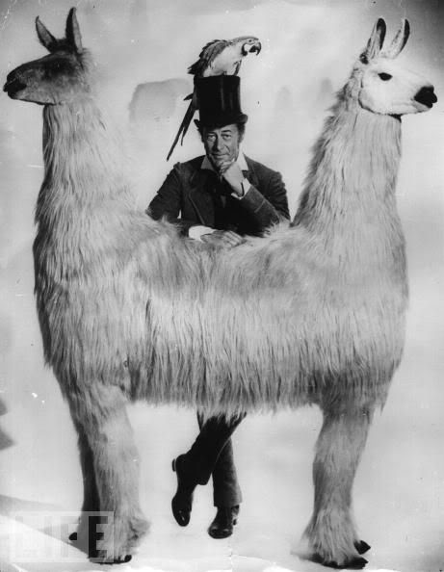
DET can’t rely on pull
mechanisms alone
https://www.etsy.com/listing/66337627/push-me-pull-you-lamas-in-porcelain-and

Slide 11
DET Status
Technical working group
Governance working group
Aiming to seek formal approval within the next 6 months

Slide 12
Thanks, and stay tuned!
Mark Patterson
m.patterson@elifesciences.org

