Slide 1

What’s new with altmetrics at Mendeley?
William Gunn, Ph.D.
Head of Academic Outreach
Mendeley
@mrgunn
https://orcid.org/0000-0002-3555-2054

Slide 2
The API
Scopus integration
Snowball altmetric

Slide 3

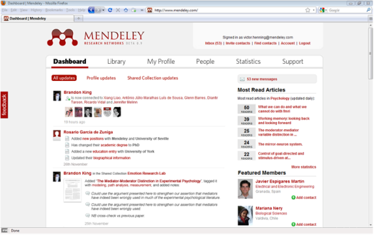



...and aggregates research data in the cloud
Install Mendeley Desktop
Mendeley extracts research data…
Collecting rich signals
from domain experts.

Slide 4
Defining readership
Each document addition is a “read”
stamped with metadata describing the context of the read event
a read is like a citation, but faster and captures more

Slide 5
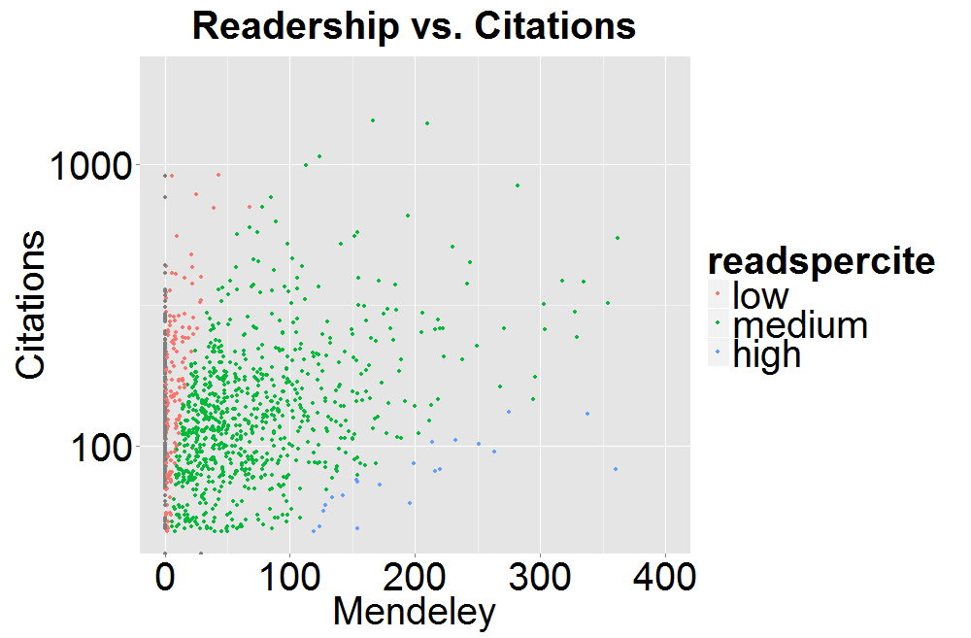

Slide 6
THE API

Slide 7
Totally redesigned API:
New developer site, new docs, interactive examples & code samples
New methods & extended methods
Scalable, rate limits lifted

Slide 8
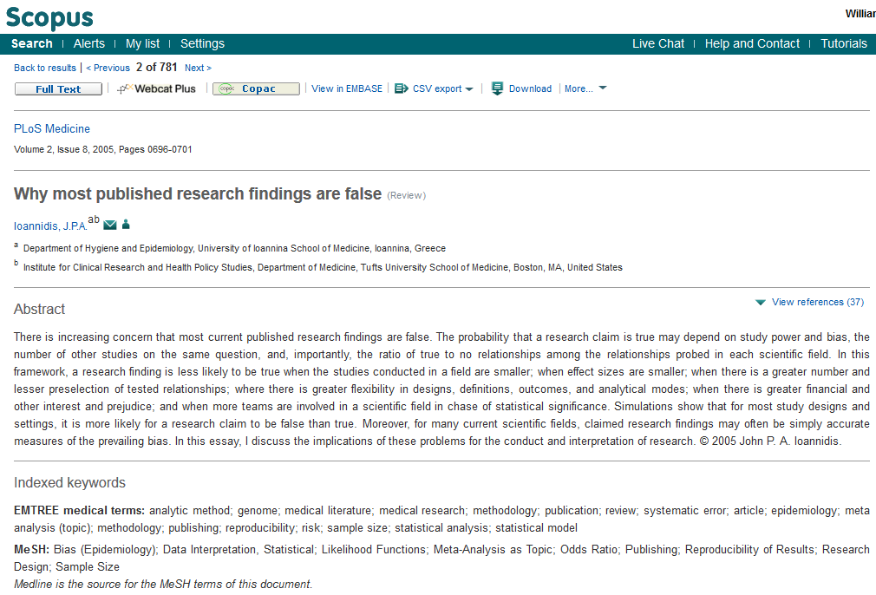
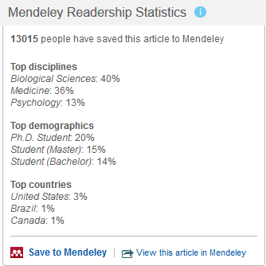
Mendeley in Scopus

Slide 9
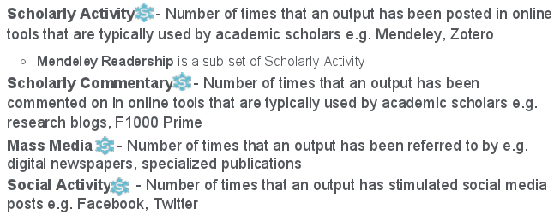
Mendeley in Snowball Metrics
Snowball metrics are designed in collaboration with UK institutions, giving altmetrics and Mendeley Readership solid institutional support

Slide 10
Issues To Be Addressed
Identity
Privacy
Attribution
Gaming
Filtration
standards/
best practice

Slide 11
NISO Altmetrics Standards
Alfred P. Sloan Foundation
American Library Association
California Institute of Technology
Center for Research Libraries
EBSCO
Elsevier
Harvard
Internet Archive
Wiley
Library and Information Technology Association
Library of Congress
Los Alamos National Laboratory
National Institutes of Health
National Library of Medicine
OCLC
Princeton
Columbia
Smithsonian
Stanford
…

Slide 12
There is no gold standard
Amgen: 47 of 53 “landmark” oncology publications could not be reproduced
Bayer: 43 of 67 oncology & cardiovascular projects were based on contradictory results
Dr. John Ioannidis: 432 publications purporting sex differences in hypertension, multiple sclerosis, or lung cancer. Only one data set was reproducible
http://reproducibilityinitiative.org

Slide 13

www.mendeley.com
william.gunn@mendeley.com
@mrgunn
https://orcid.org/0000-0002-3555-2054

Slide 14

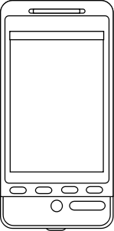
Cloud Library
Home
Work
Mobile

Slide 15


Shared Folder

Slide 16
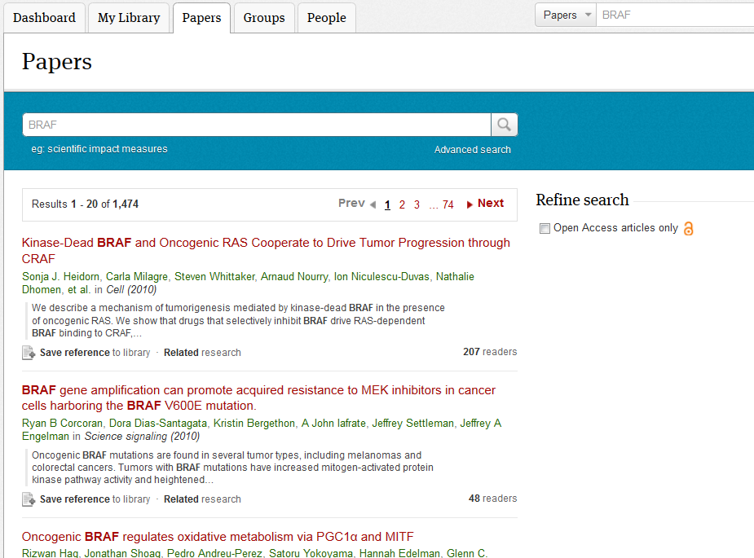
Mendeley Research Catalog

Slide 17
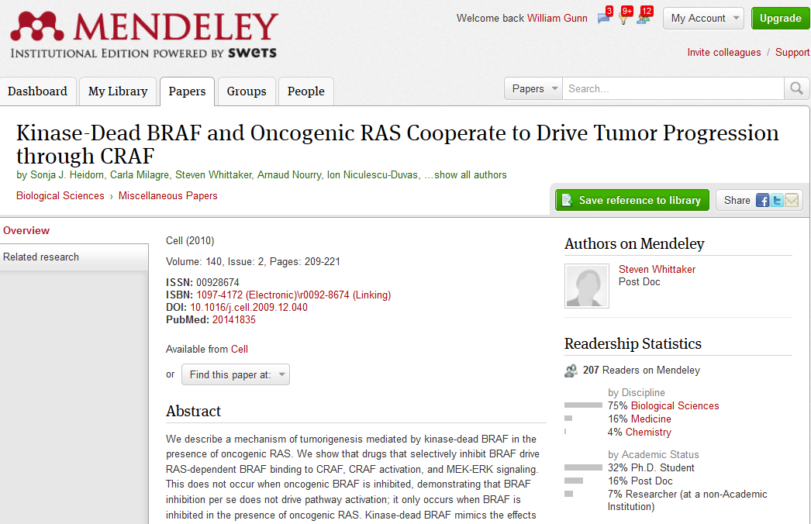
Mendeley Research Catalog

Slide 18
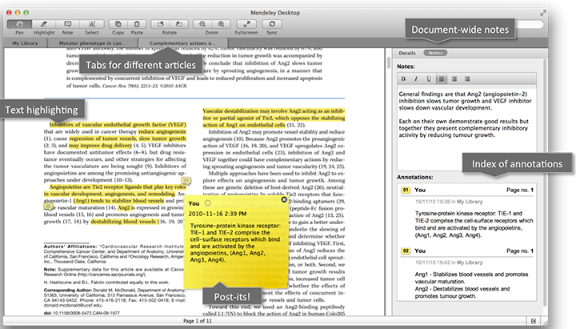
Read papers + keep track of notes
470M documents

Slide 19
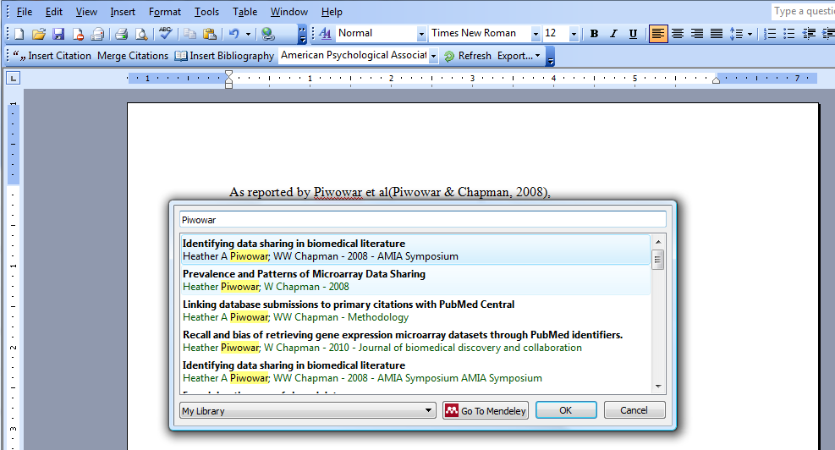
Taking some misery out of writing

Slide 20
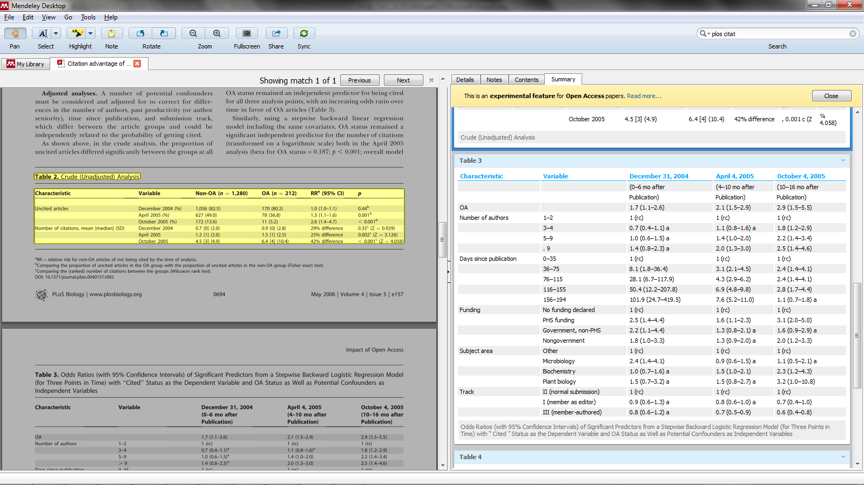
Information Extraction

Slide 21
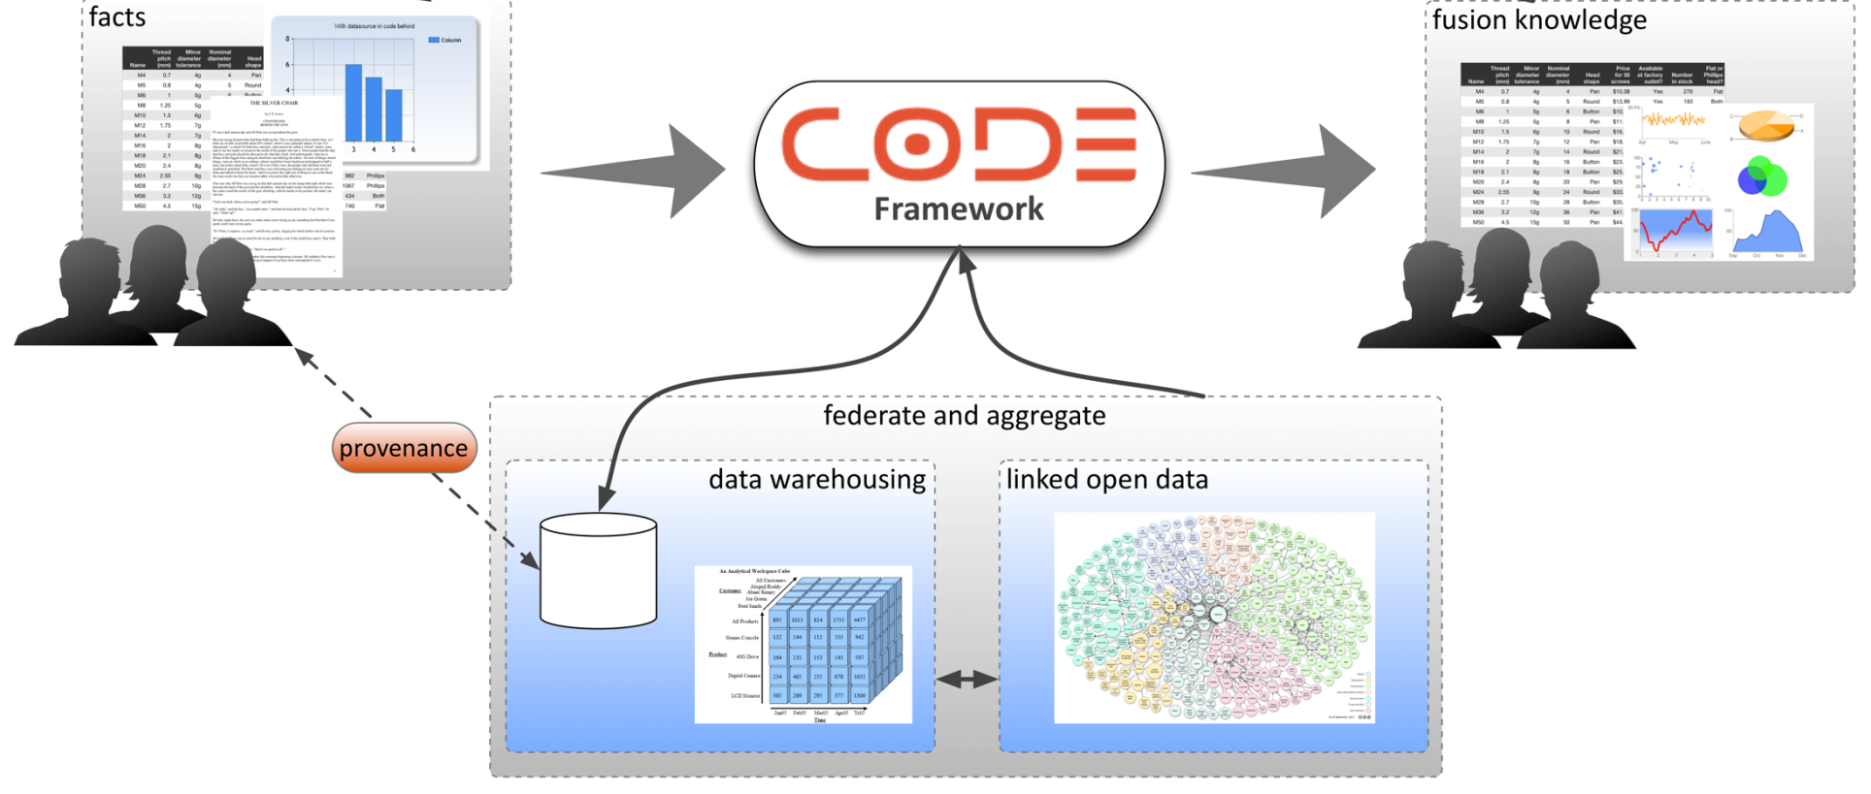

We are publishing this data to the LOD cloud
http://code-research.eu/

