Slide 1

Making Sense of Altmetrics @ NTU
1AM: Altmetrics Conference @ London by Joan WEE
Who am I
Altmetrics to us
What did we do
Next Steps

Slide 2



Altmetrics is an indication of quality research or just HOT topics
IATUL Conference

Slide 3
Altmetrics to us
Altmetrics measures impact (Priem, 2012)
 | Scholarly | Public
Recommended | Faculty of 1000 | Popular press
Cited | Traditional citation | Wikipedia
Discussed | Scholarly blogs | Blogs, twitter
Saved | Mendeley, citeulike | Delicious
Viewed | Pdf views | Html views

Slide 4




Altmetrics to us
Tools
altmetric.com
impactstory.org
plumanalytics.com
PLoS metrics

Slide 5
Altmetrics to us
We like to find out if…..
Is altmetrics applicable to our community?
What is the impact of altmetrics?
What is the relationship of altmetrics with tradition citation?

Slide 6
What did we do….
Top 20 most cited articles in WOS across 18 broad subject categories have an altmetric score;
Top 20 articles with highest altmetric score have WOS citation for the same 18 broad subject categories
altmetrics only measure popular research topics that is more “newsy” in nature

Slide 7
Data & Methodology
Top 20 most cited articles published between 2011 to 2013 in Web of Science (WOS) for 18 subject categories
Top 20 articles from altmetric.com with high altmetric score for 18 subject categories
Subject categories –
(1) economics; (10) biology;
(2) medicine, general & internal; (11) business;
(3) mathematics; (12) literature;
(4) sociology; (13) language and linguistics;
(5) psychology; (14) law;
(6) computer science, information systems; (15) history;
(7) engineering, multidisciplinary; (16) art;
(8) physics, applied; (17) music
(9) chemistry, applied; (18) communication.

Slide 8
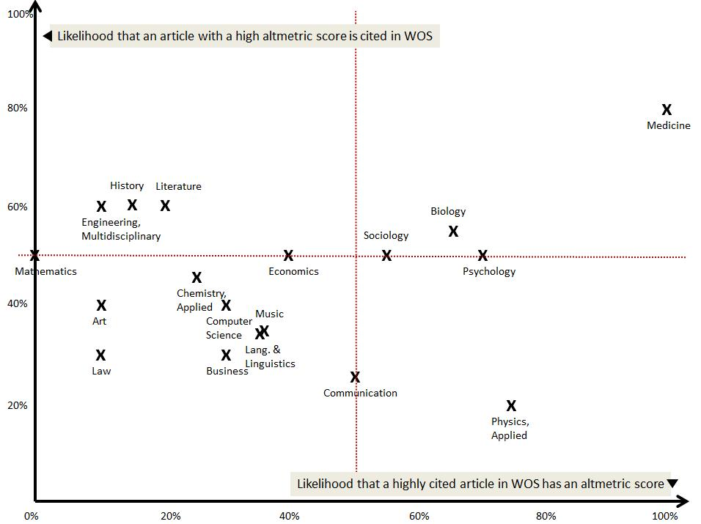

Is there a relationship between altmetrics scores and citation counts for these 18 subject categories?
Top articles in medicine are likely to be both highly cited and have high social impact (altmetric score)
What is the correlation?

Slide 9
Table 1 :
Pearson Correlation between most cited articles in WOS and their altmetrics scorie and vice versa
 | Subject | Most cited in WOS | High Altmetric score
 |  | Pearson Correlation ¹ | Pearson Correlation
1 | Economics | (0.1408) | 0.1681
2 | Medicine, General & Internal | 0.3637 | 0.0126
3 | Mathematics | NA | 0.2101
4 | Sociology | 0.4935 | 0.2546
5 | Psychology | 0.2521 | 0.1371
6 | Computer Science, Info. Systems | 0.0405 | 0.0546
7 | Engineering, Multidisciplinary | (0.0205) | 0.3474
8 | Physics, Applied | 0.3946 | 0.1234
9 | Chemistry, Applied | (0.0424) | 0.2540
10 | Biology | (0.1209) | 0.2429
11 | Business | (0.1967) | 0.0869
12 | Literature | 0.6155 | (0.0597)
13 | Language and Linguistics | 0.2423 | 0.2685
14 | Law | 0.1590 | (0.0355)
15 | History | 0.3112 | (0.0929)
16 | Art | 0.4117 | 0.2312
17 | Music | 0.6711 | 0.0168
18 | Communication | 0.0890 | 0.3078
 | Average | 0.19572 | 0.14044

Slide 10
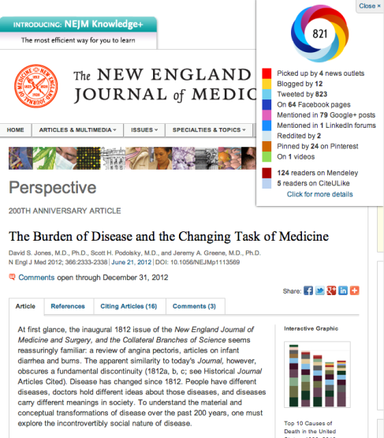
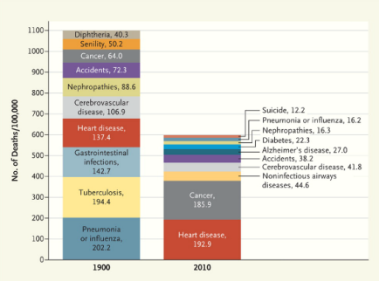
An example - High altmetric score but low citation count
What is the correlation?

Slide 11
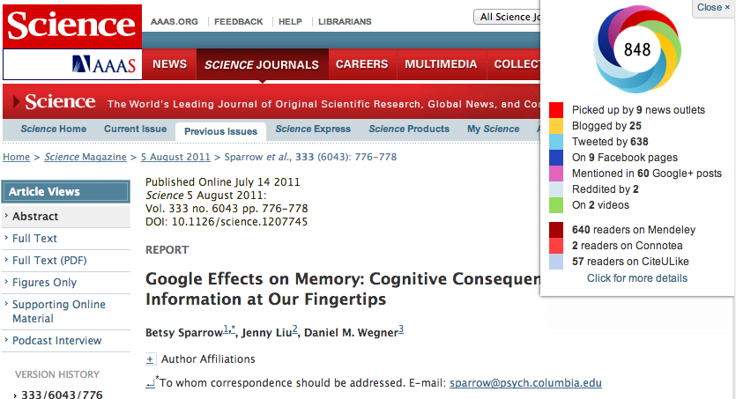

Another example

Slide 12
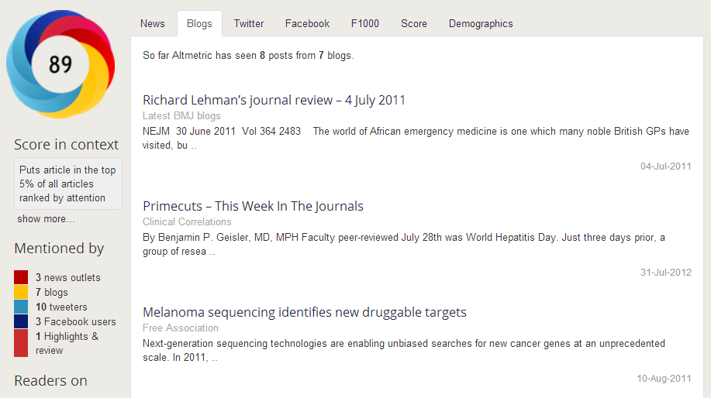
Low altmetric score but high citation count

Slide 13
Making sense of altmetrics
(Costas, Zahedi, & Wouters, 2014; Thelwall, Haustein, Larivière & Sugimoto, 2013; Esyenbach, 2011)
Positive Correlation exists between altmetrics and citation (particularly Twitter, Mendeley).
  Study by Esyenback, 2011, states that highly tweeted articles are 11 times more likely to end up highly cited.
  Study by Costas, et al., 2014, there is a positive but weak correlation between altmetrics and citations.
Altmetrics for more recent articles may be higher because of the increasing uptake of the social web and because articles may be mentioned mainly when they are published. Frequency of tweets per article tend to be very high in the first 5 days and tapered off as days progress. (Receny biases)
Capture a broader (even different) aspect of research visibility compared to traditional citation counts (read but may not cite)

Slide 14
What to do with Altmetrics?
Do we still use altmetrics? Is altmetrics important?
Is altmetrics just measuring hot topics?
How accurate or comprehensive is the altmetrics data?

Slide 15
Our Answers
Yes! It is important.
Tweeting your article might help to increase your WOS citation for some subjects
Offers a more holistic approach eg. capture usage by non-researchers
Changes in searching behaviours and the sharing of research
Altmetrics is gaining acceptance. More funding agencies (e.g. NSF) and academic institutions accept altmetrics as a measure of one’s research impact

Slide 16
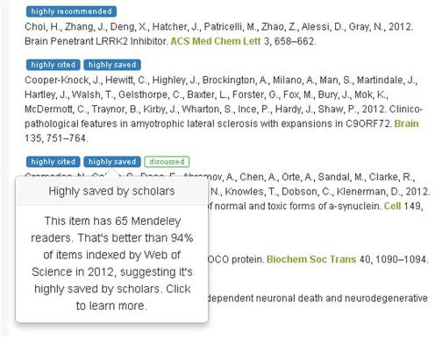
Research Funders looking at altmetrics
UK Parkinson’s Disease Consortium at UCL integrated ImpactStory into their publications page

Slide 17
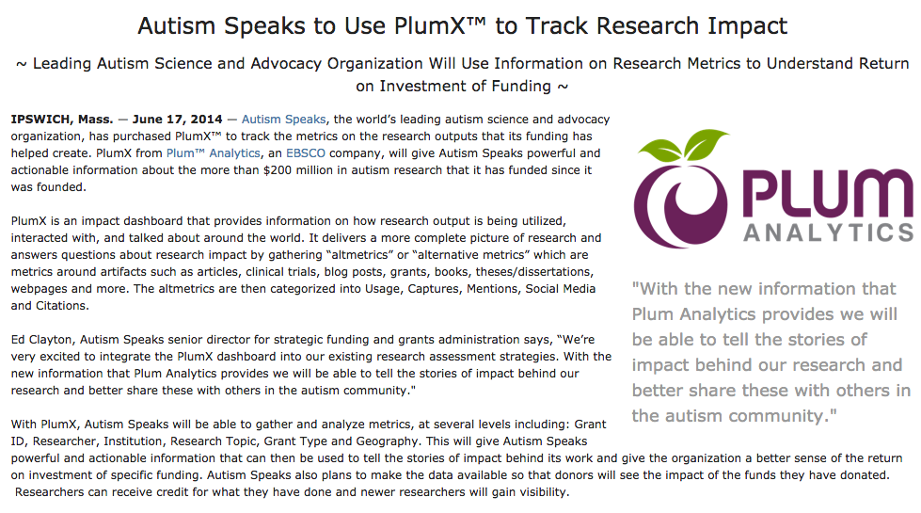
Research Funders looking at altmetrics
Austism Speaks purchased PlumX to make better sense of ROI of specific funding

Slide 18
Table 2 : Percentage of social consumption for articles with high altmetric scoring
 | Subject (High altmetric scoring) | Social Consumption
 |  | Twitter | Facebook | News | blogs
1 | Economics | 89% | 3% | 1% | 6%
2 | Medicine, General & Internal | 82% | 7% | 7% | 2%
3 | Mathematics | 73% | 3% | 14% | 6%
4 | Sociology | 89% | 1% | 0% | 8%
5 | Psychology | 79% | 4% | 9% | 6%
6 | Computer Science, Info. Systems | 70% | 7% | 19% | 2%
7 | Engineering, Multidisciplinary | 78% | 11% | 3% | 5%
8 | Physics, Applied | 83% | 8% | 1% | 3%
9 | Chemistry, Applied | 65% | 7% | 11% | 12%
10 | Biology | 82% | 5% | 6% | 3%
11 | Business | 80% | 4% | 7% | 7%
12 | Literature | 79% | 5% | 3% | 11%
13 | Language and Linguistics | 79% | 7% | 8% | 2%
14 | Law | 83% | 7% | 5% | 3%
15 | History | 70% | 9% | 11% | 6%
16 | Art | 67% | 6% | 19% | 6%
17 | Music | 76% | 11% | 6% | 3%
18 | Communication | 73% | 6% | 13% | 5%
 | Average | 78% | 6% | 6% | 6%
Is it all about Tweeting?

Slide 19
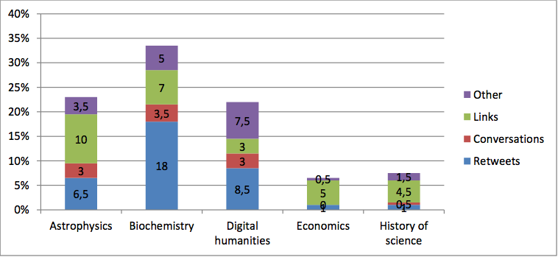
Percentage of scholarly communication tweets by type (Holmberg and Thelwall, 2014)
Figure 3 : Percentage of scholarly communication tweets by type for 5 different disciplines : astrophysics, biochemistry, digital humanities, economics and history of science (Holmberg & Thelwall, 2014)

Slide 20
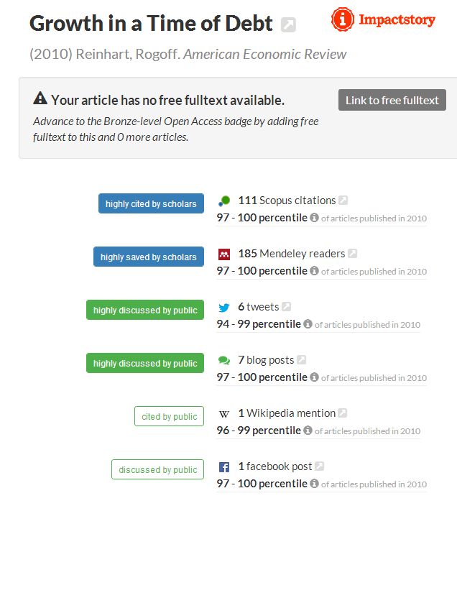
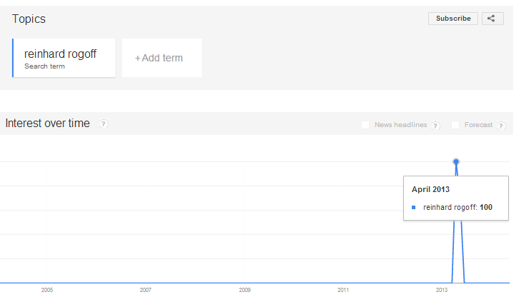
How accurate is the altmetrics data?
The Case of under-reporting Tweets
Figure 2 : Google search trends for ‘Reinhard Rogoff’ (Taylor, 2013)

Slide 21
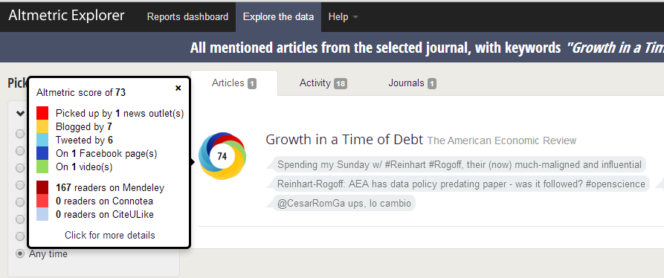

How accurate is the altmetrics data?
The Case of under-reporting Tweets

Slide 22

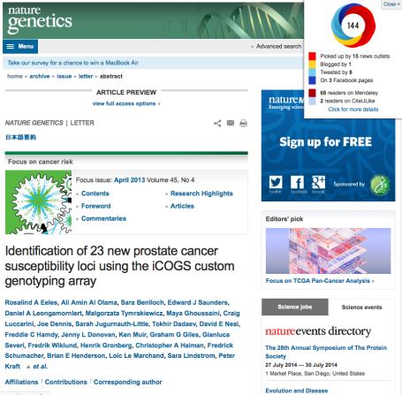
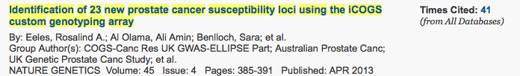
How accurate is the altmetrics data?
The Case of under-reporting Tweets

Slide 23
Assessing our faculty
Year | DOI | Type | WOS | Usages | Altmetrics | Tweets | Mendeley
2008 | 10.1126/science.xxx | Article | 73 | 389 | 68 | 25 | 69
2008 | 10.1002/adfm.xxx | Article | 34 | - | 2 | 2 | 28
2012 | 10.1126/science.xxx | Article | 31 | 1,270 | 183 | 24 | 99
2007 | 10.1016/j.actbio.xxx | Article | 29 | 9 | - | - | 26
2007 | 10.1098/rsif.xxx | Article | 29 | 5 | - | - | 24
2009 | 10.1038/nmatxxx | Article | 27 | 95 | - | - | 30
2004 | 10.1016/j.msea.xxx | Article | 26 | - | - | -- | 12
2004 | 10.1016/j.actamat.xxx | Article | 23 | 5 | - | - | 16
2010 | 10.1016/s1369-xxx | Article | 22 | 74 | 1 | 1 | 24
2009 | 10.1002/adma.xxx | Article | 18 | 6 | 4 | 4 | 27
2004 | 10.1016/j.actamat.xxx | Article | 16 | 5 | - | - | 16
2010 | 10.1074/jbc.m110.xxx | Article | 15 | 80 | - | - | 15
2004 | 10.1016/j.engfracmech.xxx | Article | 15 | 5 | - | - | 10
2007 | 10.1016/j.actamat.xxx | Article | 15 | 3 | - | - | 17
2013 | 10.1179/026708xxx | Article | 15 | - | - | - | 2
2012 | 10.1021/bmxxx | Article | 15 | 15 | - | - | 7
2013 | 10.1021/bmxxx | Article | 13 | 13 | - | - | 4
2010 | 10.1016/s0065-xxx | Book Chapter | 13 | - | - | - | 5
2013 | 10.1039/c2csxxx | Article | 7 | 7 | - | - | 13
2013 | 10.1038/nbt.xxx | Article | 4 | 79 | 68 | 25 | 55

Slide 24
Assessing our faculty
100% of articles cited in WOS got “Mendeley” data
(Pearson Correlation 0.53)
80% of articles cited in WOS got usage data (Pearson Correlation 0.39)
30% of articles cited in WOS got tweets
(Pearson Correlation 0.26)
High usage statistics evolving Mendeley readership and bookmarking
High citation statistics evolving around ebsco and SSRN

Slide 25
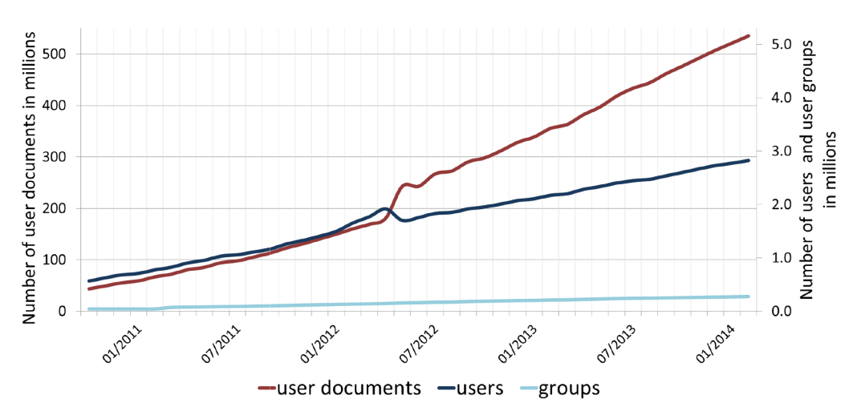

Mendeley readership and altmetrics
Figure 4 : Number of users, user documents and groups related on the Mendeley website per month from October 2010 to February 2014
Mendeley as a Source of Readership by Students and Postdocs? Evaluating Article Usage by Academic Status by Stefanie Haustein, Universite de Montreal

Slide 26
Mendeley readership and altmetrics
 |  |  | Papers with readers |  |  |  | Sector Readership status
Disciplines | Papers PubMeb WOS | Mean Citation Rate | % | Mean reader rate | Mean citation rate | ρ | Scientific | Educational | Professional | missing
All | 1,161,145 | 7.5 | 65.9% | 9.6 | 8.9 | 0.512 | 48.5% | 15.7% | 5.8% | 30.0%
Biomedical Research | 286,398 | 10.3 | 72.4% | 14.3 | 11.8 | 0.575 | 54.9% | 12.0% | 2.6% | 30.5%
Clinical Medicine | 779,707 | 6.8 | 62.8% | 7.6 | 8.2 | 0.492 | 44.2% | 17.6% | 8.7% | 29.5%
Health | 59.073 | 4.4 | 67.0% | 6.5 | 4.3 | 0.434 | 38.1% | 27.3% | 7.4% | 27.2%
Psychology | 35,967 | 6.1 | 81.0% | 14.0 | 6.6 | 0.545 | 46.6% | 19.0% | 1.8% | 32.5%
Table 3 Number of papers, mean citation rate, percentage of papers with at least one reader on Mendeley, mean reader rate and mean citation rate for papers with at least one reader on Mendeley for PubMed papers published between 2010 and 2012 covered by Web of Science.

Slide 27
Next Steps
Get faculty support to study their social impact
Market to Research Office
  Altmetrics does not replace citation or indicate quality research
  Indicates engagement surrounding a particular article, video, presentation, etc.
  Raising recognition by research funders as it provides an indication of ROI of the money they had spend
Awareness to our faculty
  What tools to up their impact
  Understanding the trend through social media

Slide 28
Conclusion
Weak or no direct correlation between altmetrics and citation counts for many subjects
Except for a few subjects, an article with a high altmetric score does not imply it will be highly cited and vice versa
An article with a high altmetric score may be focusing on a hot topic
Altmetric measures a different impact from traditional citation
Mendeley readership seems more relevant to our researchers

Slide 29
Presenter
Joan WEE Jee Foon, Senior Librarian, New Media Group, Library, Nanyang Technological University, Singapore – joanwee@ntu.edu.sg

Slide 30
References
Costas, R., Zahedi, Z., & Wouters, P. (2014). Do altmetrics correlate with citations? Extensive comparison of altmetric indicators with citations from a multidisciplinary perspective. Retrieved from http://arxiv.org/abs/1401.4321
Eysenbach, G. (2011). Can Tweets Predict Citations? Metrics of Social Impact Based on Twitter and Correlation with Traditional Metrics of Scientific Impact. Journal of Medical Internet Research, 13(4:e123). doi: 10.2196/jmir.2012
Holmberg, K., & Thelwall, M. (2014). Disciplinary differences in Twitter scholarly communication - Online First - Springer. Scientometrics. doi: 10.1007/s11192-014-1229-3
Loria P. (2013, Mar 5). The new metrics cannot be ignored – we need to implement centralised impact management systems to understand what these numbers mean. [Web log] Retrieved from http://blogs.lse.ac.uk/impactofsocialsciences/2013/03/05/the-new-metrics-cannot-be-ignored/

Slide 31
References
Piwowar, H. (2013). Altmetrics: Value all research products. Nature, 493, 159-159. doi: doi:10.1038/493159a
Priem, J. (2012, Dec 4). Altmetrics and revolutions. Scholarly impact in the age of web-native scholarships. [Powerpoint]. Retrieved from https://docs.google.com/presentation/d/1Y4JnchsmHHiOQdJsEpQr33qmMWqhZJrPTDAg1cZoCcI/pub?start=false&loop=false&delayms=3000#slide=id.i0
Roemer, R. C. & Borchardt, R. (2012). From biblometrics to altmetrics : a changing scholarly landscape. College & Research Libraries News,70(10). 596-600. Retrieved from http://crln.acrl.org/content/73/10/596.full
Taylor, M. (2013). The Challenges of Measuring Social Impact Using Altmetrics. Value of Bibliometrics, June 2013(33)
Thelwall, M., Haustein, S., Lariviere, V. & Sugimoto, C. (2013). Do altmetrics work? Twitter and ten other social web services. PLoS ONE 8(5):e64841. doi: 10.1371/journal.pone.0064841.

Slide 32

Thank y u =)

