Slide 1
Dr Lisa Colledge Director of Research Metrics, Elsevier and Snowball Metrics Program Manager
How are people using altmetrics now?
The Snowball Metrics perspective

Slide 2




Snowball Metrics in a nutshell
Vision: Snowball Metrics enable benchmarking by driving quality and efficiency across higher education’s research and enterprise activities, regardless of system and supplier
Bottom-up initiative: universities define and endorse metrics to generate a strategic dashboard. The community is their guardian
Draw on all data: university, commercial and public
Ensure that the metrics are system- and tool-agnostic
Build on existing definitions and standards where possible and sensible

Slide 3
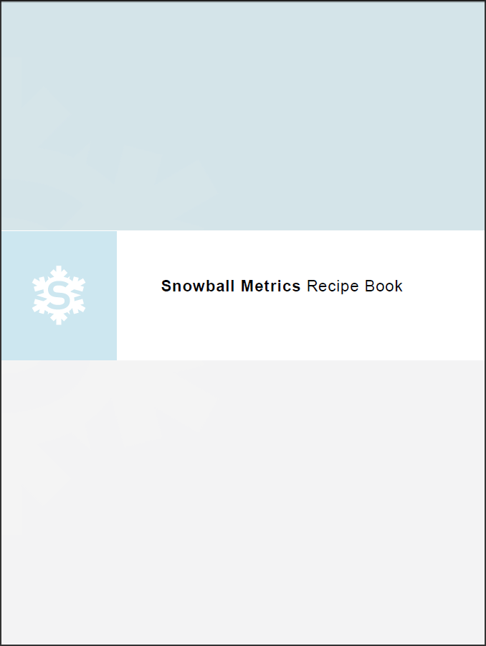
The output of Snowball Metrics
“Recipes” – free, agreed and tested metric methodologies – are the output of Snowball Metrics
From Statement of Intent:
Agreed and tested methodologies… are and will continue to be shared free-of-charge
None of the project partners will at any stage apply any charges for the methodologies
Any organization can use these methodologies for their own purposes, public service or commercial
www.snowballmetrics.com/metrics
Statement of Intent available at http://www.snowballmetrics.com/wp-content/uploads/Snowball-Metrics-Letter-of-Intent.pdf

Slide 4
Main roles and responsibilities
Universities control their own destinies
Agree the metrics to be endorsed as Snowball Metrics
Determine methodologies to generate the metrics in a commonly understood manner to enable benchmarking, regardless of systems
Elsevier supports
Ensures that the methodologies are feasible
Distribute the outputs using global communications networks
Day-to-day project management of the global program
Everyone covers their own costs
Outside the remit of the Snowball Metrics program
Nature and quality of data sources used to generate Snowball Metrics
Provision of tools to enable generation and use Snowball Metrics

Slide 5
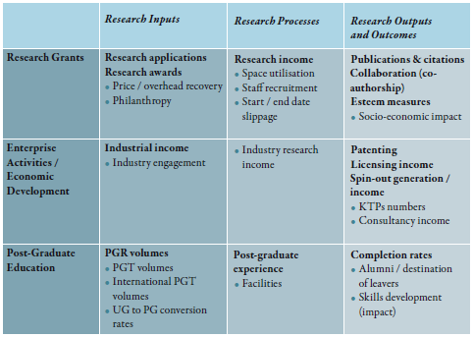
The Snowball Metrics Landscape
Sliced and normalised by a set of denominators

Slide 6
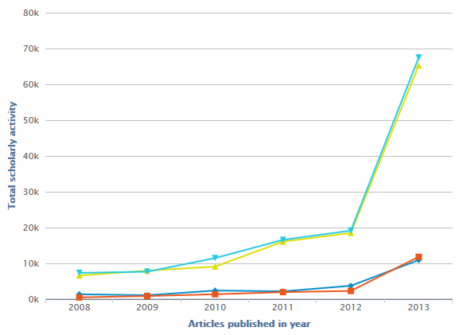
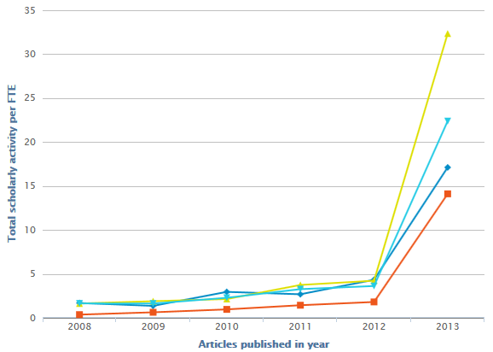
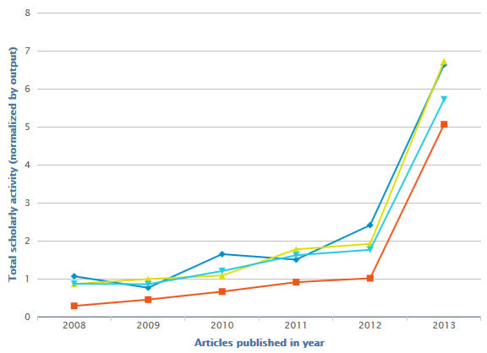
Altmetric: Scholarly Activity flavour
Institution – total counts
Normalised by FTE
Normalised by outputs

Slide 7
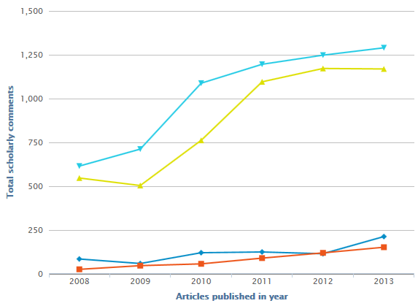
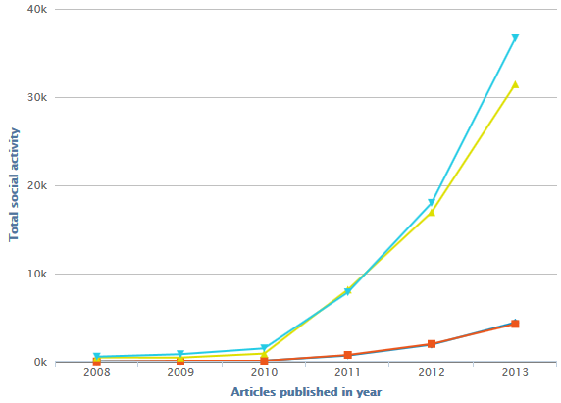
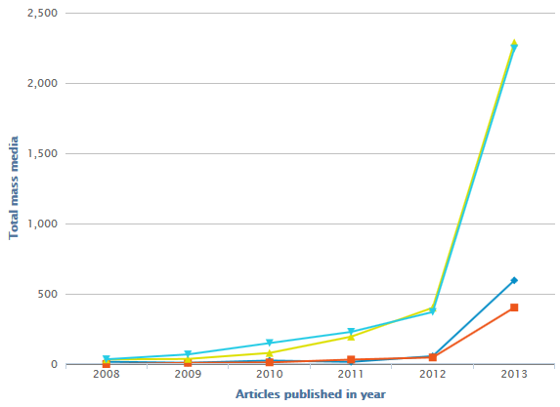
Snowball Altmetrics: 4 flavours
Scholarly Activity: posts in scholarly tools
Scholarly Commentary: comments in scholarly tools
Social Activity: social media posts
Mass Media: references from newspapers etc.

Slide 8
Why the interest in altmetrics?
Measures of engagement with the wider scholarly community
Measures of engagement outside the academic sphere
“I firmly believe that altmetrics offer a unique chance to bring Stem and non-Stem together again. How better to build on the current process of the evaluation of research (and the recent introduction in the UK of impact assessment) than by gathering, publishing and analysing data on scholarly influence among the audience beyond the scholarly sphere?”
Part of the Snowball Metrics landscape that aims to provide the most complete picture of research performance possible
“I would argue that altmetrics alone in their current form cannot be used to judge the quality of research or its output... Nevertheless, pending on improving the underlying data sources, it is likely that altmetrics will play a crucial role in informing the research assessment and impact agenda…”
Quotes from “Expanding altmetrics to include policy documents will boost its reputation”, Juergen Wastl, Head of Research Information, University of Cambridge, available at http://www.theguardian.com/higher-education-network/blog/2014/jul/23/expanding-altmetrics-include-policy-documents-boost-reputation?commentpage=1

Slide 9
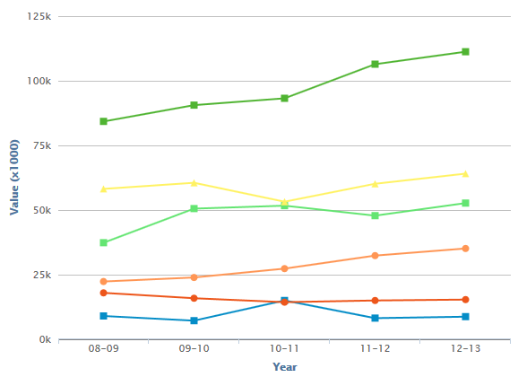
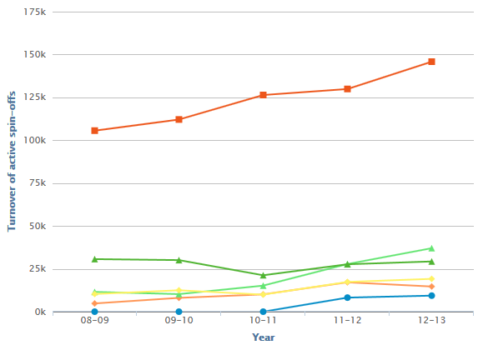
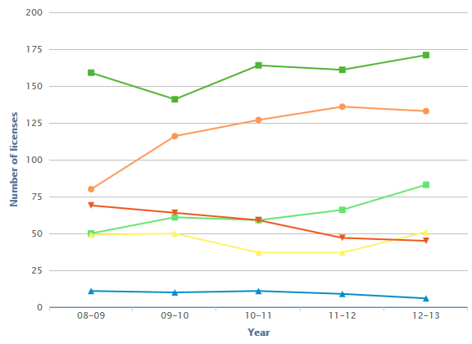
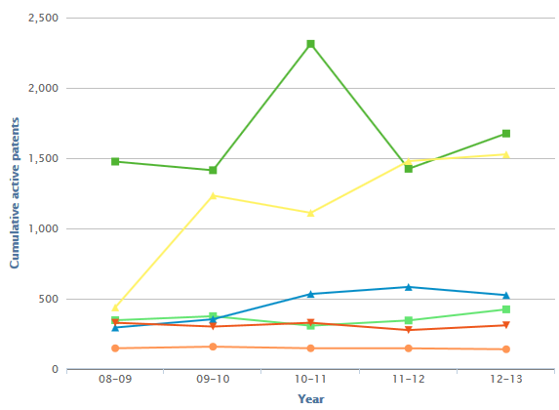
A set of metrics is critical for an accurate picture of performance
Contract Research
Spin-Off-Related Finances
IP Volume / Licenses
Cumulative Active Patents

Slide 10

THANK YOU FOR YOUR TIME AND ATTENTION! l.colledge@elsevier.com snowballmetrics@elsevier.com

