Slide 1


Making scholarly statistics count in UK repositories
Paul Needham, Kings Norton Library, Cranfield University
1:AM Altmetrics Conference, September 2014
Notes:
As part of today’s presentation I’ll be giving an overview of the IRUS-UK service, doing a demo of the reports available, and sharing some user feedback.

Slide 2
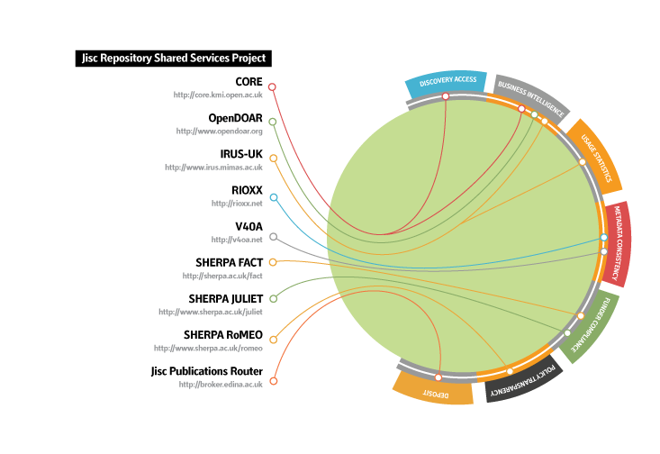
IRUS-UK
IRUS-UK: Institutional Repository Usage Statistics – UK
Project Team Members:
Mimas – Project & Service Management & Host
Cranfield University - Development
Evidence Base, Birmingham City University – User Engagement & Evaluation
Funded by Jisc
Bringing together key repository services to deliver a connected national infrastructure to support OA
Notes:
IRUS-UK – same team who brought you JUSP
PIRUS2 proved technical feasibility, but highlighted some concerns for (some) Publishers.
Easier to start with IR community.

Slide 3
IRUS-UK: background
PIRUS2 (Publisher and Institutional Repository Usage Statistics)
Aimed to develop a global standard to enable the recording, reporting and consolidation of online usage statistics for individual journal articles hosted by IRs, Publishers and others
Proved it was *technically feasible*, but (initially) easier without ‘P’
http://www.cranfieldlibrary.cranfield.ac.uk/pirus2/
Main outcomes:
IRUS-UK
http://www.irus.mimas.ac.uk/
Release 1 of the COUNTER Code of Practice for Articles
http://www.projectcounter.org/counterarticles.html
Notes:
IRUS-UK – same team who brought you JUSP
PIRUS2 proved technical feasibility, but highlighted some concerns for (some) Publishers.
Easier to start with IR community.

Slide 4
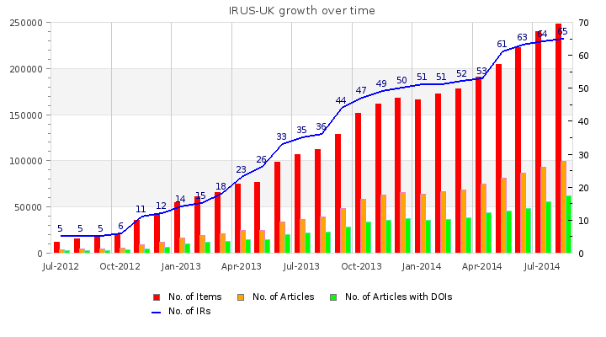
IRUS-UK: aims and objectives
Provide a national aggregation service, enabling (a growing number of) UK Institutional Repositories to share/expose usage statistics at the individual item level, based on a global standard – COUNTER
Collect raw download data from UK IRs for *all item types* within repositories
Process those raw data into COUNTER-compliant statistics
Facilitate comparable, standards-based measurements
Provide an evidence base for repositories to develop policies and initiatives to help support their objectives
Provide consistent and comprehensive statistics, presenting opportunities for benchmarking at a national level
Notes:
IRUS-UK – same team who brought you JUSP
PIRUS2 proved technical feasibility, but highlighted some concerns for (some) Publishers.
Easier to start with IR community.

Slide 5
IRUS-UK: gathering data
The method we use to gather raw download data is simple:
Whenever a file is downloaded from a participating repository, it sends a message to the IRUS-UK server with some details about the download
Accomplished by adding a small piece of code to repository software, which employs the ‘Tracker Protocol’
http://www.irus.mimas.ac.uk/help/toolbox/TrackerProtocol-V3-2014-04-22.pdf
Pushes minimal raw download metadata to a third-party server as OpenURL (like) Key/Value strings
Patches for DSpace (1.8.x, 3.x, 4.1) and Plug-in for Eprints (3.2-3.3.x)
Implementation guidelines for Fedora
Not in IRUS-UK scope, but also successfully deployed by:
OAPEN Library - freely accessible academic books, ARNO software
CORE - millions of scholarly articles aggregated from many Open Access repositories
Notes:
IRUS-UK – same team who brought you JUSP
PIRUS2 proved technical feasibility, but highlighted some concerns for (some) Publishers.
Easier to start with IR community.

Slide 6
IRUS-UK: processing data
The ingest process has been described in detail previously, see earlier presentations and webinars, available from the IRUS-UK News page: http://www.irus.mimas.ac.uk/news/
The key point is that we adhere to the processing rules specified in:
Release 4 of the COUNTER Code of Practice for e-Resources
Release 1 of the COUNTER Code of Practice for Articles
i.e. we filter out robot accesses and double clicks on the same basis as scholarly publishers
The COUNTER Robot Exclusion list is specified only as a *minimum requirement*
So we’ve supplemented the COUNTER CoPs by adding additional filters to
Remove more user agents
Apply a simple threshold for ‘overactive’ IP addresses
However, there’s still more can be done!
Notes:
IRUS-UK – same team who brought you JUSP
PIRUS2 proved technical feasibility, but highlighted some concerns for (some) Publishers.
Easier to start with IR community.

Slide 7
IRUS-UK: robots and unusual usage
We commissioned Information Power to:
Analyse raw data we’ve collected since July 2012
Test the feasibility of devising a set of algorithms that would ‘dynamically’ identify and filter out unusual usage/robot activity
A report on that work is available from http://www.irus.mimas.ac.uk/news/
Key findings from the work are
Suspicious behaviour can’t necessarily be judged on the basis of one day’s usage records or a month’s.
At certain levels of activity machine/non-genuine usage is practically indistinguishable from genuine human activity.
Taking this forward
We’re involved in the recently formed COUNTER Working Group on Robots
Devising more sophisticated - but practical - algorithms to filter out 'rogue' usage
Outcomes will eventually become incorporated into the COUNTER standard
And, of course, adopted by IRUS-UK!
Notes:
IRUS-UK – same team who brought you JUSP
PIRUS2 proved technical feasibility, but highlighted some concerns for (some) Publishers.
Easier to start with IR community.

Slide 8
IRUS-UK: Exposing statistics
Web User Interface - The IRUS-UK Portal
Access currently behind Shibboleth authentication/authorisation, though with community agreement we hope to make it openly accessible:
Open Access, Open Data, Open Metrics!
The portal offers:
a wide range of views – slicing and dicing stats from the IRUS-UK database
Reports available for download as CSV/Excel spreadsheet files
Altmetric donuts for individual items ☺
SUSHI service
standard client/server web service utilizing a SOAP request/response to retrieve the XML version of COUNTER or COUNTER-like reports
SUSHI Lite API
A new, simpler ‘21st century’ approach, under development by the NISO SUSHI Lite Technical Report Working Group (http://www.niso.org/workrooms/sushi/sushi_lite/)
RESTful: uses standard HTTP GET returning JSON
Allows retrieval of stats snippets to be embedded into Repository (and other) web pages
Notes:
IRUS-UK – same team who brought you JUSP
PIRUS2 proved technical feasibility, but highlighted some concerns for (some) Publishers.
Easier to start with IR community.

Slide 9
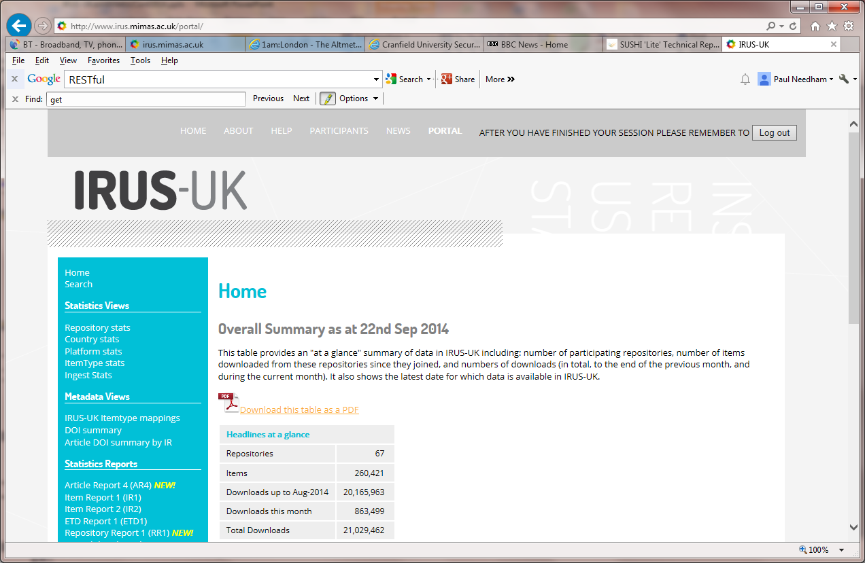
IRUS-UK: Overall Summary
Notes:
IRUS-UK – same team who brought you JUSP
PIRUS2 proved technical feasibility, but highlighted some concerns for (some) Publishers.
Easier to start with IR community.

Slide 10
IRUS-UK: Best features (our survey said)
Reliable, authoritative statistics
COUNTER compliant statistics
Filtering of robots
IR1 used for reporting to SCONUL
Can repurpose for other reporting mechanisms and different audiences
Ability to benchmark against others
Comparison of download statistics across participating IRs
Number (and range across the sector) of participating institutions
Easy to use
Easy to setup and use
User friendly way to get stats
96% find the current user interface clear
96% find the current functionality clear to understand
Notes:
IRUS-UK – same team who brought you JUSP
PIRUS2 proved technical feasibility, but highlighted some concerns for (some) Publishers.
Easier to start with IR community.

Slide 11
IRUS-UK: Value
An altmetric that no-one else is providing - yet!
Demonstrates the importance of repositories in disseminating scholarly outputs
Uniquely positioned to act as an intermediary between UK repositories and other actors:
Funders
Publishers
National shared services
Etc.
2014 IRUS-UK user survey:
68% reported that IRUS-UK has improved statistical reporting
66% reported that IRUS-UK saves time collecting statistics
66% reported that IRUS-UK enables reporting previously unable to do
83% hope to use IRUS-UK for benchmarking
Notes:
IRUS-UK – same team who brought you JUSP
PIRUS2 proved technical feasibility, but highlighted some concerns for (some) Publishers.
Easier to start with IR community.

Slide 12
Contacts & Information
If you wish to contact IRUS-UK:
irus@mimas.ac.uk
@IRUSNEWS
Project web site:
http://irus.mimas.ac.uk/
“The set up was quick and painless, which is always a delight!”
“Consistent collection of statistics without me having to do it!”

