Slide 1
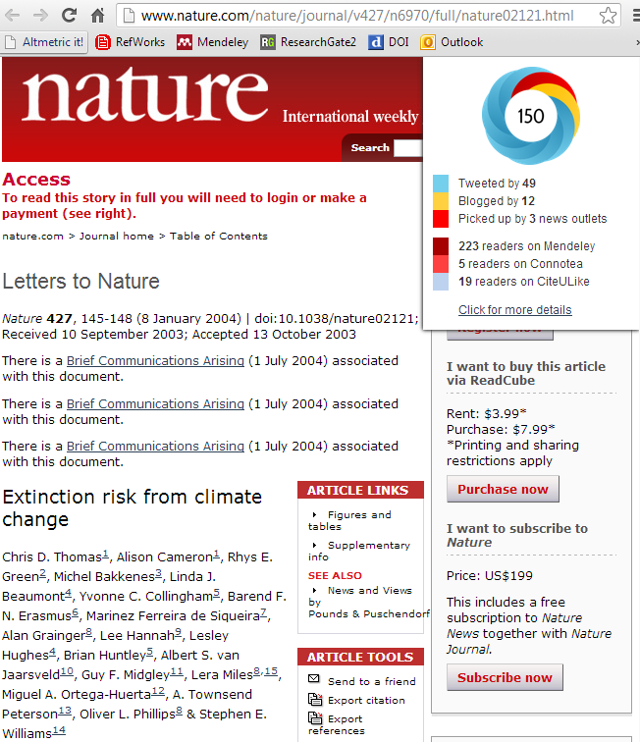
Article-Level Altmetrics: The Empirical Evidence
Mike Thelwall & Kayvan Kousha
Statistical Cybermetrics Research Group
University of Wolverhampton

Slide 2
The Problem
Are altmetrics random or do they reflect some type of impact?
The Solution
Check if altmetric scores correlate with citation counts for a sample of articles from the same year and field (sometimes multiple fields)
Conduct a content analysis of altmetric sources (if possible) for a sample of articles
Notes:
Should use Spearman correlations and not Pearson correlations because the data is skewed. See Sud & Thelwall (2004) for evaluation methods.

Slide 3
Why check correlations with citations?
Evidence that altmetrics are not random
Evidence that altmetrics indicate something that is related to scholarly communication
Evidence of the extent to which altmetrics behave similarly to citations [which are a known quantity]
See Sud & Thelwall (2004) for more evaluation methods discussions
Notes:
Citations have been extensively researched for decades so are more of a known quantity.

Slide 4
Mendeley: Empirical Evidence
Mendeley readership counts correlate strongly (0.5-0.7: medicine, science) or moderately (0.3-0.5: social science & humanities) and positively with citations for articles in:
Nature and Science in 2007 (Li, Thelwall, & Giustini, 2012)
Genomics and Genetics in F1000 from 2008 (Li & Thelwall, 2012)
4 library and information science journals in each of the years 1996 to 2007 (Maflahi & Thelwall, in press)
Web of Science from 2008 in each of: clinical medicine, engineering and technology, social science, physics, chemistry (Mohammadi, Thelwall, Haustein, & Larivière, in press), psychology, social sciences, education, library and information science, business, philosophy, history, linguistics and religion (Mohammadi & Thelwall, 2014)
Web of Science 2005-2011 (Zahedi, Costas, & Wouters, in press).
45 medical fields in 2009 (Thelwall & Wilson, in preparation)

Slide 5
Twitter: Empirical Evidence
citations tweets
2014
Publication year
Tweets tend to associate with citations
but do not correlate with them.
Publication year tweets correlate with subsequent citations in one informatics journal (Eysenbach, 2011)
Early tweets correlate with later downloads and citations for arXiv preprints (Shuai, Pepe, & Bollen, 2012)
Tweets may have zero or negative correlations with citations because scientific Tweeting increasing rapidly
Tweets can associate with citations in PubMed articles even when there is no positive correlation (Thelwall, Haustein, Larivière, & Sugimoto, 2013)
But article tweets are typically just titles or highlights and links (Thelwall, Tsou, Weingart, Holmberg, & Haustein, 2013).
Notes:
The association was assessed with a purpose-built statistical test, the sign test (Thelwall, Haustein, Larivière, & Sugimoto, 2013).

Slide 6
Other Altmetrics: Empirical Evidence
Many other altmetrics correlate positively but weakly with citation counts but are rare.
The following altmetrics correlate significantly and positively with citation counts for PubMed articles but are rare (Thelwall, Haustein, Larivière, & Sugimoto, 2013; see also: Costas, Zahedi, & Wouters, 2014; Zahedi, Costas, & Wouters, in press):
Facebook wall posts, Google+, Reddit, Pinners, LinkedIn
Also blogs (Shema, Bar‐Ilan, & Thelwall, 2014), Forum posts [not really altmetrics]
altmetric.com data

Slide 7
F1000 Ratings: Empirical Evidence
F1000 judge ratings correlate significantly and positively with citations (Bornmann & Leydesdorff, 2013; Li & Thelwall, 2012; Mohammadi & Thelwall, 2013; Waltman & Costas, 2014; see also: Wouters & Costas, 2012), but not for ecological articles (Wardle, 2010).
F1000 not really an altmetric

Slide 8

Alternative Metrics; Empirical Evidence
The following correlate significantly and positively with WoS citations to articles or books:
Google Books citations (Kousha & Thelwall, in press)
Worldcat.org library holdings (White, Boell, et al. 2009)
Amazon book reviews (Kousha & Thelwall, in press)
Web mentions (Vaughan & Shaw, 2003)
URL citations (Kousha & Thelwall, 2007)
Web syllabus mentions (Kousha & Thelwall, 2008)
& even more Kousha metrics!
Notes:
These are not gathered from the social web via an API but are typically gathered with the free Webometric Analyst software http://lexiurl.wlv.ac.uk/

Slide 9
Conclusion
Lots of empirical evidence that altmetrics correlate with citations
Mendeley is FANTASTIC!!!
Twitter is OK but very weak
A range of other altmetrics are rarer than Mendeley and Twitter and weaker than Mendeley
Little evidence of the type of impact that altmetrics reflect
Exception: Mendeley = citations?
Exception: Twitter = publicity? Journal marketing?

Slide 10
Adie, E., & Roe, W. (2013). Altmetric: enriching scholarly content with article-level discussion and metrics. Learned Publishing, 26(1), 11-17.
Bar-Ilan, J. (2012). JASIST@mendeley. In ACM Web Science Conference 2012 Workshop. http://altmetrics.org/altmetrics12/bar-ilan/
Bornmann, L., & Leydesdorff, L. (2013). The validation of (advanced) bibliometric indicators through peer assessments: A comparative study using data from InCites and F1000. Journal of Informetrics, 7(2), 286-291.
Borrego, Á., & Fry, J. (2012). Measuring researchers’ use of scholarly information through social bookmarking data: A case study of BibSonomy. Journal of Information Science, 38(3), 297-308.
Costas, R., Zahedi, Z., & Wouters, P. (2014). Do altmetrics correlate with citations? Extensive comparison of altmetric indicators with citations from a multidisciplinary perspective. arXiv preprint arXiv:1401.4321.
Eysenbach, G. (2011). Can tweets predict citations? Metrics of social impact based on Twitter and correlation with traditional metrics of scientific impact. Journal of Medical Internet Research, 13(4), e123.
Haustein, S., Larivière, V., Thelwall, M., Amyot, D., & Peters, I. (in press). Tweets vs. Mendeley readers: How do these two social media metrics differ. IT—Information Technology.
Haustein, S., & Siebenlist, T. (2011). Applying social bookmarking data to evaluate journal usage. Journal of Informetrics, 5(3), 446-457.
Henning, V., & Reichelt, J. (2008). Mendeley - A Last.fm for research? In. IEEE Fourth International Conference on eScience. (eScience'08) (pp. 327-328). Menlo Park: IEEE.
Kousha, K. & Thelwall, M. (2007). Google Scholar citations and Google Web/URL citations: A multi‐discipline exploratory analysis. Journal of the American Society for Information Science and Technology, 58(7), 1055-1065.
Kousha, K. & Thelwall, M. (2008). Assessing the impact of disciplinary research on teaching: An automatic analysis of online syllabuses, Journal of the American Society for Information Science and Technology, 59(13), 2060-2069.
Kousha, K. & Thelwall, M. (2007). Google Scholar citations and Google Web/URL citations: A multi-discipline exploratory analysis, Journal of the American Society for Information Science and Technology, 57(6), 1055-1065.
Kraker, P., Schlögl, C., Jack, K., & Lindstaedt, S. (2014). Visualization of co-readership patterns from an online reference management system. arXiv preprint arXiv:1409.0348.
Li, X., Thelwall, M., & Giustini, D. (2012). Validating online reference managers for scholarly impact measurement. Scientometrics, 91(2), 461-471.
Li, X., & Thelwall, M. (2012). F1000, Mendeley and traditional bibliometric indicators. In Proceedings of the 17th International Conference on Science and Technology Indicators (Vol. 2, pp. 451-551).
Maflahi, N. & Thelwall, M. (in press). When are readers as good as citers for bibliometrics? Scopus vs. Mendeley for LIS journals. Journal of the Association for Information Science and Technology.
Mohammadi, E., Thelwall, M., Haustein, S., & Larivière, V. (in press). Who reads research articles? An altmetrics analysis of Mendeley user categories. Journal of the Association for Information Science and Technology.
Mohammadi, E., & Thelwall, M. (2013). Assessing non-standard article impact using F1000 labels. Scientometrics, 97(2), 383-395.
Mohammadi, E. & Thelwall, M. (2014). Mendeley readership altmetrics for the social sciences and humanities: Research evaluation and knowledge flows. Journal of the Association for Information Science and Technology, 65(8), 1627-1638.
Mohammadi, E., (2014). Identifying the invisible impact of scholarly publications: A multi-disciplinary analysis using altmetrics. Wolverhampton, UK: University of Wolverhampton.
Piwowar, H., & Priem, J. (2013). The power of altmetrics on a CV. Bulletin of the American Society for Information Science and Technology, 39(4), 10-13.
Priem, J., Piwowar, H. A., & Hemminger, B. M. (2012). Altmetrics in the wild: Using social media to explore scholarly impact. arXiv preprint arXiv:1203.4745.
Priem, J., Taraborelli, D., Groth, P., & Neylon, C. (2010). Altmetrics: A manifesto. http://altmetrics.org/manifesto/
Shema, H., Bar-Ilan, J., & Thelwall, M. (2012). Research blogs and the discussion of scholarly information. PloS ONE, 7(5), e35869.
Shema, H., Bar‐Ilan, J., & Thelwall, M. (2014). Do blog citations correlate with a higher number of future citations? Research blogs as a potential source for alternative metrics. Journal of the Association for Information Science and Technology, 65(5), 1018-1027.
Shuai, X., Pepe, A., & Bollen, J. (2012). How the scientific community reacts to newly submitted preprints: Article downloads, Twitter mentions, and citations. PloS ONE, 7(11), e47523.
Sud, P. & Thelwall, M. (2014). Evaluating altmetrics. Scientometrics, 98(2), 1131-1143.
Thelwall, M., Haustein, S., Larivière, V. & Sugimoto, C. (2013). Do altmetrics work? Twitter and ten other candidates. PLOS ONE, 8(5), e64841. doi:10.1371/journal.pone.0064841
Thelwall, M. & Maflahi, N. (in press-a). Guideline references and academic citations as evidence of the clinical value of health research. Journal of the Association for Information Science and Technology.
Thelwall, M. & Maflahi, N. (in press-b). Are scholarly articles disproportionately read in their own country? An analysis of Mendeley readers. Journal of the Association for Information Science and Technology.
Thelwall, M., Tsou, A., Weingart, S., Holmberg, K., & Haustein, S. (2013). Tweeting links to academic articles. Cybermetrics: International Journal of Scientometrics, Informetrics and Bibliometrics, 17(1), paper 1.
Vaughan, L., & Shaw, D. (2003). Bibliographic and web citations: what is the difference? Journal of the American Society for Information Science and Technology, 54(14), 1313-1322.
Waltman, L., & Costas, R. (2014). F1000 Recommendations as a potential new data source for research evaluation: a comparison with citations. Journal of the Association for Information Science and Technology, 65(3), 433-445.
Wardle, D. A. (2010). Do 'Faculty of 1000' (F1000) ratings of ecological publications serve as reasonable predictors of their future impact? Ideas in Ecology and Evolution, 3(1), 11-15.
White, H. D., Boell, S. K., Yu, H., Davis, M., Wilson, C. S., & Cole, F. T. (2009). Libcitations: A measure for comparative assessment of book publications in the humanities and social sciences. Journal of the American Society for Information Science and Technology, 60(6), 1083-1096.
Wouters, P., & Costas, R. (2012). Users, narcissism and control: tracking the impact of scholarly publications in the 21st century. Proceedings of the 17th International Conference on Science and Technology Indicators (Vol. 2, pp. 487-497).
Zahedi, Z., Costas, R., & Wouters, P. F. (2013). What is the impact of the publications read by the different Mendeley users? Could they help to identify alternative types of impact?. PLoS ALM Workshop. https://openaccess.leidenuniv.nl/handle/1887/23579
Zahedi, Z., Costas, R., & Wouters, P. (in press). How well developed are altmetrics? A cross-disciplinary analysis of the presence of ‘alternative metrics’ in scientific publications. Scientometrics.

Slide 11
P.S. Advantages
Evidence for wider impacts of research
Educational usage (Mendeley, syllabus mentions, downloads?)
Societal interest or public engagement (Twitter?/YouTube?/Blog citations?)
Book-based impact [humanities/education?] (Google Books)
Professional/commercial impact (F1000 “Changes clinical practice” labels)

Slide 12
P.P.S. Disadvantages
Easy to manipulate
No quality control
Users often anonymous (no trail of evidence to check)
The numbers involved are not large so it would be easy to pay someone to inflate them (exceptions: F1000; web news media citations?)
Much accidental manipulation, e.g.,
Viral tweets for articles with funny titles
Lecturers in universities using Mendeley promoting their own works to their students
All altmetrics reflect a very small and biased proportion of the activity of interest
Site owners probably unwilling to embed enough quality control to give reliability for REF-type applications

