Slide 1
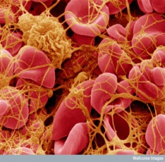

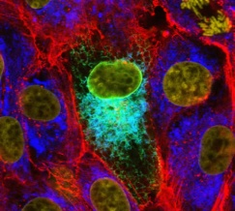
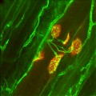
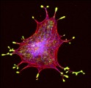
Impact assessment in the funding sector: the role of altmetrics
Adam Dinsmore
a.dinsmore@wellcome.ac.uk

Slide 2

Outline
The Wellcome Trust
Altmetrics
Why they are important to us
How we currently use them
The altmetrics ecosystem
Consistency, transparency, availability

Slide 3
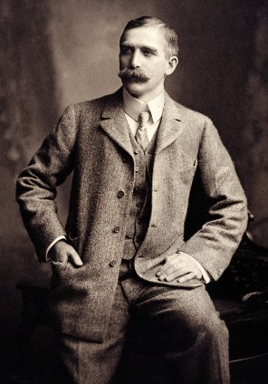
The Wellcome Trust
Set up in 1936 under the will of Sir Henry Wellcome.
Our vision is to achieve extraordinary improvements in human and animal health.
Our mission is to support the brightest minds in biomedical research and the medical humanities.
We spent approx £538 million on research in FY 2012/13.

Slide 4
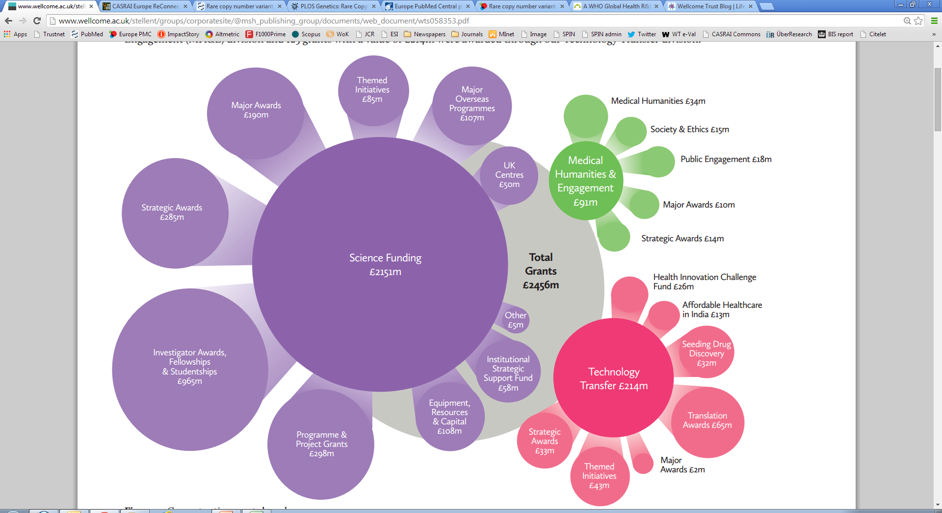
Current grant portfolio
Notes:
4
Important to note different areas we spend in….

Slide 5
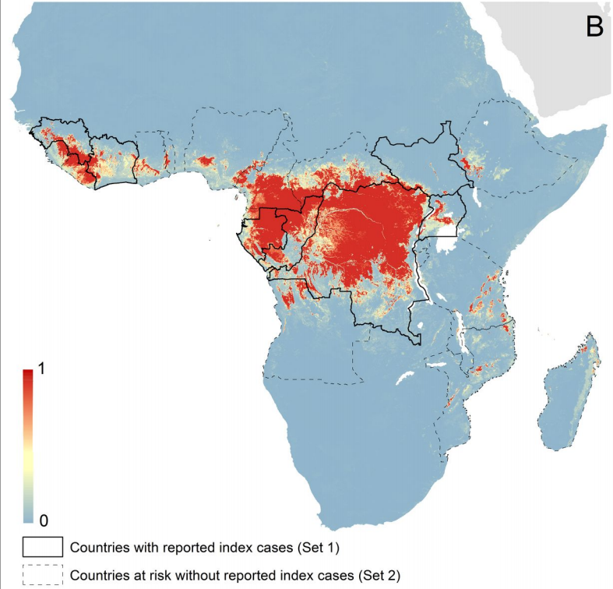
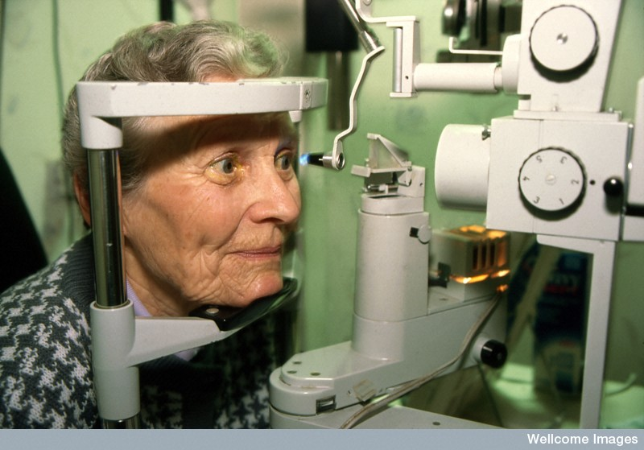
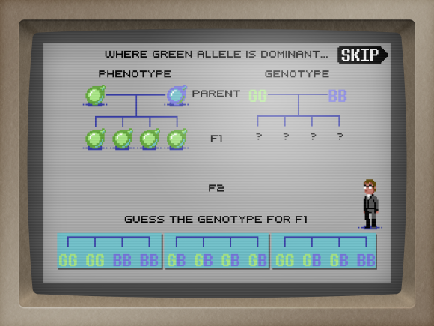
Credit: Piggott et al 2014 (eLife; 10.7554/eLife.04395). CC-BY-4.0
Credit: Thomas Forth / Mobile Pie
Notes:
Density map of the ongoing Ebola outbreak in West Africa to assist with health system preparedness; New diagnostic devices for Glaucoma; Game based on Mendelian genetics ‘gamify your PhD’

Slide 6
Monitoring progress: WT’s key indicators
Outcomes | Key indicators of progress
Discoveries Applications Engagement Research leaders Research environment Influence | significant advances in the generation of new knowledge contribute to discoveries with tangible impacts on health contribute to the development of enabling technologies, products and devices uptake of research into policy and practice enhanced level of informed debate in biomedicine significant engagement of key audiences & increased reach develop a cadre of research leaders evidence of significant career progression among those we support key contributions to the creation, development and maintenance of major research resources contributions to the growth of centres of excellence significant impact on science funding & policy developments significant impact on global research priorities and processes
Notes:
6
Research papers – long seen as falling under discoveries, where citation data can provide some indication of impact

Slide 7

The Wellcome Trust: OA Policy
Supports unrestricted access to the published output of research as a fundamental part of its charitable mission.
Expects authors to maximise the opportunities to make their results available for free.
Requires papers be made available through PubMed Central within six months of publication.
Provides additional funding to cover open access charges.
Encourages Creative Commons Attribution licence (CC-BY).
Affirms the principle that it is the intrinsic merit of the work, and not the title of the journal in which the author’s work is published, that should be considered in making funding decisions.

Slide 8
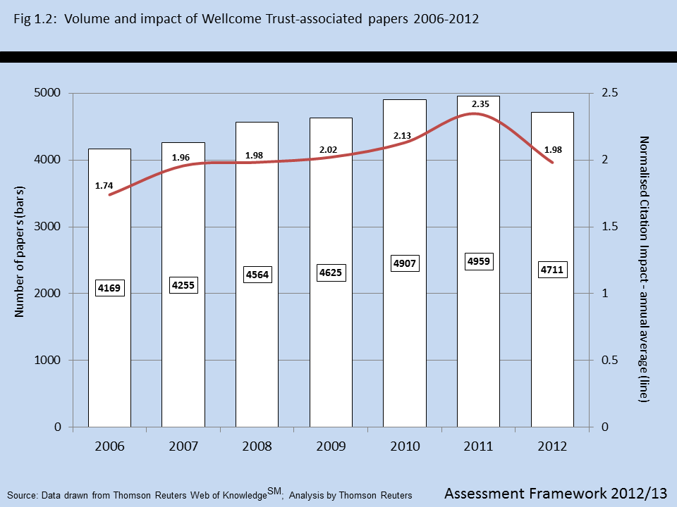
Notes:
Volume and impact of WT-associated papers 2006-2012 . Normalised Citation Impact used – compares each paper with the average paper published in the same year in the same research area.

Slide 9
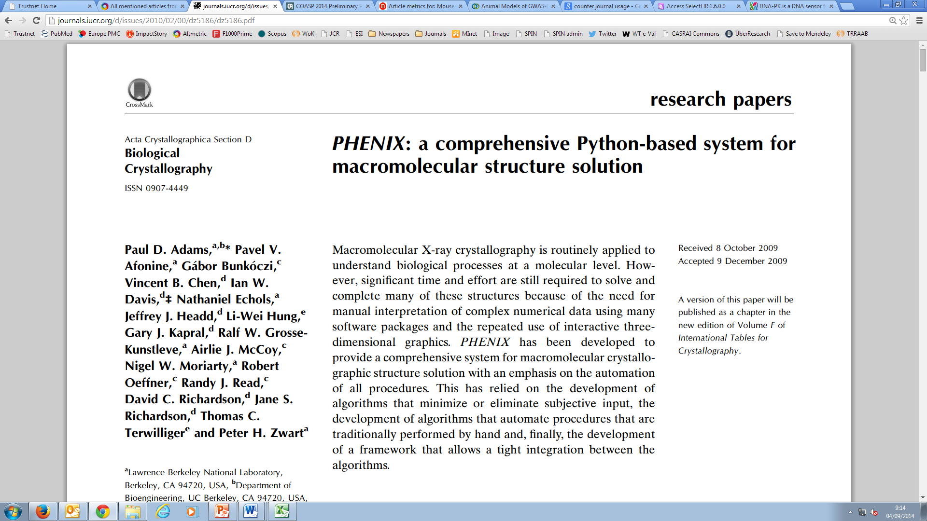
Article level metrics vs. Journal level metrics
Cited 2904 times;
Normalised Citation Impact = 327;
Acta Crystal D JIF = 7.232
Notes:
On the value of ALMs vs. journal level metrics. Don’t want to dwell on this, but worth mentioning that we don’t use the JIF at all in our evaluation activities – the WT-associated paper with the highest normalised citation impact since 2006 is this 2010 paper from Acta Crystallographica – not Nature or Science. Interestingly 2012 JIF was >14, when this paper was counted

Slide 10
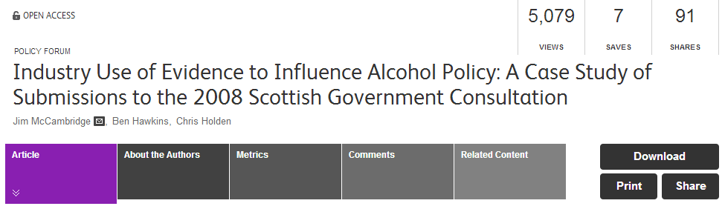
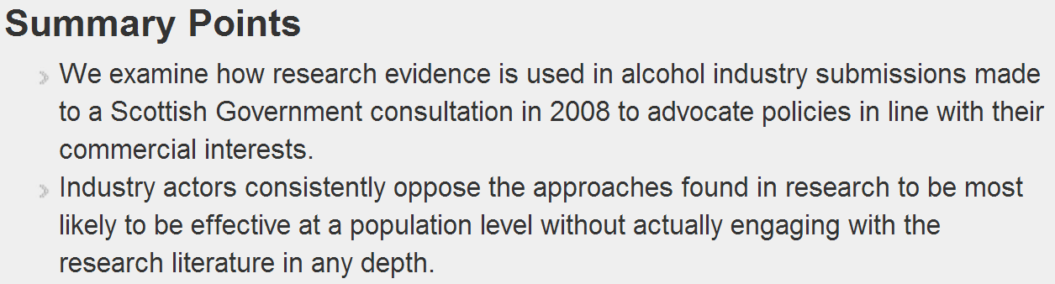
Current use of altmetrics at Wellcome
Engagement/Influence beyond citations
Notes:
Jim McCambridge one of our RCDFs (2009)

Slide 11
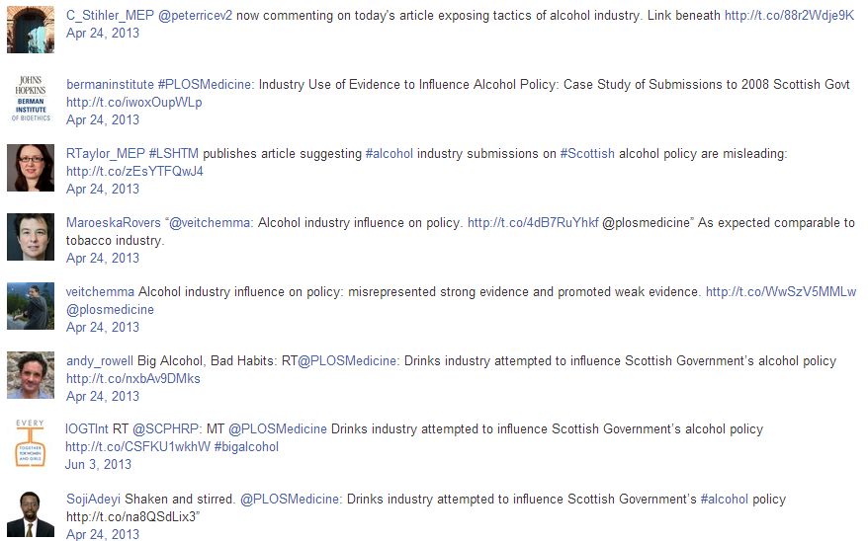
Engagement/Influence beyond citations
MEP
Centre for Bioethics
MEP
Professor of EBM
Journal editor
Health journalist
NGO
Health, Population & Nutrition @ The World Bank
Notes:
Of these twitter accounts, only the attention of the Centre for Bioethics and possibly the journal editor are likely to be visible to ciation metrics (eventually).
Our next job as 'the Evaluation Team' in a funder - having presented such examples - would be to track whether any policy changes were effected following this publication and tweet etc. Quicker.

Slide 12
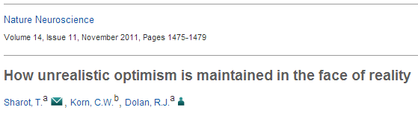
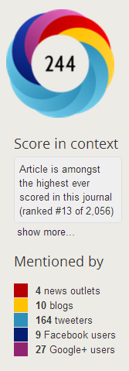






Engagement/Influence beyond citations
Paper cited 9 times to year end 2012.
However, tweeted about 164 times; among the highest ever for Nat. Neuroscience.
Identity of tweeters possibly indicative of impact on policy, public debate.
Science journalist, Author
Editor, Medical History
Intelligence Consultant

Slide 13
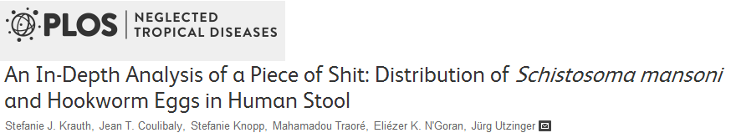
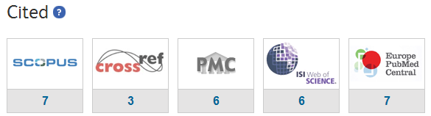
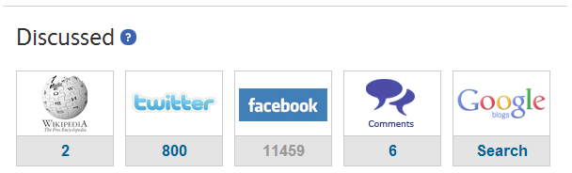
2012 Trust-associated paper in PLOS Neglected Tropical Diseases.
Cited very few times, but discussed extensively on social media.
However, likely due to funny title rather than genuine public engagement.

Slide 14
Monitoring progress: WT’s key indicators
Outcomes | Key indicators of progress
Discoveries Applications Engagement Research leaders Research environment Influence | significant advances in the generation of new knowledge contribute to discoveries with tangible impacts on health contribute to the development of enabling technologies, products and devices uptake of research into policy and practice enhanced level of informed debate in biomedicine significant engagement of key audiences & increased reach develop a cadre of research leaders evidence of significant career progression among those we support key contributions to the creation, development and maintenance of major research resources contributions to the growth of centres of excellence significant impact on science funding & policy developments significant impact on global research priorities and processes
Notes:
14

Slide 15
Monitoring progress: WT’s key indicators
Outcomes | Key indicators of progress
Discoveries Applications Engagement Research leaders Research environment Influence | significant advances in the generation of new knowledge contribute to discoveries with tangible impacts on health contribute to the development of enabling technologies, products and devices uptake of research into policy and practice enhanced level of informed debate in biomedicine significant engagement of key audiences & increased reach develop a cadre of research leaders evidence of significant career progression among those we support key contributions to the creation, development and maintenance of major research resources contributions to the growth of centres of excellence significant impact on science funding & policy developments significant impact on global research priorities and processes
Notes:
15
Delighted to see altmetric announce tracking of policy documents, already started tracking:
Intergovernmental Panel on Climate Change
National Institute for Care and Health Excellence (UK)
World Health Organization
Médecins Sans Frontières (Doctors Without Borders)
AWMF – Association of Scientific Medical Societies (Germany)
European Food Safety Authority
International Committee of the Red Cross

Slide 16
What we’re currently exploring…
Credit: Statistical Cybermetrics Research Group, University of Wolverhampton.
Notes:
Building on interest in policy sphere; Thelwall group provided data on citations in PDFs across numerous policy domains: List of domains

Slide 17
What we’re currently exploring…
Credit: Statistical Cybermetrics Research Group, University of Wolverhampton.
Notes:
Jim McCambridge one of our RCDFs (2009)

Slide 18
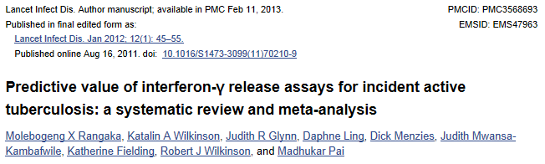
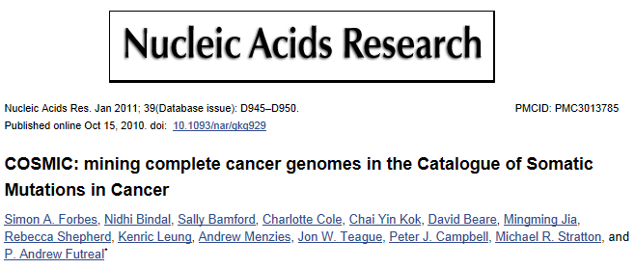
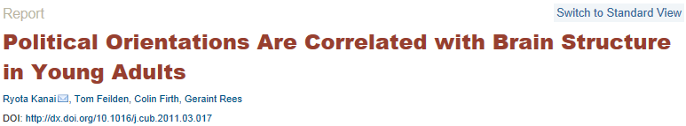
What we’re currently exploring…
Notes:
Again, the numbers aren’t especially important on their own. But they allow us to dig in and access stories of impact.

Slide 19
Altmetrics ecosystem
Consistency (of definitions)
Transparency
Availability

Slide 20


Altmetrics ecosystem - Sources of data
We need metrics data which is consistent in its source and meaning in order to enable sensible comparisons between outputs of different schemes
Differences between publisher-provided data mean that, primarily, we use third-party data providers:
Thomson Reuters Web of Knowledge
Altmetric

Slide 21
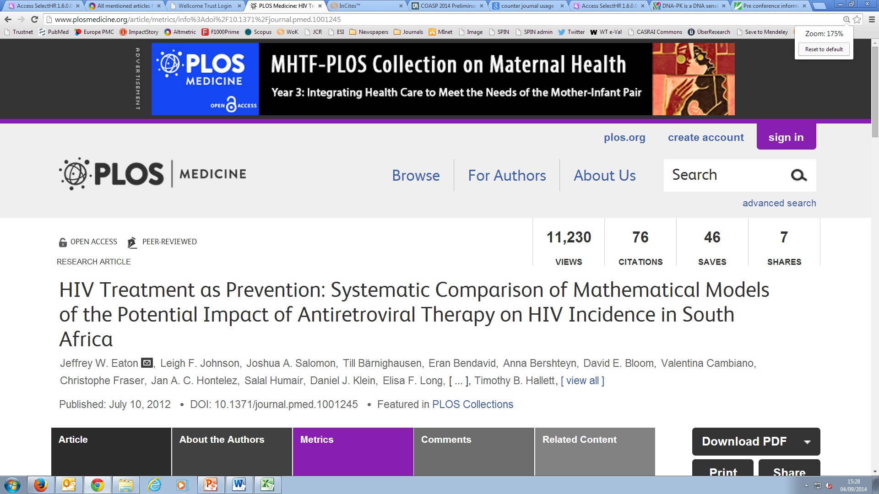
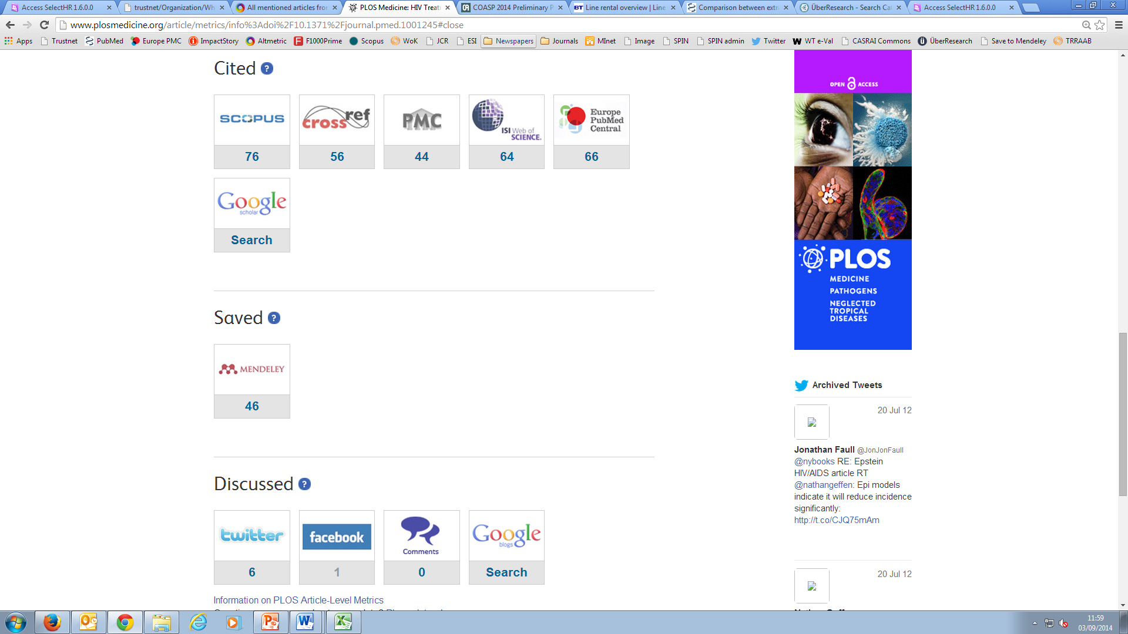
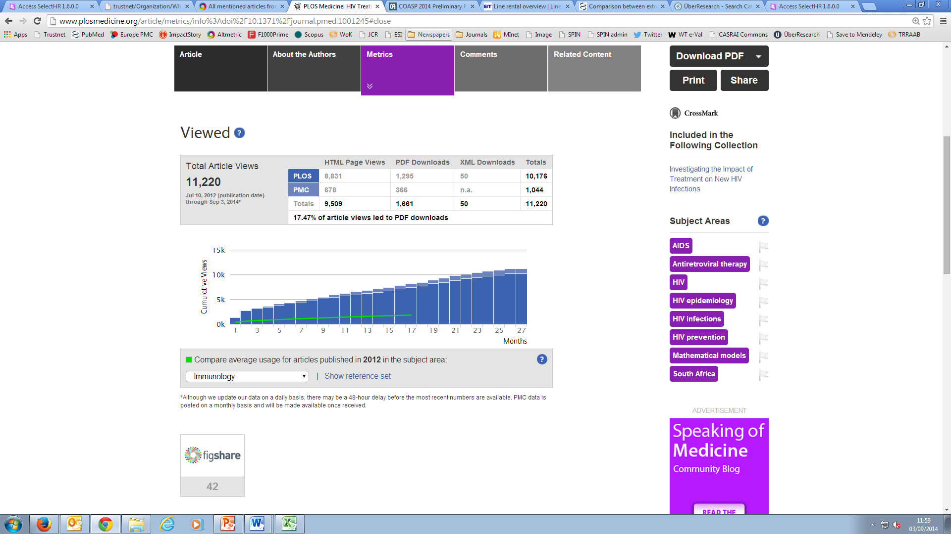
Differences in citation data
Notes:
Even then, there isn’t one simple answer to “How may citations?”. Example of a PLoS paper (with lots of lovely altmetrics), and the different citation sources show different answers.

Slide 22
Differences in citation data
Source | Number of citations
Scopus | 76
Web of Science | 64
Google Scholar | 103
CrossRef | 56
PMC | 44
EuropePMC | 66
For a sample of 358 Wellcome-associated papers, on average:
WoS had 10 cites per paper
Scopus 12 cites per paper
Google Scholar 18 cites per paper
Notes:
More detail on that. And some wider data.

Slide 23
Summary:
The Wellcome Trust is interested in all of the different types of impact which arise from the work it supports (and numerous means of measuring it).
Therefore delighted that helpful tools are being developed.
Greater consistency, transparency, and availability would serve the Trust’s requirements.

Slide 24
-Thank You- Adam Dinsmore Wellcome Trust Strategic Planning & Policy Unit a.dinsmore@wellcome.ac.uk

