Slide 1
Impact assessment in the funding sector: the role of altmetrics Liz Philpots, head of research, AMRC

Slide 2
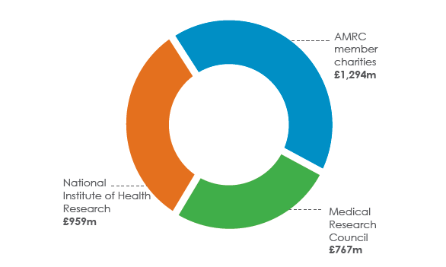
A view from funders…. Medical research charities invest heavily in research ….and want to see the impact these funds are having

Slide 3
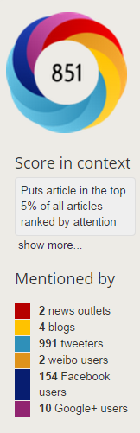
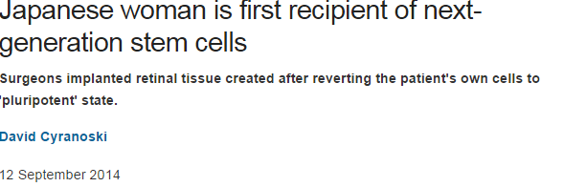
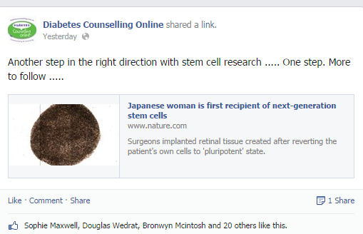
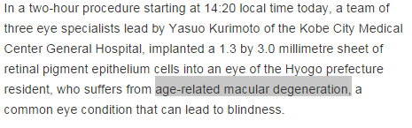
Roles for altmetrics: Finding research that is getting social media attention - for patient education

Slide 4
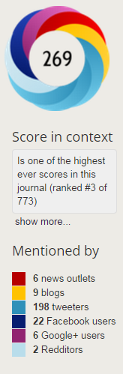
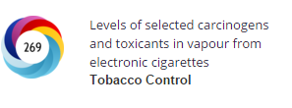
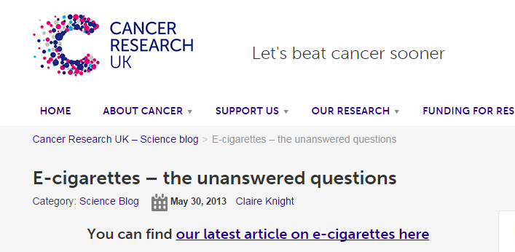
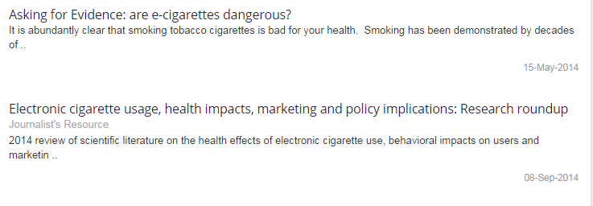
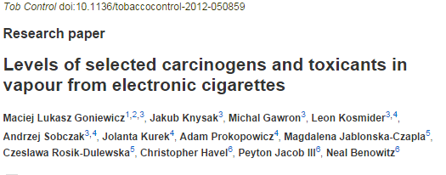
Roles for altmetrics: Keeping track of research that is getting social media attention

Slide 5
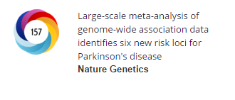
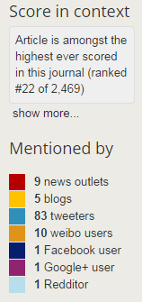
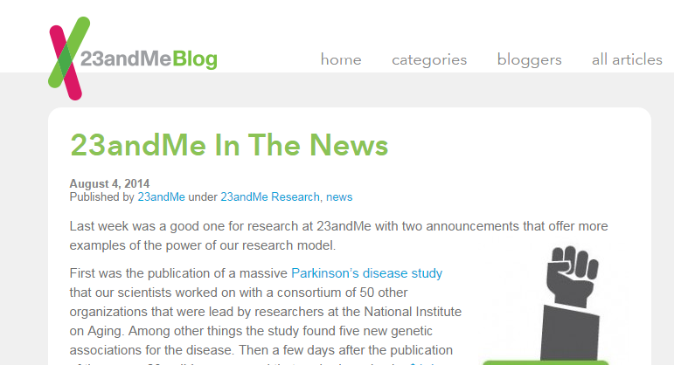
Roles for altmetrics: media monitoring…

Slide 6
Challenges….
what does it mean as an ‘impact’?
educating researchers to get best out of altmetrics (learn the rules/ include DOI in tweet – or retweet original article?)
gameplaying……
What behaviour do we WANT to see?

