Slide 1


Science Foundation Ireland
Dr Ruth Freeman
Director, Strategy and Communications
1:AM London 2014
25-26th September, Wellcome Collection, Euston Road

Slide 2
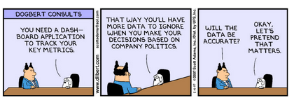
Copyright : Dilbert 2007

Slide 3
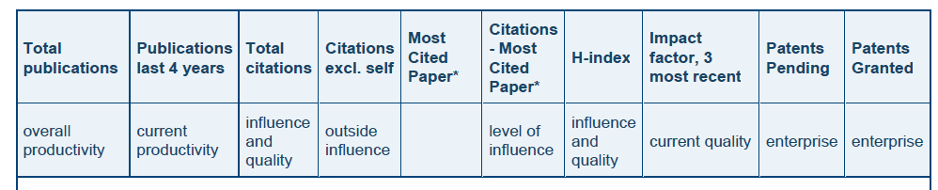
Strong focus on:
Publications
Citations
Patents

Slide 4
What is Impact?
Impact can be described as “the demonstrable contribution that excellent research makes to the economy and society”.
Impact
Immediate / Long-term
Far-reaching
High-risk/Low-risk
Difficult to measure
Economic / Non-economic
Notes:
Far-reaching – beyond SFI’s ability to even capture the information or the researchers' ability to even know about the impact.

Slide 5
Input
Activity
Output
Outcomes
Impact

Slide 6
Inputs
Activities
Outputs
Funding/Support
Hosting/Admin
Facilities
Awards granted
Teams established
Research undertaken
Education
Technology Transfer
Publications
Networks
Pre-Commercial Outputs
Funding diversification
Events
Notes:
We mostly still measure Outputs/Outcomes rather than impact…. Is it out of our reach to measure this? Therefore use “proxies” or indicators of impact (e.g. industry cash or co-publication as an indicator of industry engagement and therefore contribution of research to economic & social development)

Slide 7
Outcomes
Impact
Research capacity/leaders
Research quality/productivity
Sustainability
Recruitment of graduates
Industry more competitive
Increase research & innovation capacity
Established international Sci/Tech profile
Transformational change in research by industry (directly and in collaboration with academia)
Contribution of research to economic and social development
Improved international competitiveness
National economic employment and growth
Though not necessarily linear!
Notes:
We mostly still measure Outputs/Outcomes rather than impact…. Is it out of our reach to measure this? Therefore use “proxies” or indicators of impact (e.g. industry cash or co-publication as an indicator of industry engagement and therefore contribution of research to economic & social development)

Slide 8
SFI describes impact in different Categories
Economic and Commercial Impact | Societal Impact
Impact on public policy and services | Health Impact
Environmental Impact | Impact on Professional Services
Notes:
Economic: E.g. performance of a business has been improved through the introduction of new, or the improvement of existing, products, processes or services; the adoption of new, updated or enhanced technical standards and/or protocols, or the enhancement of strategy, operations or management practices
Societal: quality of life, knowledge, behaviours, creative practices and other activity have been influenced positively. E.g. Public debate stimulated by STEM
Impacts on public policy and services: impacts where the beneficiaries may include government, non-governmental organisations (NGOs), charities and public sector organisations and society, either as a whole or groups of individuals in society e.g. Policy decisions or changes to legislation, regulations or guidelines have been informed by research evidence
Environmental Impacts: the environment has been improved through the introduction of new product(s), process (es) or service e.g. he management or conservation of natural resources, including issues around global competition for energy, water and food resources, has been influenced or improved.
Health Impact: health outcomes have been improved, quality of life enhanced (or potential harm mitigated)
Impacts on Professional Services: e.g. changes to professional standards, guidelines or training have been informed by research.

Slide 9
How do we measure Impact?
Impact Statement
International Peer Review of Scientific Excellence and Impact (Proposed Research, Statement, Applicant/Team)
Annual Reporting: Impact Declarations
Annual Reporting: Supporting Metrics
Case Studies: Provide a “picture” of Impact
Researcher articulates the planned and potential impact of the proposed research at application stage.
Researcher selects from 10 declarations , for e.g. “The research conducted through my award has…Attracted developing and nurturing businesses, through for example, the licensing of technologies”
E.g. Patents exploited; funding leveraged; collaborations with industry, NGOs or govt; contributions to policy (technical reports) etc
Midterm Review of Impact Statement
International Panel
Altmetrics?
The process may vary according to programme size and objectives
Notes:
Altmetrics slide
The Impact Statement will be evaluated by reviewers with expertise in research translation and commercialisation and it should therefore be written primarily in lay, non-technical language, it should be as specific and comprehensive as possible and it should cover potential economic and societal impacts by answering the following overarching questions:
• Who will benefit from this research?
• What plans will you put in place to increase the chances of economic and societal impacts from the proposed research?
• Over what timeframe might the benefits from your research be realised?

Slide 10
The Promise of Alternative Metrics
Access to new information which could be used as:
Indicators of reach – for e.g. public interest and engagement in STEM …who is downloading, tweeting, blogging, etc. science? And which researchers are engaging with the public.
Indicators of attitude to science by the public (E.g. analysis of twitter or public commentary)
Indicators of early excitement around papers
Possible indicator of technology usage/sentiment

Slide 11
The Pitfalls of Alternative Metrics
Putting too much emphasis measuring a researcher’s performance based on one metric
Using altmetrics on their own (should support/compliment a suite of metrics)
Confusing downloads with citations and opinions (blogs) with fact etc.

Slide 12
Email: ruth.freeman@sfi.ie
Tel : +353 1 607 3240
www.sfi.ie
alerts@sfi.ie

