Slide 1
Capitola C90 - high level software features and R&R Details

Slide 2
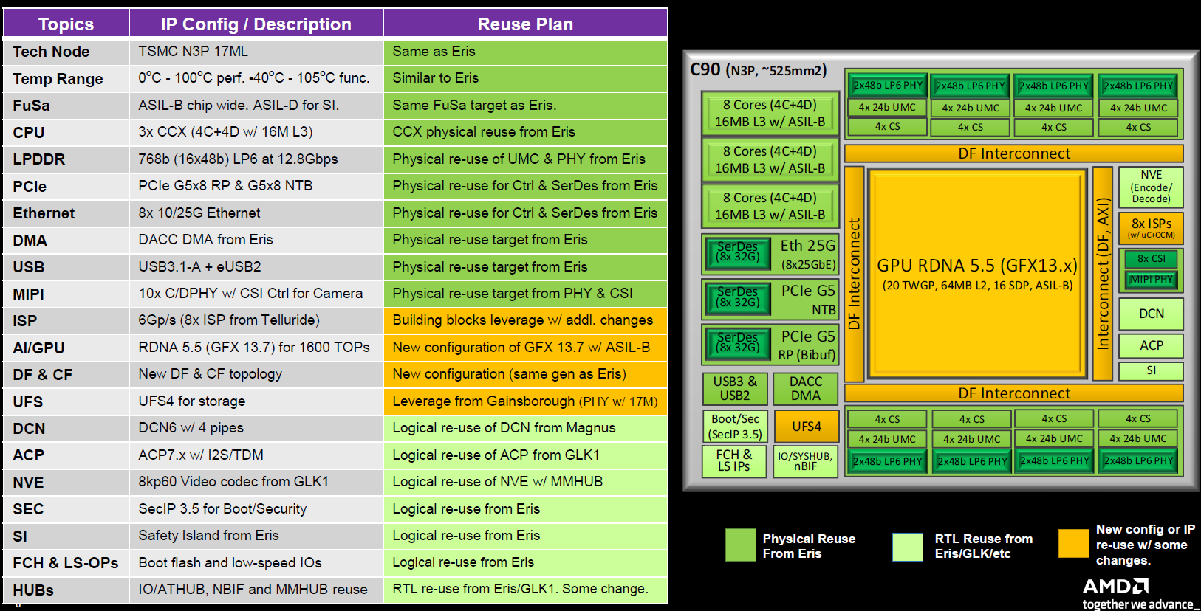
Capitola C90 Overview

Slide 3
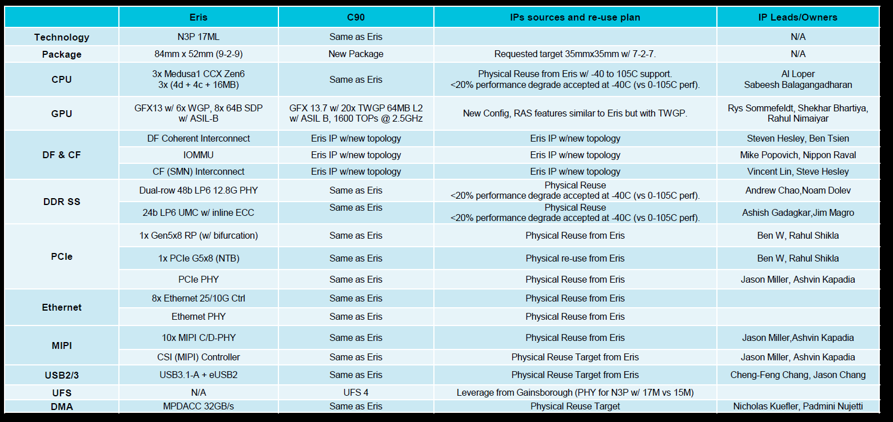
Capitola C90 High-Level IPs Summary (1/2)

Slide 4
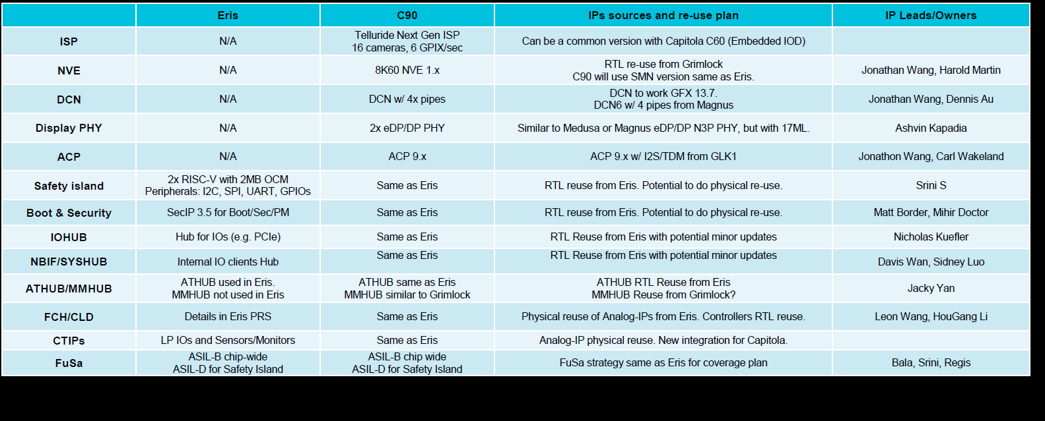
Capitola C90 High-Level IPs Summary (2/2)

Slide 5
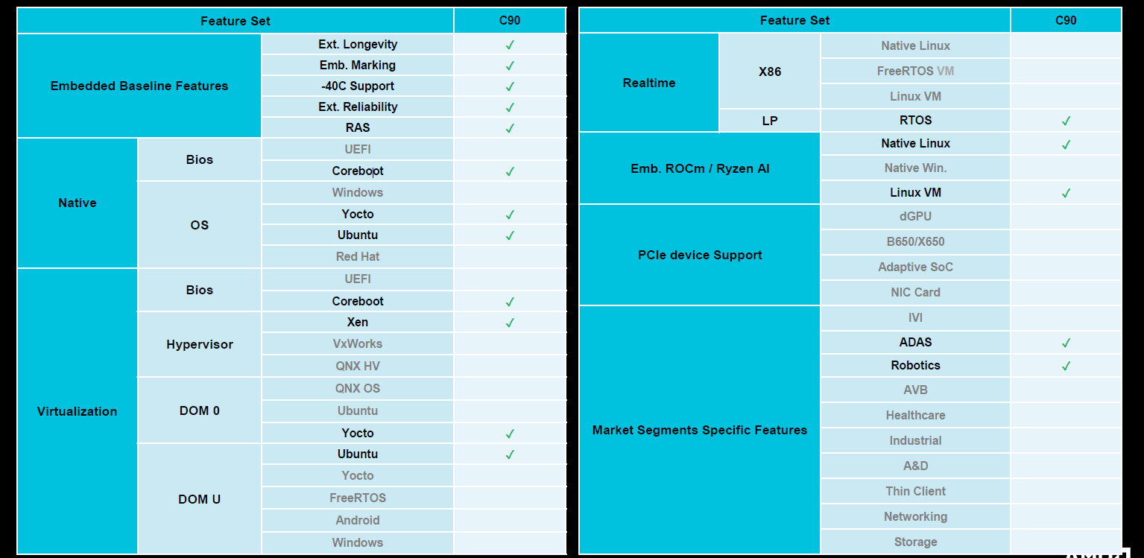
C90 Feature Enablement

Slide 6
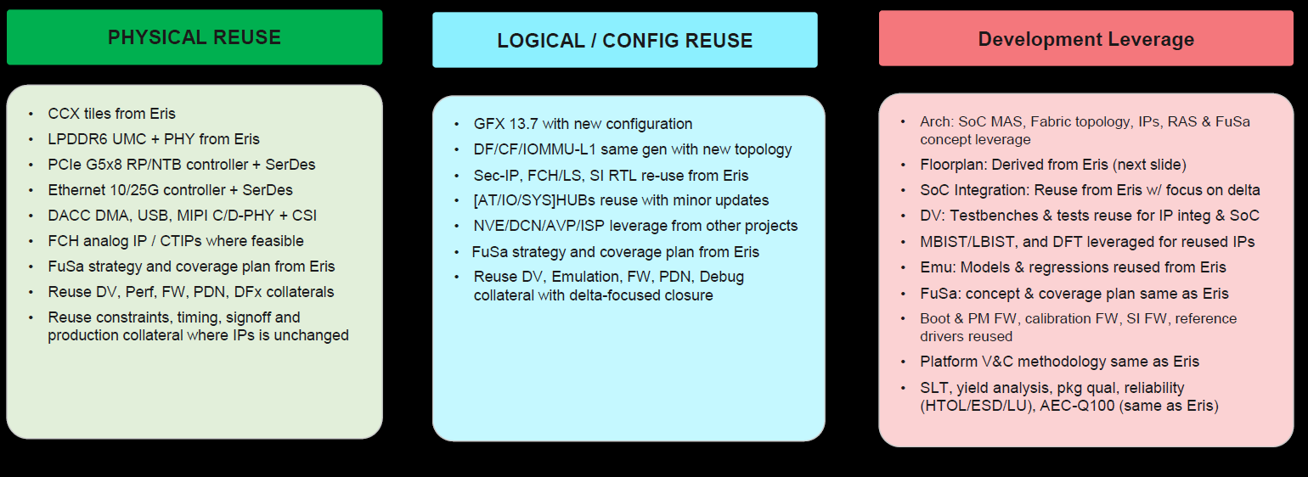
C90 Reuse Strategy – IPs and Collateral

Slide 7
R&R Summary Slide across the teams and ASk
Ownership | Component | Details
G&E | OS/Drivers | Linux GPU Driver on latest kernel on Ubuntu OS Support till IP. Assume leverage from Eris for GFX, NVE from Grimlock, DCN from magnus GFX - OpenGL, Vulkan, Multimedia, Gstreamer. GPU RAS support. Display – Same as Magnus with enhancements. Power Management (S0ix3, reboot) Pre-silicon validation support for GFX driver.
 | Firmware (PFO) | Base FW for Pre-Silicon and Post-Silicon activities. PFO will support till UU and Bring-up, EPD owns after Bring-up. FuSa baseline leveraged from Eris for common IPs and scope for newer IPs PFO support for AGESA-V10, OpenSIL for C90 SoC IPs.
 | Audio | Linux AAF support for ACP and X86 Driver for I2S/TDM
PSW/T&E | IO Drivers | NVME, UART, SPI, I2C, I3C, GPIO, USB3(same as Eris), USB4(
AECG EPD |  | Power/Performance Projections, SoC and System characterization Platform Emulation EDKII and coreboot BIOS support Ethernet – X4A (Leverage from Eris, Dependency with NTSG) Security FW features leveraged from Medusa RAS support Post SoC IP Validation IOMMU support in BIOS and Drivers DACC with SDXI Driver and FW MIPI CSI Controller Driver support, MIPI CSI and ISP (Telluride Next Gen) integration. Customer use case validation
AECG | Human Vision ISP ( Telluride Next Gen IP) | ISP FW and Linux Driver ISP Tuning
 | Safety Island | SI FW/Drivers

Slide 8
OS Details
Category | Feature | Details
OS | Linux | Ubuntu LTS OS with latest mainline kernel EPD to own porting to LTS kernel on Ubuntu and Yocto All drivers to be open source by GA + 3months
AECG | Xen Hypervisor | Xen Hypervisor

Slide 9
HIGH level BIOS/FW features
Category | Feature | Details
BIOS | EDKII | EDKII BIOS. Coreboot support
Firmware | Security | Security features Secure boot, A/B recovery, FAR, fTPM, ROM Armor, etc. (Detailed security feature requirement is not available currently, assume regular security feature enablement on Zen6)
 | RAS | RAS feature support
 | Pre-silicon FW support | Pre-silicon FW support

Slide 10
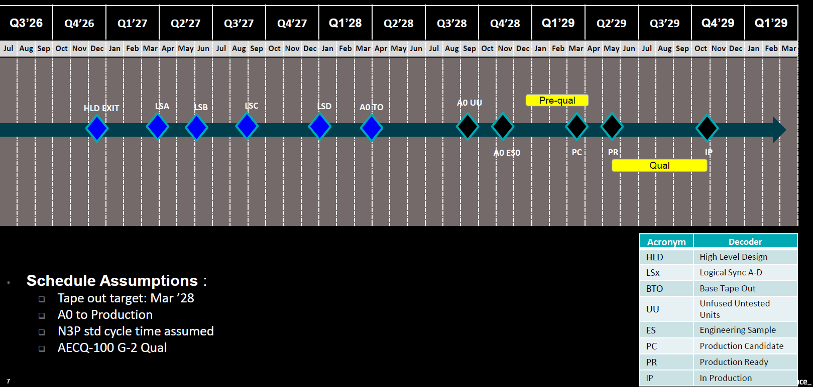
Capitola C90 Preliminary Schedule

Slide 11
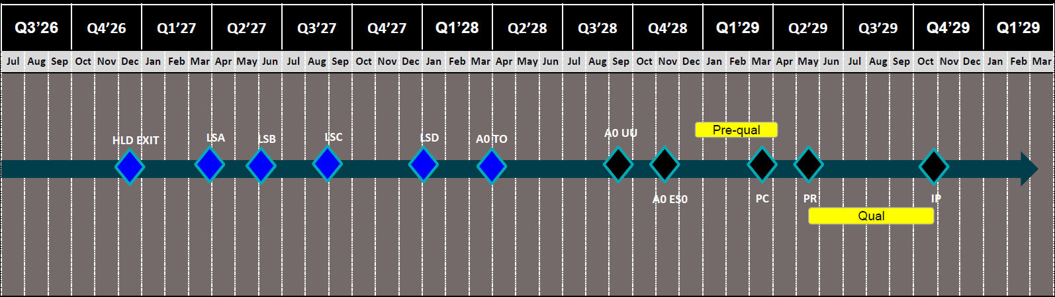
C90 Preliminary Program Schedule
SW(OS/Driver)Support
Pre-silicon support – GFX Driver
Post-Silicon support – GFX, Audio, IO’s Support

Slide 12
Back up

