Slide 1
Capitola 40 - high level software features and R&R Details

Slide 2
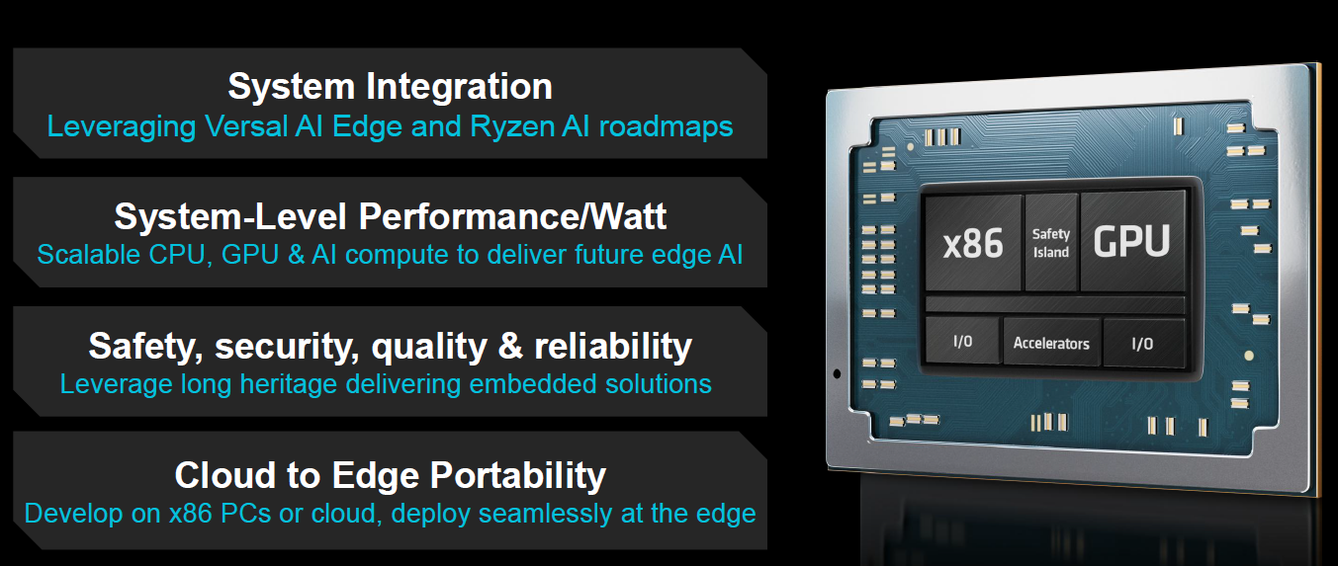
Capitola : A Platform Built for Next Generation Edge AI
Single-Chip CPU/GPU Integration for Edge AI

Slide 3
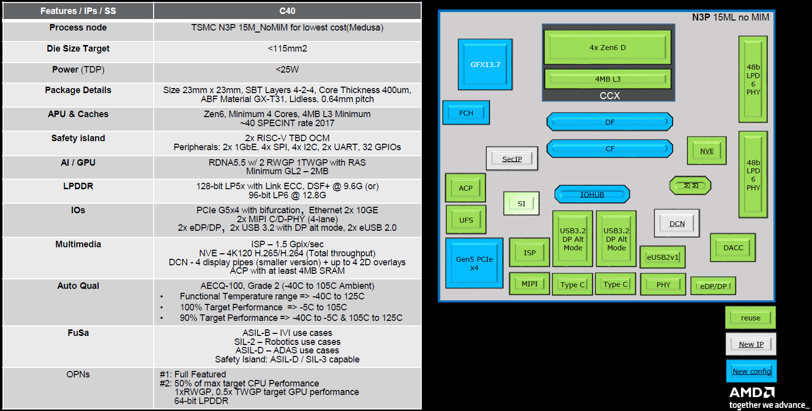
Capitola C40 Overview

Slide 4
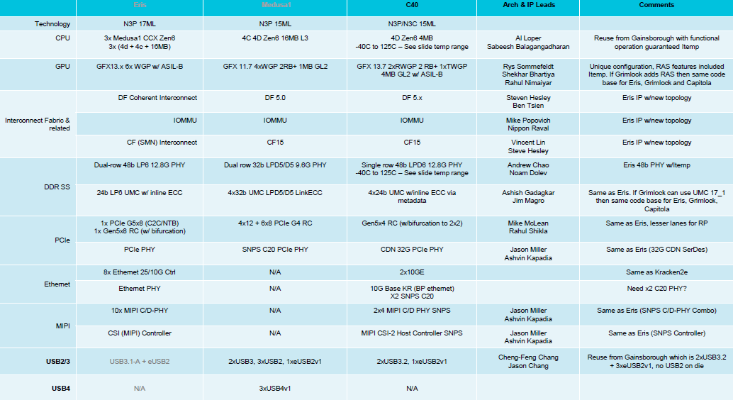
Capitola C40 High-Level IPs Summary (1/2)

Slide 5
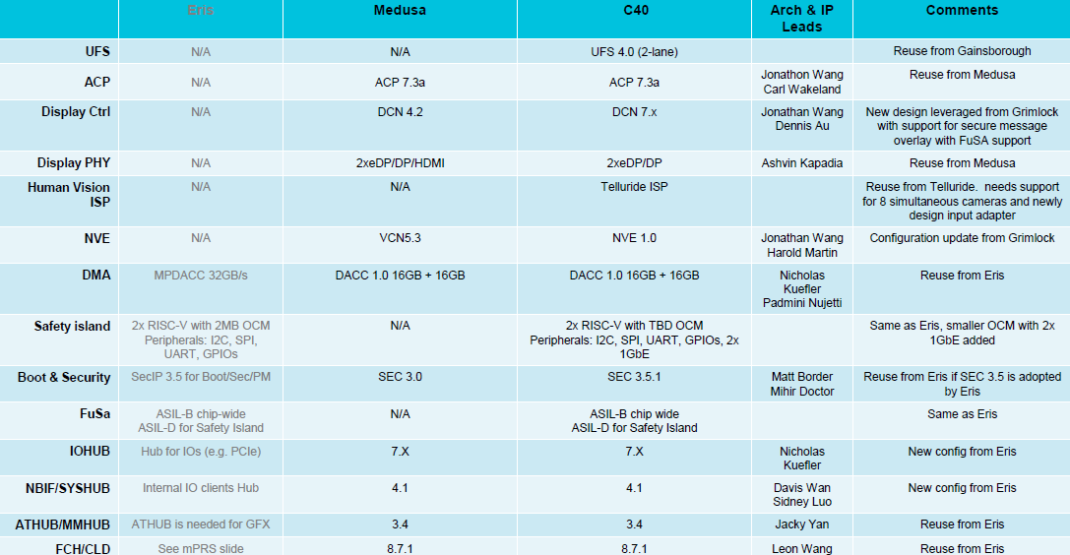
Capitola C40 High-Level IPs Summary (2/2)

Slide 6
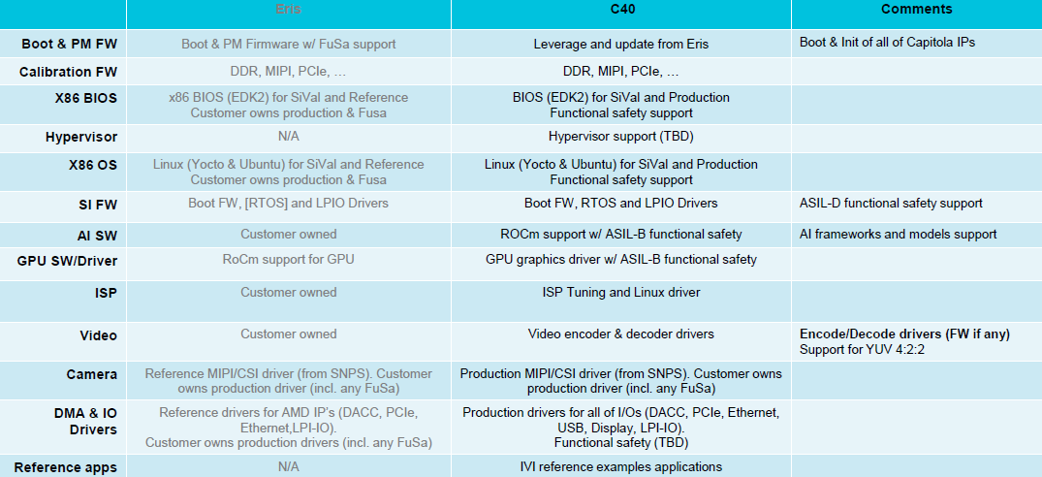
Capitola C40 Software/Firmware/Tools Requirements

Slide 7
R&R Summary Slide across the teams and ASk
Ownership | Component | Details
G&E | OS/Drivers | Linux GPU Driver on Linux OS (Ubuntu) Support till IP. Assume leverage from Grimlock for GFX/MM/Display/PM – Reactive support GFX - OpenGL, Vulkan, Multimedia, Gstreamer. Same code base as Grimlock. GPU RAS support. Display – Same as Grimlock with enhancements, New RAS features. Power Management (S0ix3, reboot) Pre-silicon validation support for GFX SW driver, Same as Grimlock
 | Firmware (PFO) | Base FW for Pre-Silicon and post silicon PFO will support till UU and Bringup, EPD owns after Bringup.
 | Audio | Linux AAF support for ACP and X86 Driver for I2S/TDM.
PSW | IO Drivers | Leverage from existing programs – Reactive support for : NVME, UART, SPI, I2C, I3C, GPIO, USB3, USB4
 | XGBE Driver | Leverage from KRK2e for Ethernet – Reactive support 2x10Gbe Ethernet Driver. Post SoC support.
AECG EPD |  | Power/Performance Projections, SoC and System characterization Platform Emulation EDKII BIOS support Security FW features leveraged from Medusa RAS support Post SoC IP Validation IOMMU support in BIOS and Drivers DACC with SDXI MIPI CSI Controller Driver support Customer use case validation
AECG | Human Vision ISP (Leverage Telluride IP) | ISP Tuning and Linux driver
 | Safety Island | SI FW/Drivers

Slide 8
Peripheral drivers
Ownership | Driver | Details
AECG EPD | PCIe | PCIe Gen5 x8 (bifurcate-able) RC for NVMe
AECG EPD | DMA | DACC 64GB/s max bandwidth support SDXI driver
AECG EPD | MIPI CSI /Camera | MIPI CSI-2 Support ( same as Eris) 8x MIPI interface
AECG EPD | IOMMU | IOMMU Driver
PSW | Ethernet | 2x 10GBe Ethernet support (SNPS). Same as KRK2e. Reactive support
PSW | Other IO | NVMe, UART, SPI, I2C, GPIO, USB 3.1-A. Reactive support.

Slide 9
OS and Power management
Category | Feature | Details
OS | Linux | Ubuntu LTS OS with latest mainline kernel EPD to own porting to LTS kernel on Ubuntu and Yocto All drivers to be open source by GA + 3months
AECG | Xen Hypervisor | Xen Hypervisor
Power management | S0i3 | s0i3 low power state support
 | Reboot | Warm and cold reboot support

Slide 10
HIGH level BIOS/FW features
Category | Feature | Details
BIOS | EDKII | EDKII BIOS. Scoping can happen with it. If Coreboot support is required, that will require addition scoping
Firmware | Security | Security features Secure boot, A/B recovery, FAR, fTPM, ROM Armor, etc. (Detailed security feature requirement is not available currently, assume regular security feature enablement on Zen6)
 | RAS | RAS feature support
 | Pre-silicon FW support | Pre-silicon FW support

Slide 11
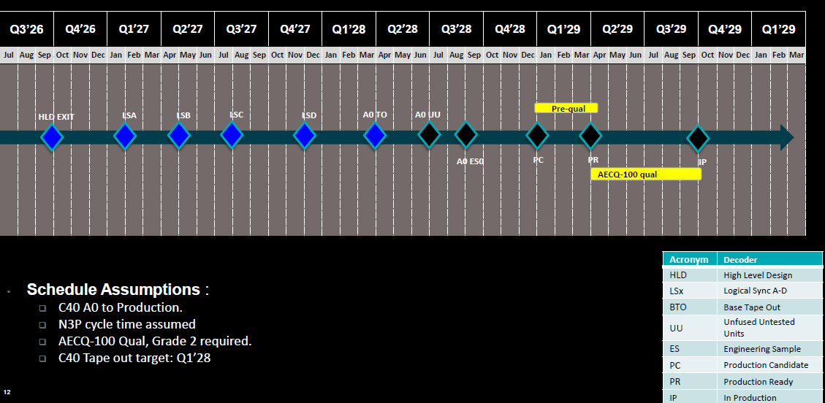
Capitola Preliminary Program Schedule
Pre-silicon support
GFX Driver
Base FW from PFO
Post-Silicon support –
GFX,
Audio,
IO’s
Ethernet Support
SW(FW/BIOS/OS/Driver)Support

Slide 12
Fusa
Any FuSa efforts, can be comprehended on top of the base support and called out separately

Slide 13
Back up

