Slide 1
Capitola C40 interlock between PAVS and G&E Version 1 on 6/18/2026

Slide 2
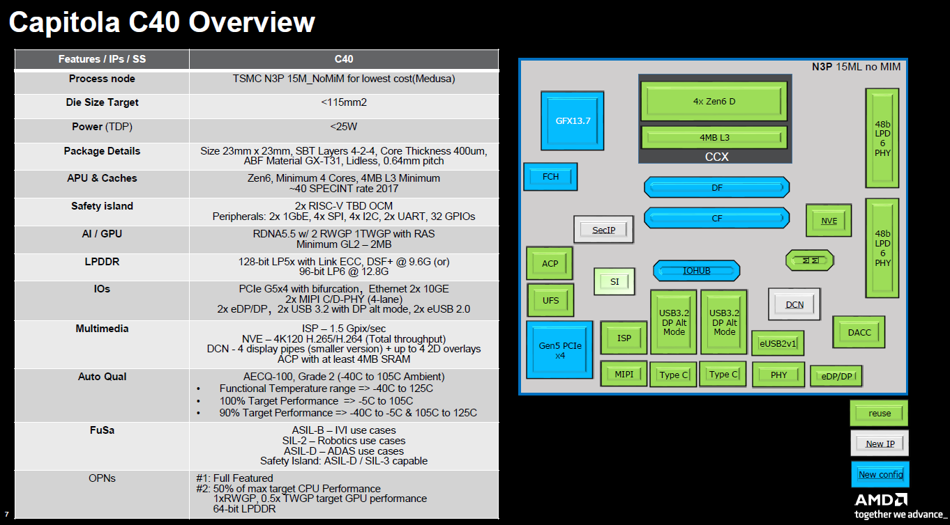
Capitola C40 Overview

Slide 3
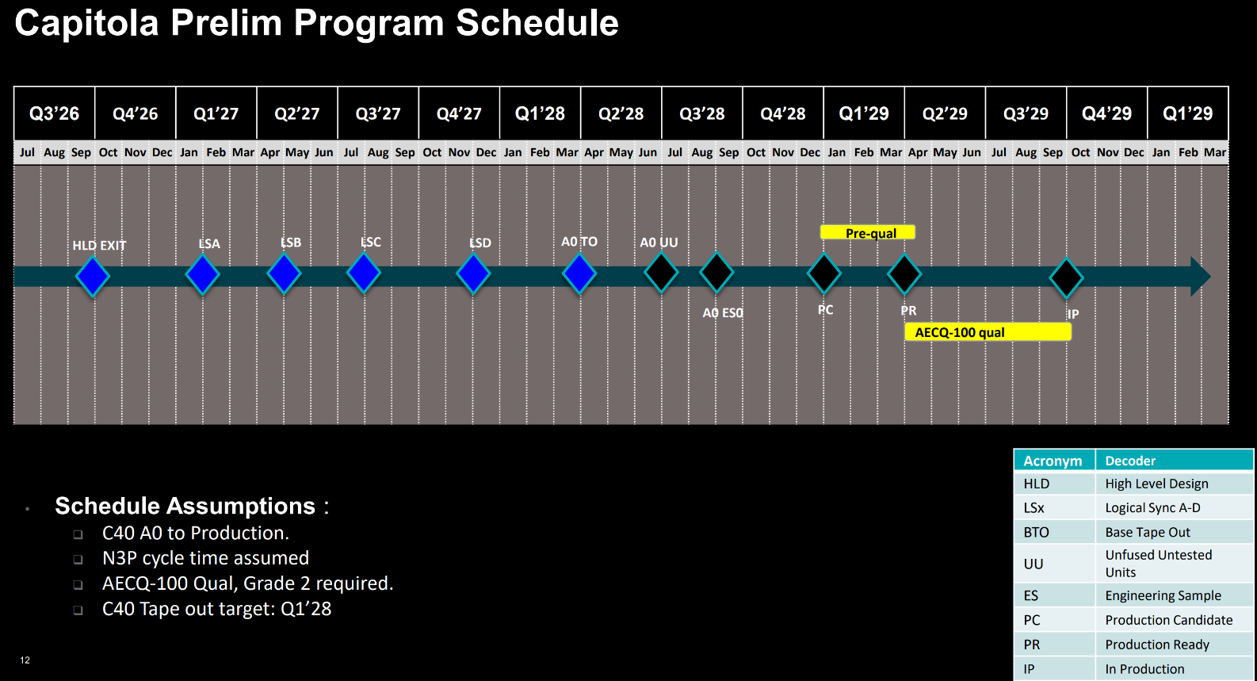
Notes:
Assume Features already present:
(+) stable 35 RAVE2 platform with BIOS available by End Q2
(+) No dependency on telluride for boot order or splash/spi-rom
(+) No UFS for APU

Slide 4
High level requirements
Target Applications
IVI
Low Level ADAS functions (AEB, ACC, Surround View)
Robotics (Cobots, Low end AMRs)
Industrial
Operating Systems & Safety
Linux: Yocto, Ubuntu
FreeRTOS:
Virtualization & Isolation
Xen Hypervisor – Must have
VAS 3.0 (Includes Android Automotive)
VIS
Compute, Graphics & Acceleration
Vulkan
OpenGL
GPU / Heterogeneous Compute:
OpenCL, ROCm
HIP (CUDA → ROCm portability)
Perception & Vision
OpenCV
AI & ML Frameworks
PyTorch, ONNX, TensorFlow
Robotics Middleware & Autonomy
ROS2, PX4, ArduPilot
SW Release Milestones
2027 |  |  |  | 2028 |  |  |  | 2029
Q1 | Q2 | Q3 | Q4 | Q1 | Q2 | Q3 | Q4 | Q1 | Q2 | Q3 | Q4
BTO
Alpha
Beta
IP/GA
Notes:
Assume Features already present:
(+) stable 35 RAVE2 platform with BIOS available by End Q2
(+) No dependency on telluride for boot order or splash/spi-rom
(+) No UFS for APU

Slide 5
Release Plan – Capitola C40
2028 |  |  |  |  |  | 2024 |  |  |  |  |  | 2029
Q1 Jan Feb Mar |  |  | Q2 Apr May Jun |  |  | Q3 Jul Aug Sept |  |  | Q4 Oct Nov Dec |  |  | Q1 Jan Feb Mar |  |  | Q2 Apr May Jun |  |  | Q3 Jul Aug Sept |  |  | Q4 Oct Nov Dec
R1
R2
R3
R4
R8
G&E SW Release plan
R8
R4
GA
R1
R2
R3
PAVS Release plan
ROCm features (heap, runtime, lib etc)
Notes:
R1: ROCm Debugger and profiles
R2: ROCm 7.9, LTS kernel 6.18
R3: ROCm all features (heap, runtime, lib etc)
R4: ROCm 8.0

Slide 6
IVI – Ownership (1/2)
Category | Feature | Owner | Comments
OS/VMs | Yocto Dom0 | PAVS
 | AAOS VM, FreeRTOS(Control Domain, Safe layer Renderer ) | PAVS
AAOS – EAP | AAOS – EAP | EPD
Xen Hypervisor | Xen BSP | AECG (Stephano)
 | Xen Boot | EPD
 | InterVM communication: virtio-vsock, vitio-msg | PAVS
 | Device Virtualization – Graphics, Multimedia, Display | G&E
 | Device Virtualization: Camera, Audio, IO, Ethernet | PAVS
Graphics | GPU driver (amdgpu) | EPD
 | Display Driver | EPD
 | Android display HAL, Codec2 HAL | G&E ATG
 | Multi-Media | EPD
Camera | MIPI-CSI driver, ISP driver, tuning | SSW
 | Camera Virtualization, RVC, SVC/360 view | PAVS
Audio | Audio HALs | PAVS
VAS in Cloud | VAS in Cloud | PAVS
PAVS Ownership

Slide 7
IVI – Ownership (2/2)
Category | Feature | Owner | Comments
Security | Secure boot for BIOS/Firmware | EPD
 | Secure boot till DOMU/Android | PAVS
 | WVL1 | G&E
Debug & recovery | GFX/VCN/DCN/SDMA detect and recovery in virtualization | G&E
 | Xen crash detect and recovery in virtualization | AECG (Stefano)
 | Unified Debugger | AECG
VAS documentation | GPU subsystem: Graphics, Video, Display, WVL1 etc | G&E
 | Audio, IO’s, Camera, Input, Android (except GFX/MM), boot | PAVS
PhysicalAI SDK | Integrate PhysicalAI SDK | PAVS
Audio SDK | Integrate Audio SDK | PAVS
Integration, Use-case, KPIs | IVI IDK | PAVS
PAVS Ownership

Slide 8
Industrial – Ownership
Category | Feature | Owner | Comments
OS | Windows | G&E
Virtualization | Windows DomU | G&E
Realtime | Xen + realtime | PAVS
PAVS Ownership

Slide 9
Physical AI SDK - Ownership
Category | Feature | Owner | Comments
ROCm | ROCm support in bare-metal stack | AIG | AIG enables in baremetal with latest kernel. No ASIL-B requirement on ROCm stack
 | ROCm support in virtualized stack | AIG + G&E | G&E enables virtio-gpu, AIG enables higher layers
LTS OS and Kernel | ROCm enablement on LTS OS kernel and LTS kernel | PAVS
AI Frameworks | PyTorch, ONNXRT, vLLM, lamma.cpp, Lemonade, fast.llm, ncnn, … | AIG
AI Model enablement | Model enablement and optimization | AIG
Use-case development | Use-case pipeline development | PAVS
Audio Use Cases | Audio generation Ambient Noise Classification and Sensory awareness Person Detection Speech recognition Voice Assistant | PAVS
Benchmarking | AI model benchmarking | PAVS
OOB experience | Build and packaging Dockers Scripts Documentation | PAVS
Functional safety | Open – What implication does it have on Physical AI SDK | Foundation EPD + AIG + G&E + PAVS | Functional safety requirement needs to be studied
PAVS Ownership

Slide 10
ROBOTICS - Ownership
Category | Feature | Owner | Comments
ROS2 | ROS2 frameworks, custom nodes, ROS2 driver nodes GPU accelerated ROS2 nodes | PAVS
Use-case pipelines | Sample Robotic applications Use-case pipelines | PAVS
Hardware accelerated middleware | GPU accelerated OpenCV AI acceleration Gstreamer with accelerated AI plugins AART(AMD Accelerated ROS Transport) AARP(AMD Accelerated ROS Packages) | PAVS | AI acceleration comes as part of Physical AI SDK
Camera Integration | Camera driver integration support | PAVS
Real-time latency | Baremetal | EPD
 | Virtualization | PAVS
 | Virtualization | PAVS
Functional safety | SIL-2 certification? Open – What implication does it have on Robotics SDK | Foundation EPD + AIG + G&E + PAVS | SIL-2 certification requirement needs to be studied
AudioSDK Integration | Robotics use-cases, Beamforming and noise cancellation in Robotics | PAVS
PhysicalAI SDK Integration | Robotics use-case | PAVS
PAVS Ownership

Slide 11
Thanks

