Slide 1
The Art of the Meme
A comprehensive guide to internet culture's finest moments
1

Slide 2
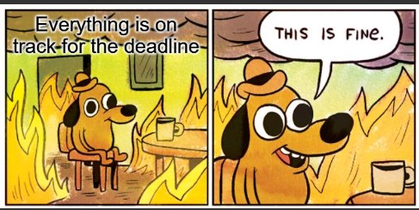
This Is Fine
Dog sitting in a burning room, drinking coffee
The universal symbol for every standup meeting ever
"Everything is on track for the sprint deadline"
First appeared in KC Green's Gunshow webcomic, 2013
2

Slide 3
Two Types of Developers
Before Code Review
After Code Review
"It works on my machine"
Ship it, YOLO
Comments? Documentation? Never heard of it
400-line function? It's called efficiency
Added unit tests
Refactored into small functions
Documented the edge cases
Wondering who wrote the original code (it was you)
3

Slide 4
Stages of Debugging
1
2
3
Denial
→
Blame
→
Print Statements
"Works on my machine"
The compiler, the OS, or cosmic rays
Add them everywhere
4
5
6
Read the Error
→
The Typo
→
Cover Up
For the first time
Line 3. It was always line 3.
Delete all print statements
4

Slide 5
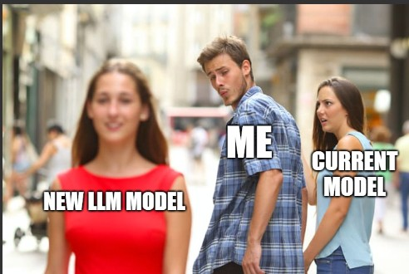
Distracted Boyfriend
The most versatile meme format in history
Man labeled "developers" looking at "new JavaScript framework"
Girlfriend labeled "current JavaScript framework" looking upset
Originally a stock photo by Antonio Guillem, 2015
Has been used to explain every technology decision ever made
5

Slide 6
Drake Hotline Bling
Drake Says No
Drake Says Yes
Writing documentation
Testing in production
Reading the error message
Attending meetings
Stack Overflow copy-paste
"It works, don't touch it"
Blaming DNS
Adding TODO comments
6

Slide 7
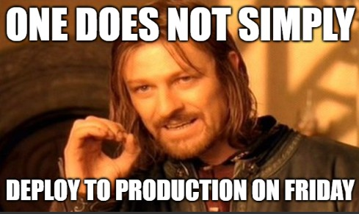
One Does Not Simply
One does not simply deploy to production on a Friday
This meme has survived every internet trend since 2001
Boromir tried to warn us about scope creep
The original "I told you so" format
7

Slide 8
Expanding Brain
1
2
3
4
Small Brain
Normal Brain
Big Brain
Galaxy Brain
→
→
→
Using git pull
Using git fetch and merge
Using git worktrees for parallel development
Rebasing interactively while resolving conflicts in vim
8

Slide 9
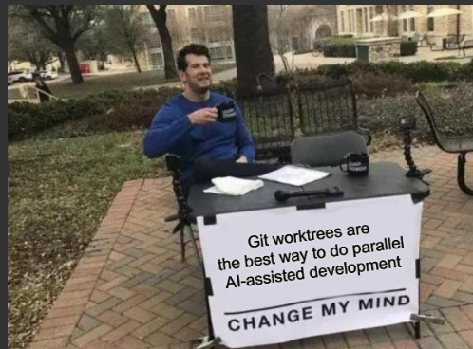
Change My Mind
Steven Crowder sitting at a table
Sign reads: "Git worktrees are the best way to do parallel AI-assisted development"
The table is outside, inviting debate
Nobody has successfully changed his mind
9

Slide 10
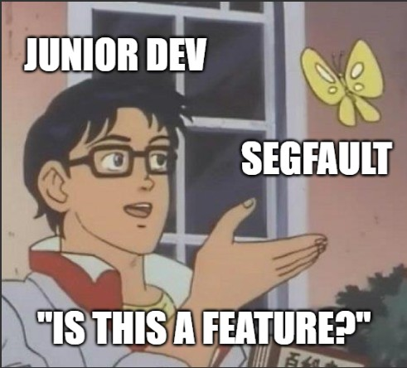
Is This a Pigeon?
Anime character pointing at a butterfly
Character labeled: "Junior developer"
Butterfly labeled: "A segfault"
Caption: "Is this a feature?"
From the anime "The Brave Fighter of Sun Fighbird" (1991)
10

Slide 11
Conclusion: Always Has Been
Wait...
Always Has Been
The real presentation was the memes we shared along the way
PowerPoint is just a meme delivery vehicle
AI can generate slides but not dank memes
Wait, it's all memes?
Always has been
Every meeting is better with memes
The future of corporate communication
Thank you for coming to my TED talk
11

