Slide 1
Stock Price Prediction using deep learning

Slide 2
Scope
A MODEL WHICH WILL BE HELPFUL IN PREDICTING THE FUTURE STOCK PRICES MAKING THE INVESTMENTS EASY

Slide 3
dataset
April to august 2017
41266 minutes of data

Slide 4
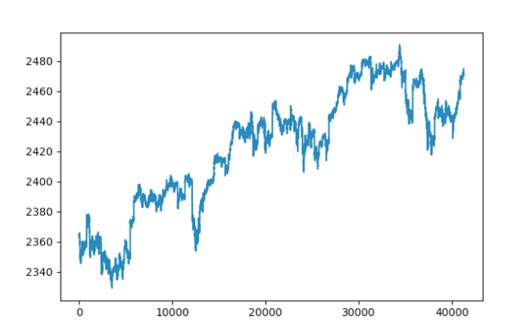
Preprocessing the data
Importing and preparing the data
Preparing training and test data
Data scaling

Slide 5
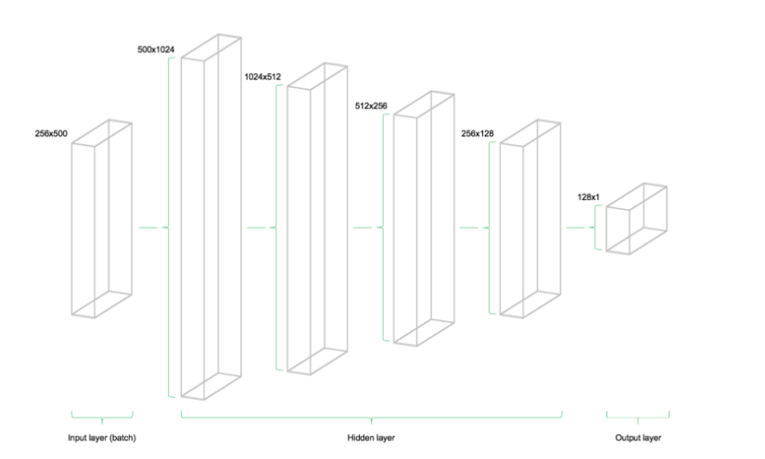
Tensorflow
Placeholders
Variables
Designing the network architecture

Slide 6
tensorflow
Cost function : relu
Optimizer : Adam optimizer
Fitting the neural network

Slide 7
references
Retrieved from:
https://medium.com/mlreview/a-simple-deep-learning-model-for-stock-price-prediction-using-tensorflow-30505541d877
https://machinelearningmastery.com/adam-optimization-algorithm-for-deep-learning/
https://www.tensorflow.org/api_docs/python/
https://www.researchgate.net/publication/269935079_Adam_A_Method_for_Stochastic_Optimization

