Slide 1

Happy teacher's day

Slide 2
I am really happy that I get to show you this
I thought making a ppt would bore you so I made a website that I'll show you at the end

Slide 3
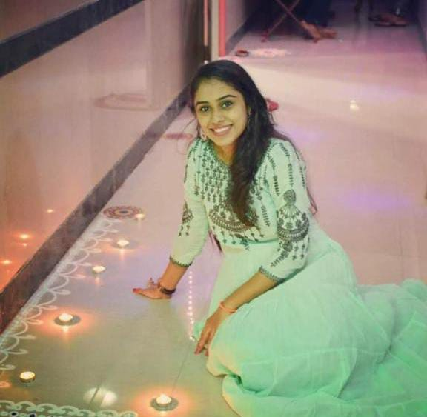
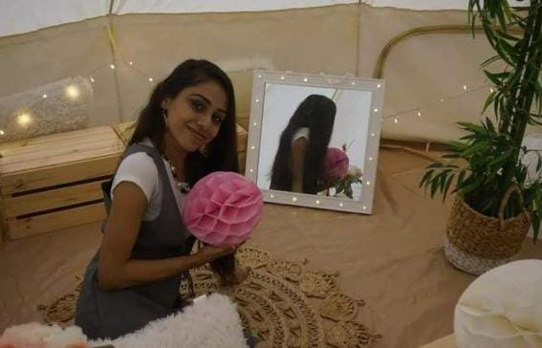
First let's get you through some Photos of yours
Dinisha teacher...

Slide 4
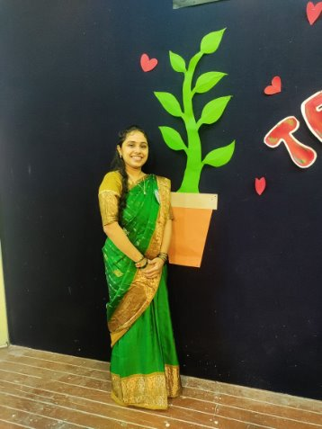
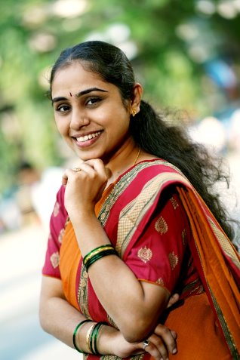
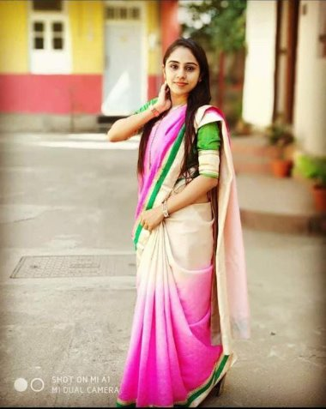

Slide 5
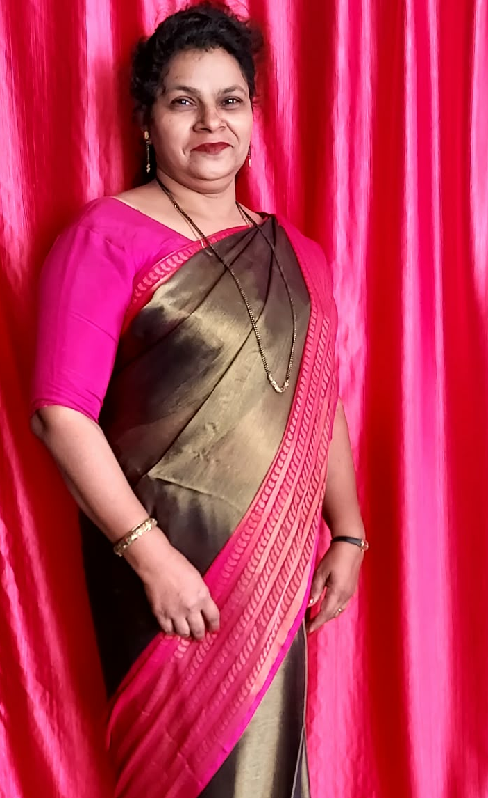
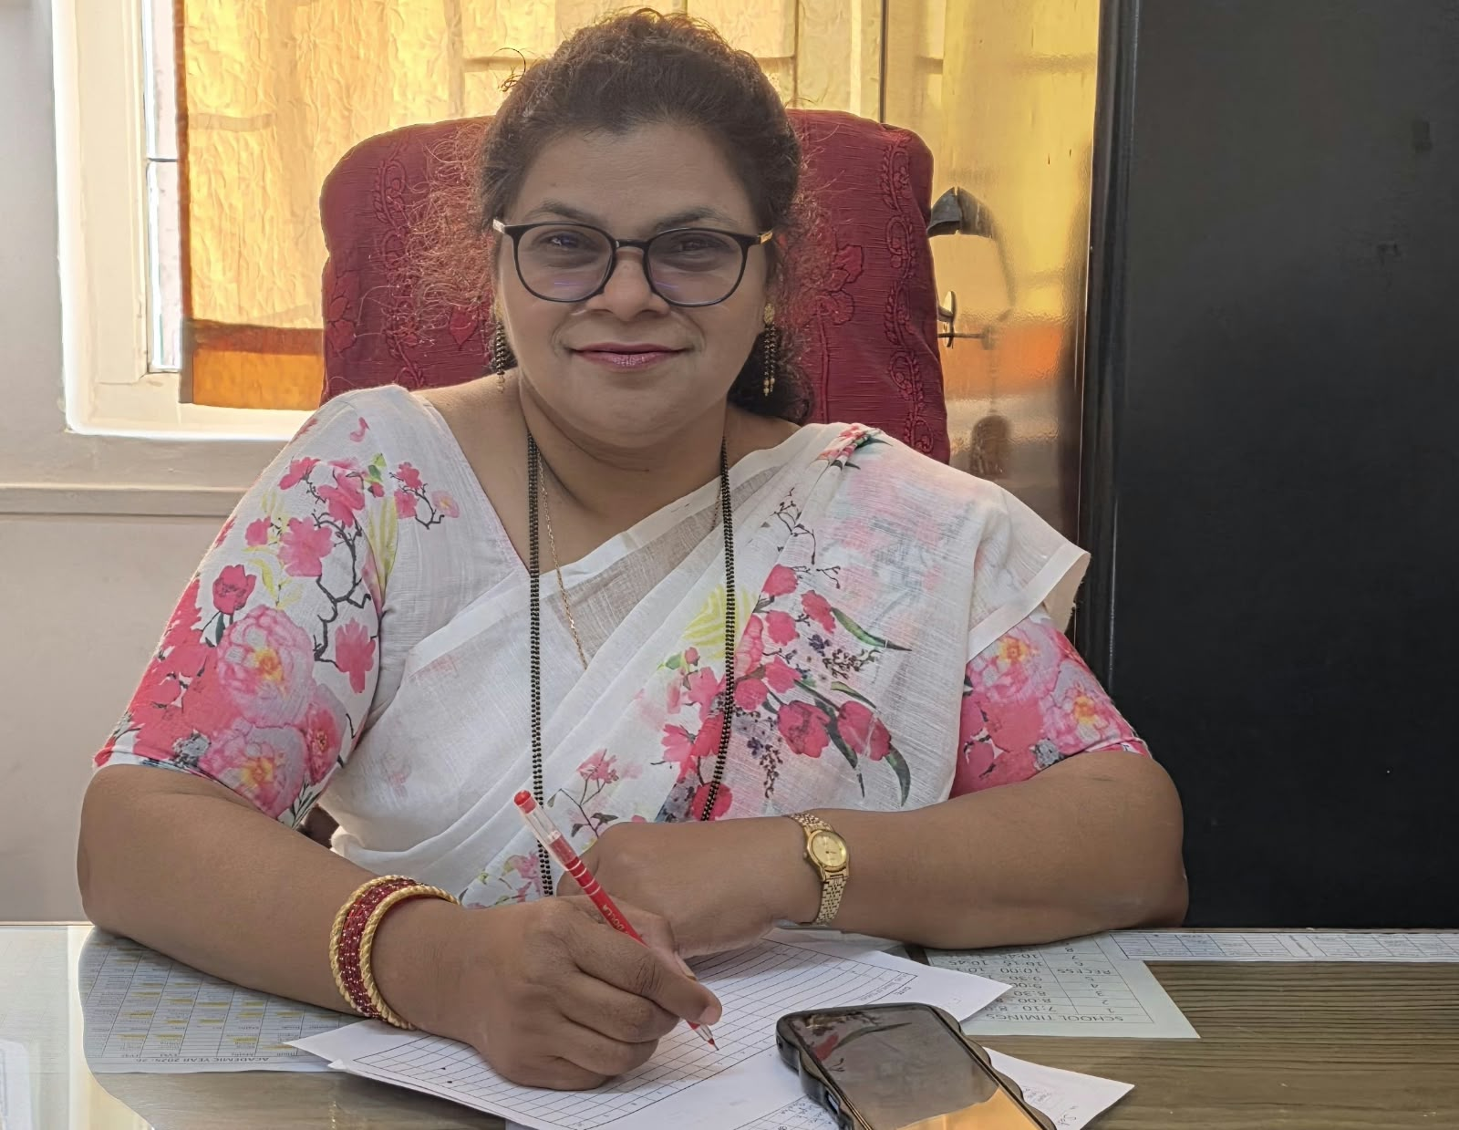
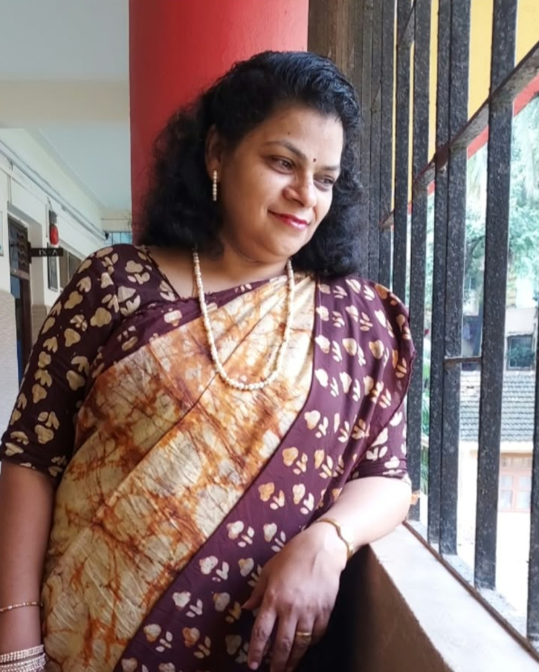
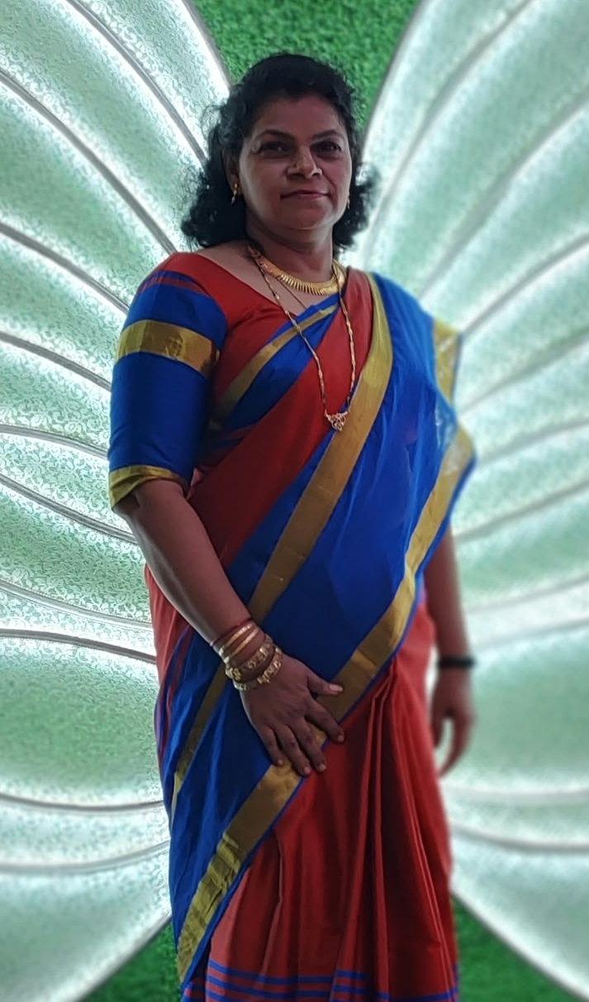
Margret teacher!

Slide 6

Im sad I didn’t get enough photos of margret teacher

Slide 7
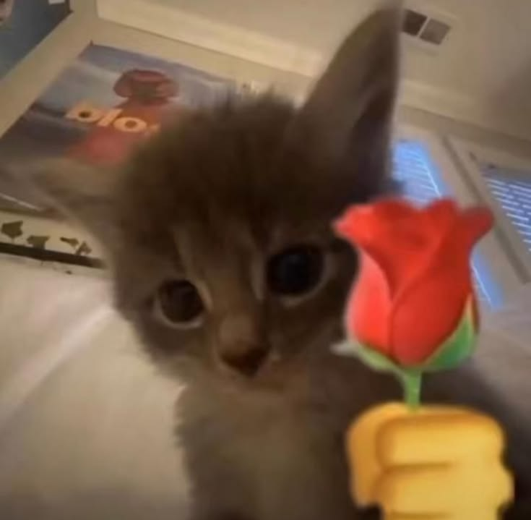

BUT AS I said... There is a WEBSITTEEEEE!
This website was made with
Veryyyyy mehnat by Caesar
(yeah the one you call anwar)
https://teachers-daysurprise.app/

