Slide 1
UnderTheRock
Making the Complete GPU Stack as Simple to Develop As ROCm Alone
Aligning firmware and kernel development with theRock's direction for ROCm 7.0+
Presented by: Chris Sosa Date: March 2026

Slide 2
Executive Summary
UnderTheRock — One Unified Platform for the Complete GPU Stack
What it is:
The Solution — Three Principles:
Aligns firmware (IFWI) and kernel driver development with theRock's direction for ROCm 7.0+. Makes developing on the complete GPU stack—from firmware through ROCm—as straightforward as developing on ROCm alone.
Trunk is Shippable — Pre-submit gates, revert-first (<4h), nightly LKG
Simplified Codebase — GitHub consolidation, one CI platform, one LKG manifest
Consistent, Comprehensive, Reproducible Releases — Manifest-driven BKC, 18× coverage
The Problem:
Fragmented tooling — Different tools, workflows, infrastructure
Trunk frequently broken — No pre-submit testing; 24-48h regression detection
No shared baseline — Developers guess which I×K×R combos work
QA-driven triage — Developers brought in reactively days later
Key Benefits:
For Developers: Trunk always usable, 30-min feedback, zero friction baseline
For AMD: 96% faster regression detection, 18× test coverage, fewer field failures
Timeline:
Phased rollout (PoC first to determine build mechanics; progressive delivery through phases)
UnderTheRock Executive Briefing | Chris Sosa | March 2026

Slide 3
The Problem — Development is Unnecessarily Complex
Fragmented Tools, Broken Trunk, No Shared Baseline
"Will my IFWI change work with the latest kernel? With ROCm 7.1? I won't know until QA runs tests tomorrow night." "I pulled latest ifwi/main this morning. It doesn't boot. I'll check Slack to see if anyone knows which commit broke it."
What Makes Development Hard:
Fragmented tooling — IFWI uses DCAuto + Conductor + IFWI Builder + Perforce; kernel uses Jenkins + Gerrit; ROCm uses theRock + GitHub Actions
Trunk frequently broken — No pre-submit testing for IFWI or kernel; bad commits sit undetected for 24-48 hours
No shared baseline — No LKG manifest; developers guess which IFWI/kernel/ROCm combinations work together
QA-driven triage — Regressions found downstream; developers brought in reactively days after committing
Testing gap — Only 1 I×K×R combination tested per week; compatibility matrix not systematically validated
Root cause: Testing and release infrastructure are fragmented, downstream of development, and QA-centric. Developers lack tools to own quality.

Slide 4
Solution Principle 1 — Trunk is Shippable
Shift-Left: Pre-Submit Gates + Revert-First Culture
What this means:
Every commit tested before merge — 30-minute pre-submit validation (SimNow + hardware smoke tests)
Trunk always usable — Bad commits never land; PRs blocked if they break tests
Revert-first culture — Regressions reverted within 4 hours (not debugged in place)
Nightly LKG promotion — Full stack passes validation (18 builds across 6 products) → LKG manifest updated
Developer-owned triage — Component TLs rotate as 'gardeners' to keep trunk green
Developer Experience Before vs. After:
TODAY:
WITH UNDERTHEROCK:
Commit Monday ↓ Wait for nightly (Tuesday night) ↓ QA finds regression (Wednesday) ↓ Debug Thursday (what was I thinking?)
Open PR ↓ Pre-submit runs automatically (<30 min) ↓ Pass → Merge | Fail → Fix before merging ↓ Trunk stays green, everyone unblocked
Benefit: Time to detect regression: 24-48 hours → <30 min (96% faster)

Slide 5
Solution Principle 2 — Simplified Codebase
One Platform, One Workflow, One Baseline
What this means:
GitHub consolidation — Perforce, Gerrit, Cerberus migrate to GitHub (Cloud/EMU/On-Prem ER)
One CI platform — GitHub Actions for all three layers (no more DCAuto scripts + Jenkins jobs + theRock workflows)
One LKG manifest — Single lkg-manifest.yaml contains validated SHAs for IFWI + kernel + ROCm
One branching model — Chrome OS-style: development on main, firmware branches cut at tapeout
Three groups of repositories — amd/ifwi, amd/kernel, ROCm/TheRock
Developer Experience:
TODAY:
WITH UNDERTHEROCK:
"Which Perforce branch has MI300X PSP?"
"Which Jenkins job for kernel tests?"
"Do these versions work together?"
"How do I test this change?"
Clone the super repo you need
Read lkg-manifest.yaml
Open PRs the same way for all repos
Same CI, same workflow, same commands
Benefit: CI platforms: 3 systems → 1 system (67% reduction) | Note: Exact repository structure and build mechanics are TBD

Slide 6
Solution Principle 3 — Consistent, Comprehensive, Reproducible Releases
Manifest-Driven Traceability + Matrix Testing
What this means:
Nightly LKG promotion — 18 builds pass → LKG manifest updated daily
BKC releases from manifests — Weekly BKC is promoted LKG manifest + git tags across all repos
Matrix testing — Nightly: bleeding-edge I×K×R combos; Weekly: N-1, N-2 compatibility validation
Automated changelogs — git log <last-tag>..<this-tag> across all repos
Release branches visible — firmware-mi300x.B, kernel-6.8.x, rocm-7.1.x in GitHub
Developer Experience:
TODAY:
WITH UNDERTHEROCK:
Customer reports BKC 25.12 failure ↓ Search Confluence for IFWI version ↓ Find kernel build number in JIRA ↓ Guess ROCm version from release notes ↓ Manually reconstruct (1-2 hours)
Check manifest: { ifwi: abc1234, kernel: def5678, rocm: ghi9012 } ↓ git checkout those SHAs ↓ Reproduce exact customer env (5 min)
Benefit: BKC reproducibility: 1-2 hours manual → 5 min automated (95% faster)

Slide 7
How These Principles Simplify Development
Workflow Comparison — Today vs. UnderTheRock
Today (Fragmented):
With UnderTheRock (Unified):
Developer wants to test firmware change:
Developer wants to test firmware change:
Find hardware (Conductor Web, manual reservation)
Figure out which DCAuto command to run
Check if kernel on that system is compatible
Flash IFWI (hope it doesn't brick the system)
Reboot, check dmesg, collect logs manually
Compare against... what? (no baseline)
If it breaks, file bug for QA to investigate
Open PR on amd/ifwi
GitHub Actions runs pre-submit automatically:
• Fetches LKG kernel + ROCm SHAs from manifest
• Builds IFWI from PR branch
• Runs SimNow on 6 products (required)
• Reserves hardware via DCAuto, flashes, boots
PR shows pass/fail in <30 min
If green, merge. If red, fix.
Trunk stays green. Everyone downstream unblocked.
The difference: Complexity handled by automation. Developer focuses on code, not infrastructure.

Slide 8
Quantified Benefits
Impact on Development Velocity and Quality
Key Improvements:
Time to detect regression: 24-48 hours → <30 min (96% faster)
Trunk usability: Frequently broken → Always usable (100% uptime)
Nightly test coverage: 1 I×K×R combination → 18 I×K×R combinations (18× coverage)
BKC reproducibility: 1-2 hours (Confluence) → 5 min (git checkout) (95% faster)
CI platforms: 3 systems → 1 system (GitHub Actions) (67% reduction)
Developer onboarding: Weeks (tribal knowledge) → Days (documented, visible)
Developer Workflow Improvements:
"Is trunk safe to pull?" — Unknown (check Slack) → Always (LKG guarantee) — Zero friction
"Which I×K×R combo works?" — 30 min (Confluence) → 5 sec (read manifest) — 99.7% faster
"Submit hardware test" — 30 min (manual DCAuto) → 0 min (automated in PR) — 100% automated
Bottom line: UnderTheRock removes complexity barriers so developers spend time writing code, not navigating infrastructure.

Slide 9
Strategic Alignment with theRock
One Unified Platform Across the Complete GPU Stack
theRock's Three Principles (ROCm 7.0+) Now applied to IFWI + kernel via UnderTheRock
1. TRUNK IS SHIPPABLE • Pre-submit gates • Revert-first (<4h SLA) • Nightly LKG promotion • Developer-owned gardening
2. SIMPLIFIED CODEBASE • GitHub consolidation • One CI platform (GitHub Actions) • One LKG manifest • Unified workflows
3. CONSISTENT, COMPREHENSIVE, REPRODUCIBLE • Manifest-driven BKC • Matrix testing (18× nightly coverage) • Automated changelogs • Full traceability
Before vs. After:
ROCm: theRock (unified repos, pre-submits, LKG, gardening) → theRock (same) Kernel: Jenkins + Gerrit, QA-gated, no LKG, no pre-submits → Same as theRock ✓ IFWI: DCAuto + Perforce, QA-gated, no LKG, no pre-submits → Same as theRock ✓
Result: One unified platform. Developers work the same way across all three layers.

Slide 10
Unified Testing Architecture — How Teams Integrate
One LKG Flow — Teams Plug In Tests at the Right Tier
Testing Flow:
EAM BKC vs. Other Components:
PRE-SUBMIT (< 30 min) — GHA Workflows
• EAM: IFWI (SimNow 6 products), Kernel (Kbuild)
• ROCm (theRock pre-submits)
→ BLOCKS MERGE
EAM BKC
Other Components
IFWI: SimNow, Racer, hardware on 6 products
MI450: Rack-level recipe testing
Kernel: Weekly BKC (stress, SRIOV, IP)
CPU BKC: Independent validation
NIGHTLY CONTINUOUS (2-4 hrs)
• EAM: IFWI (Racer+HW 6 products), Kernel (stress)
• ROCm (theRock nightlies), MI450 mini-rack
• Target: Unified LKG | Transition: Independent
→ LKG PROMOTION (quorum required)
ROCm: theRock nightlies
Platform components: various tests
Primary targets from day 1
Flexible timeline, plug in when ready
WEEKLY RELEASE — Long-Duration
• EAM: IFWI regression, Kernel IP+perf, ROCm
• MI450 full rack (week-long), workloads
Contribute to LKG quorum (target)
Run independently initially
EAM BKC is primary integration target from day 1. Other components integrate when ready. Target: One LKG flow with clear integration points (GHA workflows, results API, manifests).

Slide 11
Roles & Responsibilities
Starting with EAM BKC (IFWI + Kernel + ROCm)
EAM BKC COMPONENT OWNERSHIP (First Step)
IFWI
PFO IFWI Team
• PSP
• MPIO
• PMFW
• RAS
• UMC
• VBL
Kernel
RTG Kernel Team
• amdgpu driver
• Feature impl
• Component testing
Kernel
RTG Kernel Team
• amdgpu driver
• Feature impl
• Component testing
ROCm
ROCm Teams
• Runtime (HIP, ROCr)
• Libraries (rocBLAS, rocFFT)
• Frameworks
ROCm
ROCm Teams
• Runtime (HIP, ROCr)
• Libraries (rocBLAS, rocFFT)
• Frameworks
Other BKCs (Future Integration)
CPU • HPM • DCSCM • NIC • AI NIC (binary) • Storage • Non-EAM Compute • AIFM • SwitchOS (binary) • Tools • Diags • RMC/Switches
Other BKCs (Future Integration)
CPU • HPM • DCSCM • NIC • AI NIC (binary) • Storage • Non-EAM Compute • AIFM • SwitchOS (binary) • Tools • Diags • RMC/Switches
↕ COORDINATION ↕
↕ COORDINATION ↕
UNDERTHEROCK GARDENING (NEW - EAM BKC Coordination)
UNDERTHEROCK GARDENING (NEW - EAM BKC Coordination)
IFWI Gardener
Weekly Rotation
• Monitor CI
• Triage to owners
• 4h revert
• LKG auth
IFWI Gardener
Weekly Rotation
• Monitor CI
• Triage to owners
• 4h revert
• LKG auth
Kernel Gardener
Weekly Rotation
• Monitor CI
• Triage to owners
• 4h revert
• LKG auth
Kernel Gardener
Weekly Rotation
• Monitor CI
• Triage to owners
• 4h revert
• LKG auth
ROCm Gardener
Weekly Rotation (RFC0002)
• Monitor CI
• Triage to owners
• 4h revert
• LKG auth
ROCm Gardener
Weekly Rotation (RFC0002)
• Monitor CI
• Triage to owners
• 4h revert
• LKG auth
Platform Integration Gardener • Rack-level tests (MI450) • Cross-layer coord • L2 escalation
Rack Integration Gardener • Rack-level tests (MI355, MI450) • EAM BKC coord • L2 escalation

Slide 12
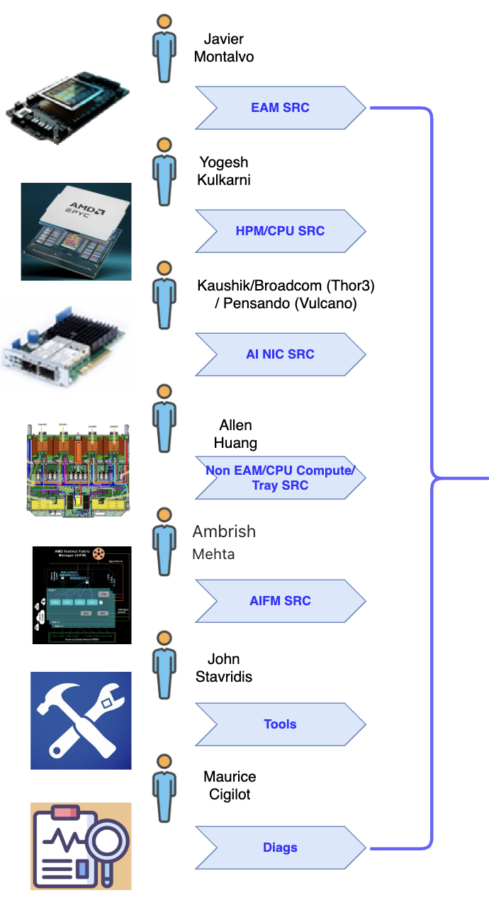
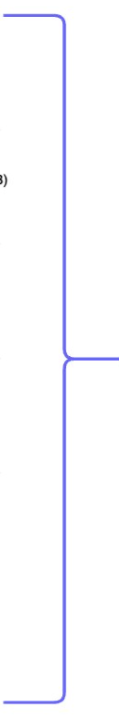
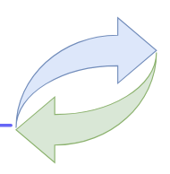
UnderTheRock - CI/CD Workflow
Component's
Source Code*
UnderTheRock Super-Repo
Nightly / OnDemand Builds for all modules
==> Individual BKCs
(EAM, CPU, etc)
EAM BKC
CPU BKC
^ UTR
Recipe
Resolver
DPEG
Recipe
Resolver
AINIC BKC
LKG Rack Recipe
(Last Known Good)
Rack Recipe ^
Non-EAM/CPU Comp Tray
AIFM BKC
Component & Basic Rack Tests
Rack CI Tests
TOOLS
DIAGS
* Goal is to build everything from source code san some exceptions (3rd party binaries from sanmina, meta s/w, etc)

Slide 13
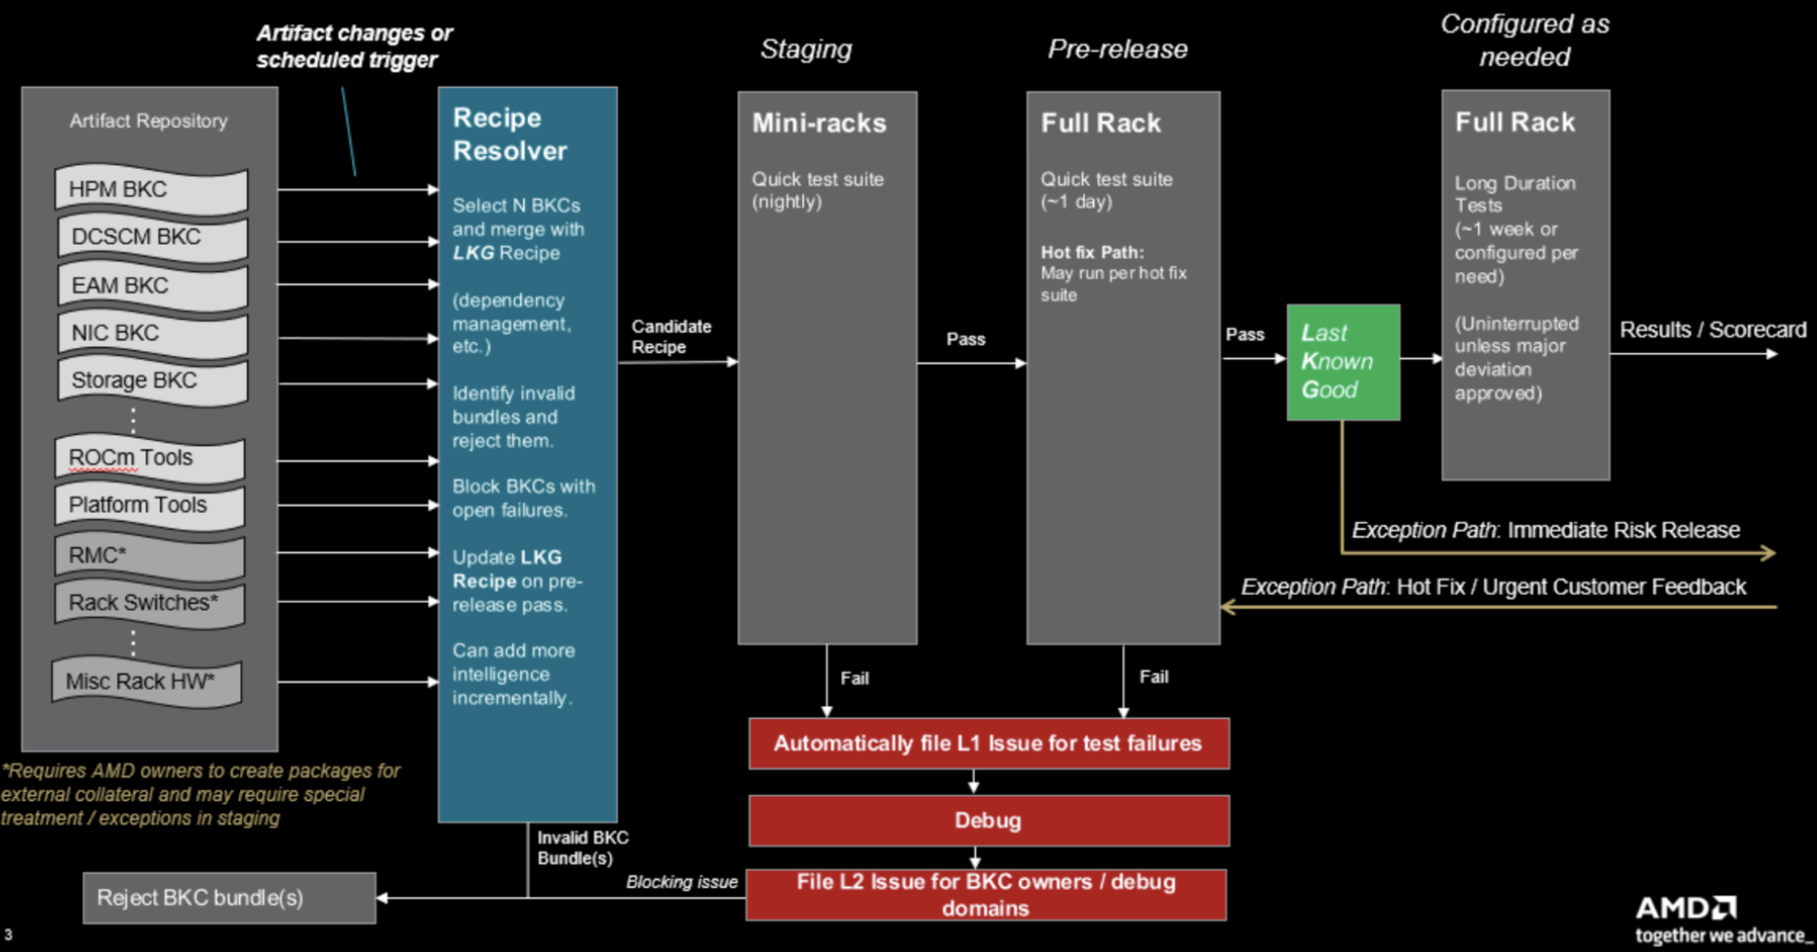
DPEG - Rack Recipe Test Flow

Slide 14
UnderTheRock + DPEG - Rack Recipe Test Flow
UnderTheRock
provides
Candidate Rack SW-FW Recipe

Slide 15
CI/CD Steps
Individual component's CI/CD: Pre-Checkin for all commits
UnderTheRock build individual BKCs
UnderTheRock build SW-FW Rack Recipe / E2E BKC
UnderTheRock run basic tests with SW-FW Rack Recipe / E2E BKC
DPEG to run extended tests with SW-FW Rack Recipe / E2E BKC
Declare LKG BKC

Slide 16
Phased Plan
CI-Lite: Build BRP from BKC binaries, Run basic CI tests, Publish LKG
Build EAM BKC from Sources in UnderTheRock
Very few exceptions in taking binaries (3rd party binaries from Sanmina, etc)
Nightly/on-demand E2E BKC built of Component BKCs built in UnderTheRock
If some BKCs need more time, start taking them directly until they are built in super-repo
Rack Recipe tested in CI-Lite infra (short term)
Rack Recipe tested in DPEG Rack Level Test Flows to declare LKG BKCs
Build Automatic Bisection / Resolver workflows to pick right commits/components/BKCs etc to generate LKG BKCs
Parallel Tracks:
Generate multiple Rack Recipes for multiple customers and HW configurations

Slide 17
Ask for Component Owners
Add all modules to the BKC modules sheet with details (BKC Name, Build Engineer, Source Repo, Build Recipe, Dependencies to build, etc)
Provide source repo accesses and signing procedures to UnderTheRock build team
Build engineer help reproduce the builds in “UnderTheRock” super-repo (contact Chris Sosa)
Setup CI/CD tests for qualifying individual and E2E BKCs
Establish programmatic way of source code update/frequency/guidelines/hooks into super-repo

Slide 18
Implementation Timeline
PoC-First Approach with Phased Rollout
Phase 0: PoC — Tiger Team • Parallel probes: IFWI Builder API (Option A) vs. source build (Option B) • PoC gate: Architecture decision → Phase 1 begins
Phase 1: Foundation • IFWI build pipeline in GHA (based on PoC outcome) • LKG manifest schema and tooling • SimNow pre-submit live
Phase 2: Hardware Pre-Submit • DCAuto integration for hardware testing • Merge blocking enforced (<30 min, >90% pass rate)
Phase 3: Nightly Integration + LKG • 18 nightly builds running • LKG promotion automation (83% quorum)
Phase 4: Gardening + Firmware Branches • Oncall rotation established; revert automation • All 6 firmware branches nightly
Phase 5: Release Traceability + Matrix Coverage • Release manifests for every BKC • Compatibility matrix coverage expansion
Note: Build mechanics, repo structure, and integration approach are TBD—determined by tiger team during PoC.

Slide 19
Status and Next Steps
Where We Are and What Comes Next
Current Status:
Architecture designed around three principles (aligned with theRock's ROCm 7.0+ direction)
Implementation approach flexible (PoC determines mechanics)
Next action: Bootstrap tiger team (Eric Eaton + others)
What the Tiger Team Determines (PoC Phase):
IFWI build approach: Option A (IFWI Builder API) or Option B (source builds)
Repository structure: Super repos (like theRock) or individual component repos
Kernel CI integration: Build process, test harness, hardware pool
ROCm artifact generation: How theRock produces artifacts for UnderTheRock workflows
Signing pipeline: When and where signing happens
What Happens Next:
PoC completion: Architecture decision gate (Option A or B selected)
Phased implementation based on validated PoC architecture
Deliverable: One unified platform where firmware, kernel, and ROCm developers work the same way
This briefing is: An FYI on the direction and design. Resource planning for the tiger team is the immediate next step.

