Slide 1
Stackoverflow – Time until Answer
Team – 4
Gaurang Mhatre
Parth Upadhyay
Amruta Dhondage

Slide 2

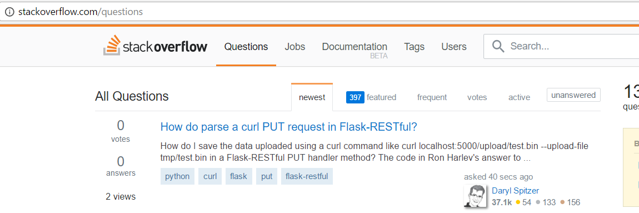
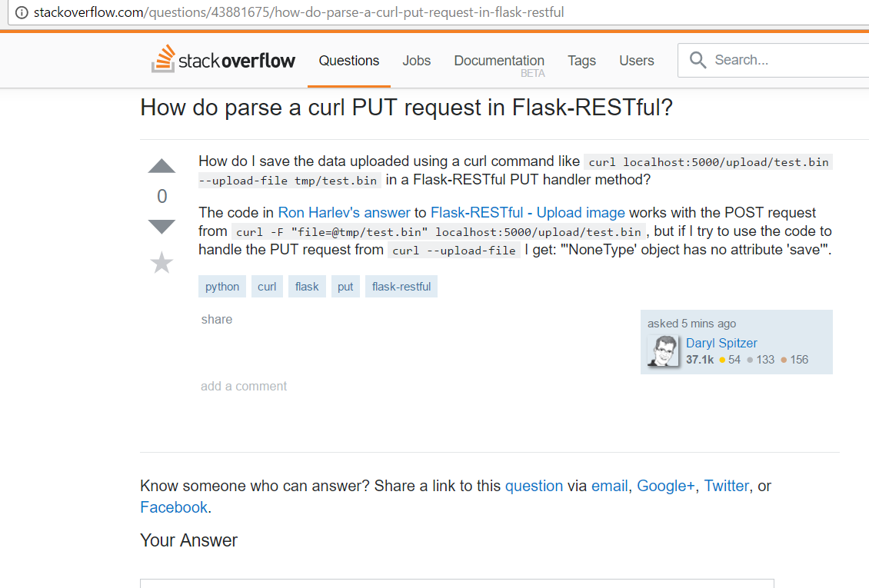

Problem Statement:

Slide 3

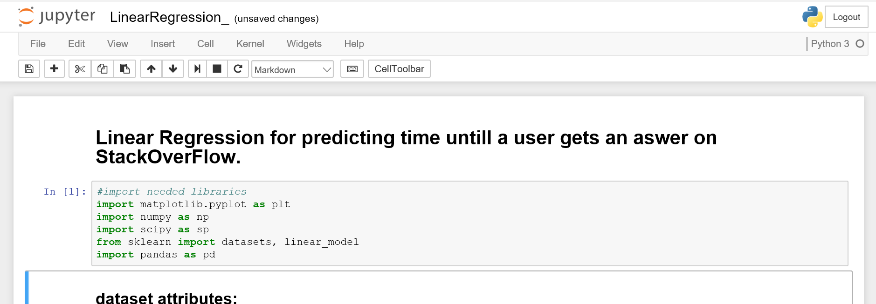

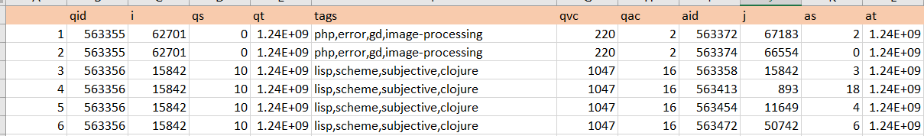
Dataset used:
Tools / Technologies used:
https://www.ics.uci.edu/~duboisc/stackoverflow/
Records : 3162491

Slide 4
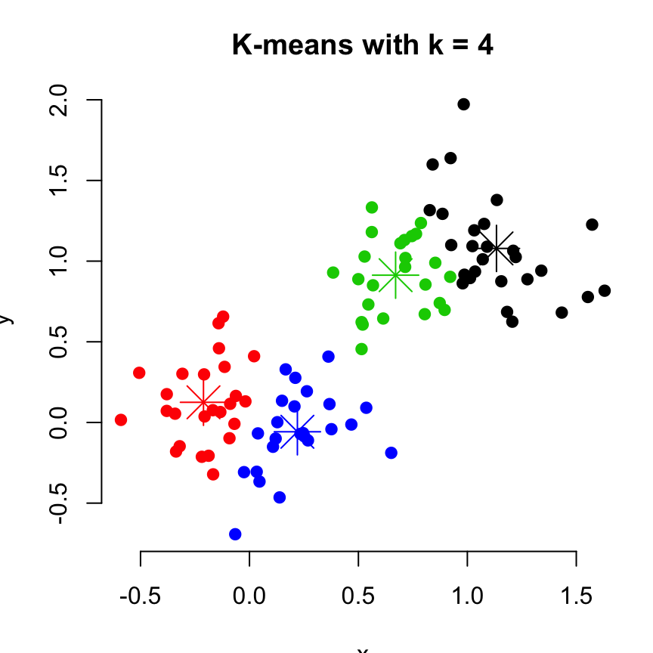
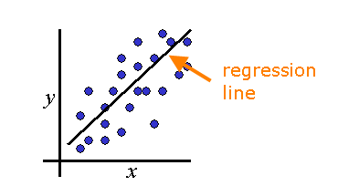
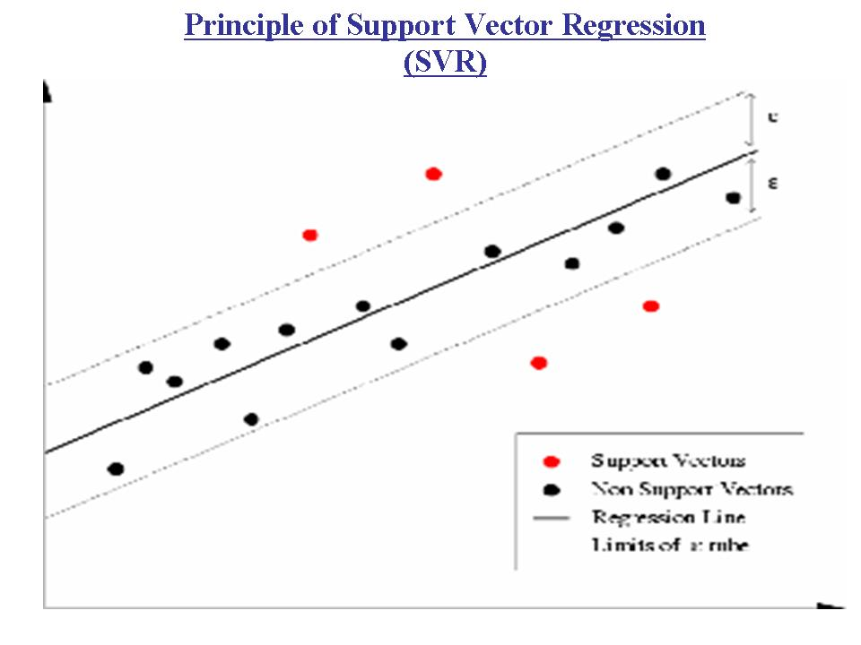
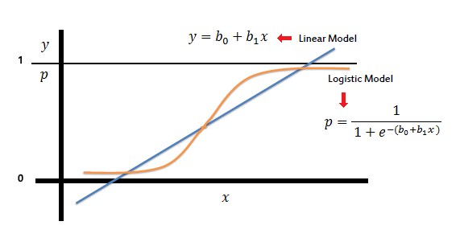
Approach:
Progressive data : Regression
Clustering Regression
Linear Regression
Logistic Regression
SVM Regression

Slide 5
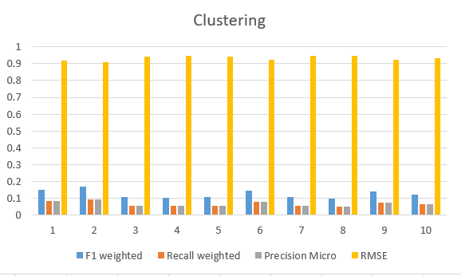
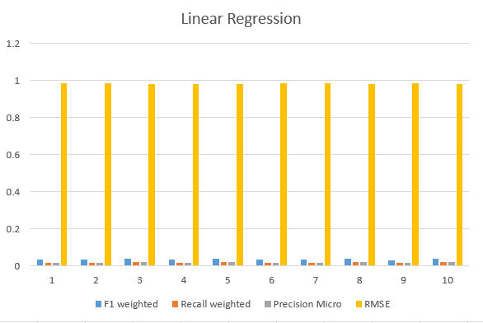

Slide 6
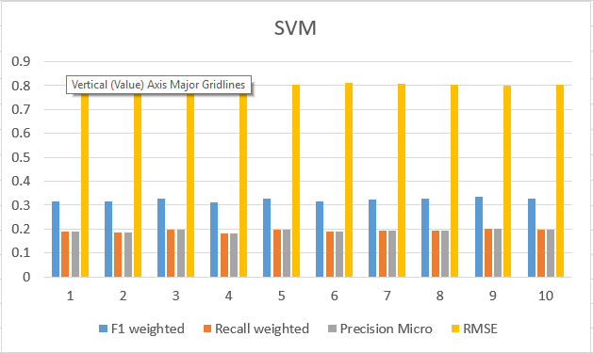
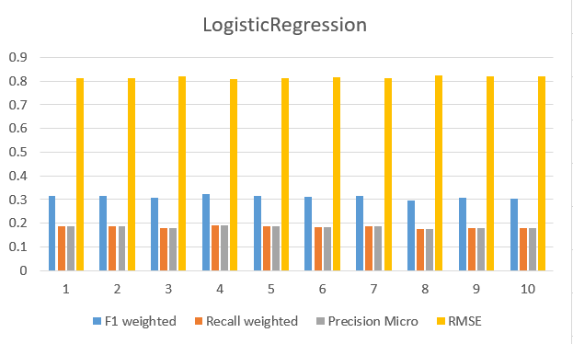

Slide 7
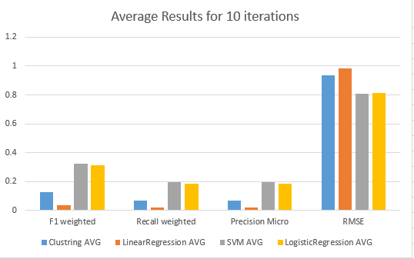

Slide 8
Conclusion
Regression Data mining algorithm is used for predicting time.
Clustering approach is experimented for prediction.

Slide 9
Questions??

