Slide 1

Drop Gr de Requirements Presentation
Madison McHam, Alan Donham, Shane Peters, Nick Levert

Slide 2

Why we are creating this app
Problem Definition
Reason’s
What can I make on my remaining tests/assignments to get an A in a class, given the grades that I’ve already made so far ?
Help student’s manage work load throughout semester
Scheduling classes easier for students
No errors in calculations
No more endless calculations

Slide 3
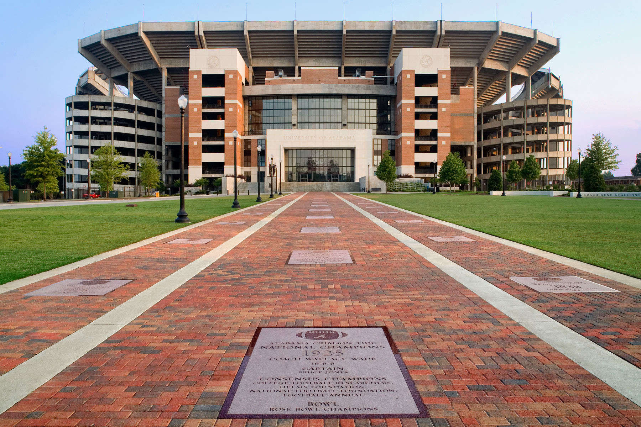
System Goal
Develop an app that will be easy to use and benefit all The University of Alabama students and minimize the stresses of College

Slide 4
Scope of System
Login Screen
What the user will see when opening the application
Add Course /Edit Course
Add information about your courses
Edit/ Update information about your course
Enter Grades
Enter your grades for exams/ homeworks/ projects/ quizzes etc. throughout the semester
Enter Final Grades
View Professors Stats
Can view professors grade average for a certain class
Leave comments
Leave comments about professors

Slide 5
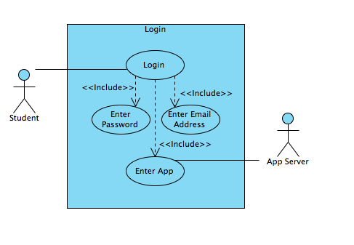
Use Case Diagram

Slide 6
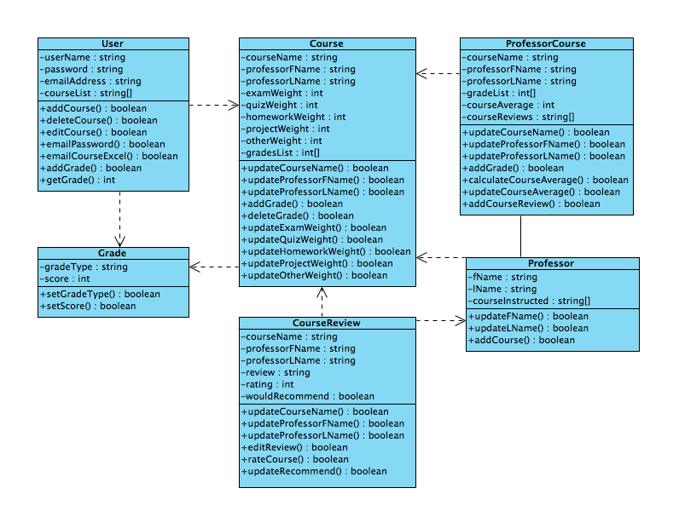
Class Diagrams

Slide 7
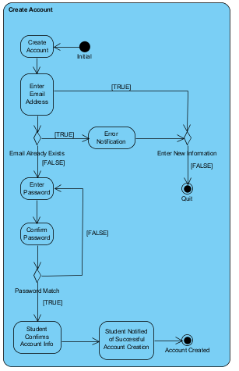
Activity Diagram Create Account

Slide 8
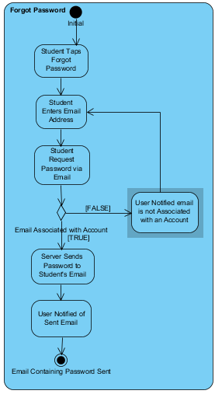
Activity Diagram Forgot Password

Slide 9
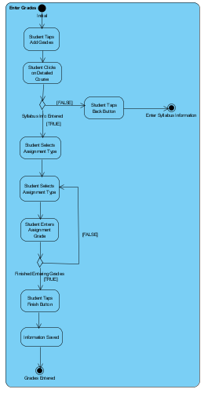
Activity Diagram Enter Grades

Slide 10
Functional Requirements
Functionality | Status
Create Account | Required
Log In | Required
Retrieve Password | Required
Add Course | Required
Add Course Info | Required
Enter Grades | Required
Submit Final Grade | Required
Manipulate Final Grade via the What-If-View | Required

Slide 11
Functional Requirement Cont.
Functionality | Priority
Send Reminders to user when they have an exam/ project/ assignment due | Stretch
Store course information (including grade scale | Stretch
Export Data to an excel spreadsheet | Stretch

Slide 12
Non-Functional Requirements
Functionality | Status
Database that stores all the information about courses/ grades/ instructors | Required
User interface that accessible for all type of user | Required
The system must not be a significant drain on battery life. | Required

Slide 13
Potential Risks
Student update final grades into the database with false information
Also forgetting to upload their final grades
Unable to gather and store all the data collected in a way that will allow us to provide useful statistics to the user very quickly and in real time.
This is also our number one goal to tackle
Students leaving negative comments about a teacher

Slide 14
Summary discussion of Project
We will use all the grades and profiles created to create a database of anonymous grades and their associated professors
The app will help assist students in deciding which professor to take
We are planning on doing this for only UA students, however to expand this to other colleges would simply require additional databases

