Slide 1

Drop Gr de
Madison McHam, Alan Donham, Shane Peters, Nick Levert

Slide 2

Why we are creating this app
Problem Definition
Reason’s
What can I make on my remaining tests/assignments to get an A in a class, given the grades that I’ve already made so far ?
Help student’s manage work load throughout semester
Scheduling classes easier for students
No errors in calculations
No more endless calculations

Slide 3
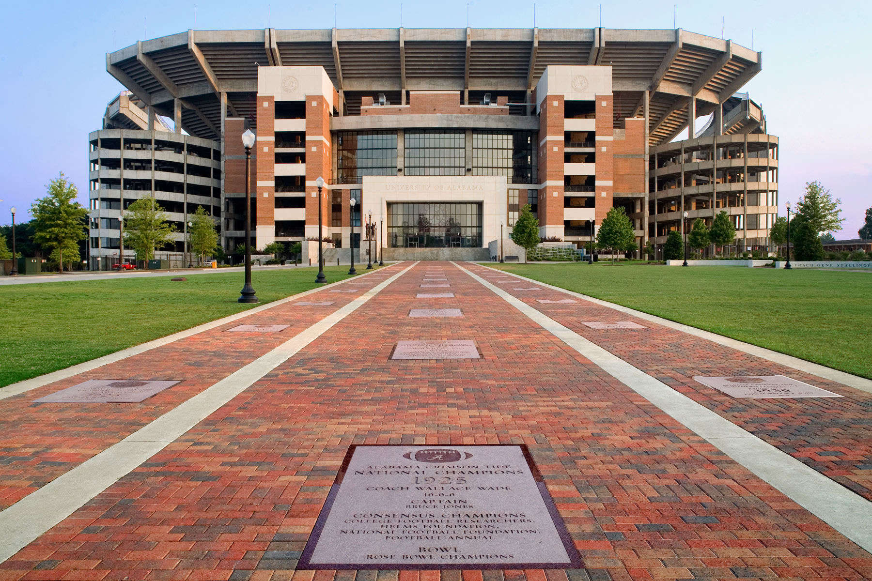
Scope of System
Drop Grade will benefit all the the University of Alabama students who are enrolled and have a crimson.ua.edu email address

Slide 4
Use Case Diagrams…

Slide 5
Use Case Diagrams Cont…

Slide 6
Class Diagrams

Slide 7
Activity Diagram

Slide 8
Features
Required | Priority
Ability for users to sign up with crimson email | High
Ability for users to set up profiles for each class | High
Ability users to input syllabuses for each class | High
What if scenario | High
Allow users to select a teacher and view average grades | High

Slide 9
Features Cont…
Possible | Priority
Notify users to update their final grades | Medium
Future Work

Slide 10
Potential Risks
Student falsely update final grades

Slide 11
Summary discussion of Project
We will use all the grades and profiles created to create a database of anonymous grades and their associated professors
The app will help assist students in deciding which professor to take
We are planning on doing this for only UA students, however to expand this to other colleges would simply require additional databases

