Slide 1

Drop Gr de
Madison McHam, Alan Donham, Shane Peters, Nick Levert

Slide 2

Why we are creating this app
Problem Definition
Reason’s
What can I make on my remaining tests/assignments to get an A in a class, given the grades that I’ve already made so far ?
Help student’s manage work load throughout semester
Scheduling classes easier for students
No errors in calculations
No more endless calculations

Slide 3
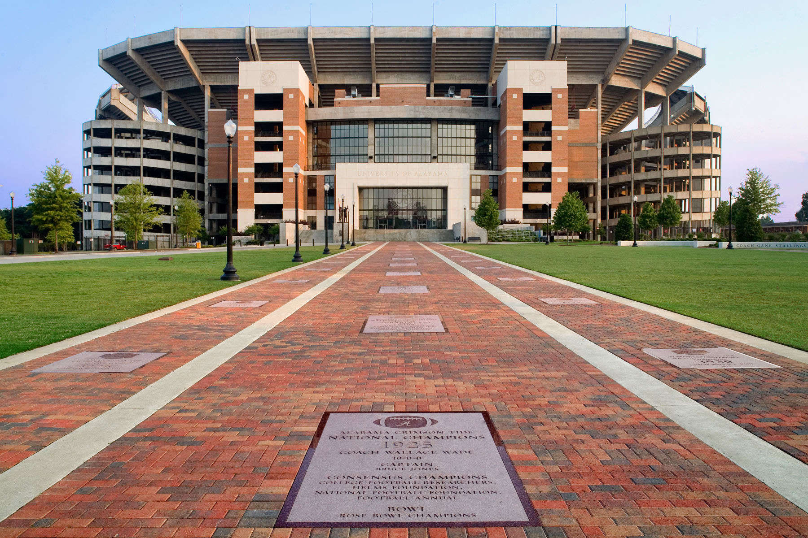
Scope
Our goal for the semester is to develop the DropGrade app that will benefit all The University of Alabama students and minimize the stresses of College

Slide 4
Use Case Diagrams…

Slide 5
Use Case Diagrams Cont…

Slide 6
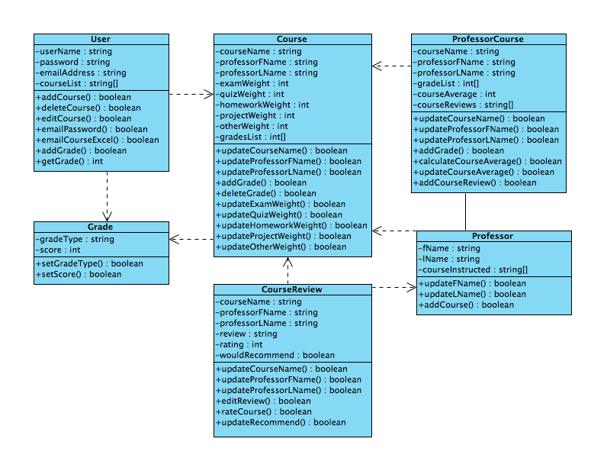
Class Diagrams

Slide 7
Activity Diagram

Slide 8
Functional Requirements
Functionality | Status
Create Account | Required
Log In | Required
Retrieve Password | Required
Add Course | Required
Add Course Info | Required
Enter Grades | Required
Submit Final Grade | Required
Manipulate Final Grade via the What-If-View | Required
Export Data to an excel spreadsheet | Stretch

Slide 9
Functional Requirement Cont.
Functionality | Priority
Send Reminders to user when they have an exam/ project/ assignment due | Stretch
Store course information (including grade scale | Stretch

Slide 10
Potential Risks
Student update final grades into the database with false information
Gathering and storing all the data collected in a way that will allow us to provide useful statistics to the user very quickly and in real time.

Slide 11
Summary discussion of Project
We will use all the grades and profiles created to create a database of anonymous grades and their associated professors
The app will help assist students in deciding which professor to take
We are planning on doing this for only UA students, however to expand this to other colleges would simply require additional databases

